Slide 1
LEVEL 4 READING PROFICIENCY
Final Report on the Prototype Test
Jana Vasilj-Begovic, FL Stds O – MPG, Canada, and Associate BILC Secretary
Dr. Dugald Sturges, Head of English Language Instruction, Federal Office of Languages, Hürth, Germany
Kåre Kildevang, Associate Professor, Royal Danish Defense College
Gerard Seinhorst, Project Manager Assessment & Quality Assurance, NLD Defence Language Centre
Vienna, May 2017

Slide 2
Scope of Presentation
Introduction and Background
Products of the Working Group
Level 4 Reading Skill Construct
Prototype Test
Piloting & Validation
Challenges

Slide 3
“He who speaks (reads, writes) at level 4 at all times has no friends.”
Dr. Dugald Sturges

Slide 4
Introduction and Background
Formation of BILC Working Group on Level 4 Proficiency
Istanbul 2010
Aim:
to assist nations feeling ill-equipped for testing at Level 4
to amplify STANAG 6001 Level 4 descriptors
to discuss testing related implications

Slide 5
Working Group Members
Jana Vasilj-Begovic – Leader (CAN)
Gerard Seinhorst – Co-leader (NLD)
Members:
Petya Georgieva (BGR)
Nancy Powers & May Tan (CAN)
Kåre Kildevang & Allan Christiansen (DNK)
Dugald Sturges (GER)
Michael Adubato (SHAPE)
Annette Nolan & Keith Farr (SWE)
Peggy Garza, David Oglesby and Ray Clifford (USA)
Special Consultants:
Mary Jo Di Biase, Martha Herzog (USA)

Slide 6
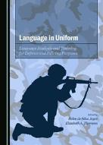
Products
Paper: “NATO STANAG 6001 Level 4 Language Proficiency – A Conceptual Model and Implications for Testing” (April 2013)
Article “Defining and Assessing STANAG 6001
Level 4 Language Proficiency” (Chapter 10,
Language in Uniform, Cambridge Scholars, 2015)
Level 4 Reading Test Specifications
Tutorial (principles of text rating, differences btw Level 3 and Level 4 texts, sample texts, sample test development procedure, etc.)
Level 4 Test Prototype (Tester and Examinee Booklets for speaking/writing modality; administration and rating procedure)
Test Familiarization Guide
Feedback Questionnaire

Slide 7
Level 4 Construct
Level 4 - “Expert”
typically only achieved by individuals who use the foreign language extensively on a daily basis as part of their profession or specialization
usually more characteristic of individual ability than of job requirements
evaluative comprehension – reading/listening “beyond the lines”
prerequisite: higher order thinking skills (e.g., deductive and inductive reasoning, analyzing, and synthesizing)

Slide 8
Level 4 Language Use
Language use is highly precise, nuanced and effective
Readily adapt and tailor language to suit the purpose and situation
Firm grasp of various levels of style and register
Ability to hypothesize and persuade
In very demanding academic and professional settings:
challenging and high-stakes situations
negotiate and persuade effectively in international environments
Examples of military-related tasks at Level 4:
serve as spokesperson responsible for press release and press conference requiring nuanced, culturally appropriate communications
act as an arbiter between warring factions during a sensitive peace-keeping assignment
analyze the hidden communicative intent of diplomatic pronouncements

Slide 9
The Level 4 Reader
readily understands all forms of written language, incl. lengthy, highly abstract, structurally or linguistically complex texts
demonstrates strong competence in identifying author tone and attitude, and implied opinions
can follow innovative and unpredictable turns of thought
reads “beyond the lines” and makes evaluative judgements about the author’s assertions
has a vast vocabulary across a broad range of topics, but may have some difficulty with slang.

Slide 10
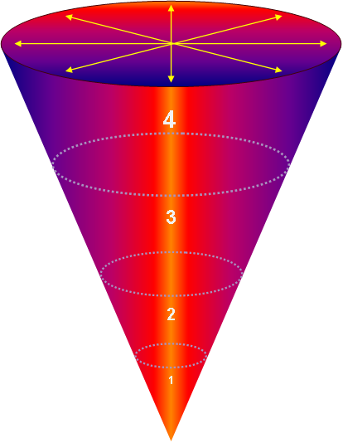
The Expanding Scale
Highly individualized, abstract, innovative and culturally dense texts
Multiple-paragraph texts on abstract subjects or arguing a point of view
Factual paragraph-length texts with a predictable organization
Short
simple
texts

Slide 11
Prototype Test
Reading is tested via speaking/writing
Format: two texts of ca. 1400 words each
Six questions per text
Administration & Rating:
speaking modality – face to face or telephonic (ideally 2 testers/raters)
writing modality – 2 raters
responses rated as Successful / Partial / Unsuccessful

Slide 12
Piloting (via Speaking/Writing)
15 trial tests administered, based on careful selection of candidates:
Nine officers (2 Danish, 4 German, 2 Swedish, 1 Czech)
Six civilians (3 native speakers, 3 near-native)
Seven PASS ratings (47%)

Slide 13
Trialing (NATO HQs Brussels and SHAPE)
No of Examinees | Nationality | Rank
2 | France | Civilian and Colonel
3 | US | Colonel (2), Capt. (N) 1
2 | Norway | Colonel (1), Major (1)
3 | Romania | LTC (3)
1 | Italy | Civilian
1 | Belgium | Colonel
1 | Poland | Colonel
1 | Canada | Civilian
1 | Turkey | Colonel
1 | Netherlands | Colonel

Slide 14
Level 4 Reading Text Sample
(Excerpt from text)
Conceptual trinities are inherently problematic, but especially in the context of contemporary American politics and policy. It is difficult enough to convey the meaning and implications of any single idea. But the world in which we actually operate is, despite what partisans and fundamentalists of various stripes like to pretend, never the simple unfolding of any one concept or force. Unfortunately, expanding a discussion even to two coexisting or contending ideas requires a philosophical leap into the obscure realm of “dialectical thinking”– especially if one’s purpose is more sophisticated than seeking merely to eliminate one of the two options or to split the difference. Attempting to adjust to the complex situation routinely created by the ongoing collision of two real-world facts thus makes one, in modern parlance, a “hopeless flip-flopper.”

Slide 15
Sample Test Item
Question:
What complexity does the author highlight by mentioning the “obscure realm of dialectical thinking”?
Task:
To understand analysis of an abstract topic and to relate ideas from the text to a wider social, cultural and historical context.

Slide 16
Sample Performance
Question:
What complexity does the author highlight by mentioning the “obscure realm of dialectical thinking?
Successful answer
Unsuccessful answer
The author wants to suggest that most people need to have one truth only to live by. Hegelian dialectics of thesis-antithesis-synthesis is very difficult to understand. It requires the acts of balancing a dilemma, or even a trilemma, in one’s mind. So the reality is that the world is complex and requires complex thinking, but our public discourse has a tendency to shy away from this kind of complexity. Most people are simply unable to fathom contradictory ideas within the same framework of thought.
He highlights the complexity of Clausewitz’s intellectual tool to analyse the world realities. This dialectical thinking is complex and thus not well applied by contemporary thinkers.

Slide 17
Validation
16 IMS and SHAPE trialing samples were rated
4 were clearly pass
7 were clearly fail
5 received split ratings

Slide 18
Validation Results (multi-faceted Rasch measurement [MFRM])
Test does distinguish between distinct levels of performance
Top 4 candidates stand out as L4 readers
Raters do not apply the rating criteria with the same rigour
Threshold performance not yet established

Slide 19
Challenges
Challenges met
Finding texts and developing constructed-response items via online collaboration
Finding appropriate piloting population
Challenges looming
Training testers and norming raters
Rating and scoring (partial answers)
Establishing threshold performance

Slide 20
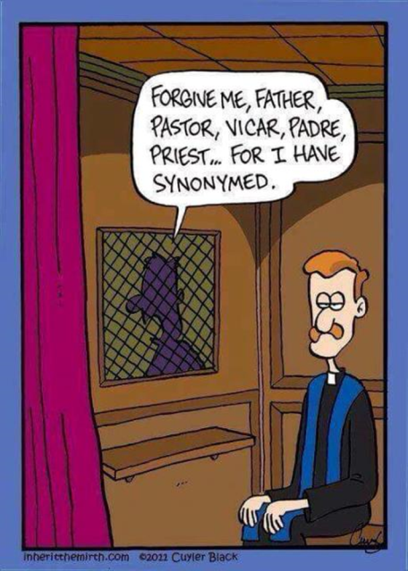

Slide 21
Next Steps?
Re-rating samples to establish cuf-off score
Workshop – PLTCE, Garmisch 2017
Release of test and supporting documents to nations
Article….?

Slide 22
References
Alschuler, C. and N. Moussa. Testing Reading at ILR Levels 4, 4+ and 5: A Tester Training Model (unpublished paper).
Child, J.R. (1998) Language Proficiency and the Typology of Texts, Foreign Language Annals. 31:3, pp. 381-391.
Lowe, Pardee, Jr. (1988) The Unassimilated History. In: Lowe, P. & Stansfield, C.W. (Eds.) Second Language Proficiency Assessment: Current Issues. Englewood Cliffs, NJ: Prentice Hall Regents.

Slide 23
Thank you!

Slide 24
Level 4 Reading Construct
Content – Task - Accuracy
Demonstrates strong competence in reading all styles and forms of the written language used for professional purposes, including texts from unfamiliar general and professional-specialist areas. Can readily follow unpredictable turns of thought on any subject matter addressed to the general reader. Shows both global and detailed understanding of texts including highly abstract concepts.
Contexts include newspapers, magazines, and professional literature written for the well-educated reader and may contain topics from such areas as economics, culture, science, and technology, as well as from the reader’s own field.
Can understand almost all cultural references and can relate a specific text to other written materials within the culture. Demonstrates a firm grasp of stylistic nuances, irony, and humour.

Slide 25
Level 4 Text Classification
Author Purpose | Typical Text Type | Reader Purpose
Project lines of thought beyond the expected, connect previously unrelated ideas or concepts, and present complex ideas with nuanced precision and virtuosity – often with the goal of propelling the reader into the author’s world of thought | Extended discourse that is tailored for the message being sent and for the intended audience. Texts are highly individualized, abstract, innovative and culturally dense, and may contain unpredictable shifts in thought, tone and register. To achieve the desired tone and precision of thought, the author will often demonstrate the skillful use of low-frequency, subtle and nuanced vocabulary, cultural and historical concepts, and an understanding of the audience. Examples: articles from the fields of military philosophy/ethics, literary criticism, treaties, policies, professional literature, politics, economics, etc. | Read “beyond the lines”, to understand the author’s sociolinguistic and cultural references, follow innovative turns of thought, and interpret the text in view of its wider cultural, societal, and political setting.
Dr. Ray Clifford, 1998

