Slide 1
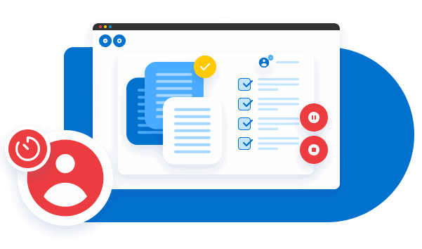
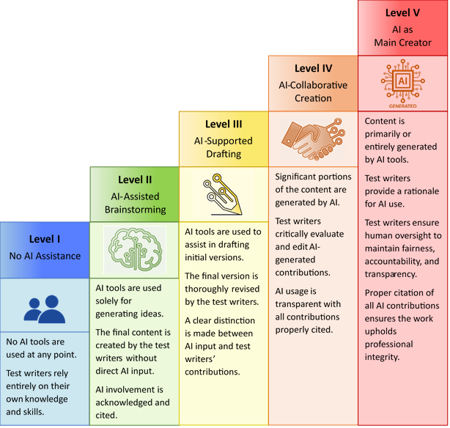
The Safe and Ethical Use of Generative AI in Language Assessment
Understanding GenAI
Potential Risks
Using GenAI safely and responsibly
What is Generative AI?
A form of artificial intelligence technology capable of autonomously generating outputs, such as text or speech, based on learned patterns from large datasets. Generative AI is particularly powerful for tasks that require creativity, adaptation, and nuanced understanding of human language and behaviour.
Bias in AI outputs
Opaque or unclear decision-making processes
Ethical dilemmas: accountability for AI’s decisions and content ownership
Insufficient awareness of AI’s Limitations
Vulnerabilities in data security and privacy protections
Lack of human oversight
Do use GenAI as a helpful tool
Do ensure the use of GenAI is fair, accountable and transparent
Do provide clear guidelines for users
Do verify the information used is true and correct
Do train test developers on how to use GenAI safely and responsibly
Do exercise caution when using open-source AI
Do monitor performance
Do incorporate stakeholder feedback
Don’t ignore bias
Don’t neglect privacy and data security
Don’t rely only on GenAI to succeed
Don’t make big decisions based solely on GenAI proficiency ratings
Don’t allow unauthorized AI use during test sessions
Don’t claim AI-generated content as your own
Don’t hide AI involvement
Don’t overlook legal implications or ownership issues when using AI-generated content
Test Development
Help develop or improve test items and prompts
Safety Measures
Safety concerns
Test Administration
Remote proctoring, adaptive question sequencing or tailored content delivery, making the test more relevant and meaningful
Avoid sharing confidential defence information in AI queries
Prioritize privacy and data security in AI applications
Perform regular risk assessments to identify vulnerabilities
Ensure compliance with legal and regulatory standards for GenAI use
Rating and Scoring
Automated evaluation of test taker responses across multiple linguistic dimensions, accelerating the scoring process and minimising human bias
Application in Language Assessment
Fairness & Equity
Test Quality Control
Collect and analyse data on test performance, feedback from test takers and the outcomes of quality control checks to refine and improve test items and processes over time
Maintain human oversight throughout AI processes
Prevent discrimination by actively monitoring AI outputs
Proactively identify and eliminate biases
Foster cultural and technological inclusivity
Regularly align AI Systems with established scoring rubrics and proficiency standards
Ethical considerations
AI Involvement Scale
(proposed)
What can BILC do?
Accountability
Define clear responsibilities for the outputs created by AI
Implement mechanisms for monitoring, reviewing, and correcting AI decisions and processes
Establish procedures for addressing the harmful use of GenAI (such as manipulation, violation of privacy or plagiarism)
BILC can assist testing teams by providing guidance in
developing guidelines and checklists
aligning AI policies in BILC member nations
establishing standardized symbols for marking AI-generated content
providing a platform for dialogue
sharing and promoting best practices
educating and raising awareness
conducting case studies
Transparency
Inform all stakeholders whenever AI tools are used in the language testing process
Provide comprehensive reports that explain the reasoning behind AI-generated scores
Clearly label and distinguish any content generated by AI
Adapted from The AI Assessment Scale (Perkins 2024)
Designed by Gerard Seinhorst, 2024

