Slide 1
2025 NATO BILC CONFERENCE
BILC INFORMATION BRIEFING
BILC Secretariat

Slide 2
Outline of presentation
BILC Background & Mandate
STANAG 6001 (ATrainP-5)
NATO Language Training Context
Program of Work & Standardization Efforts
Notes:
2

Slide 3
Bureau for International
Language Co-ordination
NATO’s consultative and advisory body for language training and testing issues.
Main responsibility: custodian of STANAG 6001
Community of language teaching/testing professionals from MoDs and defense-sponsored organizations.
Purpose: To foster cooperative professional support among BILC member nations and to extend support to NATO within the field of language training and education and language assessment.
Notes:
NATO relies on a shared language and culture to operate internally (support staff and planning), in joint operations, and in the training events that lead to them. An organizational culture's shared perceptions, procedures, and processes are expressed in a shared language. We each contribute severally, but we collectively share a standard to which we aspire. The role of BILC is to facilitate the exchange of expertise, skills, and knowledge.

Slide 4
Bureau for International
Language Co-ordination
1966 – DEU, FRA, GBR, ITA, USA
1967: Belgium, Canada, Netherlands 1975: SHAPE and IMS/NATO (non-voting members) 1978: Portugal 1983: Türkiye 1984: Denmark and Greece 1985: Spain 1993: Norway 1999: Czech Republic, Hungary, Poland 2004: Bulgaria, Estonia, Latvia, Lithuania, Romania, Slovakia, Slovenia
2009: Albania, Croatia
2017: Montenegro
2020: North Macedonia
2023: Finland
2024: Sweden
PfP, MD & ICI countries, ‘partners across the globe’ – welcome to attend and/or observe
Notes:
BILC has been NATO’s advisory body since 1966.
Founding members are France, Germany, Italy, the United Kingdom, and the United States. 1967 – Belgium, Canada, the Netherlands….

Slide 5
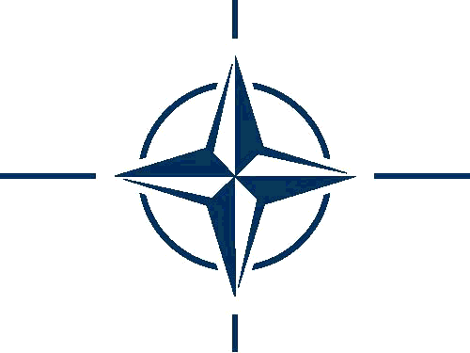
BILC Steering Committee
GBR (1966-1981)
DEU (1982-1996)
USA (1997-2008)
CAN (2008-2014)
USA (2014-2016)
BGR (2016-2019)
SVN (2019-2022)
HRV (2022-2025)
Chair
Irena Prpić Đurić
Senior Advisor
Dr. Ray Clifford
Secretaries
Suzana Horvat
Borjana Soldo
Associate Secretaries
Dr. Edelmira Nickels
Peggy Garza
Julie Dubeau
Jana Vasilj-Begovic
Notes:
BILC has three constitutional components: a. Members, b. The Secretariat, and c. The Steering Committee.
Participating nations are represented at BILC through a steering committee consisting of their national representatives.
The Secretariat and Steering Committee run the BILC.
This is our formal structure.
To the left, you can see the countries that have provided the Secretariat over the years. Currently, the Secretariat consists of 8 members.
Associate secretaries and the senior adviser are long-standing/permanent members of the BILC who support and assist a presiding nation in various ways.
The BILC Chair presides over the Steering Committee, which holds its annual meeting at the conference. Voting rights are held by NATO national representatives. Partner nations are invited to attend and observe at Steering Committee meetings, but they do not have the right to vote.

Slide 6
Bureau for International
Language Co-ordination
1978 – 2011 – the Joint Services Sub-Group within NATO Training Group (NTG)
2011 – 2023 – under the auspices of the Supreme Allied Commander Transformation (HQ SACT); the HQ SACT Joint Force Development, Human Capital Enhancement & Individual Training Branch (HCEIT Branch) → MEMORANDUM OF COOPERATION between SACT and BILC (2019)
2024???/2025 – New era – negotiations to renew the MOC; Deputy Chief of Staff (DCOS) of the Multidomain Force Development Directorate (MDFD) at the Headquarters of the Supreme Commander Allied Command for Transformation (HQ SACT)
Notes:
From 1978 to 2011, BILC was associated with the NATO Training Group through the Joint Services Sub-Group. With the reorganization of NTG, from 2011 until 2023, relations with BILC were placed under the auspices of the Supreme Allied Commander Transformation (HQ SACT) and regulated by the Memorandum of Cooperation between Headquarters, Supreme Allied Commander Transformation and the Bureau for International Language Co-ordination. Thus, BILC became better aligned as a strategic rather than tactical element while retaining its status as an independent advisory body.
BILC’s involvement is integral to the implementation of strategic planning in NATO.
In 2024, as you know, the NTG was dissolved, and five organizations/entities were left out without any organizational connection. We were informed that the NATO Military Committee Joint Standardisation Board would meet to decide where we should be aligned. Since then, the members of the Secretariat have been trying to reestablish the contacts with ACT HQ and renew the MOC. The efforts have paid off. We have been informed that the majority of our activities are still in the domain of the Deputy Chief of Staff (DCOS) of the Multidomain Force Development Directorate (MDFD) at the Headquarters of the Supreme Commander Allied Command for Transformation (HQ SACT). The POC for this process has been appointed on behalf of SACT, and we have already contacted her. We will inform you regularly and promptly about how this is being developed.

Slide 7
Bureau for International
Language Co-ordination
Mission:
To promote and foster interoperability among NATO and Partner nations by furthering standardization of language training and testing.
To support the Alliance's operations through the exchange of knowledge and best practices, IAW established procedures and agreements.
Vision:
To achieve levels of excellence where progress made by one is shared by all.
28 active NATO nations and about 18 partner nations including NATO bodies (i.e. NMI, ACO/SHAPE, NSO/NTO)
Notes:
Here are our vision and mission statements. BILC endeavours to live up to these ideals in concrete and practical ways. As the statements capture, our primary mission is to promote interoperability among NATO and PfP nations by standardizing training and testing practices. Our goal is to foster the exchange of knowledge and best practices.
There are plenty of civilian/academic language training and testing professional associations. However, the BILC world is the defense-sponsored world and, accordingly, has some special aspects, such as military interoperability, military terms, large numbers of people to train, and frequently higher levels than the purely civilian world of language teaching. BILC is a unique language organization.
The BILC vision
This means sharing progress made with member nations, partner nations, and any nation that wishes to advance in the field of language training for military purposes. How is this done? Through the secretariat, various initiatives aim to foster these exchanges and promote standardization.

Slide 8
STANAG 6001 (A TrainP-5) ed. 5, ver. 2 Key to Interoperability
Language proficiency descriptions developed by BILC
Standardization Agreement = STANAG
Adopted by NATO in 1976
SLP (Standardized Language Profile) SLP 3232
Numbers represent ability levels in Listening, Speaking, Reading, and Writing
0-5 scale (0: No Ability; L1: Survival: L2: Functional; L3: Professional; L4: Expert; L5: equivalent to a highly-articulate, well–educated native speaker)
SLPs in job descriptions, prerequisites for training, Language Capability Goals, Partnership Goals, etc.
BILC is responsible for periodically updating STANAG 6001
Notes:
As mentioned, BILC's primary responsibility is to be the custodian of STANAG 6001. This standard drives most BILC activities. It is not a how-to guide like other STANAGs, but a set of definitions of proficiency levels in four skills. Still, it is the standard we adhere to and forms the backbone of our training and testing systems. It influences what and how language is taught and tested.
It also provides guidance underpinning the serious subject of Standardized Language Profiles (SLPs), which are found in many basic personnel requirements, not to mention national directives and ministerial orders related to military personnel. The BILC website has it.
At each Level, there are separate performance descriptions for each skill area. The corresponding four numbers form a Standardized Language Profile (SLP) and are taken together in the order Listening-Speaking-Reading-Writing.

Slide 9
NATO Language Training Context
Each nation is responsible for own training & testing program.
Training durations vary greatly from nation to nation.
No common tests, only a common standard - STANAG 6001.
Nations certify their military with SLPs based on own STANAG - based tests.
Some nations have no tests.
Notes:
9
"…English language is the foundation of interoperability…" Gen Ralston, former SACEUR
Despite the crucial role of the English language in NATO, language training remains a national responsibility. Each nation is accountable for its training and testing program. It's important to note that there are no common tests , only a common standard. Moreover, there is no central authority overseeing language training, testing, and the accuracy of results. While BILC can and does make recommendations, it does not have the authority to enforce them on national programs.
We at BILC know that testing methods vary, and standard interpretations can cause differences in SLPs even though. BILC has made huge progress with many nations through standardizing efforts. A few nations still need to develop professional training and testing programs, yet STANAG 6001 proficiency certificates are still issued. Furthermore, Nations may not be setting realistic training goals, for example, aiming to train all officers to level 3… This is an incredible challenge for most nations. In some nations, we know it is extremely difficult to find qualified teachers with this high level of proficiency.

Slide 10
MAIN EVENTS
3 annual events and one biennial event:
Annual BILC Conference (in May)
BILC Professional Development Seminar (in October)
STANAG 6001 Testing Workshop (in September)
Military Terminology Conference (in April, every other year)
Notes:
So, what does BILC concretely do to familiarize Partner nations with the STANAG 6001 standards and the methodology for testing them? To assist them in reaching a standard and interpreting standards in the same way.
We have four main events.
They all promote the standardization of NATO and Partner nation teaching and testing systems by providing a forum for exchanging information, best practices, and new approaches in language training, managing military terminology, and testing.
At each of them, you can meet people from teachers to school commandants, from testers to policy advisors, managers, and practitioners;
Conferences and seminars are the two events each year that differ slightly in format and attendance. The fall seminar focuses primarily on more hands-on training or testing issues, while the spring conference might be more inclined toward policy issues.
Two specialized events:
The STANAG Testing Workshop is explicitly intended for testing professionals/experienced testers.
The Military Terminology Conference is a biennial event that caters to a wide range of language professionals, including terminologists, translators, proofreaders, interpreters, and military SMEs- terminology developers. It is an invaluable opportunity for these professionals to share best practices and discuss the latest developments in military terminology.

Slide 11
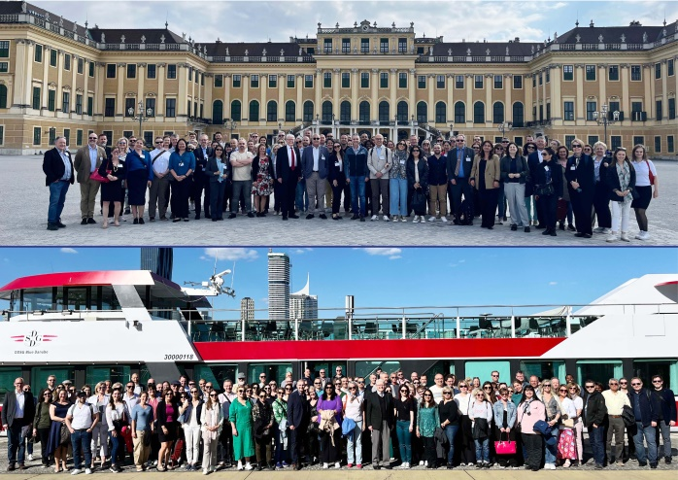
2024 NATO BILC Annual Conference Vienna, Austria 13 – 16 May 2024
“ZEITENWENDE”: Adapting Language Policy and Training Strategies to Meet New Requirements”
Current strategies, policies, and processes underpinning language training and testing in the light of
“Zeitenwende”
Providing a timely response to the ever-shifting training priorities in operational languages
The impact of the wars in Ukraine and the Middle East on language training strategies
New and old best practices in training to meet newly arisen needs
Establishing quality assurance processes for internally conducted or outsourced training
and testing
Developing methodologies to build robust training programs
Defining the optimal ratio of general versus specific training content
Implementing changes based on course evaluation and validation results
Designing effective ESP courses and measuring their success
Communicating effectively with higher-level decision-makers in order to inform and influence policy
The organizational value of having well-defined proficiency outcome standards when making data-driven decisions
Notes:
The conference theme was “ZEITENWENDE”: Adapting Language Policy and Training Strategies to Meet New Requirements”. ‘Zeitenwende’ is a German term meaning "turning point" or "epochal change." It was introduced into the public discourse by German Chancellor Olaf Scholz in regard to the war in Ukraine. However, it is also applicable to the changes and challenges which have appeared in the didactics and methodology of teaching foreign languages in the last few years. It encapsulates the essence of our discussions over the next few days. It calls upon us to recognize the crucial role of linguistic diversity and cultural sensitivity in military operations. As NATO and its partner nations engage in increasingly diverse and complex missions, your ability to communicate effectively across linguistic and cultural boundaries is paramount and greatly valued.
There were 19 presentations on the theme given by BILC members and two (2) given by two guest speakers, i.e., HN high-ranking officials. In addition, six study groups led by distinguished professionals took place. (Defining Language policies, Developing ESP courses – for JTAC, andAviation) – 98 participants from 35 countries and 2 NATO entities (SHAPE and NMI)

Slide 12
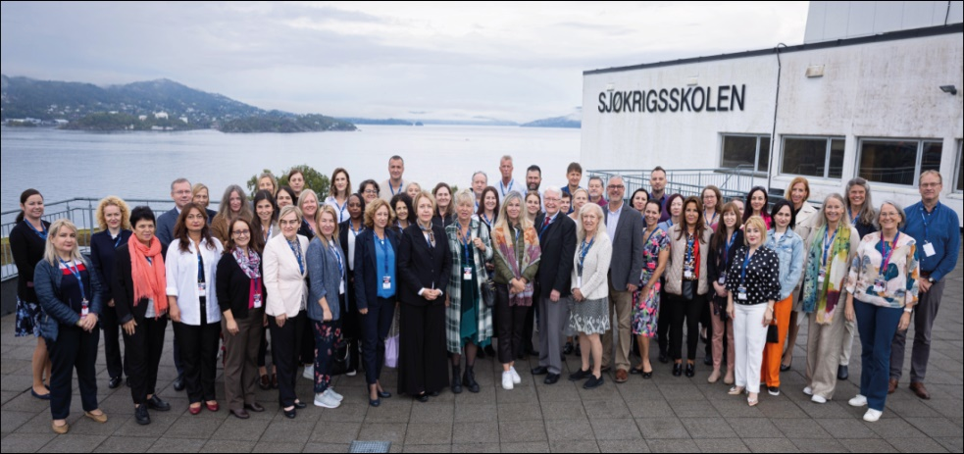
2024 NATO BILC STANAG 6001 Testing Workshop
Bergen, Norway
2 – 6 September 2024
“Plug & Play: Sustaining Validity Through Multinational Collaboration ”
Moderation of reading and listening items; rater norming for assessing speaking and writing
Integrating AI tools in test development and rating
practices
Building professionalism in the testing cadre
Test development and administration in the digital age
(testing writing, authenticity)
Notes:
The primary objectives of the Testing Workshop encompassed norming, sharing, planning course updates, and new projects and new directions in testing IAW STANAG 6001, with a particular emphasis on moderation of reading and listening items, rater norming for assessing speaking and writing, integrating AI tools in test development and rating practices, and building professionalism in the testing cadre. These objectives were successfully met through a comprehensive program that included six plenary sessions, fourteen specialized workshops, five digital poster presentations, and an expert panel discussion. All the presentations and workshops facilitated an exchange of ideas and best practices among specialists from 30 NATO and partner nations and one NATO body (SHAPE).

Slide 13
2024 NATO BILC Professional Development Seminar
Prague, Czech Republic
13 – 18 October 2024
“Rethinking the Language Training and Education: Keeping Pace with Change”
Tailoring curricula to meet ESP purposes needs
Maintaining the culture of innovation within the institution and managing resistance to change
Evolution of language assessment and standardization in response to technological advancement, such as AI
Implementing artificial intelligence in various language training contexts (gaming, virtual reality etc.)
Teaching practices that bolster positive learner attitudes
Reflecting critically on learner needs and adapting flexibly to change
Effective use of online training and mobile applications to motivate learners and foster the learning process
Adapting to and applying digital transformation for enhancing and fostering learning
Harnessing the power of big data to analyze learning patterns, predict outcomes, and tailor educational content to meet the evolving needs of NATO personnel
Notes:
The topic "Rethinking the Language Training and Education: Keeping Pace with Change" addresses the need to reassess and adapt our language instruction and assessment approach in response to a rapidly evolving global landscape.
Adapting to Technological Advances:
The role of technology (such as AI, machine translation, language learning apps) in modernizing language training.
How online platforms and digital tools can enhance or replace traditional classroom settings.
Meeting New Operational Needs:
The evolving requirements of language skills for military and security operations.
Changes in global partnerships, international diplomacy, and coalition missions that demand new language capabilities.
Tailoring Language Training for Specific Audiences:
Customizing language education to meet the needs of military personnel, diplomats, and civilian experts.
The importance of context-specific vocabulary, such as military terminology, in operational readiness.
Balancing Standardization with Flexibility:
Ensuring that standardized language proficiency (e.g., STANAG 6001) keeps pace with operational needs.
Flexibility in curricula to accommodate diverse learners and changing mission priorities.

Slide 14
BILC Professional Development Programme in Partnership Cooperation Menu
1. Language Testing Seminars (conducted at PLTCE):
Language Testing Seminar, ACT.647, 2 weeks;
Advanced Language Testing Seminar, ACT.658, 3 weeks;
Language Standards and Assessment Seminar, ACT.648, 2 weeks.
2. BILC Methodology Workshops
English Teaching Faculty Development Workshop “Teaching Speaking and Writing for Military Purposes”, ACT.659, 2 weeks. Conducted at 3 PTECs PLTCE, Bulgaria and Slovenia.
Facilitators: BILC teaching & testing experts from 24 nations.
Notes:
The Language Testing Seminars and the Advanced Language Testing Seminars play a crucial role in helping nations establish independent testing systems. They train testers in test development and offer follow-up assistance, empowering nations to take control of their language testing. They are focused on making STANAG 6001 language tests in each NATO and partner country comparable, which means that one country’s Level 3 is the same as another country’s Level 3.
Two seminars were developed for the professional training of teachers. The Language Standards and Assessment Seminar targets curriculum developers and classroom teachers who must understand modern language assessment regarding STANAG 6001. It aims to familiarize teachers and language training managers with STANAG 6001, classroom-based assessment, and the best methods for helping their students build language proficiency according to STANAG 6001.
The English Teaching Faculty Development workshop addresses teaching writing and speaking to military personnel. Teachers (primarily civilians) often have problems defining the formats and situations in which military personnel use their speaking and writing skills.
Faculty and experts from many countries conduct these seminars. While we offer seminars at PLTCEin Garmisch, the facilitators come from many different countries—two additional Language school PTECs, in Bulgaria and Slovenia, host iterations of the Faculty Development Workshop.
BILC EVENTS AND SEMINARS/WORKSHOPS – ready-made training opportunities that equip participants with practical skills to share their experience and present experiments and lessons learned.

Slide 15
SUPPORT TO PARTNER NATIONS
DEEP – Defence Education Enhancement Programme
(https://www.nato.int/cps/en/natohq/topics_139182.htm)
English is NATO’s operational language
Many DEEP military educational institutions have language programs
BILC is ready to continue to support DEEP
BILC
DEEP
Notes:
15
BILC's assistance to nations is at the forefront of standardization efforts.
It assists in attempting to reach standards and interpretations of standards, as well as in enhancing and reinforcing language teaching and testing methods.
Most NATO and partner nations have relatively large communities of teachers who teach languages at different levels in various military institutions and often need more professional training. Following recommendations from several scoping and advisory visits, BILC started to provide in-country tailor-made faculty development workshops, which help nations develop and consolidate their language training systems.
The visits and workshops are conducted at a nation's request. Small teams of experts are formed and led by members of the BILC Secretariat and supported by SHAPE, DEEP, the George Marshall Center, and Partner Language Training Center Europe (PLTCE).
For the past two years, most of these activities have been carried out under the DEEP umbrella since BILC has actively supported DEEP in its efforts to assist military educational systems in building efficient language training and testing systems.

Slide 16
BILC focus – teacher/tester/translator training
Armenia - Workshop dedicated to creating the language training and testing policy paper
Bosnia-Herzegovina - Instructor exchange, Leadership Discussions, Continuous Professional Development for instructors, Norming for STANAG 6001 testers
Colombia - Tailored faculty development workshop
Georgia - Testing IAW STANAG 6001, Teaching online and using available resources, Classroom assessment workshop, and Familiarization visit to a NATO country (Lithuania), Developing L3 items
Jordan - Advanced English proficiency course for newly-appointed language testers followed by a tailored Language Testing Seminar (LTS) and virtual testing consultations as needed
Kazakhstan - BILC advisory visit and STANAG 6001 testing familiarization workshop
Moldova - Scoping visit
Tunisia (funded by DCB) - Tailored Language Testing Seminar for future testing team, Online support in development of a language testing policy
Ukraine - Out-of-country events: two faculty development workshops, teacher exchange events, English as a Medium of Instruction (EMI) for military instructors, consecutive interpreting course, terminology management workshop, and continuous virtual support (assistance to STANAG 6001 testing team and language teachers)

Slide 17
BILC support to DEEP 2024 – 2025
ARMENIA
BOSNIA-HERZEGOVINA
COLOMBIA
GEORGIA
JORDAN
KAZAKHSTAN
MOLDOVA
UKRAINE

Slide 18
BILC Working Groups & Projects
STANAG 6001 Working Group
JTAC Working Group
Shared Item Bank Project

