Slide 1
Understanding Linguistic Diversity C2 Perspectives BILC Zagreb 2025

Slide 2
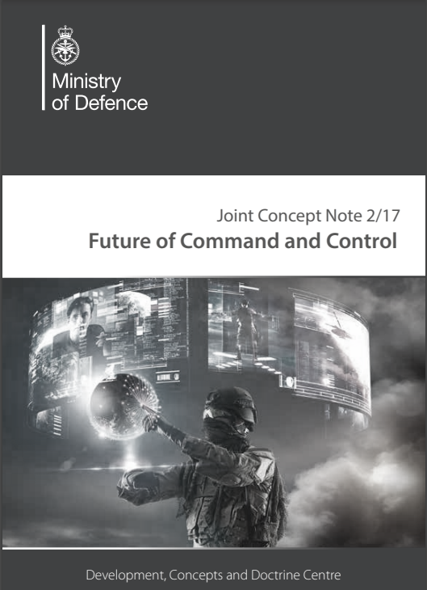
Purpose of C2
To provide focus for individuals and organisations so that they may integrate and maximise their resources and activities to achieve desired outcomes.
1
Provide focus
2
May integrate
3
Maximise resources
4
Achieve desired outcomes

Slide 3
May integrate
Languaging a form of adaptive social sense-making – Participatory Sense Making
(PSM)
2
Cuffari et. al. From participatory sense-making to language:Languaging is synonymous with linguistic sense-making and is defined as a form of social agency involving a double regulation of self and interaction that integrates the tensions inherent in dialogical organization and participation genres [3, p. 1092 2017].
Languaging is therefore, primarily dialogic in nature, it is respectful of collaborative and cooperative principles, attempts to resolve these tensions, and generates congruent shared meaning.

Slide 4
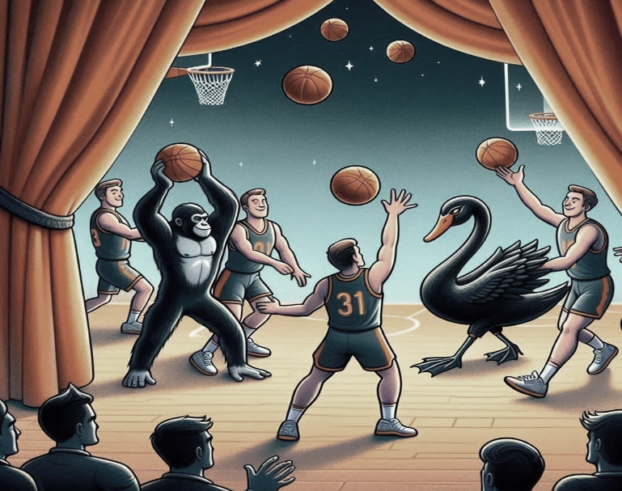
Languaging in the CEFR
Languaging – a form of social agency contingent upon:
Mediation
Interaction
Goal-oriented communication
And executed through collaborative dialogue and 'metatalk' leading to the negotiation of, and, co-construction of meaning.

Slide 5
The Foreign Language Effect – Working in an L2
How are L2 users different from L1 users when it comes to PSM and decision-making or enactive cognition?
Impacts working memory in two key ways:
Reduced attention regulation
Increased dependence (biases) on heuristics
Lower fluency information processing impacts on how thoroughly information is analysed.
[Review of the literature Costa et al. p. 149 -2017]

Slide 6
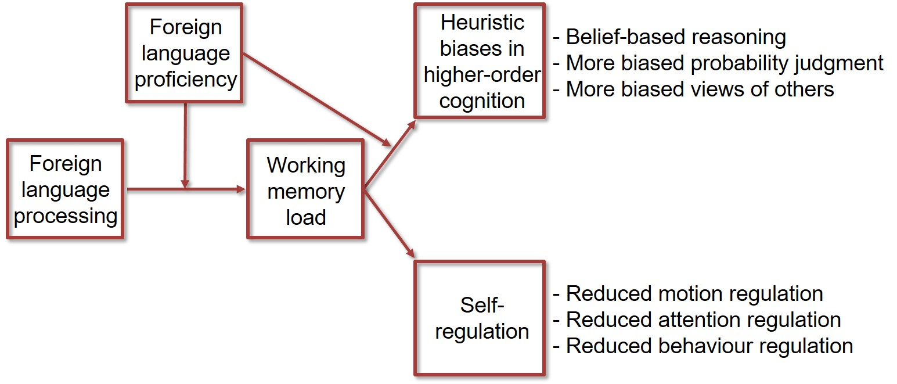
Heuristic biases and self-regulation when using L2
[Volk et al.]

Slide 7
SWOT
S
Strengths
Foreign-language processing prompts a more deliberative approach to decision making.
L2 users tend consider their options in a more thoughtful manner.
[Costa et al. p. 149]
Weaknesses
Slower information processing (attention regulation) -fluency in information processing impacts how thoroughly information is analysed by the individual
The language in which information is framed, impacts the treatment of losses, gains and risk - L2 users are less sensitive to framing - reduces illusory correlations
In other words, they are less likely to be influenced by implicit elements In language (nuance, register and implicature) information is presented
W
O
Opportunities
Greater deliberation and questioning can lead to more qualitative decisions.
May be more prone to risk-taking or more averse than in your L1 – Not always a bad thing!
Threats
Likely to increase heuristic biases in decision making and inhibit self-regulation during communication in terms of behaviour, responsiveness and attention
In other words, reduced agency and self-realization [Volk et al. p. 863]
Greater emotional disassociation than when (Empathy) processing in L1.
T

Slide 8
Reduced Attention Regulation Reading Study JACS-P 21-23
11%
(>100%)
11%
(0%)
8%
(71-100%)
Amount of extra time it takes to read in English compared to Swedish
38%
(10-29%)
22%
(50-70%)
11%
(30-49%)

Slide 9
JACS-P 21-23 Participant Scores on EPT
156 Participants
67%
C1 or higher

Slide 10
Participants in the study​
31 Swedish Captains and Majors from the JACS-P 21-23 Cohort – Test results should be predictive of mediation ability, interaction and goal-oriented communicative capability.
Self-evaluation questionnaire (Likert scale) while on a multi-national joint operational exercise.
Aimed to investigate their insights into their own ability to mediate, interact and engage in goal-oriented communication.
CEFR C1 benchmark descriptors of these three sub-competences – Professional level.

Slide 11
Mediation - Effect on Working Memory (biases)
7. I can restate, evaluate and challenge contributions from colleagues when discussing issues related to military staff work.
9. I can ask follow up questions by probing for more detail and can reformulate questions if these are misunderstood.
11. I can report on what others have said, summarising, elaborating and weighing up multiple points of view.
Mediation
general correlation between C1 particpant responses and their test scores.
two of the B1 respondents significantly overrated their abilities
two of the C2 respondents signicantly underrated their abilities
Results
echoes the findings in Volk et al that identify a correlation between higher levels of L2 proficiency and greater metalinguistic awareness
are lower-level L2 users unaware of the effects on their working memory - biases in higher order cognition?
Implications
Likert-scale responses 1-5 to C1 mediation descriptors.
Impact greater on those with lower levels of L2 proficiency – But...
…the Dunning-Kruger effect is in play.

Slide 12
5. I can easily keep up with and respond to discussions in a timely manner, even on abstract, complex, unfamiliar topics.
6. I can argue my position convincingly, responding to questions and comments.
8. I can make critical remarks or express disagreement diplomatically.
9. I can ask follow up questions by probing for more detail and can reformulate questions if these are misunderstood.
Interaction
Interaction Effect on Self-regulation
general correlation between C1 particpant responses and their test scores.
two of the B1 respondents significantly overrated their abilities
two of the B1 and B2 respondents seem to be aware that they were limited in this area – rated themselves 3 on all questions
Results
echoes the findings in Volk et al that identify a correlation between higher levels of L2 proficiency and greater metalinguistic awareness
are lower-level L2 users unaware of the effects on their working memory - biases in higher order cognition?
Implications
Likert-scale responses 1-5 to C1 interaction descriptors.
Impact greater on those with lower levels of L2 proficiency – But... unaware
the social dimension of the exercise and the partner country may impact awareness.

Slide 13
Goal-oriented communcation
A similar pattern was observable in response to questions 3 & 10 which investigated the ability to use circumlocutions (paraphrase & clarify etc.) and frame discussions and collaborate on courses of action.
B1 participants overrated their ability and C2 underrated theirs.

Slide 14
Two conclusions
When organizing groups for multinational planning, C2 should pay attention to the foreign language effect.
Language syllabus designers working with officers destined for multinational roles – incorporate the key languaging components involved in languaging & dialogic genres through Interactive or gamified & reflective learning.

Slide 15
References
A. Costa, M.-L. Vives, and J. D. Corey, “On Language Processing Shaping Decision Making,” Current Directions in Psychological Science, vol. 26, no. 2, pp. 146-151, 2017.
E. C. Cuffari, E. Di Paolo, and H. De Jaeger, "From Participatory Sense-Making to Language: There and Back Again," Phenomenology and the Cognitive Sciences, vol. 14, pp. 1089-1125, 2015.
J. Ivari and A. Nolan, "A Set-Based Approach: Searching for the Problem-Solution Eclipse," 28th International Command and Control Research and Technology Symposium, 2023.
J. Ivari and A. Nolan, "Team Up for Success: Harnessing Participatory Sense-Making with the Harmonization Emergence Model," 28th International Command and Control Research and Technology Symposium, 2023.
J. Kruger and D. Dunning, “Unskilled and Unaware of It: How Difficulties in Recognizing One's Own Incompetence Lead to Inflated Self-Assessments,” Journal of Personality and Social Psychology, vol. 77, no. 6, pp. 1121-1134, Dec. 1999
N. Luhmann et al., The Making of Meaning: From the Individual to Social Order: Selections from Niklas Luhmann's Works on Semantics and Social Structure, Oxford Academic Books, 2022.
A. Nolan, "Mediating Between Two Languages—The Effects of English Medium Learning on First Term Undergraduate Students: A Case Study at Swedish Defence University," in Advancing Language Studies for the 21st Century, Cambridge Scholars Press, 2023.
H. A. Simon, The Sciences of the Artificial, Cambridge, MA: The MIT Press, 1969/1996.
Nolan, A., & Ivari, J. (2024). Understanding linguistic diversity: A C2 enabler fostering harmonization in team dynamics through constructive-decoherence. Swedish Defence University. https://www.researchgate.net/publication/384324129
C. Richards, "Boyd’s OODA-Loop," Necesse, vol. 5, no. 1, pp. 142-165, 2020.
S. Volk, T. Kohler, and M. Pudelko, “Brain Drain: The Cognitive Neuroscience of Foreign Language Processing in Multinational Corporations,” Journal of International Business Studies, vol. 45, no. 7, pp. 862-885, 2014.
https://www.coe.int/en/web/common-european-framework-reference-languages.

