Slide 1




Bridging the Gap:
Challenges in Designing Military English Materials for Academic Settings
2025 NATO BILC CONFERENCE
ZAGREB, CROATIA
Milena Prošić
Dr Franjo Tuđman Croatian Defence Academy
Tea Glavaš, PhD
Dr Franjo Tuđman Defence and Security University

Slide 2
ELT textbooks as the primary source of input in language classrooms
“…it is commonly accepted that in most language classrooms throughout the world most lessons are still based on materials…”
(Tomlinson, 2016)
“…coursebooks remain the default language learning resource…”
(Mishan, 2021)
“…instructional materials generally serve as the basis of much of the language input that learners receive and the language practice that occurs in the classroom…”
(Richards, 2001)
“…textbooks themselves have served as models for teachers’ and learners’ expectations…”
(Tomlinson, 2001)

Slide 3

Table of contents
01
02
03
04
Academic vs. military language requirements
Addressing the challenge of authenticity
Research-informed materials development
Design research cycle in action

Slide 4

Materials at the Crossroads: Language Policy and the Educational Context of Officer Training
01
02
03
CIVIL-MILITARY HYBRID SYSTEMS
= academic degrees at civilian universities + military training through defence academies
FULLY INTEGRATED MILITARY INSTITUTIONS
= defence universities or military academies
MODULAR OR RESERVE-BASED TRAINING
Language teaching and learning serving
all three and more?
operational readiness
academic development
intercultural communication

Slide 5

Academic vs. military language requirements
Characteristics of ESP materials:
expected language level: B1 (CEFR) or Level 2 (STANAG)
focus on aspects of English related to their field of study
follow functional and communicative methodology
place emphasis on developing skills
Identify and integrate:
language skills for future military roles
OPERATIONAL COMMUNICATION
language skills in the academic setting
ACADEMIC CONTEXT LEARNING NEEDS
our focus: READING and SPEAKING

Slide 6
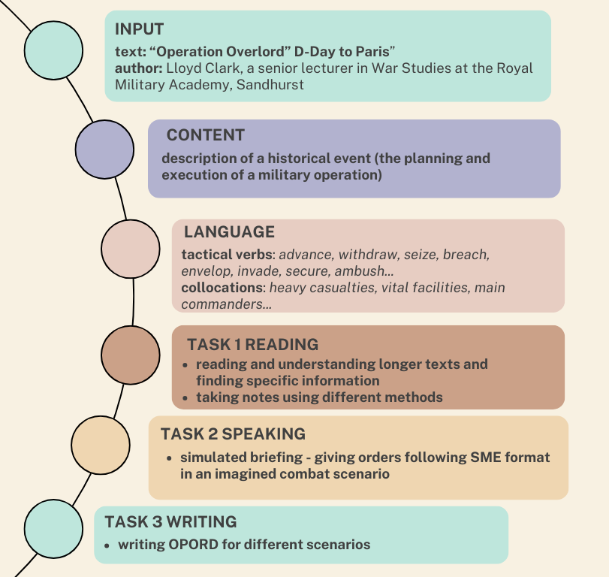
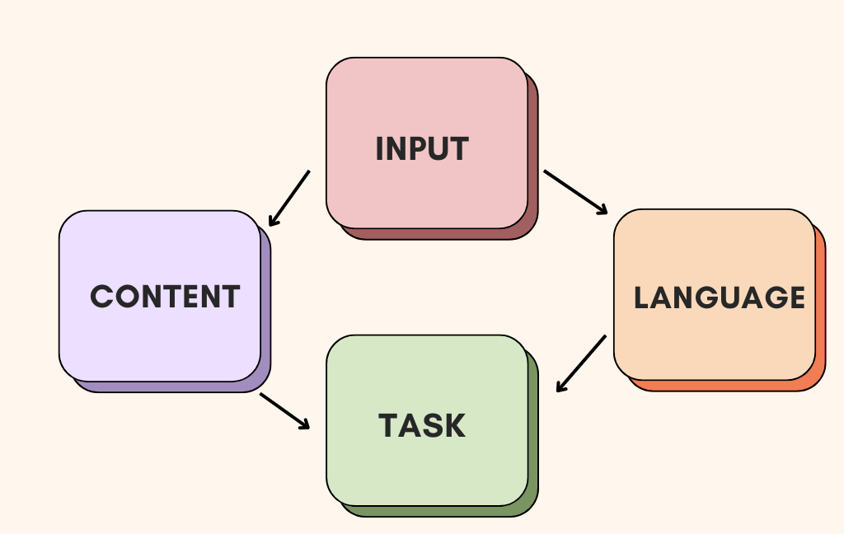
Academic vs. military language requirements
A materials design model
(Hutchinson and Waters, 2003)

Slide 7


Addressing the challenge of authenticity
ESP teachers as materials providers – our challenges:
selecting relevant texts/essential vocabulary
navigating authenticity and relevance from a non-native perspective
balancing authenticity and pedagogical suitability
authenticity – context dependent
”…in ESP any text is automatically removed from its original context, there can be no such thing as an authentic text in ESP.” (Hutchinson and Waters, 2003)
functional authenticity:
What do we want the text to do?
”…authenticity is a function not only of the language but also of the participants, the use to which language is put, the setting, the nature of the interaction, and the interpretation the participants bring to both setting and the activity.”
(Taylor, 1994)

Slide 8
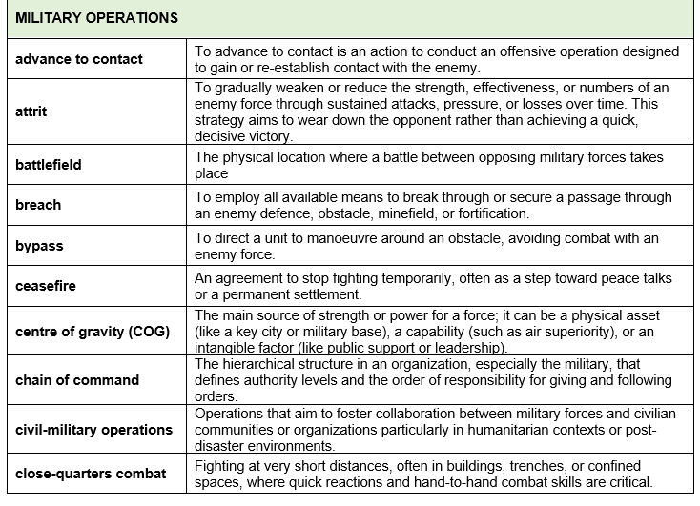
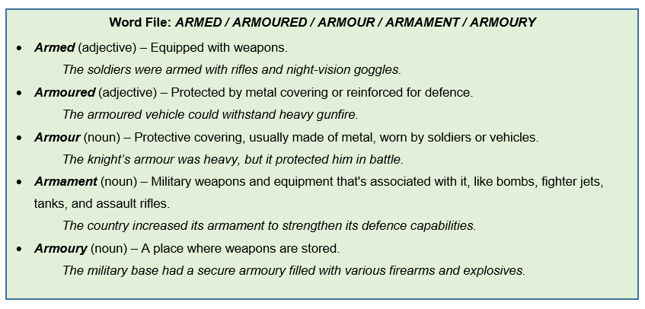
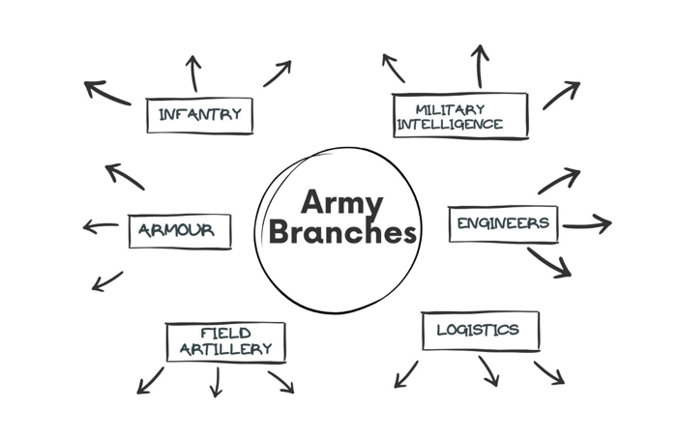
Choosing and Adapting Authentic Materials
carrier content
real content
modify texts
break down texts into manageable chunks
use scaffolding techniques
provide footnotes (Word Files)
create glossaries for specialized vocabulary
use visuals for language work…
vehicle for the real content
appropriate
understandable
must stand the test of time
match the objectives
credible
realistic
usable
engaging
Dudley-Evans and St John, (2005).

Slide 9
Research-informed materials development
SLA principle 1 = RELEVANCE
SLA principle 2 = PROCESSING issue:
exposing students to rich, meaningful, comprehensible and authentic language input
creating opportunities for contextualized and purposeful communication (+speaking at length)
engaging students both cognitively and affectively
exposing students to salient language features
“…sound instructional materials cannot be created in a theoretical vacuum. They draw on a wide variety of theoretical foundations…”
(Richards, 2010)
text-driven approach
task-based learning
language-awareness approaches
form-focused instruction
corpus-informed choices

Slide 10
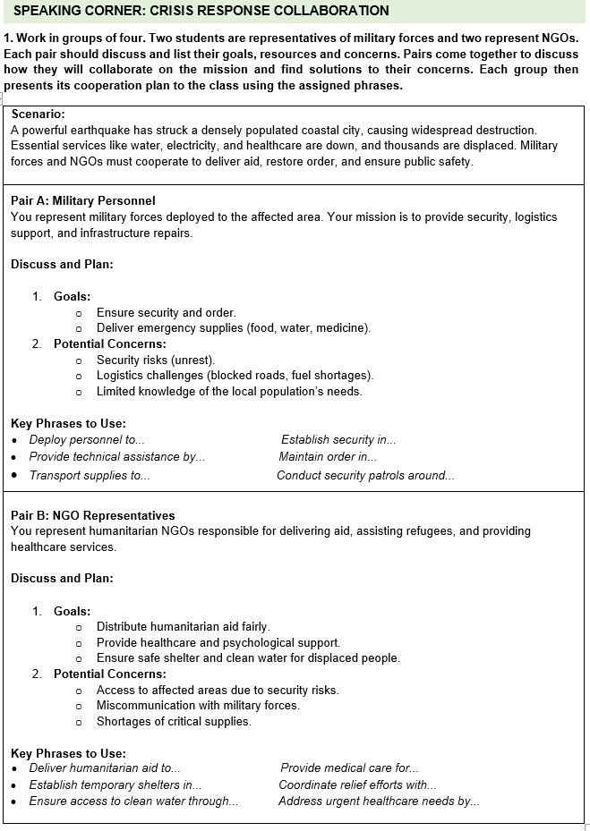
Putting theory into practice:
An example task
1. TASK-BASED & PROBLEM-SOLVING
critical thinking, intercultural awareness, and strategic communication
2. CONTEXTUALIZED, PURPOSEFUL
COMMUNICATION
authentic interaction with a clear outcome: a cooperation plan
3. FOCUS ON MEANING + FORM
using assigned functional phrases to scaffold production of key operational expressions
repeated, contextual use of targeted collocations
4. LANGUAGE AWARENESS & TEXT
ENHANCEMENT
key phrases are pre-taught and practiced in noticing-based activities
→ all 4 language skills, interactional language functions

Slide 11
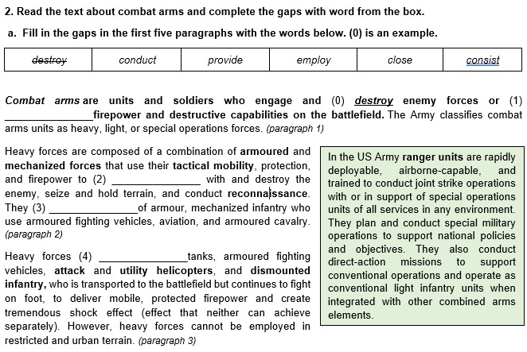
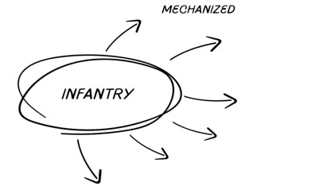
Corpus-informed choices in materials development
Corpus-informed materials development → looking at: FREQUENCY, COLLOCATION and USE
= evidence-based language choice rather than intuitive choices in decision making
SKELL Corpus data
engage the enemy | 0.34 hits per million
close with the enemy | 0.03 hits per million
mechanized infantry | 0.29 hits per million
airborne infantry | 0.11 hits per million
motorized infantry | 0.1 hits per million
dismounted infantry | 0.04 hits per million

Slide 12
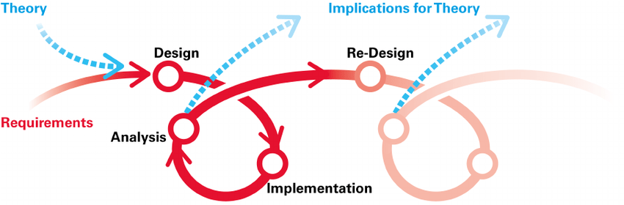
Implementing collaborative feedback into materials development
- DESIGN-BASED RESEARCH (DBR):
progressive refinement
effective collaboration between teachers and students
constant evaluation of the material
reflection on the use of the material
DBR IN ACTION:
2018. – 2025.
multiple evaluations + reflection sessions
multiple iterations
expert military professional sessions
student feedback (interviews + questionnaires)
= context-sensitive and learner-oriented material

Slide 13
Student feedback
COURSEBOOK REDESIGN:
integrating multiple skills within one task
repeating specialist terminology frequently
tasks aimed at acquiring linguistic means for expressing language functions important for the military context
providing terminology definitions related to the topic.
Student suggestions
Demografic info
definitions of target vocabulary
more focus on language structures
more group work activities
88% male
average age: 19.7 years
more than 10 years of learning English
self-assessment: 3.5 out of 5
Our concerns
Are there differences in learners' perceptions of the material based on variations in language proficiency levels and learning styles?
→ NO statistically relevant difference (p-value=0.17 / 0.69)

Slide 14

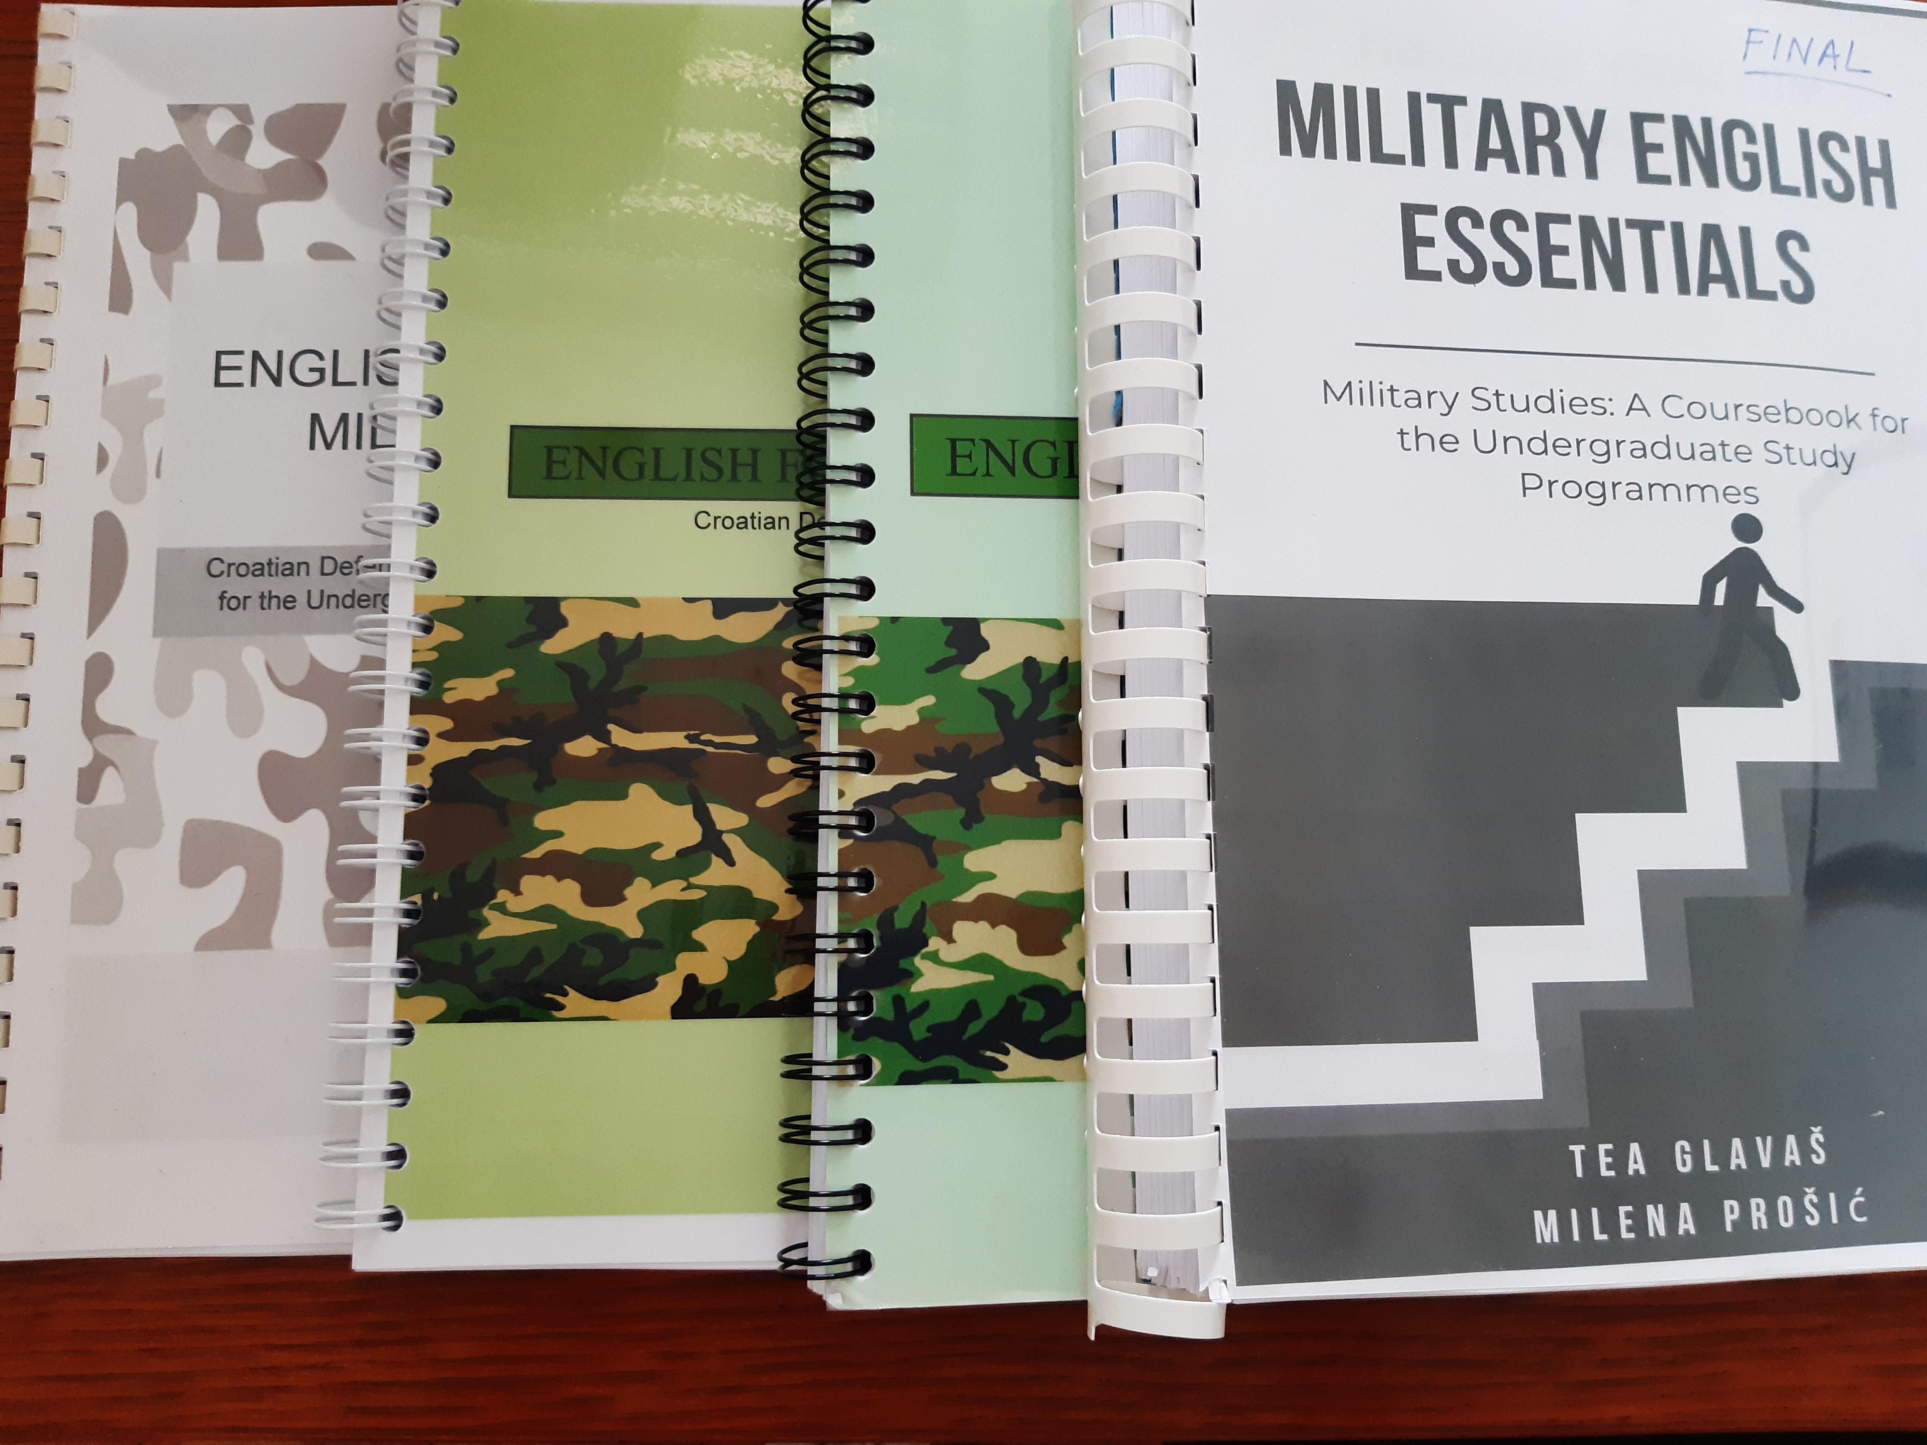
IMPROVISE, ADAPT, OVERCOME.
AND DESIGN MATERIALS…

Slide 15
Literature
Azarnoosh, M. et al. (2016). Issues in Materials Development. Rotterdam/Boston/Taipei:SensePublishers.
Dudley-Evans, T. and St John, M.J. (2005). Developments in English for Specific Purposes A multi-disciplinary approach. Cambridge: CUP.
Hutchinson, T. and Waters, A. (2003). English for Specific Purposes. Cambridge: CUP.
Long, M. (1991). Focus on form: A design feature in languge teaching methodology. IN K. deBot, R. Ginsberg and C. Kramsch (eds.), Foreign Language Research in Cross-Cultural Perspective. Amsterdam: benjamins, pp.39-52.
Mishan, F. (2010). Withstanding washback: thinking outside the box in materials development. In B. Tomlinson and H. Masuhara (eds.), Research for Materials Development in Language Learning: Evidence for Best Practice. London: Continuum, pp.353-368.
Mishan, F. (2012). The Global ELT courseboook: A case of Cinderella’s slipper. Language Teaching 55(4), pp.490-505.
Richards, J. (2001). Curriculum development in language education. Cambridge: CUP.
Taylor, D. (1994). Inauthentic Authenticity or Authentic Inauthenticity? TESL – EJ (August 1994 –Volume 1, Number 2)
Tomlinson, B. ( 2002). (ed.), Materials Development in Language Teaching. Cambridge: CUP.
Tomlinson, B. (2008). Language aquisition and language learning materials. In B. Tomlinson (ed.), English Language Teaching Materials: A Critical Review. London: Continuum, pp.3-14.
Tomlinson, B. (2013). Second Language Acquisition and Materials Development. In B. Tomlinson (ed.), Applied Linguistics and Matreials Development. London/New York: Bloomsburry Academic.
Van den Branden, K. (2006), Task-Based Language Education From Theory to Practice. Cambridge: CUP.

Slide 16
Thank you.
Any questions?
tea.glavas@sois-ft.hr / glavas.tea@gmail.com
milena.prosic@morh.hr milena.prosic@gmail.com

