Slide 1
ChatGPT and Beyond: AI’s Impact on English Language Teaching and Learning
Spanish Military Language School
Irene Pérez Garachana

Slide 2
Adapting to the AI-Enhanced Classroom
Tech-Savvy Students
High Expectations for Technology
AI is Already in Use
Understand & Guide AI Use
‍Teachers Need AI Training
AI ≠ Teacher

Slide 3
Survey
Context
English Intensive Course (8 weeks)
Advanced level (Professional Level STANAG 6001)
55 students (work in progress)
Purpose
Analyze the use students make of AI tools
Analyze the perception students have of these tools
Reflect on the most efficient way to use AI

Slide 4
Use of AI
Students
Teachers
Correct essays
Help students rephrasing
Tailor grammar and vocabulary exercises to our students
Generate exercises to revise content
Learn vocabulary
Improve their writing skills
Improve grammatical accuracy
Practice conversation
Translate
Prepare for exams

Slide 5
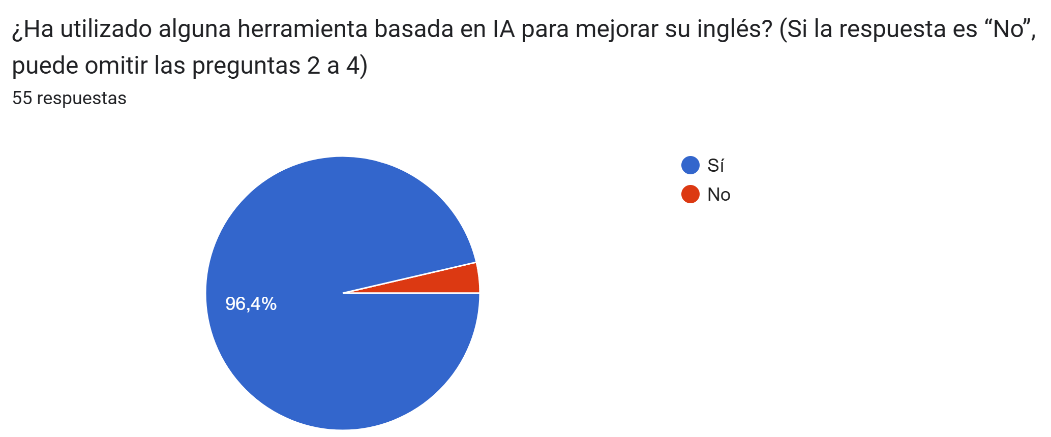
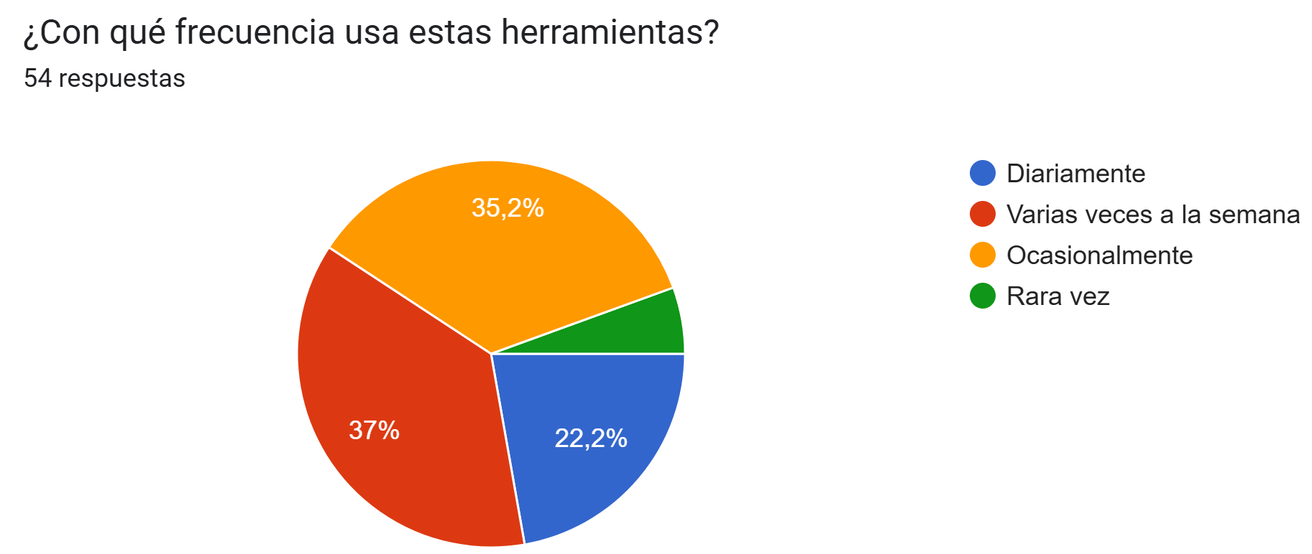
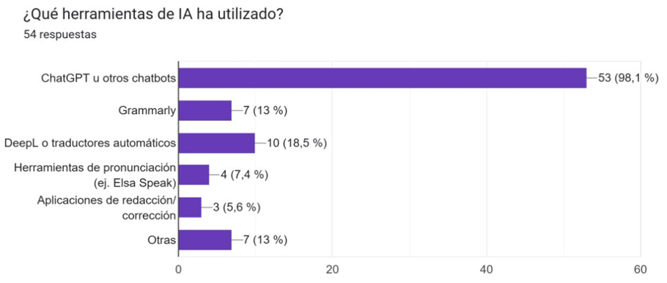
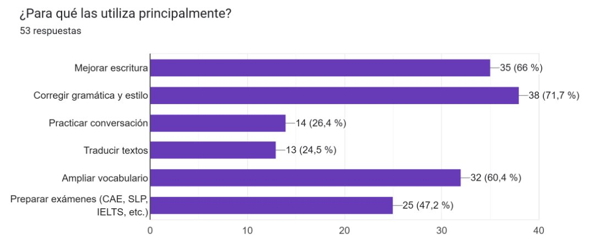
Use of AI

Slide 6
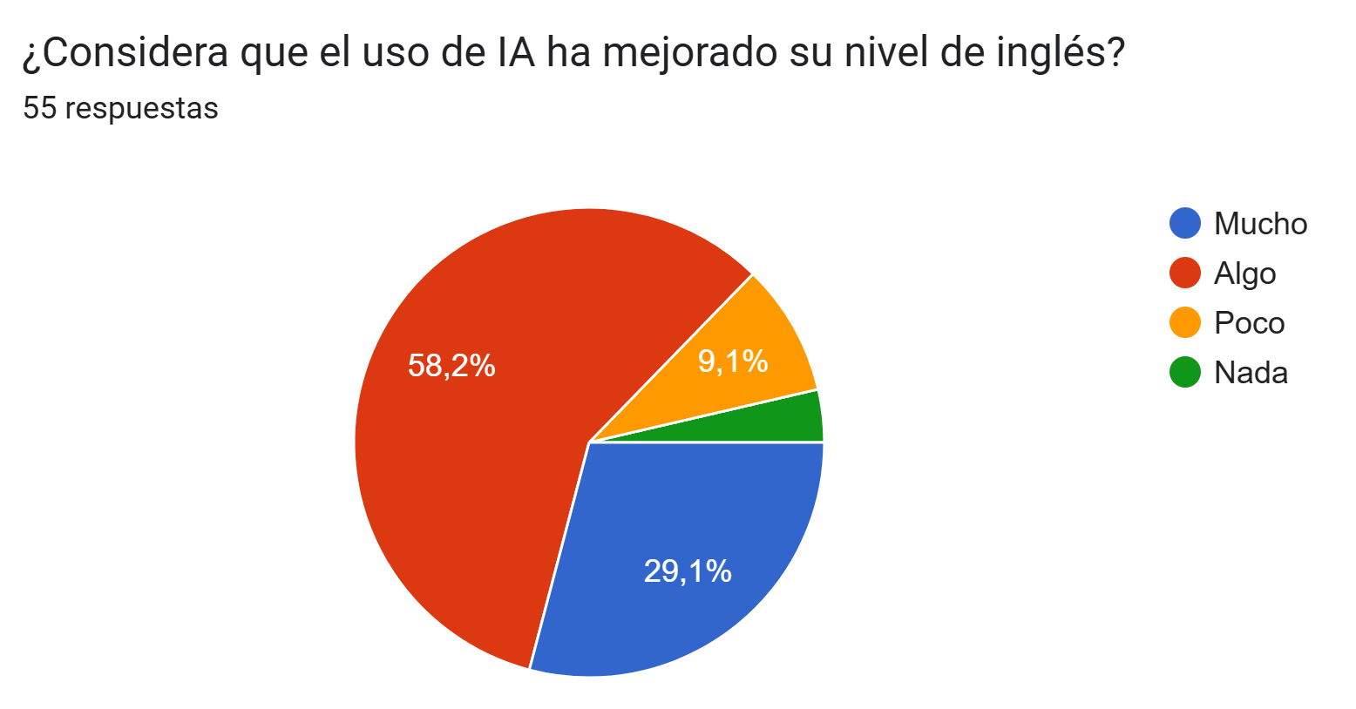
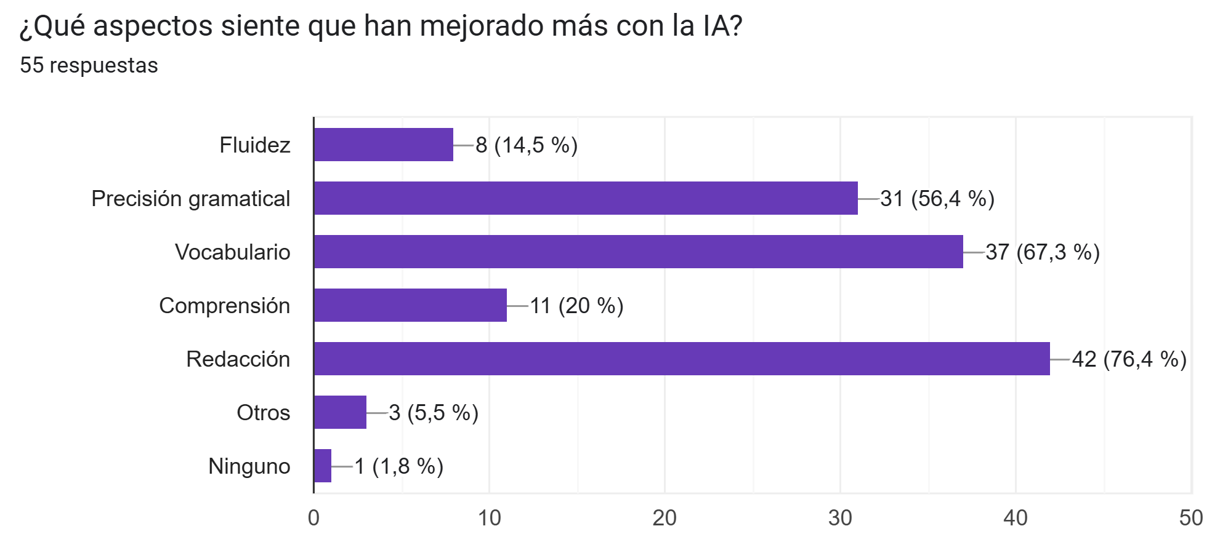
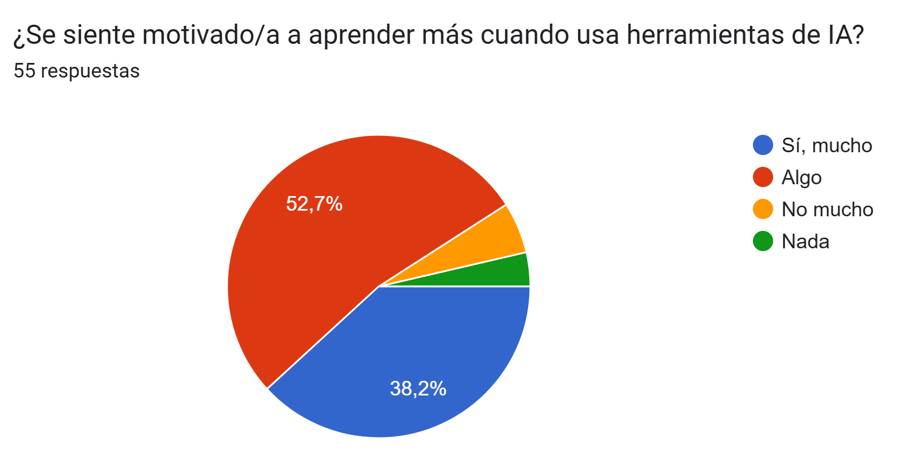
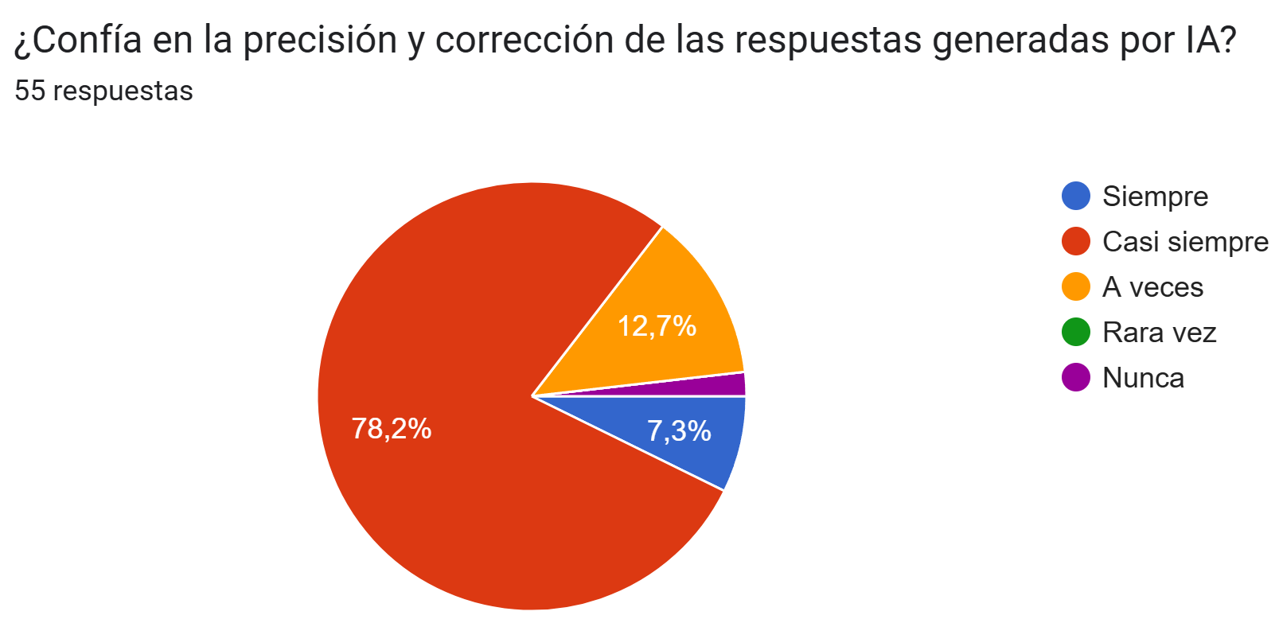
Students’ Perception

Slide 7
Advantages & Disadvantages
✅ Advantages
⚠ Disadvantages
Saves time and provides immediate feedback
Available 24/7 – supports flexible, self-paced learning
Easily accessible from various devices
Offers multiple ways to solve problems
Encourages independent learning
Cannot replace the teacher’s role and expertise
May lead to overreliance and reduced learner effort
Not always accurate or reliable
Less effective for advanced tasks (e.g., critical thinking, humor, argumentation)
Lacks personal interaction and human feedback

Slide 8
Conclusions
AI is already shaping the way students learn
Students trust AI tools
Teachers benefit from AI
AI cannot and should not replace the teacher
Both students and teachers are still learning how to use AI effectively

Slide 9
Recommendations
Promote digital and AI literacy among students
Provide structured training for teachers
Encourage open dialogue and collaboration
Monitor and evaluate AI use regularly
Keep the focus on pedagogy

