Slide 1
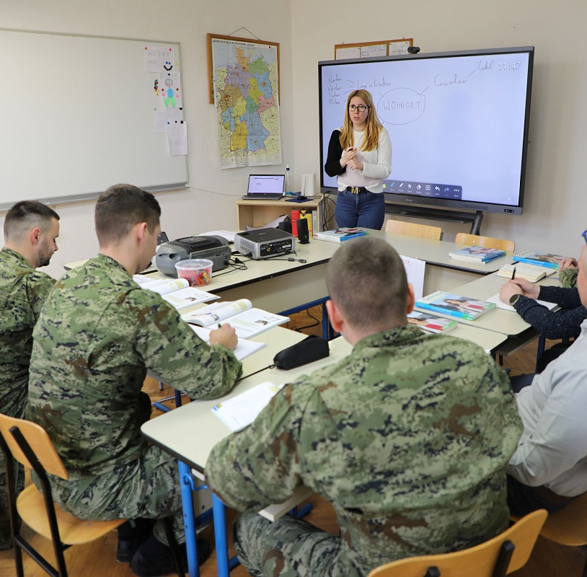
Overcoming the Lack of Teaching Resources Through Creativity: Lessons Learned from Military German Courses in Croatia
Iva Gugo
Katarina Zrinska Foreign Language Center
Dr. Franjo Tuđman Croatian Defense Academy
igugo@morh.hr
Photo by Dražen Volarić
Notes:
In this presentation, I discuss the challenges German teachers are faced with when integrating military topics and vocabulary into their courses. In doing so, I share how my colleagues at the Katarina Zrinska Foreign Language Center and I have endeavored to overcome these challenges by thinking outside the box.

Slide 2
CONTENTS
1. Status of German in the World and in the Military
2. Integration of Military Contents into German Language Courses: A Case from Croatia
2.1. Choosing Topics: Criteria and Objectives
2.2. Design and Implementation of Methods and Materials
2.3. Testing Military German Vocabulary
3. Looking Ahead: Plans for the Future
Notes:
First, I discuss the status of German among world languages and the impact which that status has on our work as teachers of German in the armed forces. Next, I outline some of the challenges my colleagues and I have encountered and demonstrate the strategies we have employed to overcome them while developing our course curricula and materials. Finally, I offer a brief insight into our future plans.

Slide 3
1. Status of German in the World and in the Military

Slide 4
 | ENGLISH | GERMAN
Position among the world’s most spoken languages (Zeidan, n.d.) | 1st | Not in top 25
Percentage of upper secondary general pupils in the EU learning this language (Eurostat, 2022) | 96% | 21.4%
Percentage of vocational pupils in the EU learning this language (Eurostat, 2022) | 79% | 18.2%
Status in NATO (NATO, 2024) | Official language | Not an official language
Percentage of primary pupils in Croatia learning this language (Kapović, 2022) | 95% | 32.55%
Percentage of secondary pupils in Croatia learning this language (Kapović, 2022) | 95 % | 37.34%
Priority status in the Croatian Armed Forces (Ordinance on Foreign Languages, 2025) | 1st | 3rd
Notes:
In ancient times, the world's lingua franca was Latin; today, it is English. The English language is spoken by 1.5 billion people worldwide (Zeidan, n.d.); this number includes both native and non-native speakers. In the European Union, it is the most commonly learned foreign language (Eurostat, 2022). It is the main language of communication in many professions, including science, computing – and the military. NATO has two official languages, one of which is English (NATO, 2024).
In Croatia, 95% of primary school pupils learn English and an equal percentage of pupils take English classes in secondary school (Kapović, 2022). Out of all the languages taught in the Croatian Armed Forces, English is given the highest priority (Ordinance on Foreign Languages, 2025). The reason for this is that English is the working language in peacekeeping missions and operations, in multinational exercises, and in international courses and training events; wherever two or more national militaries are present, English is the official language of their communication.
In contrast, the German language is not even among the top 25 most-spoken languages in the world (Zeidan, n.d.). According to Eurostat's (2022) data, it is only the fourth most-commonly learned foreign language among upper secondary general pupils in the EU. While it is the second most-often learned language among vocational pupils, the percentage of such pupils who take German classes is, in fact, lower than the percentage of upper secondary general pupils learning the same language.
Among Croatian pupils, German is the second most-often taught foreign language, but the number of pupils learning it is three times lower than the number of pupils learning English (Kapović, 2022).
In the Croatian Armed Forces, German is ranked third in importance, behind English and French, the official NATO languages. It is ranked equally with Italian, Russian and Arabic (Ordinance on Foreign Languages, 2025).
By juxtaposing English and German in this way, I do not wish to pit them against each other. However, all the statistical data on this slide clearly show that one is more widespread than the other and that the military attaches more importance to the one than to the other. The latter fact has significant repercussions on the design of curricula and materials for German language classes in the military context.

Slide 5
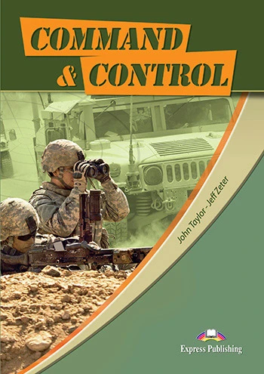
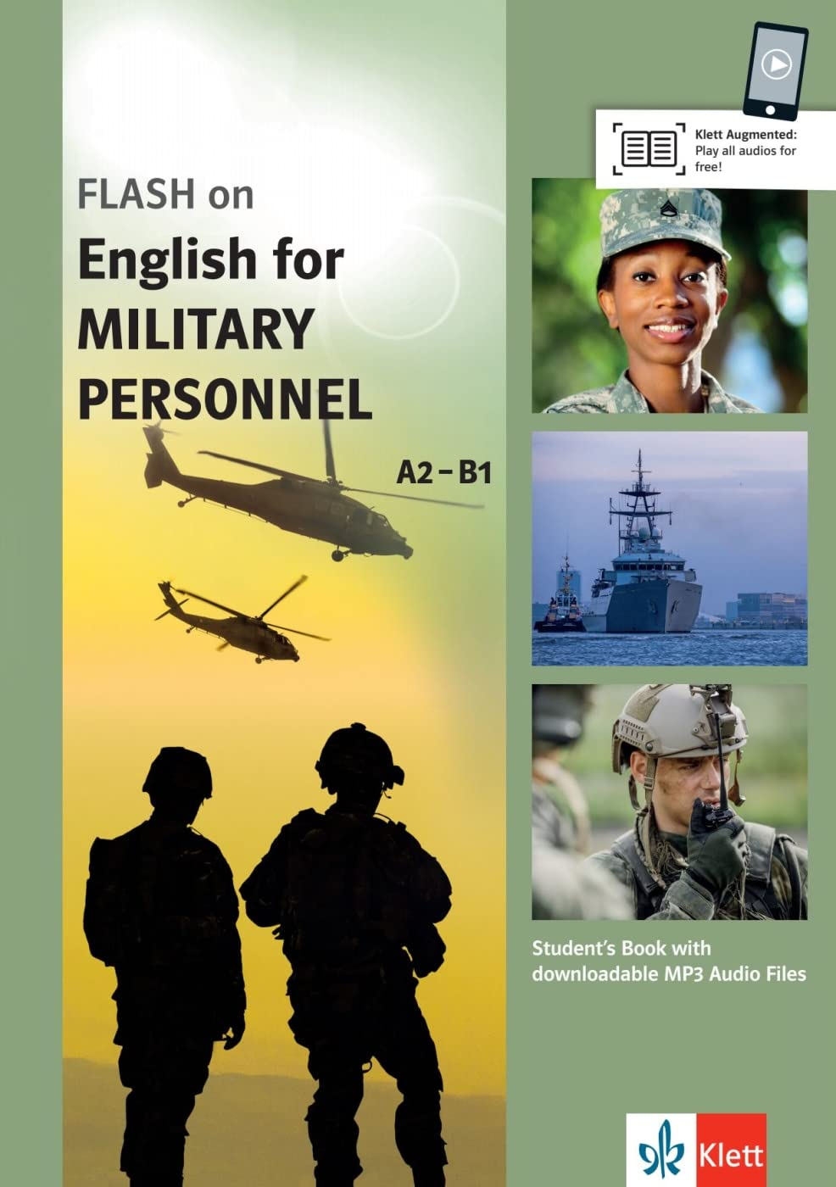
Available teaching materials for Military English
Available teaching materials for Military German
No commercially available textbooks
No unified criteria on levels, contents and vocabulary
Image copyright:
Macmillan;
Express Publishing;
Klett
Notes:
On the publishing market, there are several coursebooks for military English: Campaign (Mellor-Clark and Baker de Altamirano, 2004), Career Paths: Command and Control (Taylor and Zeter, 2013) or Flash on English for Military Personnel (Williams, 2017). On the other hand, there is not a single commercially available coursebook for military German. In private conversations with colleagues from other countries, I have learned that most of them rely on Chefsache, a coursebook made and published by the Federal Language Office (Bundessprachenamt) of the Federal Republic of Germany and procurable only from them directly. That coursebook is around 25 years old and exercises in it are mostly drill-based. While it covers a wide array of topics (19 overall), it does not divide those topics and the vocabulary related to them into levels. Consequently, German teachers working in the military are faced not only with a lack of modern, communication-based teaching materials but also with a lack of unified criteria as to what contents should be taught and on which levels.

Slide 6
2. Integration of Military Contents into German Language Courses: A Case from Croatia

Slide 7
2. 1. Choosing Topics: Criteria and Objectives
To teach or not to teach Military German?
To teach!
BUT! In a narrower scope than Military English
Criteria for topics:
Usefulness
Connection to civilian topics
Learners’ language level
Guidelines for materials and methods:
Interactivity
Inclusion of subject matter expertise
Multimodality
Support from subject matter experts
Notes:
When I started teaching German, one of the first questions my colleagues and I had to answer was whether military German should be taught alongside general German in our courses. There was no doubt in my mind that the answer was positive. The Katarina Zrinska Foreign Language Centre is an institution within the Croatian Armed Forces which caters primarily to military personnel. Because of our status and our target audience, it is only natural that our courses should include military topics and terminology, as well.
At the same time, it was clear that the scope of topics and terminology covered in German courses would not be as wide as in English courses because military German is not used as broadly as military English. For example, German terminology related to military exercises is not used in multinational exercises. Whenever members of the Bundeswehr or the Bundesheer exercise with members of allied and/or partner armed forces, the working language is English. Even when an exercise is held on German or Austrian territory, the official language is still English. Taking this into account, we quickly realized curricula for English courses could not simply be copied and pasted into curricula for German courses. Instead, we had to devise criteria which would help us define the topics to be included in our courses.
The first such criterion was usefulness and the main question to be answered was the following: if our course participants were to spend some time in a barracks in Germany or Austria, what sort of language would help them communicate with native-speaking military personnel? The answer to this question helped us narrow down the list of possible topics. For example, we found it important to teach ranks so that our course participants may be able to introduce themselves to native speakers and recognize if their collocutors are their senior or junior in rank. Also, since it is easier to find your way around a barracks in Germany or Austria if you know German names for the facilities there, we thought this would be another useful topic, as well.
Next, we deemed it necessary that the chosen military topics be taught in conjunction with general-language topics rather than separately. For instance, we decided to include the vocabulary related to everyday activities in the barracks into the lesson about the learners’ daily routine. Likewise, we chose to integrate the structure of the armed forces into the lesson about work and to teach parts of the military uniform together with everyday clothing.
Our last and maybe the most important criterion was language level. Since our plan was to teach several military topics throughout the duration of the course, we had to keep in mind what grammar and vocabulary our course participants would have already acquired up to the point when a topic was introduced as well as what the overall projected outcomes of the course were. This criterion was crucial in the selection of and vocabulary.
Having selected our topics, we moved onto the development of materials and methods for their implementation in the course. In doing so, we followed several guidelines. Firstly, it was imperative that methods and materials be interactive. Our objective was to avoid rote learning and actively engage course participants so that they learn by doing. Because they all have different personalities and every one of them learns in a different way, it was important that our methods and materials engage multiple intelligences, especially visual-spatial, bodily-kinaesthetic, linguistic-verbal and interpersonal intelligence.
Furthermore, we wanted to involve the course partipants’ subject matter expertise in the learning process, i. e. to design materials and activities which would allow them to utilize their expert knowledge as members of the armed forces.
The final guiding principle when creating materials was multimodality. Our aim was to create worksheets with textual and visual components. The text-image ratio depended on the course level, so that materials on STANAG Level 1 ultimatey ended up being predominantly visual, whereas worksheets for STANAG Level 1+ include texts consisting of short paragraphs.
Since we (the teachers) are civilians and none of us has ever gone through even basic training, we would occasionally come across military concepts that we were not entirely familiar with even in Croatian. In such situations, we would reach out to our colleagues in the Croatian Armed Forces, the Bundesheer and the Bundeswehr, who could explain them to us.

Slide 8
2. 1. Choosing Topics: Criteria and Objectives
Topics for Level 1
TOPICS FOR LEVEL 1+
NATO member countries
Ranks
Daily routine in the barracks
Military time
Structure of the armed forces
Military duties and responsibilities
Facilities in the barracks
Military equipment
Military uniform
Career in the armed forces
Diet in the armed forces
Structure of the armed forces
Military duties and responsibilities
Physical fitness in the armed forces
Military equipment
Participation in peacekeeping missions and operations
Notes:
Ultimately, the following topics were selected for Levels 1 and 1+. You may notice some topics appearing on both levels. This is because we found certain topics to be too complex and broad to be taught at just one level. Therefore, we decided to introduce basic concepts and terminology related to these topics at Level 1 and then revise and expand upon them at Level 1+.

Slide 9
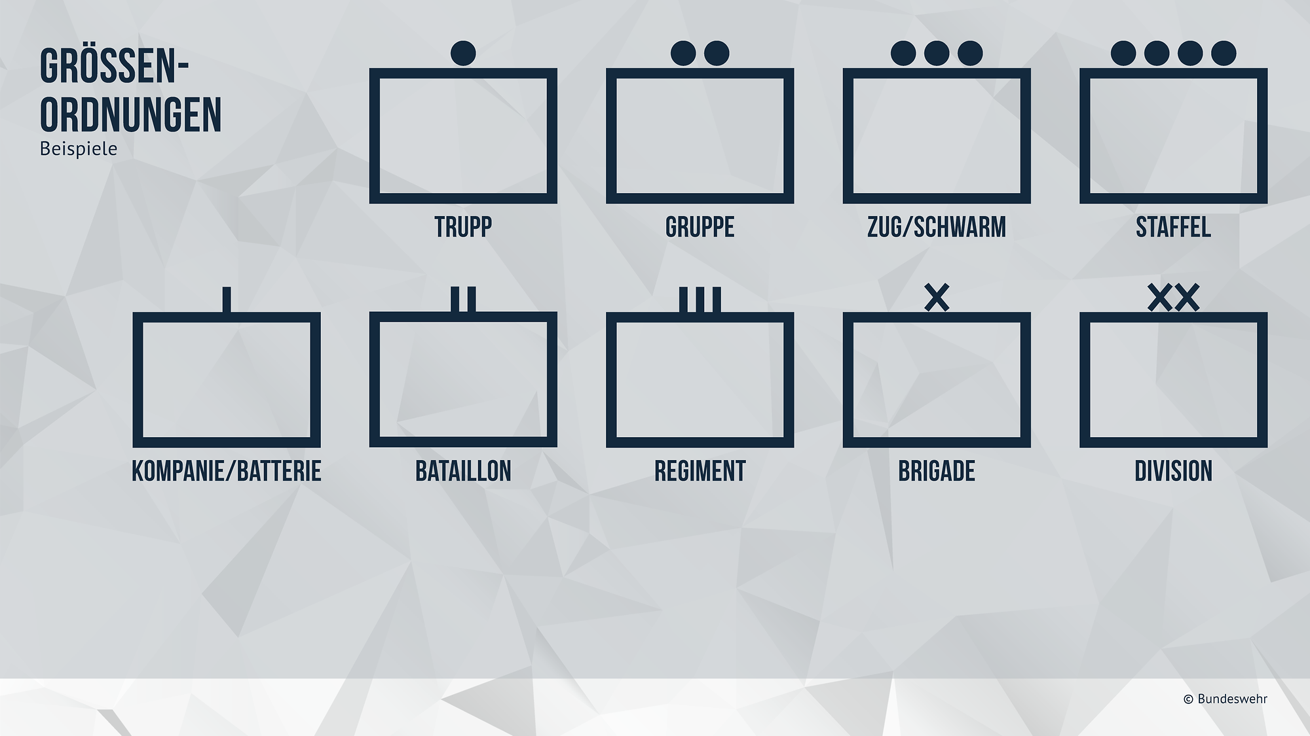
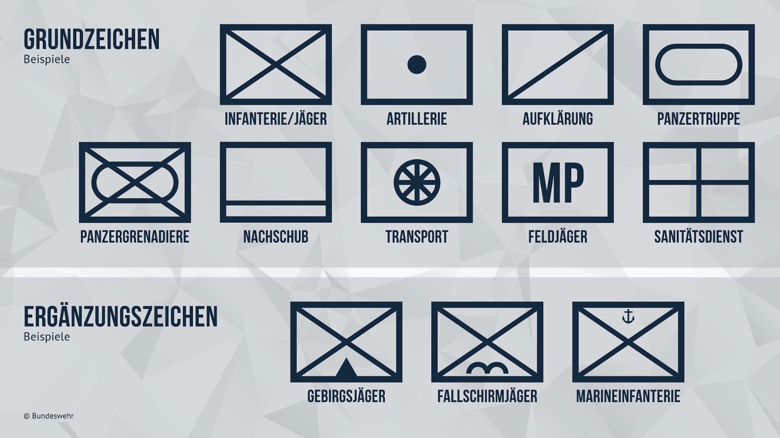
2. 2. Design and Implementation of Methods and Materials
Level 1: Structure of the armed forces
Image source: Bundeswehr
Notes:
In Level 1 courses, most of the military vocabulary in German is introduced visually. We use images from the website of the Bundeswehr and other internet sources, as well as self-created materials. When images are shown in conjunction with terminology, course participants can utilize their expert knowledge to understand the meaning of the presented words more easily and connect them to their Croatian equivalents. For example, as the symbols for branches and units are universal across NATO, learners can leverage that knowledge to quickly grasp the meaning of the new vocabulary. This allows them more time to focus on pronunciation, which is important as many of these words are compounds and our course participants need practice in pronouncing them.

Slide 10
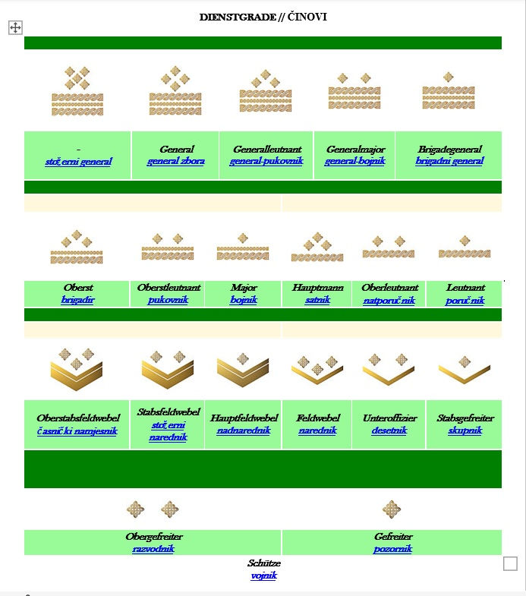
2. 2. Design and Implementation of Methods and Materials
Level 1: Ranks
Visual introduction (insignia)
Notes:
Names for ranks in German are introduced with Croatian insignia, which our learners are familiar with. We do not require of our learners to learn the rank system of the Bundeswehr, not only because that system is more elaborate than the Croatian one, but also because our objective when teaching ranks is primarily for our course participants to be able to introduce themselves with their rank when speaking with native German speakers or other speakers of German. Therefore, our learners only need to know the German equivalents of their ranks. In class, we provide them with a table that includes Croatian insignia as well as the Croatian and German name for each rank level. The translation of each rank from Croatian into German is based on NATO STANAG 2116.

Slide 11
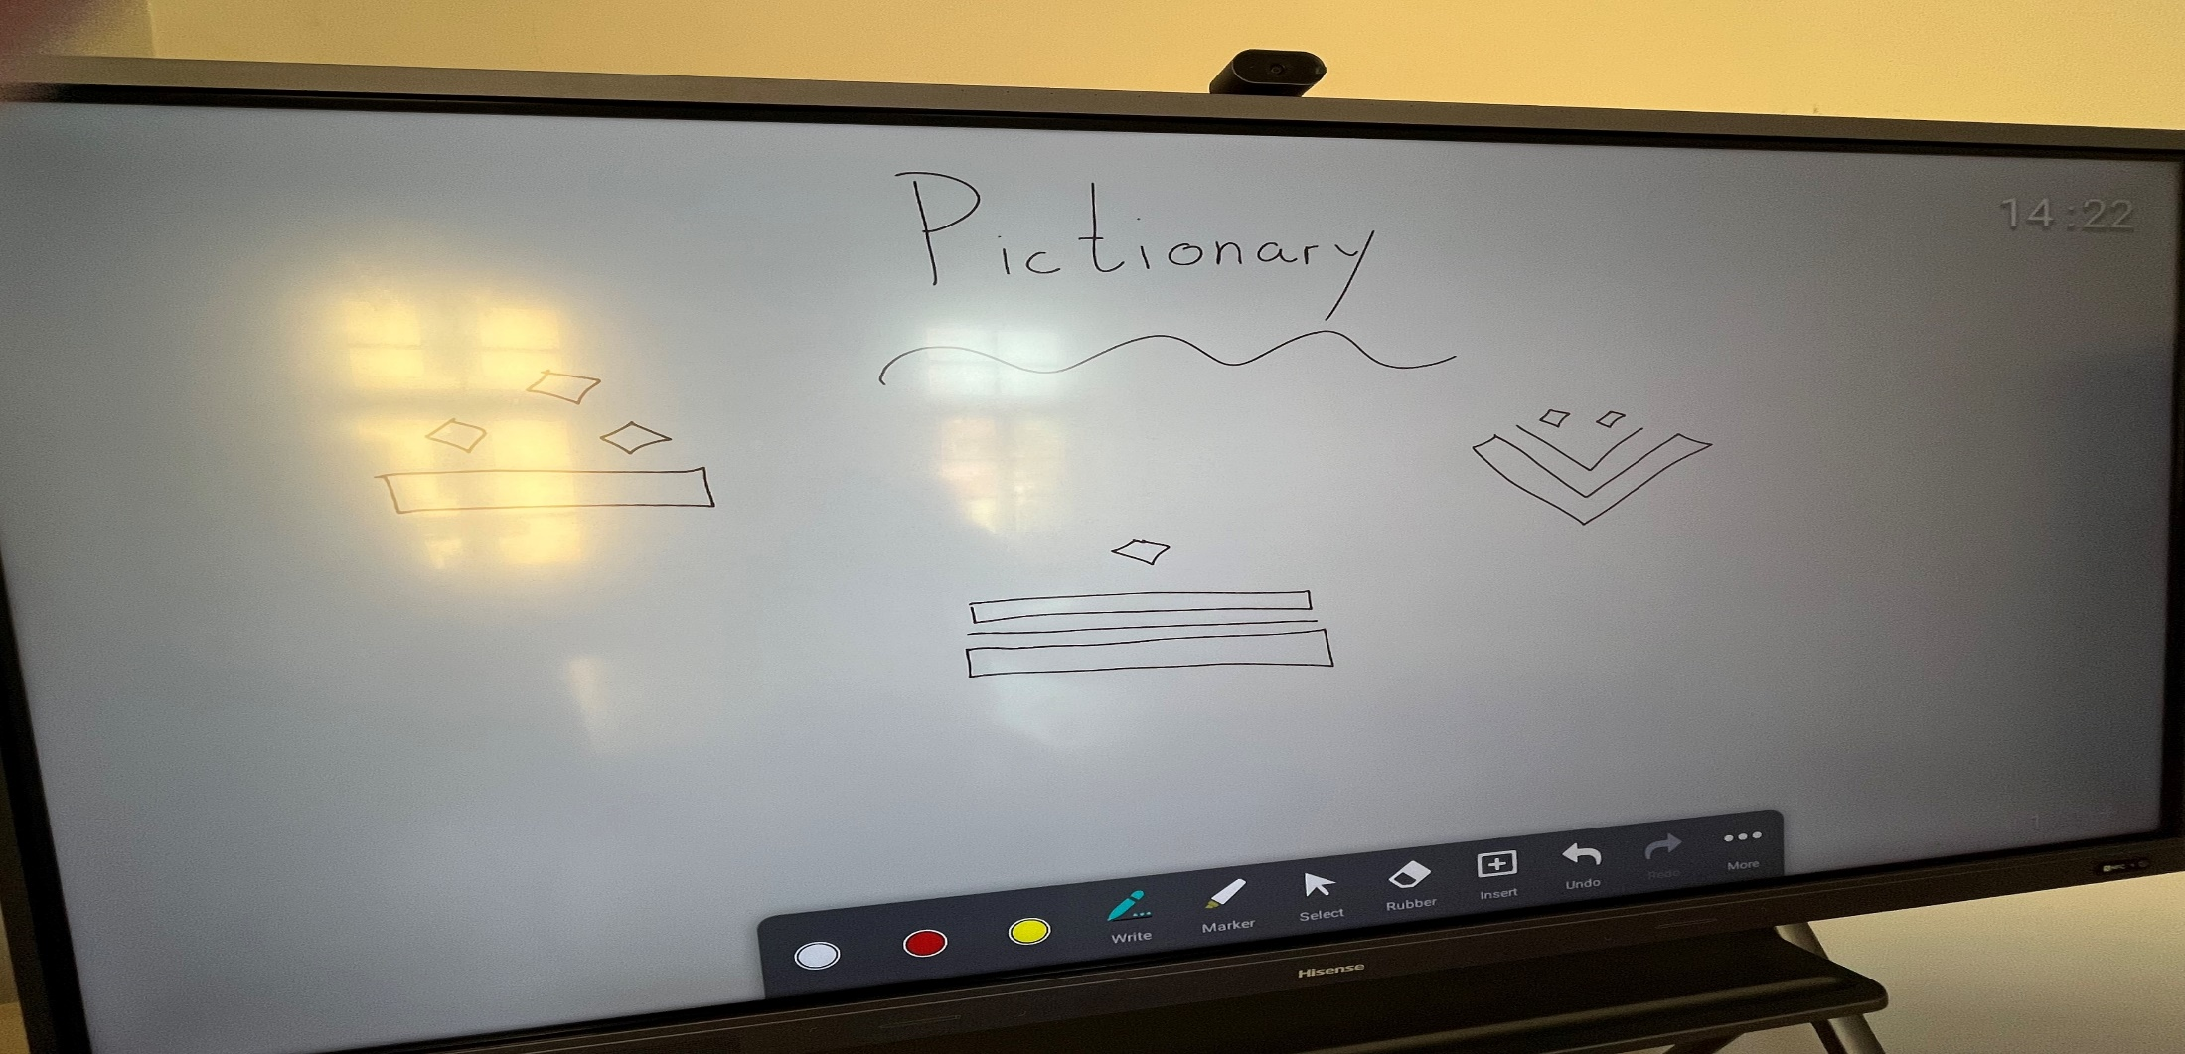
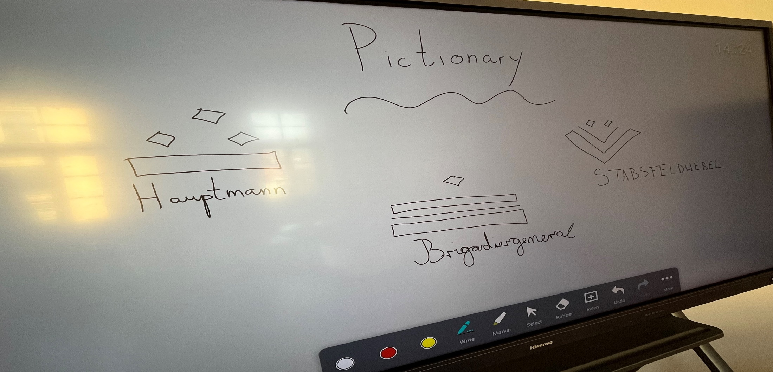
2. 2. Design and Implementation of Methods and Materials
Level 1: Ranks
Practice activity: Pictionary
Notes:
Once ranks have been introduced, we practice them through various activities. One such activity is Pictionary: I draw insignia on the board, and my course participants tell me which rank they represent in German. Another activity involves ordering: I give learners images of insignia and they have to arrange themselves in a line from the lowest rank to the highest rank. Later, each person tells me the German name for their rank.

Slide 12
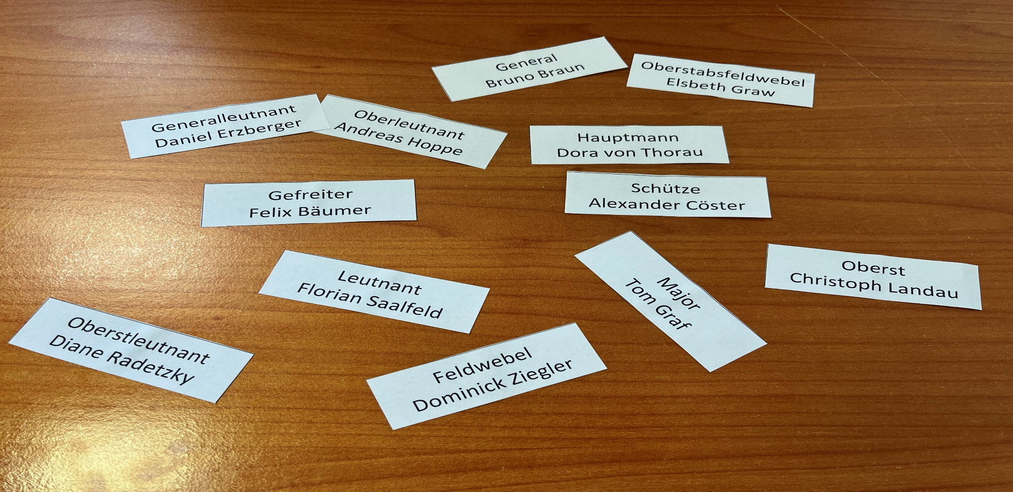
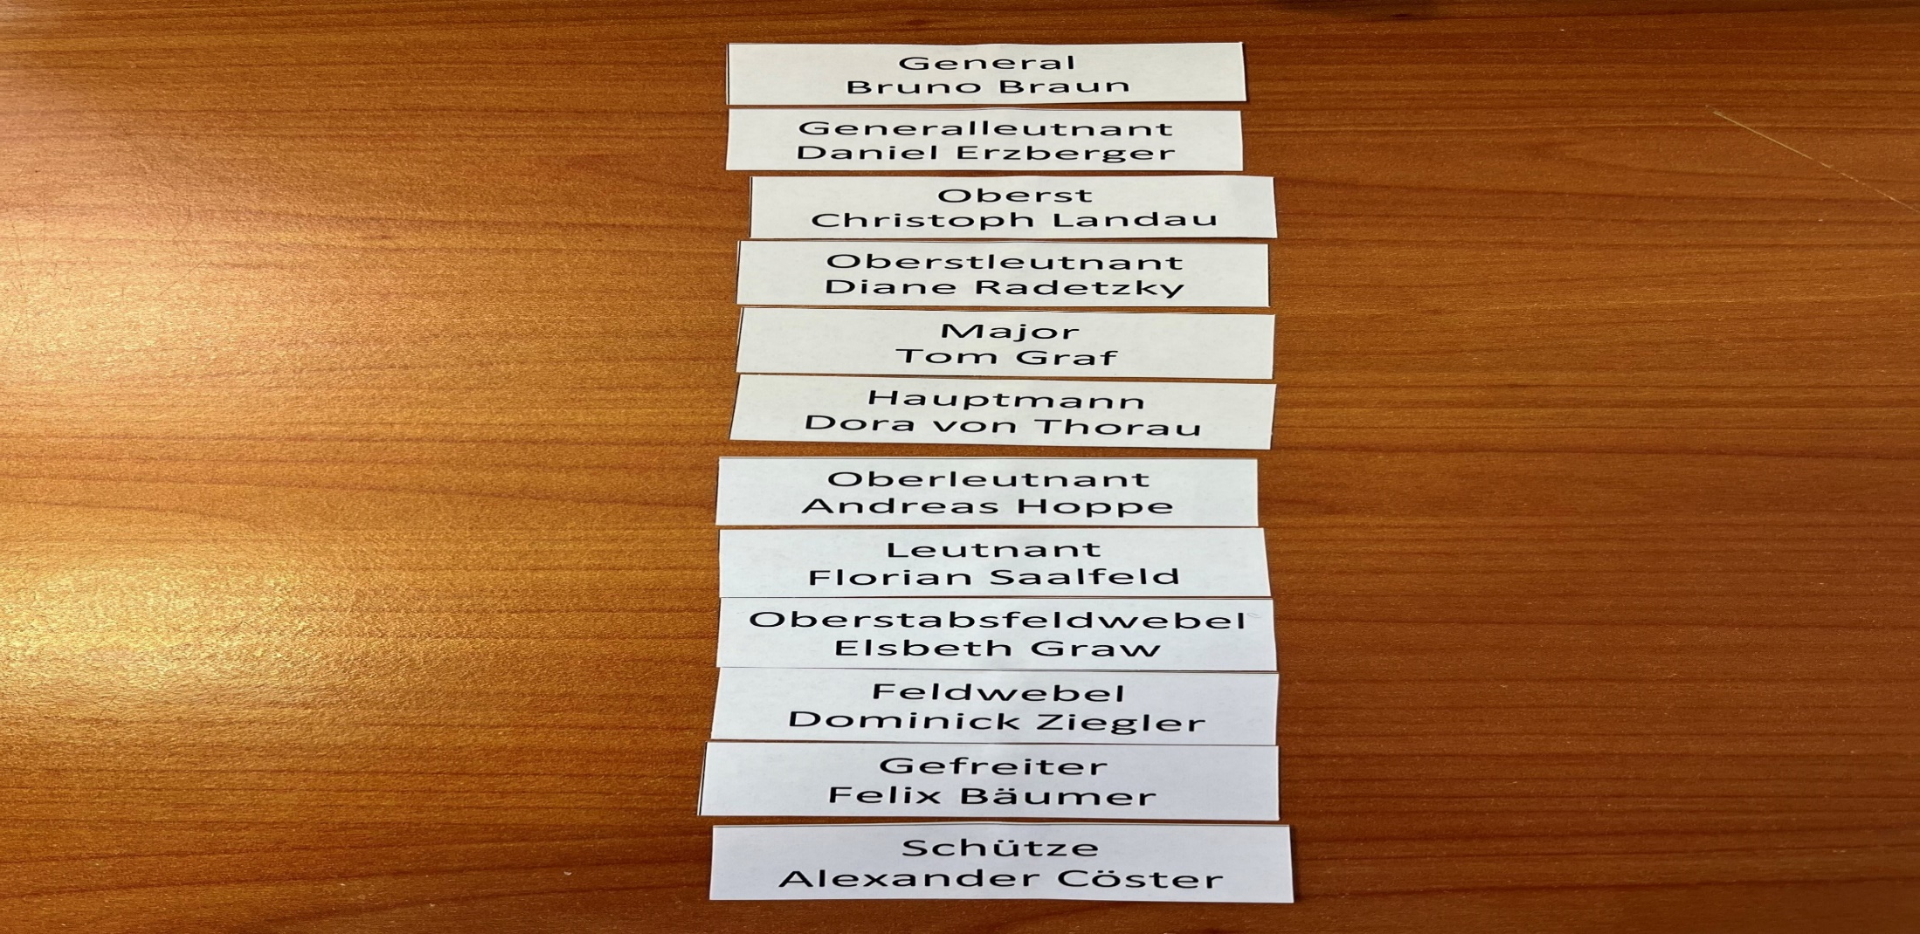
2. 2. Design and Implementation of Methods and Materials
Level 1: Ranks
Practice activity: ordering
Notes:
In a similar activity, learners receive pieces of paper with ranks and names of fictional military personnel, which they order from the person with the highest rank to person with the lowest rank or vice versa.

Slide 13
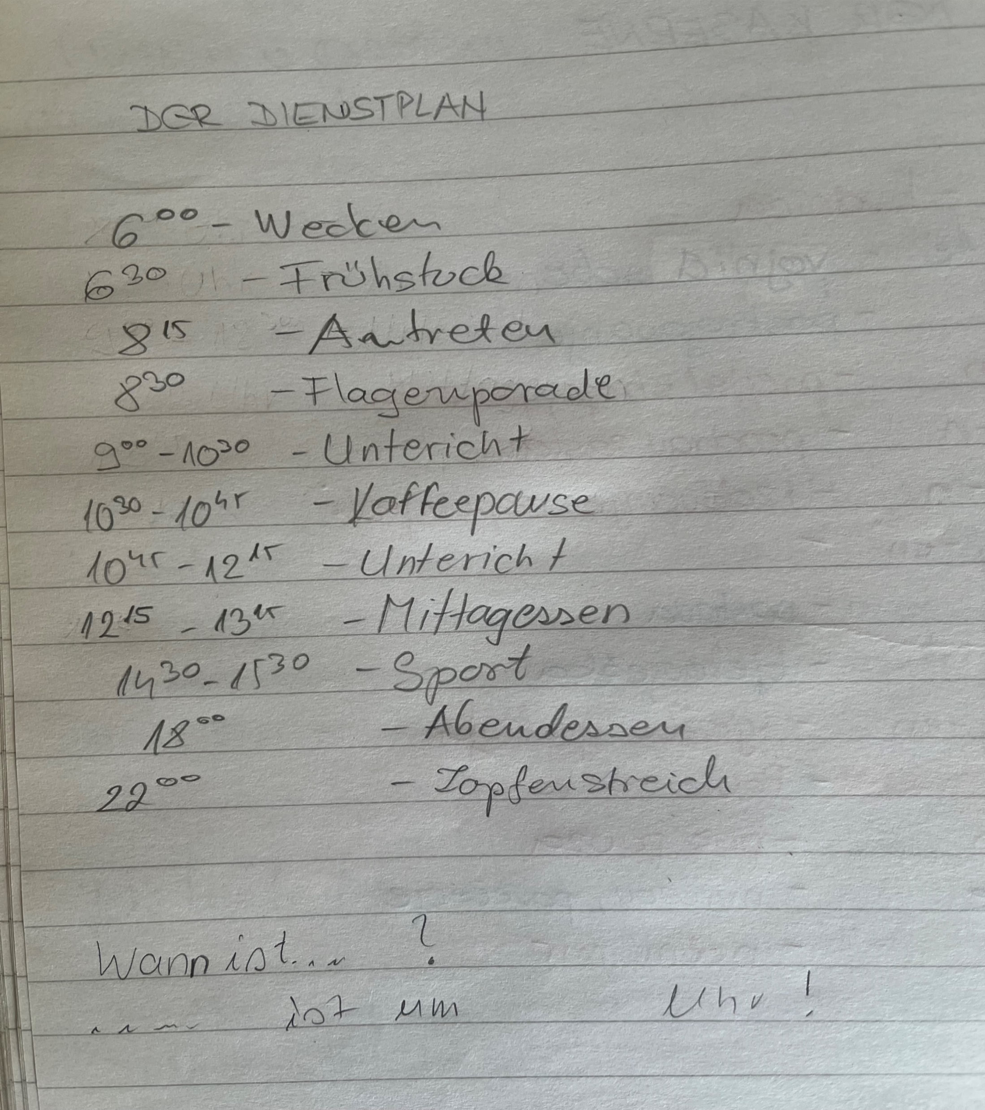
2. 2. Design and Implementation of Methods and Materials
Level 1: Daily routine in the barracks
Practice activity: writing duty rosters
Notes:
In our courses, military German is also taught through arts and crafts. For instance, once the vocabulary related to the daily routine in the barracks has been introduced, learners create their own duty rosters, on which they write down their daily work activities in chronological order, including the time when they take place.

Slide 14
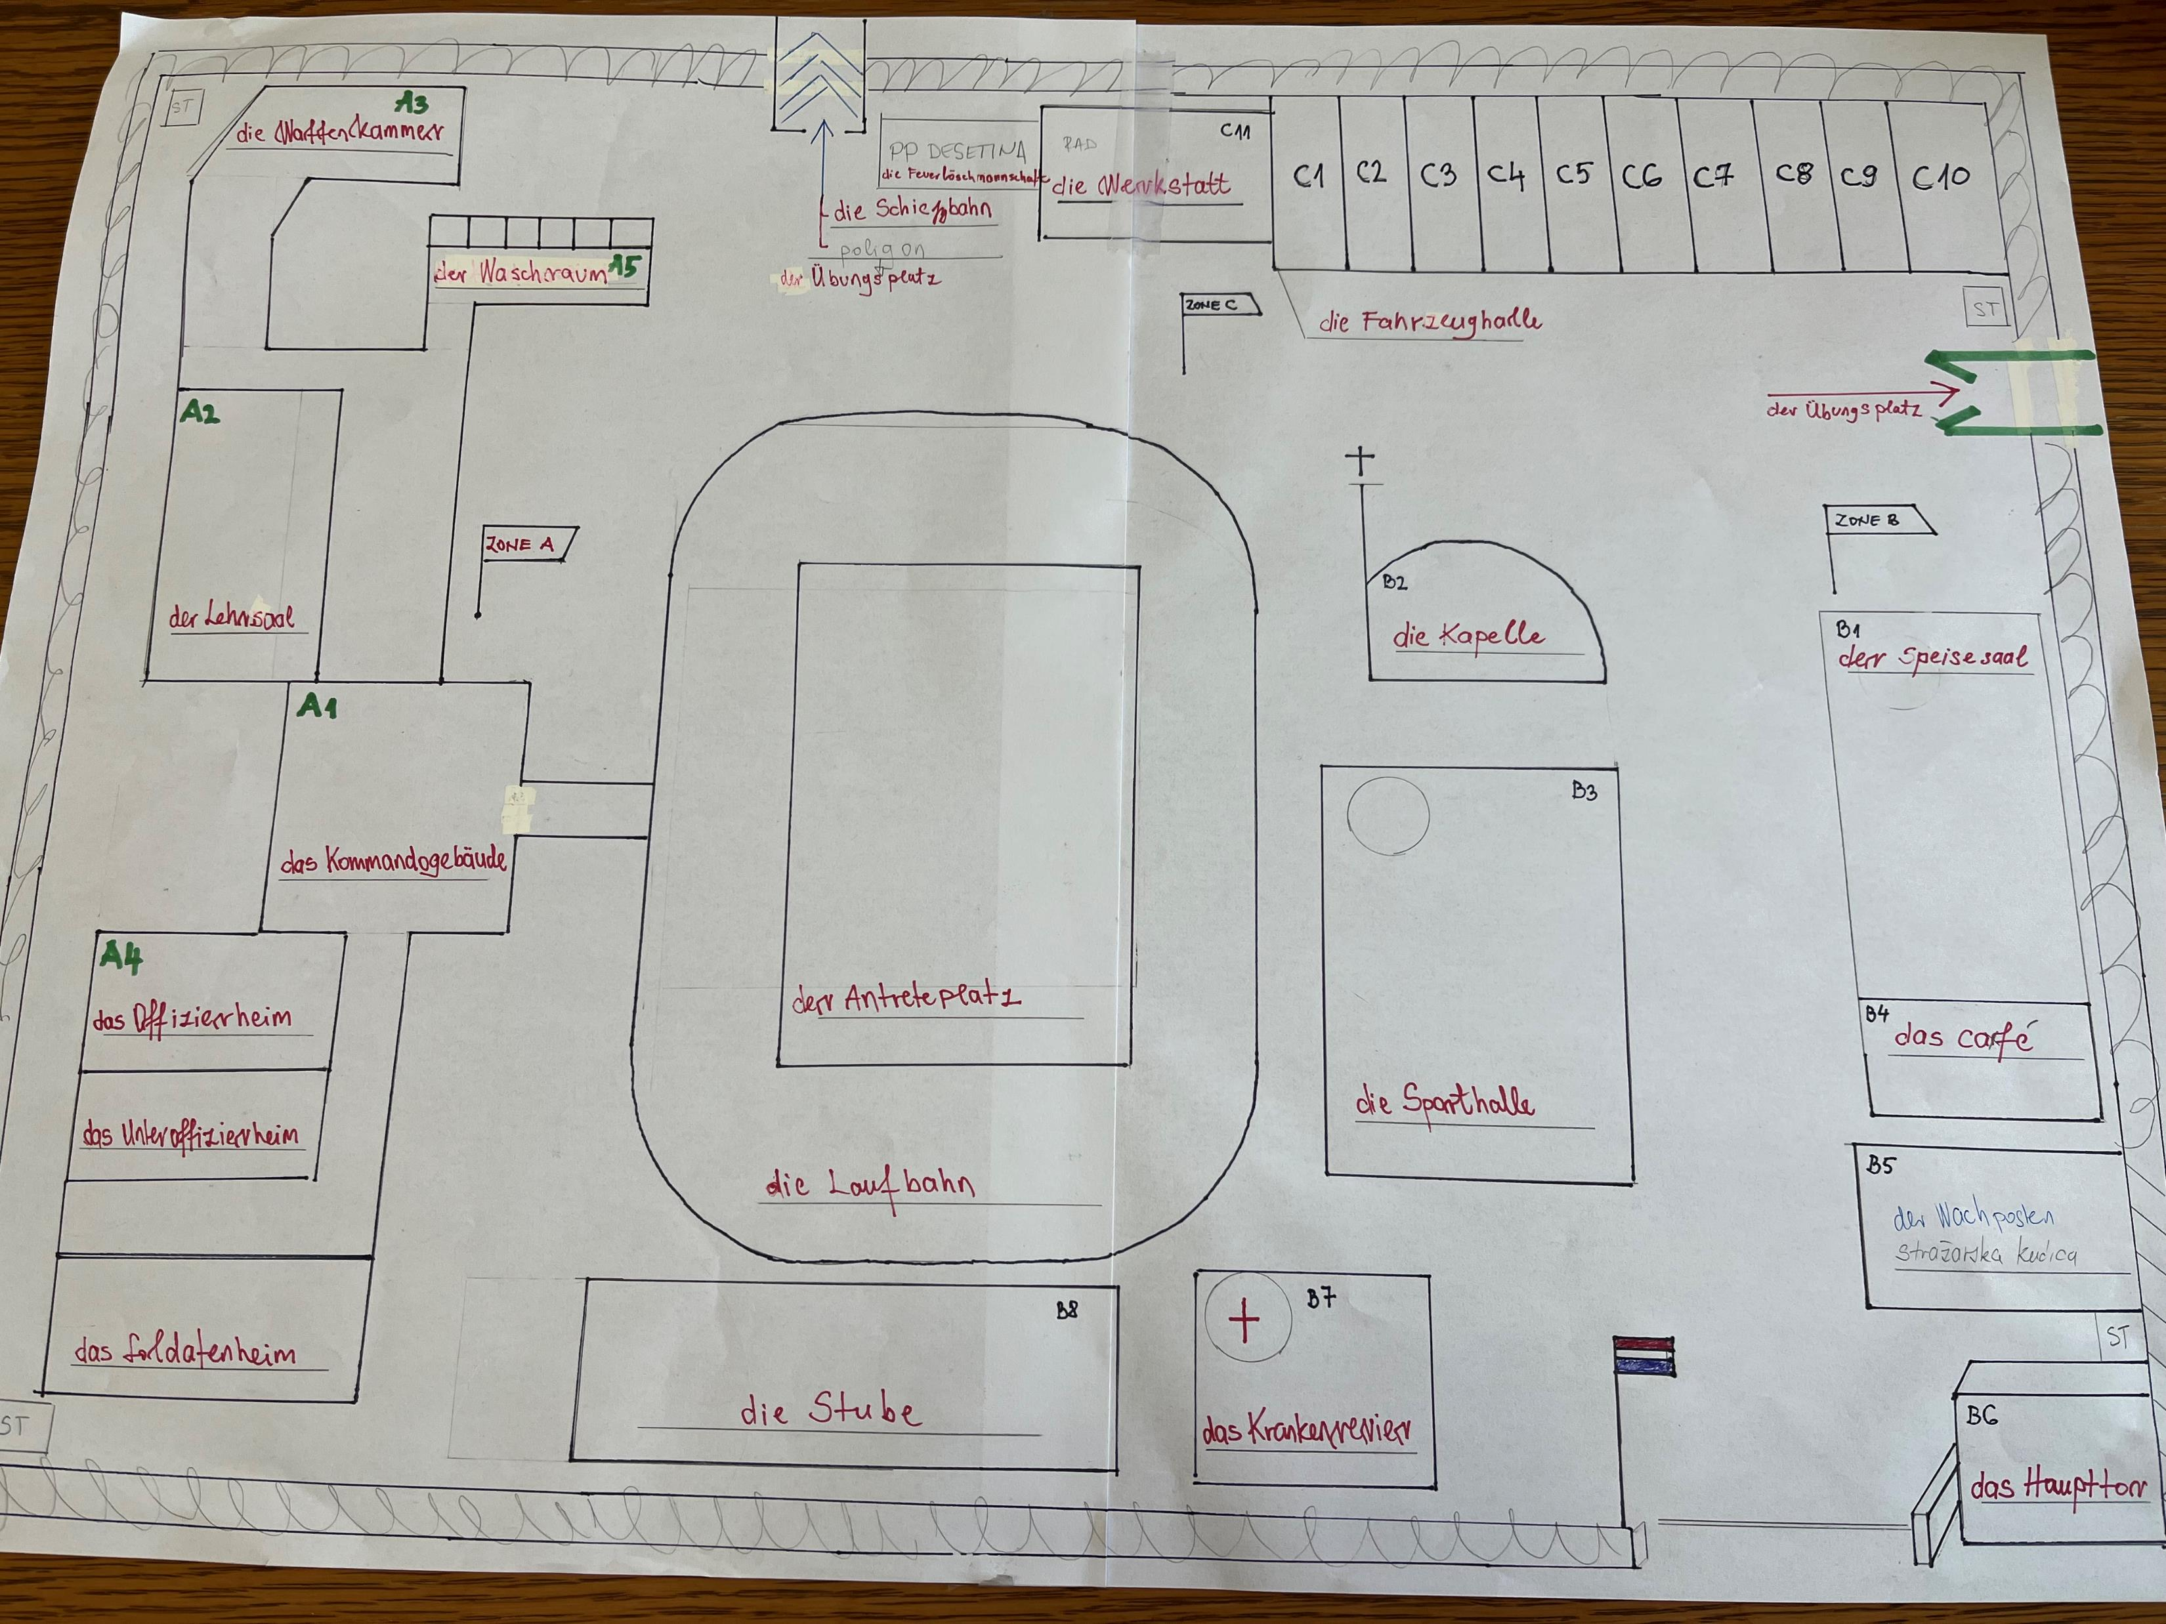
2. 2. Design and Implementation of Methods and Materials
Level 1: Facilities in the barracks
Pratice activity: drawing ground plans of barracks
Later repurposed for giving directions and practising prepositions of place
Notes:
Another example of arts and crafts involves the topic of facilities in the barracks. These facilities are not randomly positioned; there is a rhyme and reason behind their placement in a barracks or on a base. Course participants utilize that expert knowledge and combine it with newly-acquired vocabulary when creating ground plans of barracks in groups. Once their posters are completed, they are not discarded; instead, they are reused during lessons on giving directions. Looking at the posters, learners explain to one another how to get from facility A to facility B. Likewise, these posters come in handy when practicing prepositions of place, with learners describing where one facility is in relation to others.

Slide 15
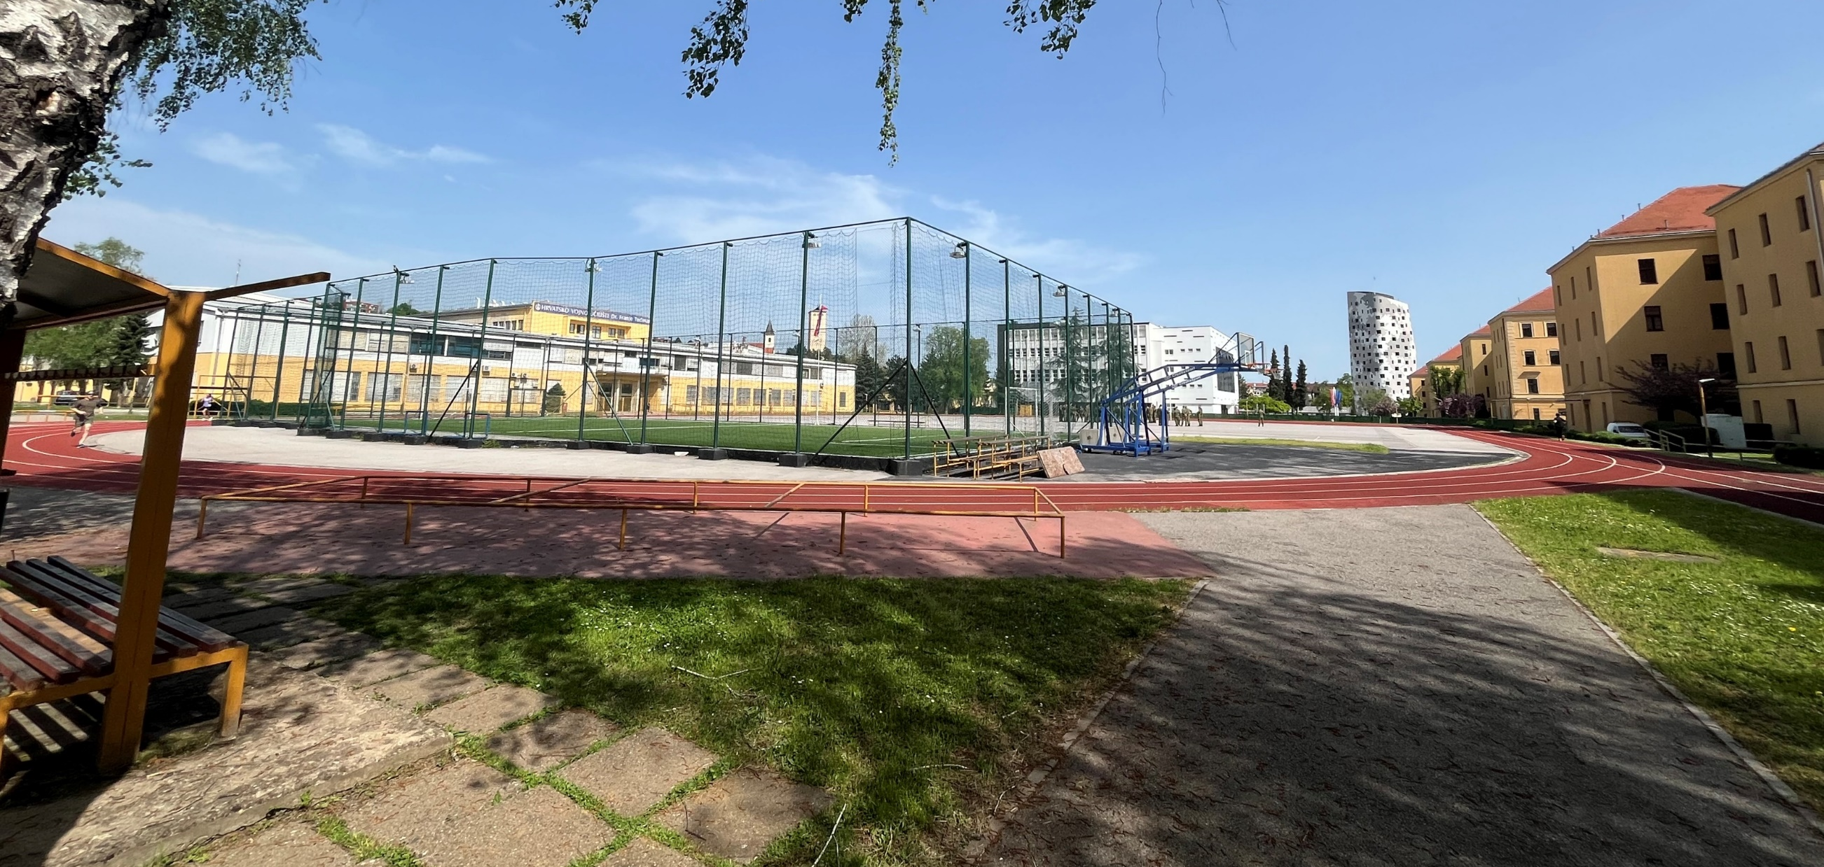
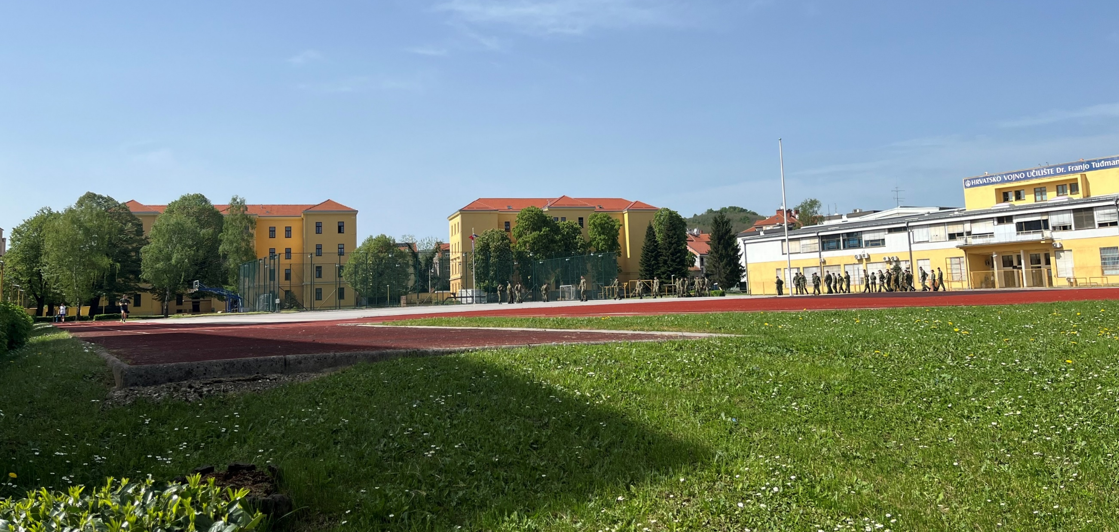
2. 2. Design and Implementation of Methods and Materials
Level 1: Facilities in the barracks
Practice activity: walking around barracks
Notes:
German military terminology is not just taught in the classroom but outside of it as well. To give an example with the aforementioned facilities in the barracks: since the Katarina Zrinska Foreign Language Center is situated within a barracks, I practice that vocabulary by taking a stroll around our barracks with my course participants. During the stroll, I point to different buildings and the course participants tell me the names for those facilities in German. In doing so, they make use of their visual-spatial intelligence; what originally seems like very abstract vocabulary becomes concrete and specific when the objects that the newly-learnt words denote are within the course participants’ reach, i. e. when they can see and touch them.

Slide 16
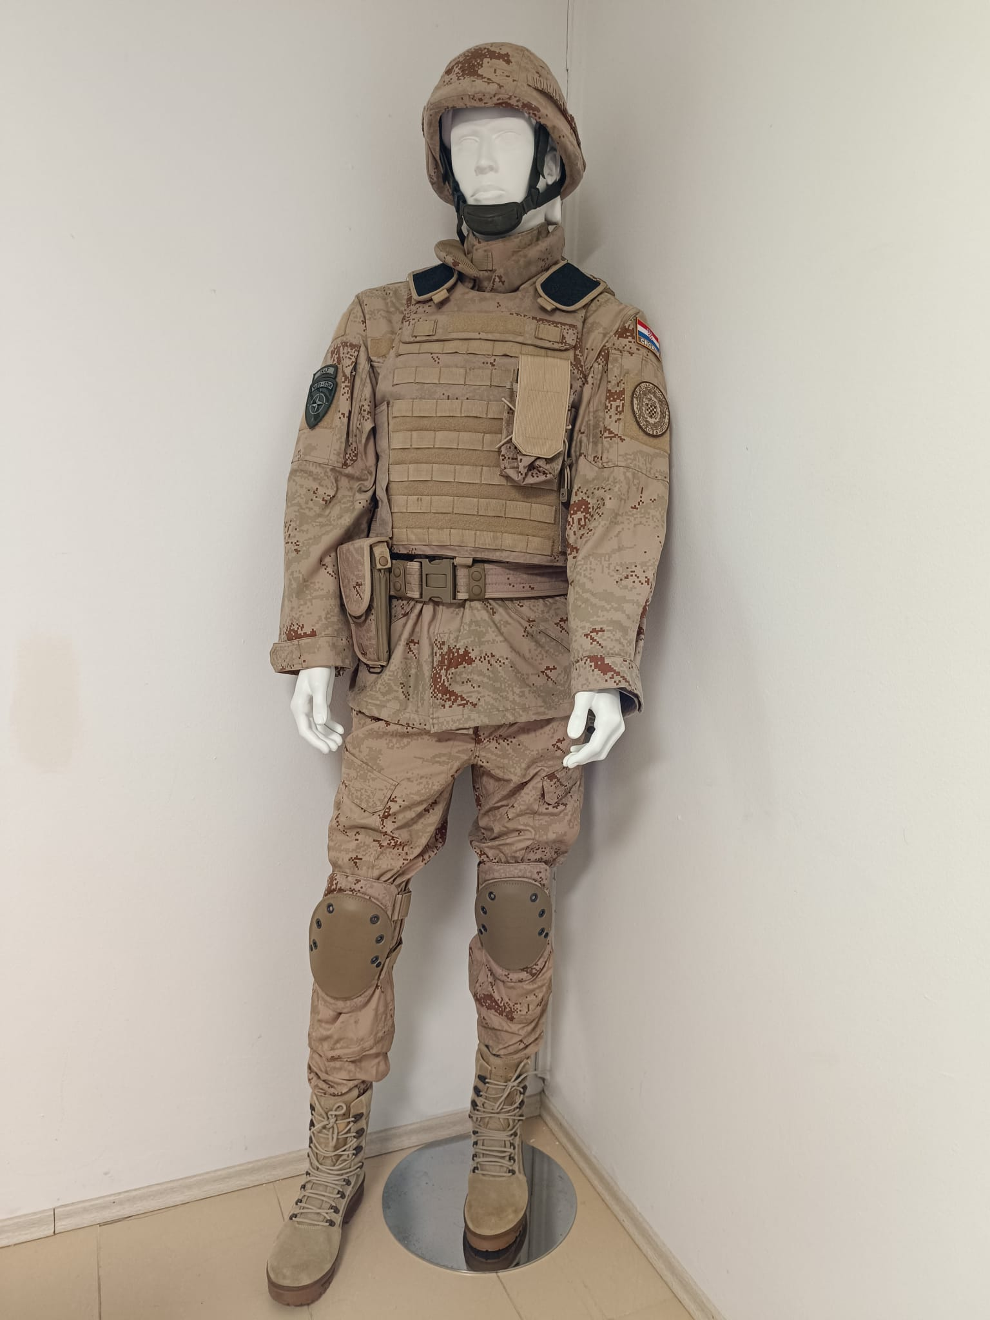
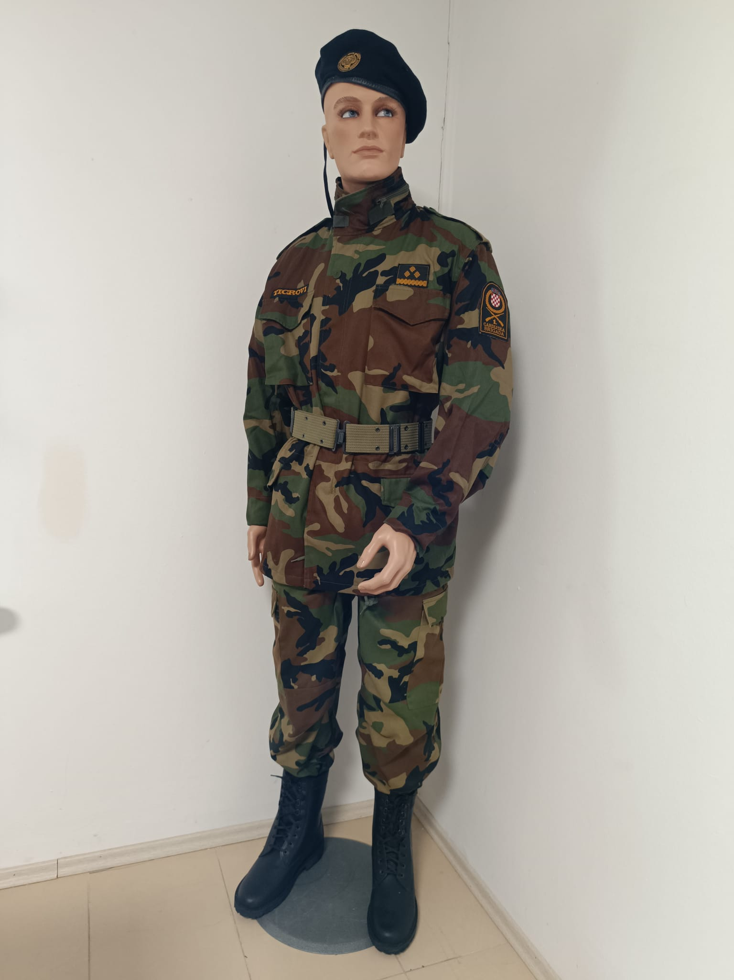
2. 2. Design and Implementation of Methods and Materials
Level 1: Military uniform
Practice activity: describing exhibits at the Croatian Military Museum
Images courtesy of
Mr. Marijo Reljanović,
Croatian Military Museum
Notes:
Similarly, what helps our course participants learn parts of the military uniform is that they have them on their body in class and can see them while learning. Additionally, I like to take my students to the archives of the Croatian Military Museum, where they can describe what the uniforms on mannequins consist of.

Slide 17
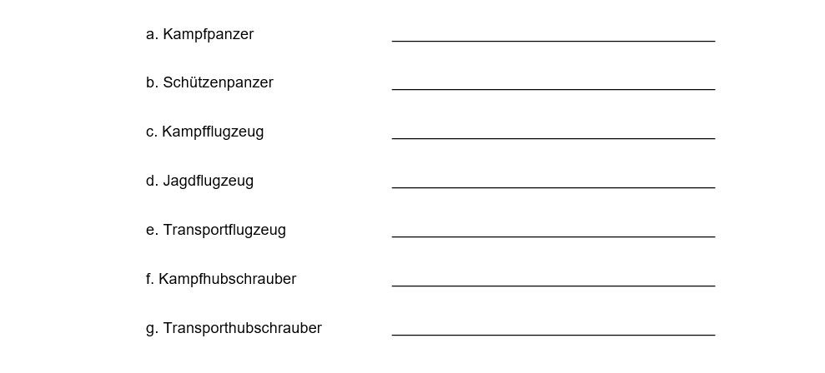
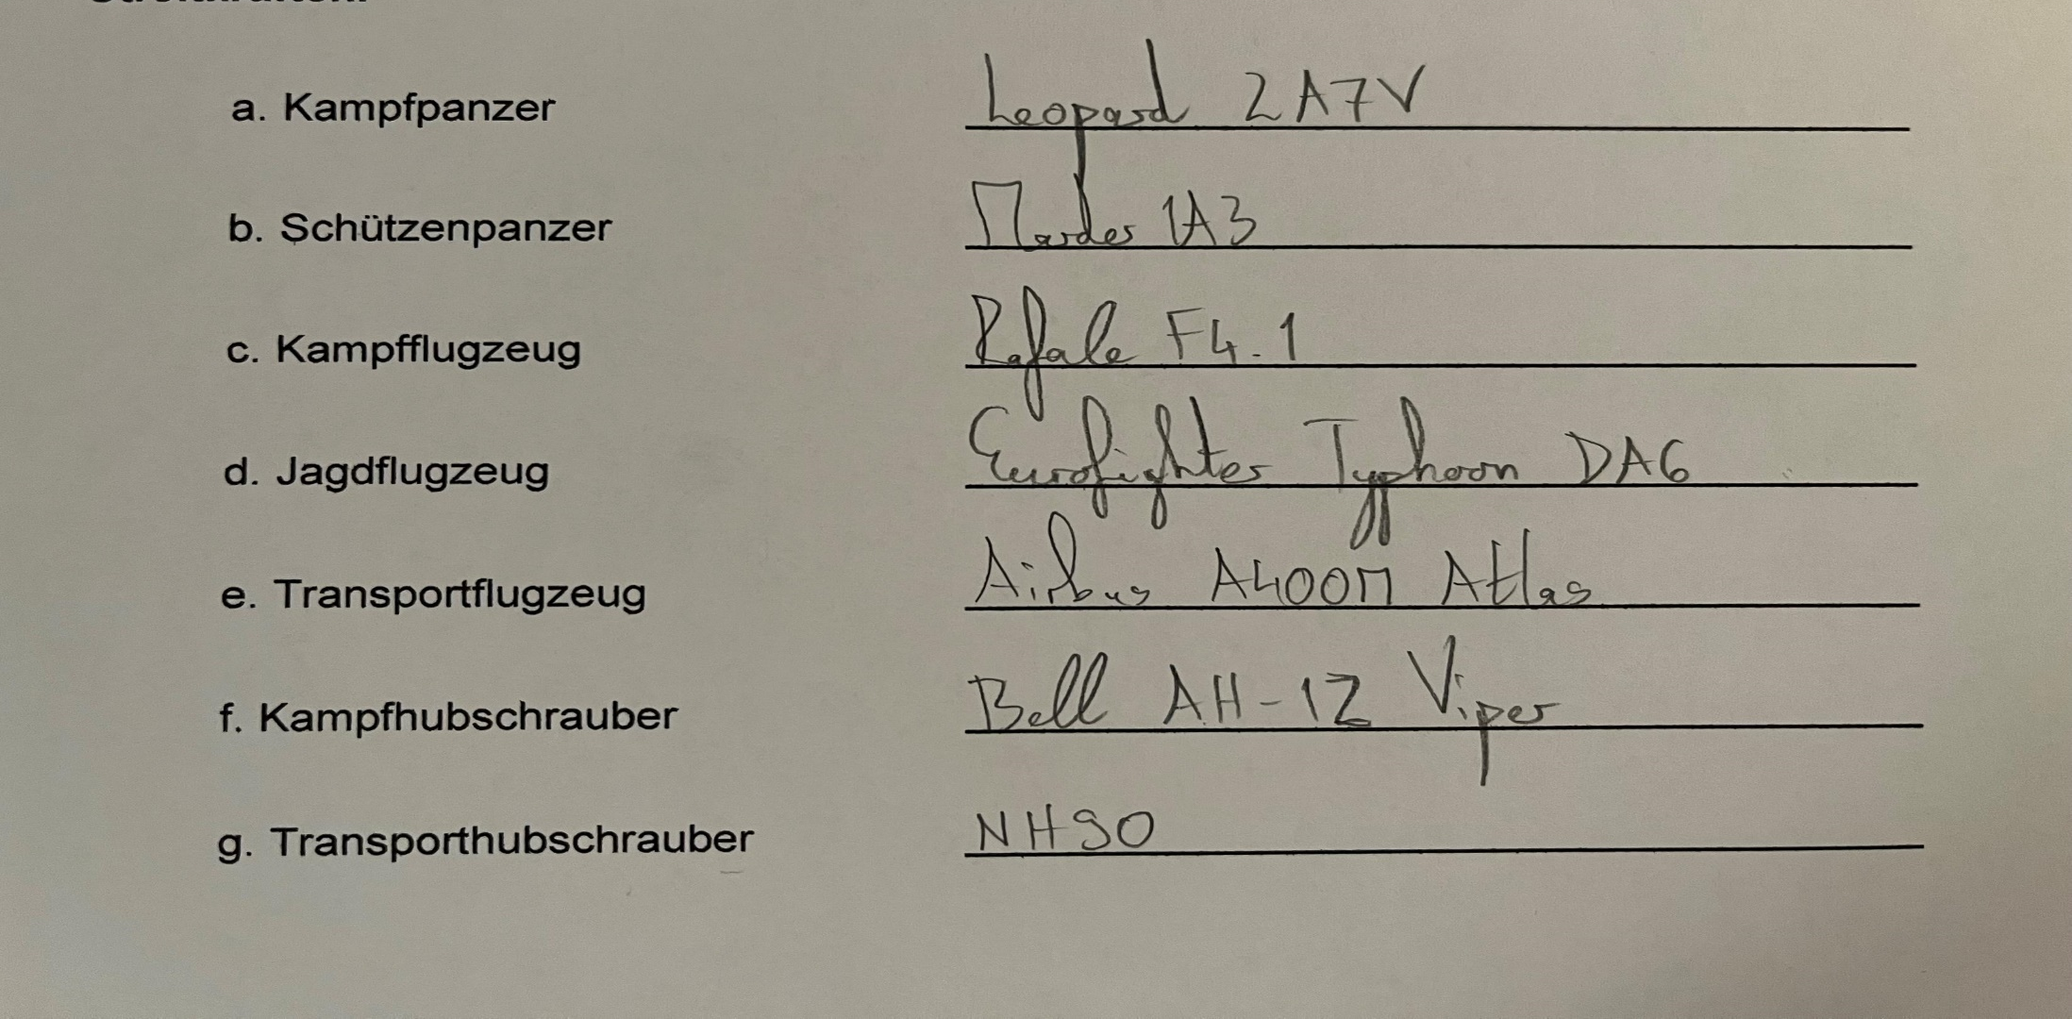
2. 2. Design and Implementation of Methods and Materials
Level 1: Military equipment
Practice activity: looking up models on the Internet
Notes:
Of course, we must not forget another useful teaching and learning tool of the 21st century – the Internet. During the lesson on military vehicles, I give my students the task of looking up the models of vehicles used by the Croatian, German or some other allied military. This is another method of making abstract concepts more specific through the implementation of subject matter expertise. On its own, the word Mehrzweckhubschrauber may not mean much to my course participants. But if they know that the NH 90 is a Mehrzweckhubschrauber, they can visualize what a Mehrzweckhubschrauber looks like, what it can do and what it is used for, among other things.

Slide 18
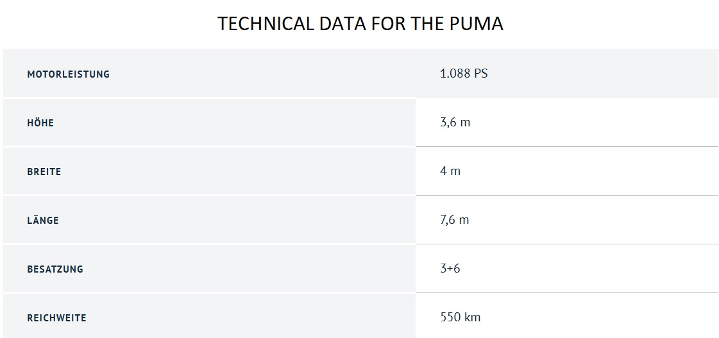
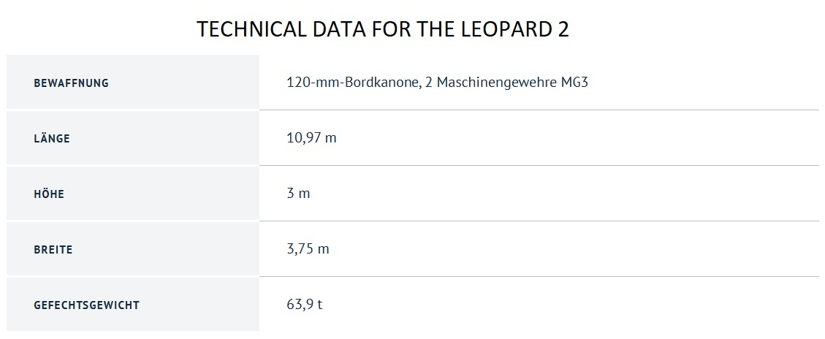
2. 2. Design and Implementation of Methods and Materials
Level 1+: Military equipment
Expanding the knowledge acquired on the previous level
Practice activity: describing vehicle specifications
Source: Bundeswehr
Notes:
Some topics from Level 1 are expanded on Level 1+. For example, the topic of military vehicles is covered more broadly, with vehicles being not just named but described, as well. The website of the Bundeswehr is once again a great source because the data on all the vehicles used by the German military are presented in a visually appealing and easy-to-read format. These materials are used to teach students how to talk about the specifications of military vehicles.

Slide 19
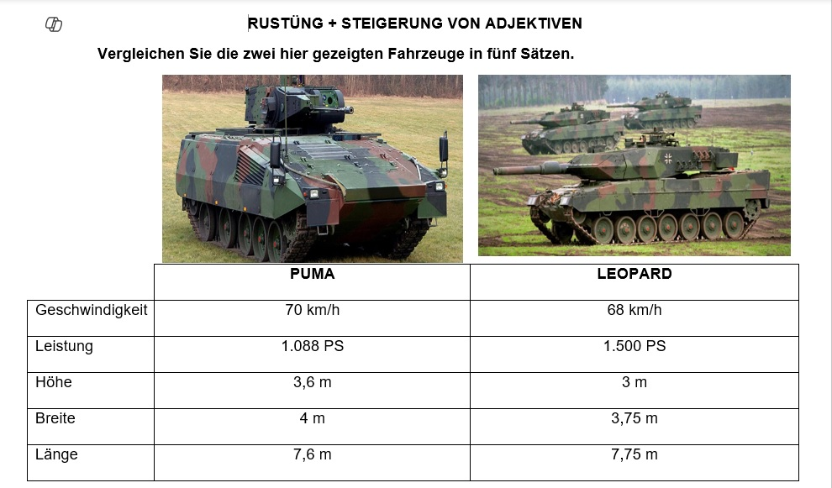
2. 2. Design and Implementation of Methods and Materials
Level 1+: Military equipment
Practice activity: comparing vehicles according to their specifications (adjective comparison)
Notes:
For homework, course participants are asked to find specifications of any vehicle of their choosing, which they present in class the next day. The same materials can be used during the grammar lesson on adjective comparison, when the class compare vehicles according to their height, width, mass, power, etc.

Slide 20
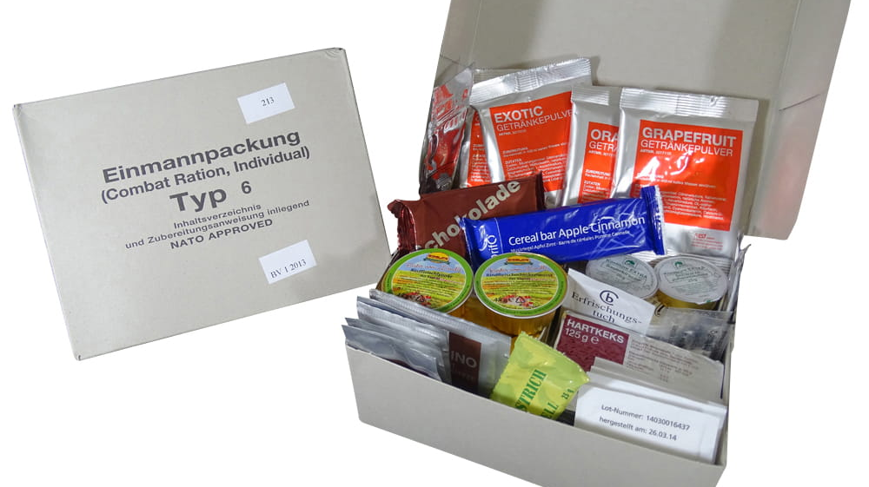
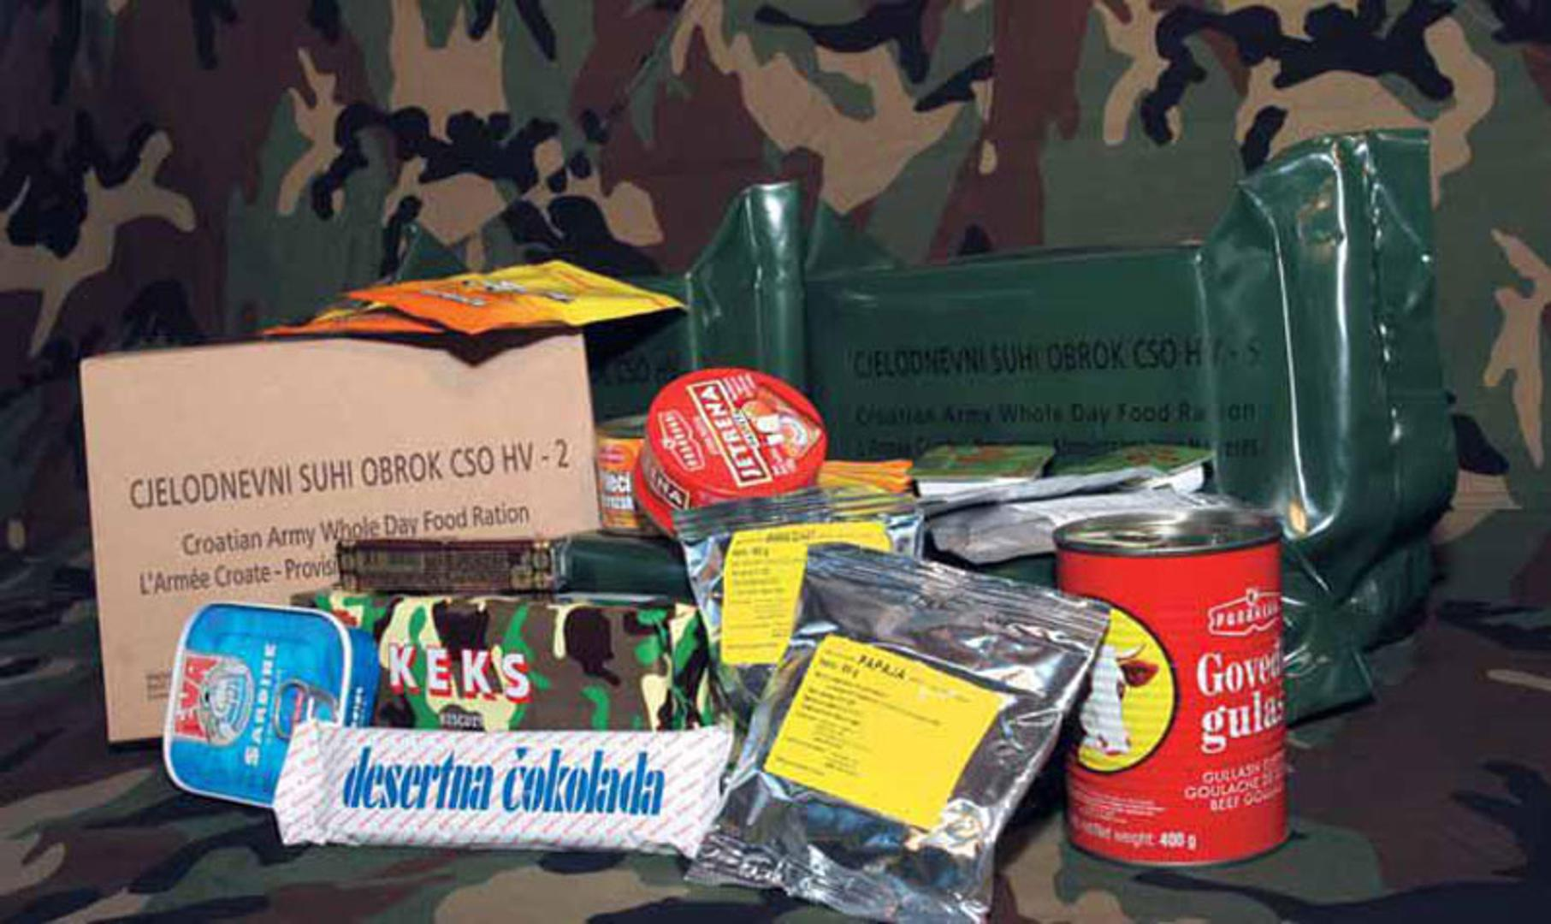
2. 2. Design and Implementation of Methods and Materials
Level 1+: Diet in the armed forces
Practice activity: describing contents of MREs
Image sources:
BW-SHOP; Večernji list
Notes:
The internet can also be utilized for other topics, such as food. The contents of the MREs in the Bundeswehr can be found online. Once learners have become acquainted with German MREs and acquired the vocabulary related to them, they can bring Croatian MREs to the classroom, describe them, and compare them to German MREs.

Slide 21
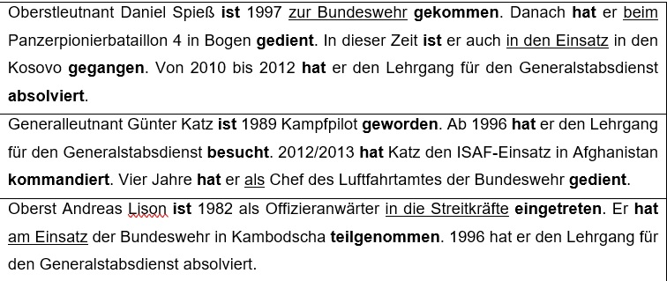
2. 2. Design and Implementation of Methods and Materials
Level 1+: Career in the armed forces
Adapting texts from the internet
Source: Bundeswehr
Notes:
As mentioned earlier, Level 1 materials are more image-based since most learners on that level start from scratch, meaning they have never learned German before or they last learned it a decade or two earlier. On the other hand, the level of knowledge that Level 1+ learners bring to the course enables them to read authentic short texts adapted from the internet. I will describe how we make use of such texts for the topic Military Career. The Bundeswehr has a podcast called Nachgefragt, which is published on their website, along with a summary of each episode and a short biography of each episode’s guest. When creating a worksheet for the aforementioned topic, I took several such biographies, adapted them and highlighted the most important phrases related to one’s path in the military. These texts are read in class and my course participants try to deduce the meaning of the highlighted phrases from the context. Since talking about one’s military career includes using the past tense, all verb phrases are written down in the infinitive, present tense and past tense forms. Furthermore, course participants note down other phrases related to the levels of education and training in the armed forces.

Slide 22
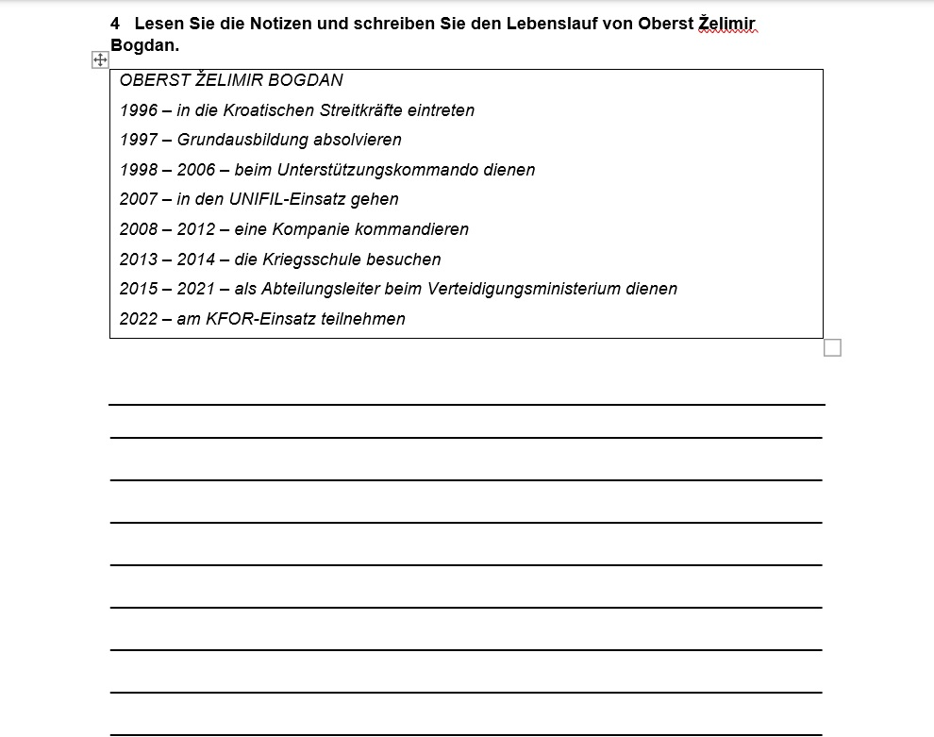
2. 2. Design and Implementation of Methods and Materials
Level 1+: Career in the armed forces
Practice activity: writing a text about a fictional soldier’s military career
Later: writing one’s own military biography
Notes:
In the next task, course participants are given bullet points with the most important phases of a fictional senior officer’s military career and are tasked with writing his biography. After that comes the final step – writing a text about one’s own military career. This is done in-class and teachers assist the learners by providing them with the German names for various courses which they have attended, units where they have served or duties which they have held.

Slide 23
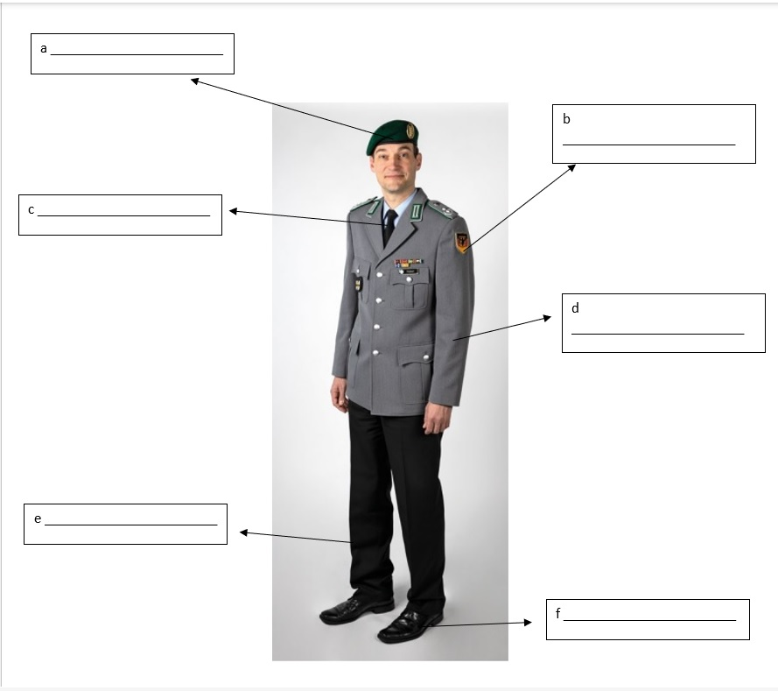
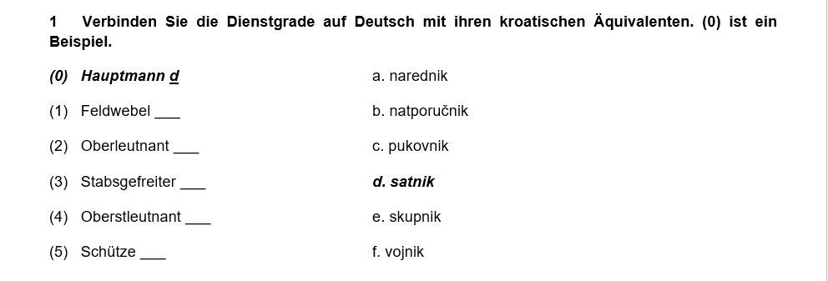
2. 3. Testing Military German Vocabulary
Variety of tasks in progress tests
Translation
Labelling
Matching
Notes:
Our course participants take a progress test every other week. The purpose of these tests is to assess which grammar and vocabulary contents the participants have mastered and which they should practice further. Each test includes one task focused on military vocabulary; we evaluated the participants’ acquisition of military vocabulary through various types of tasks, including translation, matching, and labelling.

Slide 24
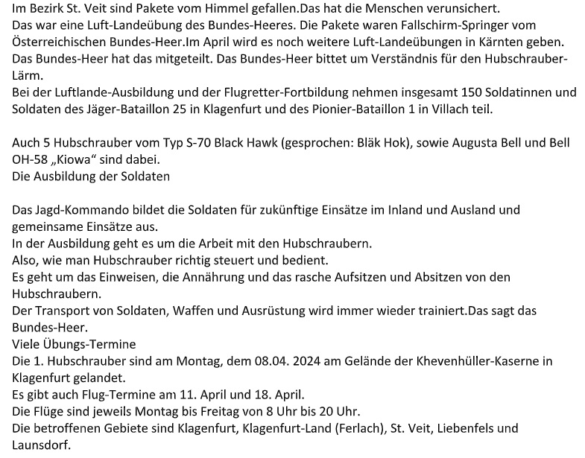
2. 3. Testing Military German Vocabulary
Issue in creating listening and reading tasks: complex authentic materials
Solution: adapting materials with the help of AI
Input
Output
AI
Notes:
At the end of the course, our learners take four achievement tests, one for each language skill: listening, speaking, reading and writing. Military topics are incorporated into the listening and reading tests. However, creating tasks for these tests poses a significant challenge due to the scarcity of authentic Level 1 or 1+ military-themed audio or written materials. Most materials from television, radio or the Internet contain grammar and vocabulary taught from Level 2 onwards, which makes them unsuitable for lower-level tests. We have addressed this issue by adapting higher-level authentic materials with the assistance of artificial intelligence. What we do is we input the original text into an AI software and provide detailed instructions for modification. The more specific the instructions, the better the output. Of course, teachers can and should further refine the AI-generated product as necessary.
Artificial intelligence can also be utilized for creating listening tasks. One can transcribe an audio file, make necessary modifications to the text and then generate a new audio file with the transcript read by AI. The quality of the recording is quite good, although intonation could use some improvement. Given how rapidly AI technology is developing, though, I am confident this issue will be resolved soon. Additionally, one can take an existing written text or create a new one, modify it with AI and convert it into an audio recording.
The usage of AI in designing German-language tests is still in its early stages, but it offers numerous possibilities and we look forward to exploring them further in the future.

Slide 25
3. Looking Ahead: Plans for the future

Slide 26
Exploring the possibilities of AI in test design
Design of materials for Level 2
Coursebook for Military German
Notes:
Apart from experimenting with AI, my colleagues and I plan to continue developing and piloting materials for other military topics at Level 1+. Our Center also offers German courses at Level 2 and once we have completed our work on materials for Level 1+, we will jointly decide on the topics to be taught at Level 2, which should lead to further development of materials for that level as well. A long-term plan and a significant aspiration of ours is to eventually compile all the materials we have created and publish them as a coursebook for military German. That coursebook would be used in our courses alongside the general-language coursebook.

Slide 27
No coursebook? No problem!
Embrace the challenge with creativity!
Notes:
To sum up, not having a coursebook when teaching military German – or any other form of language for special purposes – may seem daunting, but if you ever find yourself in such a situation, do not be discouraged. Rather, be bold, take initiative and view the situation not as a hindrance, but as a challenge. We have learned that the best way to overcome such obstacles is to be creative. So, do not be afraid to try out new methods and ideas. Some may work, others may not, but the time and effort you invest in them will pay off in the end.

Slide 28
Thank you
for your attention!

Slide 29
Bibliography
Bundeswehr (n. d.) Kampfpanzer Leopard 2. Available at: https://www.bundeswehr.de/de/ausruestung-technik-bundeswehr/landsysteme-bundeswehr/leopard-2 (Accessed 24th April 2025).
Bundeswehr (n. d.) Militärische Symbole: Zuordnung von Bundeswehr-Fahrzeugen. Available at: https://www.bundeswehr.de/de/meldungen/militaerische-symbole-bundeswehr-nato (Accessed 24th April 2025).
Bundeswehr (n. d.) Schützenpanzer Puma. Available at: https://www.bundeswehr.de/de/ausruestung-technik-bundeswehr/landsysteme-bundeswehr/schuetzenpanzer-puma (Accessed 24th April 2025).
Bundeswehr und mehr (n. d.) Original Bundeswehr EPA. Available at: https://www.bundeswehr-und-mehr.de/a-4209 (Accessed 24th April 2025).
Eurostat (2022) What languages are studied the most in the EU?. Available at: https://ec.europa.eu/eurostat/web/products-eurostat-news/-/ddn-20220923-1 (Accessed 24th April 2025).
Friedemann, J. (2023) ”Wir haben alle das Recht auf Rehabilitation” Available at: https://www.bundeswehr.de/de/meldungen/nachgefragt-so-geht-gute-rehabilitation-5670776 (Accessed 24th April 2025).
Kapović, M. (2022) ‘Strani jezici u formalnom obrazovanju u Hrvatskoj’, Strani jezici, 51, pp. 283–309, doi: https://doi.org/10.22210/strjez/51-2/6
Kather, T. (2023) ”Gefecht verbundener Waffen essenziel für Angriffserfolg”. Available at: https://www.bundeswehr.de/de/meldungen/nachgefragt-oberstleutnant-daniel-spiess-minenfelder-5653602 (Accessed 24th April 2025).
Kather, T. (2023) ”In dem Ausmaß hat es so eine Übung noch nie gegeben”. Available at: https://www.bundeswehr.de/de/meldungen/nachgefragt-mit-generalleutnant-guenter-katz-5633074 (Accessed 24th April 2025).
Mazzocco, V. (2010) ‘Rat je i u recesiji dobar posao’. Večernji list, 13th March. Available at: https://www.vecernji.hr/vijesti/rat-je-i-u-recesiji-dobar-posao-110107 (Accessed 24th April 2025).
Mellor-Clark, S. and Baker de Altamirano, Y. (2004) Campaign: English for the Military Student’s Book 1. Oxford: Macmillan.
NATO (2024) General Information – Questions and answers. Available at: https://www.nato.int/cps/en/natohq/86935.htm (Accessed 24th April 2025).
Ordinance on Foreign Languages (2025) Available at: https://narodne-novine.nn.hr/clanci/sluzbeni/2024_02_18_299.html (Accessed 24th April 2025).
Taylor, J. and Zeter, J. (2013) Career Paths: Command and Control. Newbury; Express Publishing.
Williams, H. J. (2017) Flash on: English for MILITARY PERSONNEL A2-B1. Stuttgart: Ernst Klett Sprachen.
Zeidan, A. (n. d.) Languages by total number of speakers. Available at: https://www.britannica.com/topic/languages-by-total-number-of-speakers-2228881 (Accessed 24th April 2025).

