Slide 1
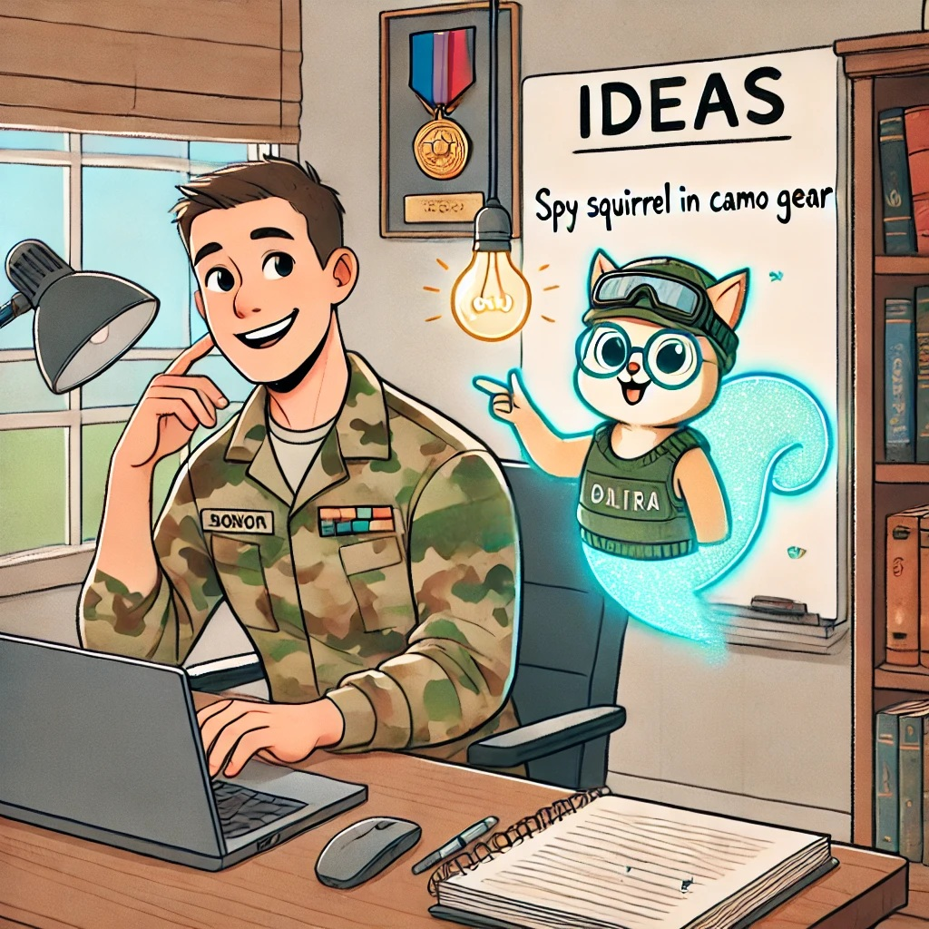
AI and the Future of Formal Military Communication
Challenges and Strategies for Teaching and Writing at Higher Proficiency Levels
Facilitators:
Tea Glavaš, Iva Gugo, Milena Prošić and Kristina Serdoz

Slide 2
DISCUSSION
Writing – still a human skill?
Meaning of writing proficiency today?

Slide 3
DISCUSSION
AI and changes in writing instruction?

Slide 4
GROUP WORK
The role of AI in …
Group 1 and 2:
designing classroom tasks
Group 3 and 4:
designing home assignments
Group 5 and 6:
designing assessment tasks

Slide 5
EXAMPLES OF EXISTING GUIDELINES FOR WRITING WITH AI
LanCASTER UNIVERSITY
AI as force multiplier
Human review needed
OPSEC risks
u. s. navy
AI prohibited
AI as assistance
AI as an integral part of the task

Slide 6
EXAMPLES OF EXISTING GUIDELINES FOR WRITING WITH AI
BILC
Do not share confidential information.
Do not use the e-mail address affiliated with your institution.
Do not input classified documents into AI applications.
Regularly evaluate AI output for potential biases.
Maintain logs of interaction with AI.
Put disclaimers on AI-generated contents.

Slide 7
DISCUSSION
Rules for AI usage in your institution?
Points of contention?
Update to STANAG 6001?

Slide 8
GROUP WORK
Guidelines for AI and expectations from BILC
Pedagogy:
AI – yes or no?
If yes – when?
Ethics:
Authorship
Transparency
Operational concerns:
Data security
NATO standards

Slide 9
KEY TAKEAWAYS
Types of tasks:
Gen AI as a source of model texts / scaffolded writing materials / error correction tasks / paraphrase tasks
Gen AI as a peer reviewer of student ideas / layouts for writing / paragraphs / complex sentences / usage of lower-frequency vocabulary refinement
GenAI as a tutor / co-teacher / activator / companion / consultant

Slide 10
KEY TAKEAWAYS
WHAT DO WE NEED?
OPEN QUESTIONS
Do students, as well as teachers/testers, need training in AI use?
Is it possible to trust AI in assessing writing?
If we want to achieve standardization, do we need a common, shared AI model for testing writing?
In the long run, will we really need to assess writing anymore?
Education/ exchange of ideas / learning platforms
Training and education in applying GenAI in language teaching and testing (courses?)
Questions as a basis for future guidelines?

Slide 11
POTENTIAL BILC GUIDELINES FOR AI USAGE
Practical guidelines not prohibitive, but promotive of responsible and transparent usage of AI (starting point for developing healthy AI habits)
Clarity on data protection
Emphasis on necessity of human supervision and review of AI products
Supplement: examples of good and bad practice
Continuous updates based on lessons learnt
Recommendations for national and institutional regulations tailored to target audiences

