Slide 1
Continuous professional development at the danish armed forces foreign-languages academy

Slide 2
The Danish armed forces foreign-languages academy, english training section
The Foreign-Languages Academy trains military linguists in Russian and Arabic, as well as Ukrainian native-speaker interpreters. There are two representatives from the relevant section present here….
The Academy is also responsible for providing English training and STANAG testing. The English Training Section runs English classes fully integrated with the respective officer-training programs at the three service academies, as well as a condensed tactics-terminology module that is part of the military-linguist program.
The section is manned by six full-time teachers and a head of section.

Slide 3
From recruitment to retention

Slide 4
recruitment
What we offer:
Full-time permanent employment.
English content that is all service-specific and fully integrated into officer training.
Cadets who are highly motivated, but maybe less so when it comes to English.
A very steep initial learning curve.
Colleagues who will mentor and support.
Limited time for formalized development and a horizontal career path….
Extensive autonomy and agency.
The profile we look for:
Academic degree in English; a track record of solid teaching experience; ESP if possible.
Experience with classroom management in an adult learning environment, coupled with a well-kitted pedagogical toolbelt.
Resilient, ambitious, realistic about the challenges of the job, comfortable with not being an SME, good at ”on-the-job learning”, unfazed about becoming an ”experienced rookie”.

Slide 5
Initial professional-Development objectives are two-fold: increased teaching quality and short-term retention
First three years (ish): demand-driven, directly applicable:
Onboarding (colleagues and support, military environment, organizational structures, jargon, etc)
Service-specific specialization (Navy, Army, Air Force) incl self-study (doctrine, etc)
Content and curriculum (a very steep learning curve, but goal is not SME level)
SME consultation (military instructors) as well as ”learning through teaching”
Mentoring (peer to peer, mutual class observation, feedback, advising)
”Inquisitive observation” sessions
Annual cadet feedback

Slide 6
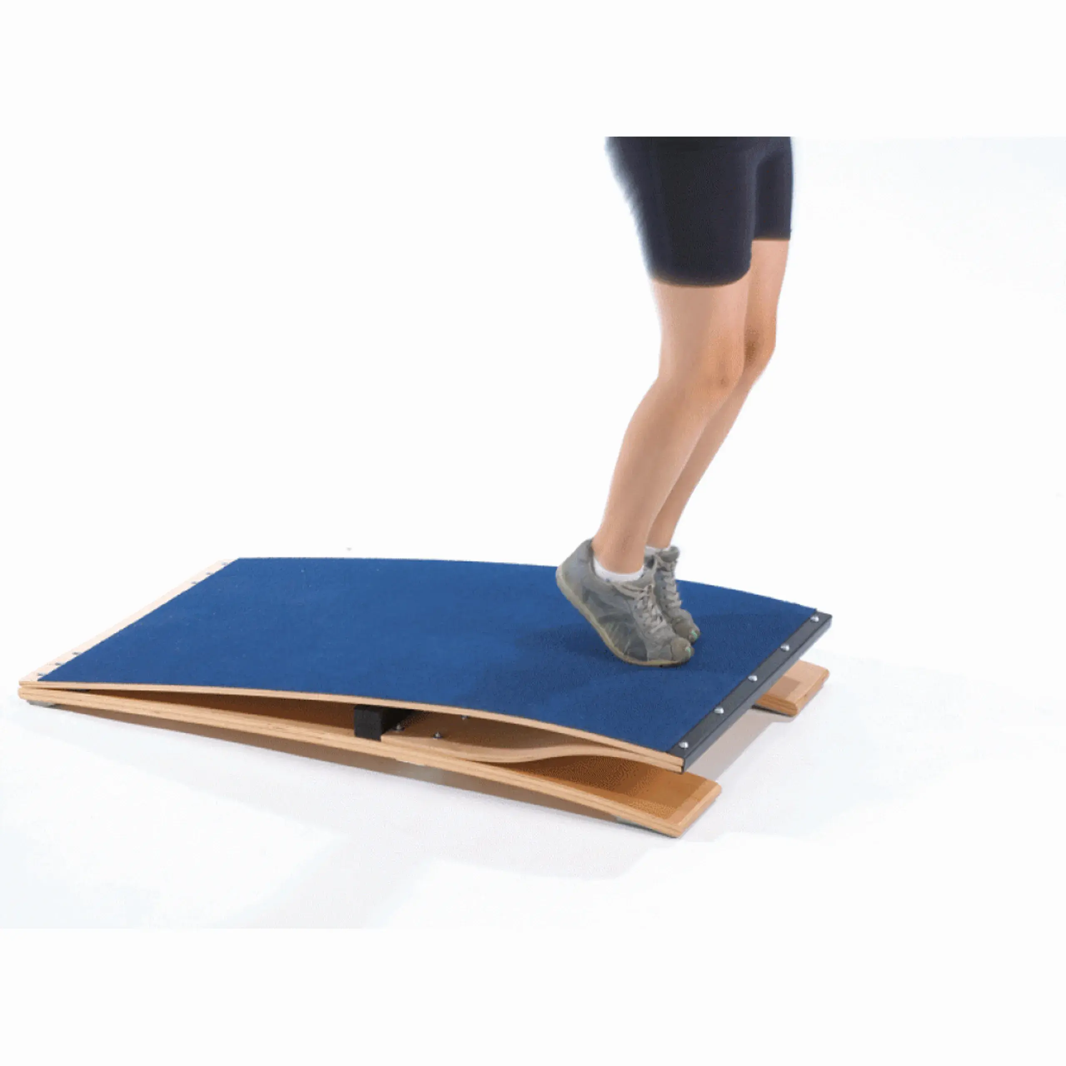
Continuous professional-Development objectives are three-fold: increased teaching quality, job satisfaction, and long-term retention
After three years (Ish): individual priorities, not necessarily directly applicable:
Autonomy and agency
Further self-study
In-house and external courses, programs, and conferences (BILC, NORDEFCO, universities, etc)
Ad-hoc visits at installations, vessels, facilities, etc
Diversifying; POC roles (modules, service-specific English, e.g.) and testing
Formalized advanced education (comes with dilemmas…)

Slide 7
Questions?

