Slide 1
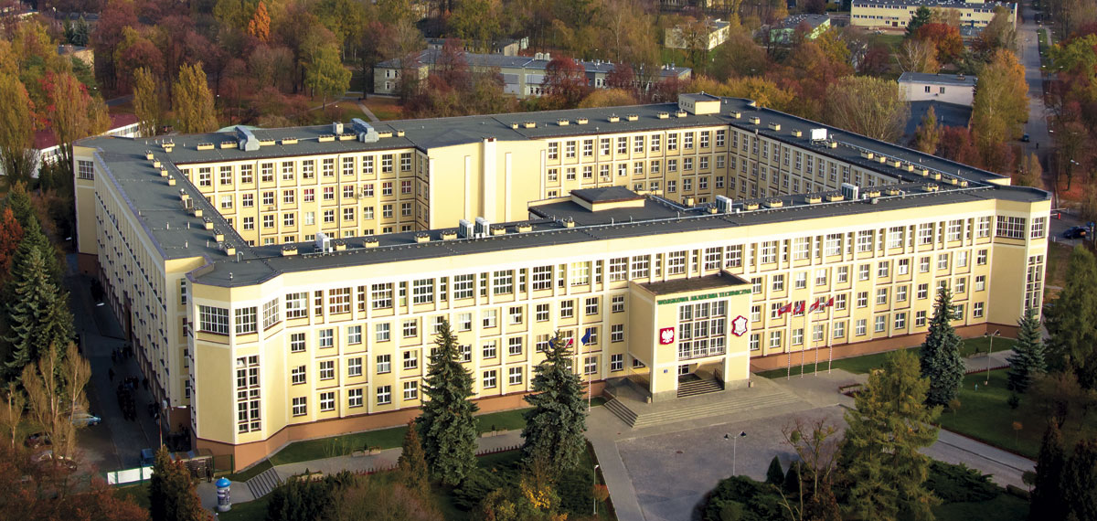

Slide 2
Interwoven Threads: Exploring the Nexus of Languages, Security and Technology
Asst. Prof. Agata Jagiełło-Tondera, PhD

Slide 3
Language reveals the engine of our souls, our mind. It illuminates us and energizes us. We share it with all we meet. It is the cognitive fire of human life. D. L. Everett, Language, The Cultural Tool

Slide 4
Task-based language teaching (TBLT)
an empirically investigated pedagogy that has garnered attention from language programs across the globe
provides an alternative to traditional grammar translation or present-practice-produce pedagogies by emphasizing interaction during authentic tasks.

Slide 5
FILM has the potential
to lift language off the page
and bring it to (technicolour!) life in the classroom.
J.Bottomley 2018

Slide 6
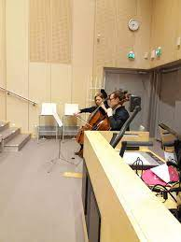
Cognitive curiosity
Warriors of Tomorrow: Teaching Military Terminology through Film
Language Teaching Tomorrow 2019
TAMK & JAMK Universities, Finland

Slide 7
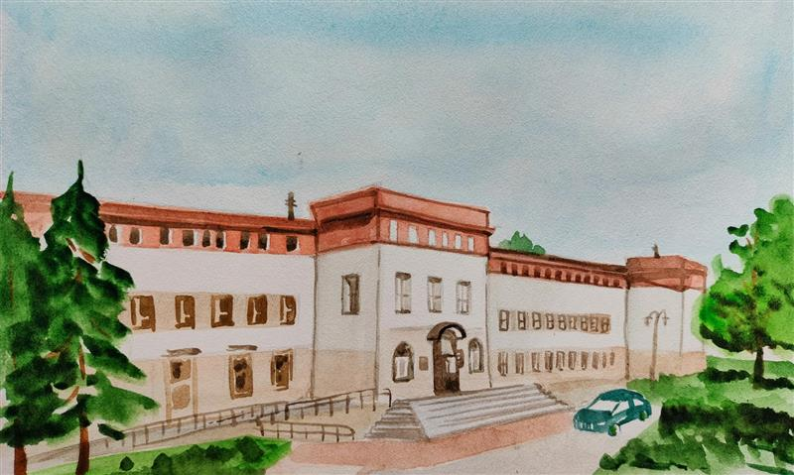
Foreign Languages
Centre

Slide 8
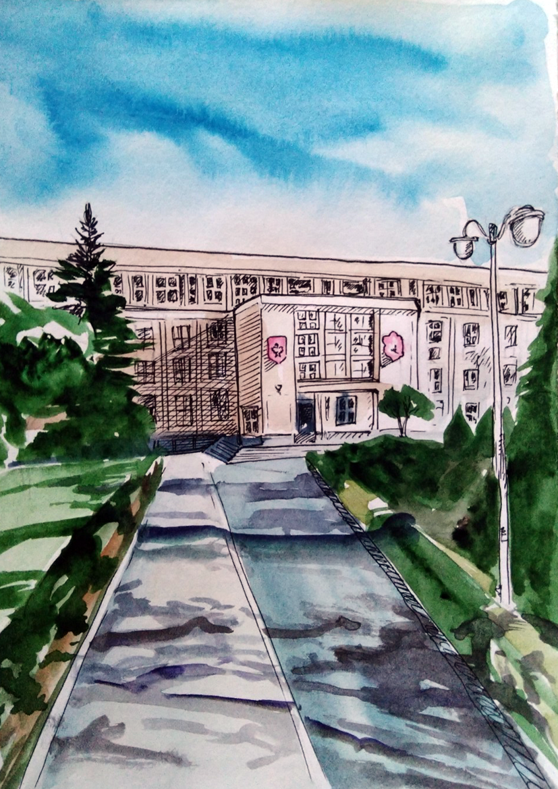
Language-Security-Technology
Conference
2019

Slide 9
Student Linguistic Association 2020
Naukowe Koło Lingwistyczne SJO WAT

Slide 10
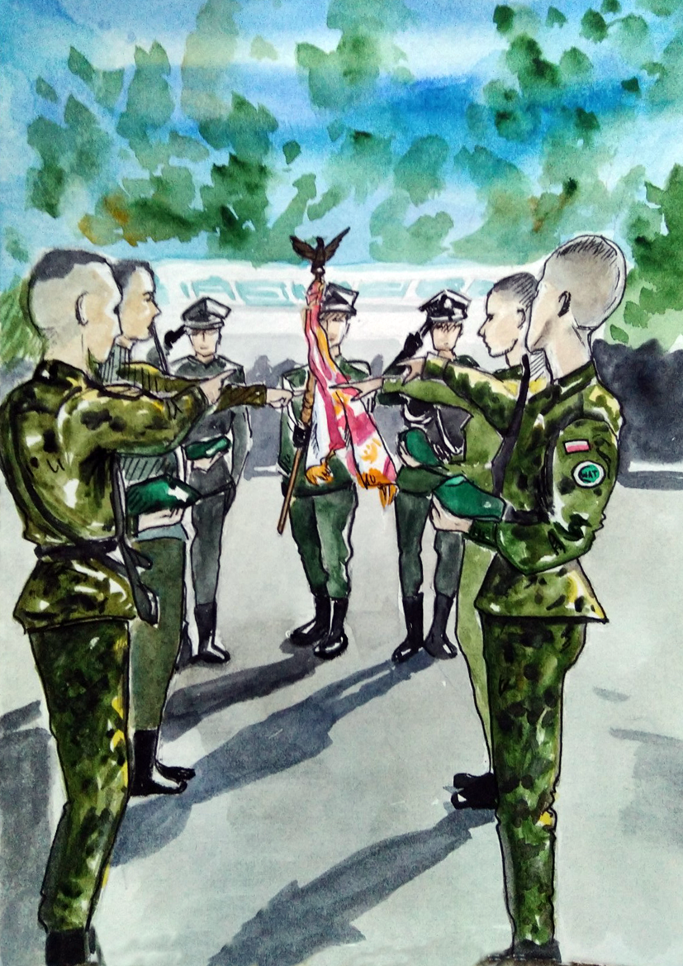
Tell me and I forget.
Teach me and I remember.
Involve me and I learn.

Slide 11
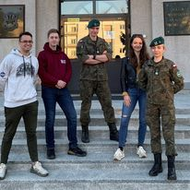
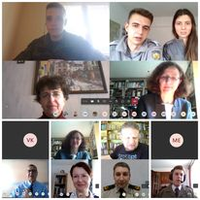
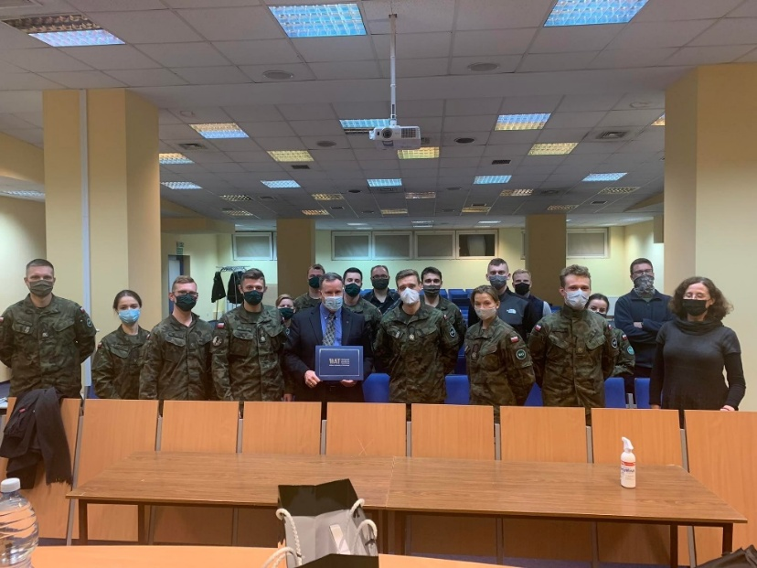
Student Linguistic Association
Webinars:
Language and security 2021
Seminars:
NATO East Flank 2020
The founders

Slide 13
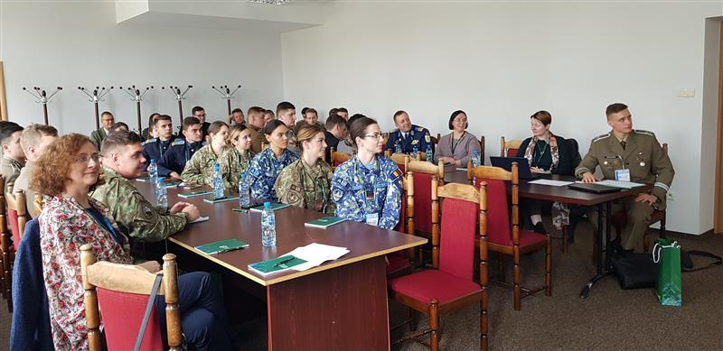
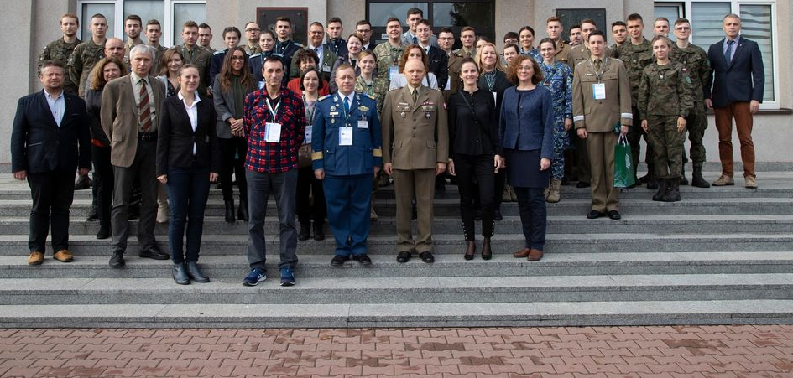
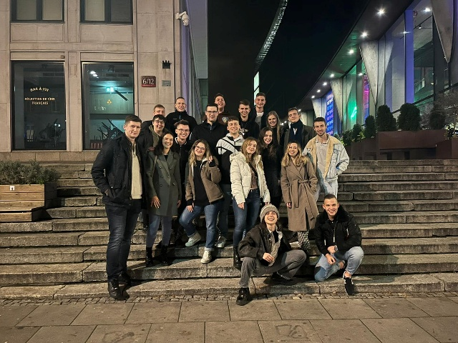
Language-Security-Technology 2022
Conference for teachers and cadets/students

Slide 14
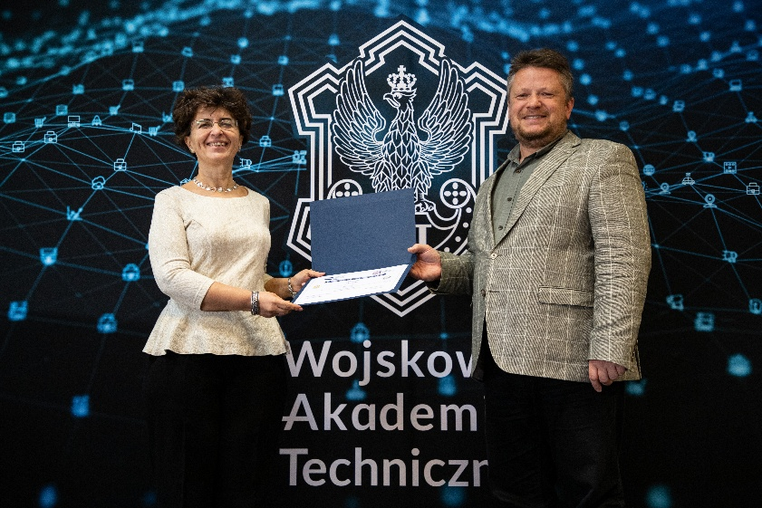
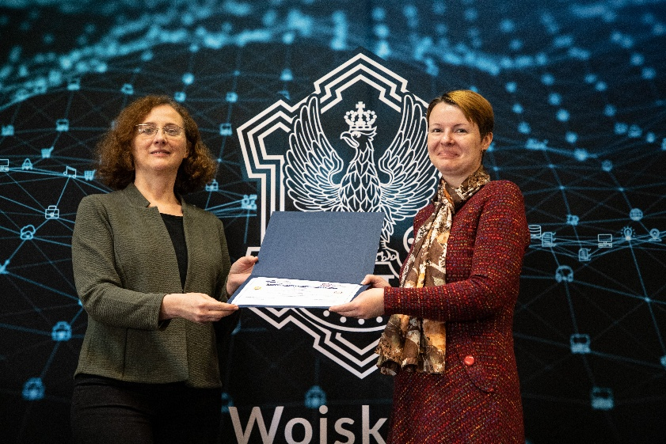
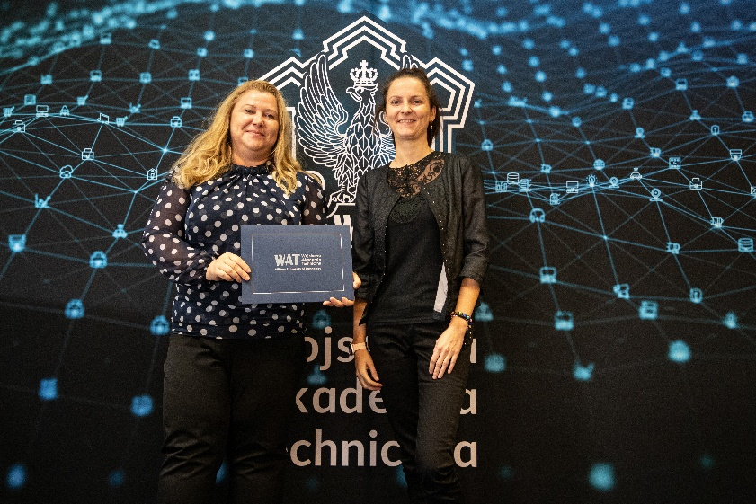
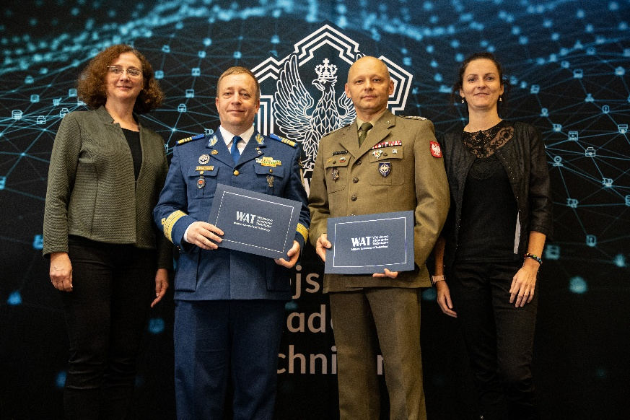

Slide 15
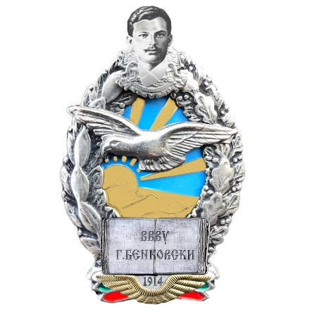
Language-Security-Technology
Conferences for teachers and cadets/students
Military Technical Academy ”Ferdinand I”
Bucharest, Romania 2023
Bulgarian Air Force Academy ”Georgi Benkovski”
Pleven, Bulgaria 2024

Slide 16
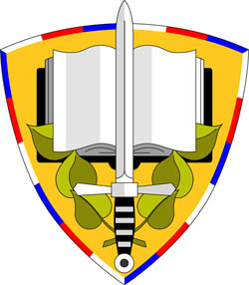
Language-Security-Technology
Conferences for teachers and cadets/students
University of Defence
Brno, Czech Republic 2025
“Henri Coanda” Air Force Academy
Braşov, Romania 2026
Spain 2027
TBC

Slide 17
“You cannot be educated, you have to educate yourself […] education requires verifiable content and self-reflection, which allows you to transfer experiences to new situations.”
Professor Gesine Schwan

Slide 18
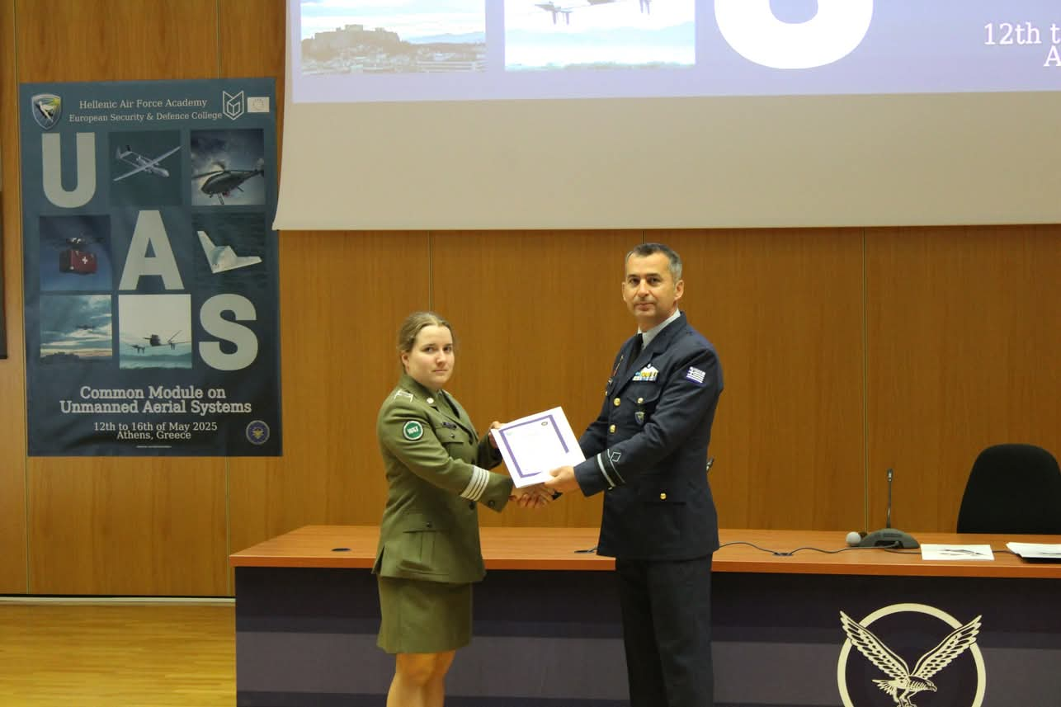
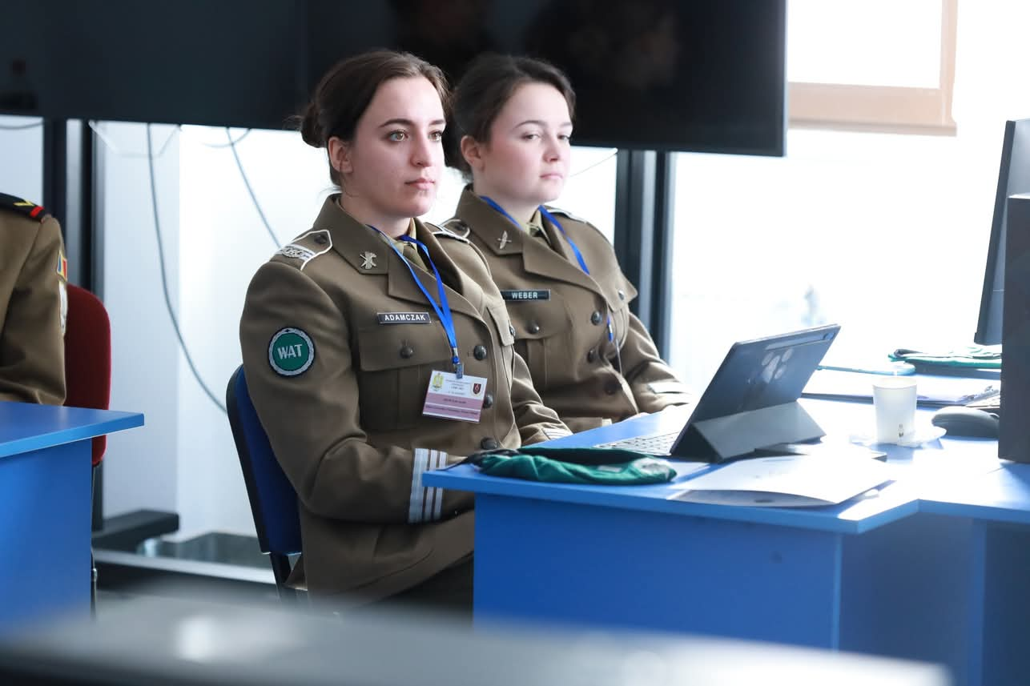
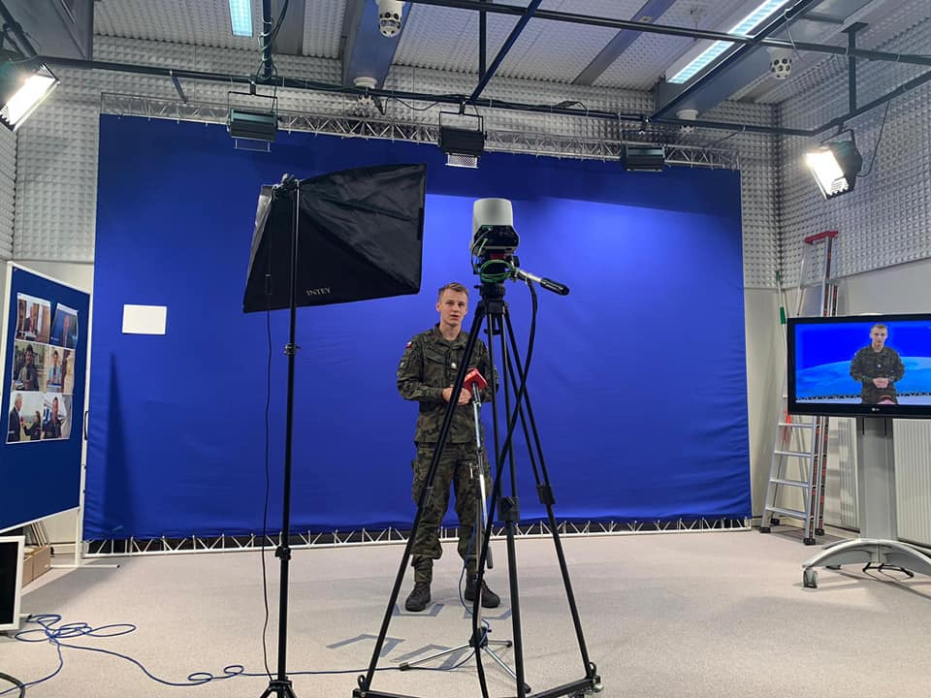
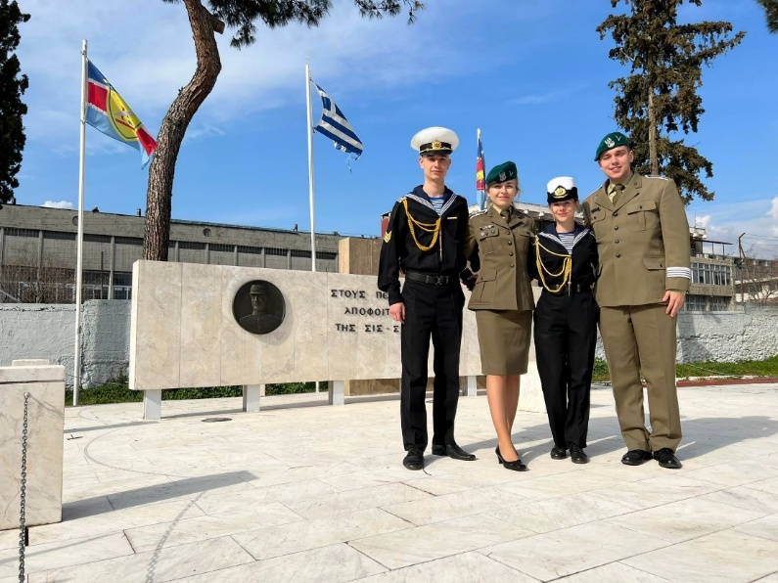
Student Linguistic Association
Participation in EMILYO workshops and events
(European initiative for the exchange of young officers inspired by Erasmus)

Slide 19
WAY AHEAD
Student Linguistic Association
MUT
Scientific Cadet Society
EMILYO

Slide 20
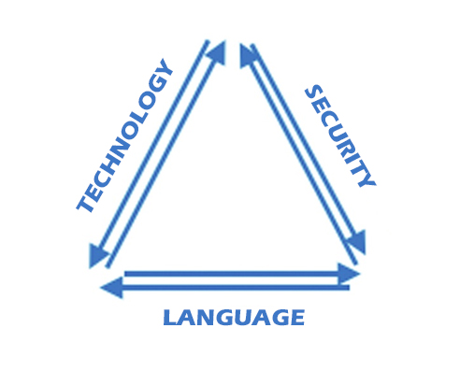
Adapting collaboration to new technologies

Slide 21
Homo reticulus
“has awareness of operating in the conditions of global social networks and the need to shape them conducive to
safe and sustainable development of civilization”
P. Sienkiewicz, 2017

Slide 22
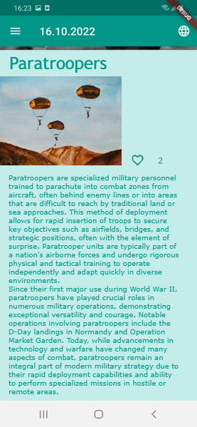
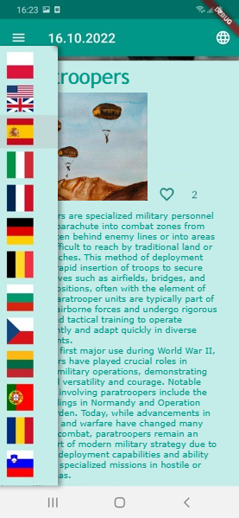
MilVocab app
Project-Based Learning
International project of military academies
Designed and prepared by cadets

Slide 23
Recommendations of the Council of the European Union on
key competences for lifelong learning (2018):
It is necessary to explore new ways of learning for the needs of a society that is becoming increasingly mobile and digital. Digital technologies are having an impact on education, training and learning, enabling the development of more flexible educational environments adapted to the needs of a highly mobile society.

Slide 24
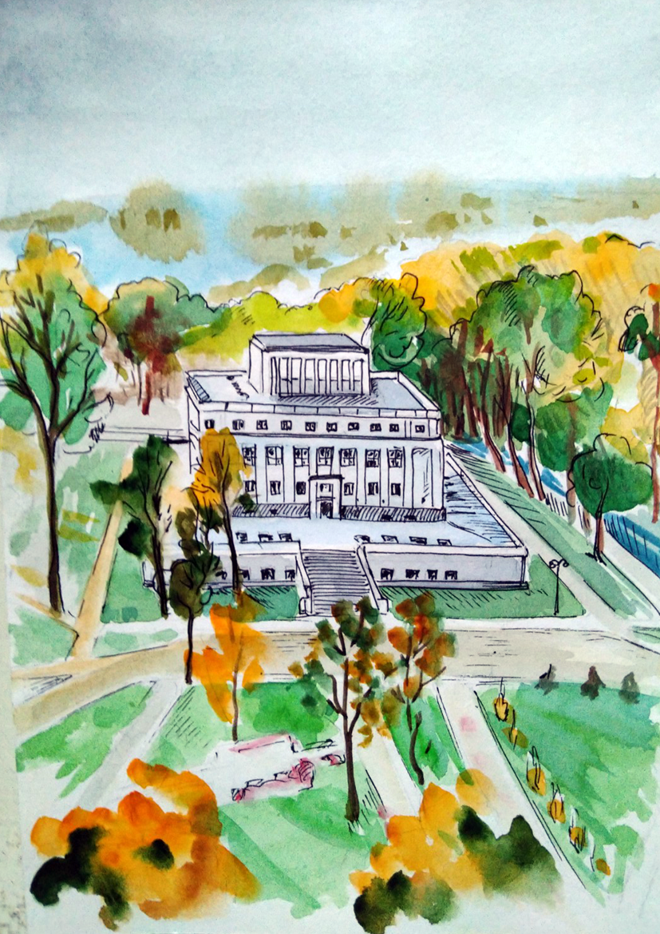
Thank you.

