Slide 1
To Use or not to Use AI in the English Language Classroom
Exploring
the benefits and
challenges

Slide 2
To Use or not to Use AI in the English Language Classroom
Exploring
the benefits and
challenges

Slide 3
Introduction
Term AI coined in 1956
ChatGPT released in 2022

Slide 4
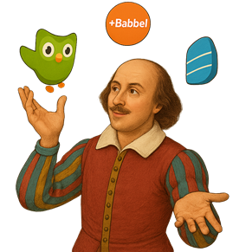
What is AI in language learning
Variety of AI tools
• Duolingo
MakesYouFluent
Babbel
TalkPal
Rosetta Stone

Slide 5
Arguments FOR Using AI
From a student’s perspective
From a teacher’s perspective
From an institution’s perspective

Slide 6
Example: Success Story
University of Tennessee
The College of Southern Idaho

Slide 7
Arguments AGAINST Using AI
Plagiarism
Students’ lack of confidence
Credibility of information
Students’ addiction to devices

Slide 8
Finding a Balance
Balance between leveraging the strengths of AI and preserving the human elements that make education meaningful.

Slide 9
Conclusion
AI is great but it’s not enough on its own
Keyword - balance

Slide 10
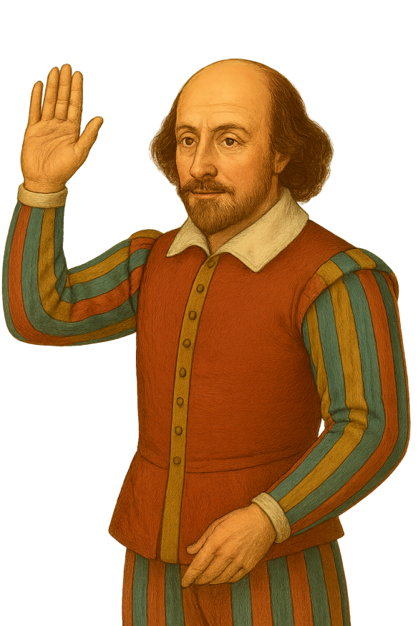
Thank you for your attention

Slide 11
References
Kyle Doty, and Lodi Lipien, “Student Perceptions and Attitudes About the Usage of Chatgpt in Online K-12 Education and Student Preferences About Learning to Use Artificial Intelligence from Teachers.” American Journal of Educational Research, vol. 12, no. 9 (2024): 348-355. doi: 10.12691/education-12-9-2.
https://makesyoufluent.com/ai-language-learning-apps/
https://kahoot.com/school/higher-ed/resources/customer-stories/college-of-southern-idaho/
https://oit.utk.edu/ai/
https://www.utc.edu/academic-affairs/walker-center-for-teaching-and-learning/resources-chatgpt/generative-ai-and-academic-misconduct
https://www.etsglobal.org/iq/en/blog/news/virtual-seminar-highlights
https://www.cambridge.org/sites/default/files/media/documents/The_Role_of_AI_in_Language_Learning_Research_Evidence_and_Strategies.pdf
Cambridge University Press & Assessment. (2024). Generative AI Idea Pack for English language teachers. https://www.cambridge.org/sites/default/files/media/ documents/GenAI_Idea_Pack.pdf

