Slide 1
NATO-BILC Conference 2025

Slide 2
Wargames in Class

Slide 3
Origins of Wargaming

Slide 4
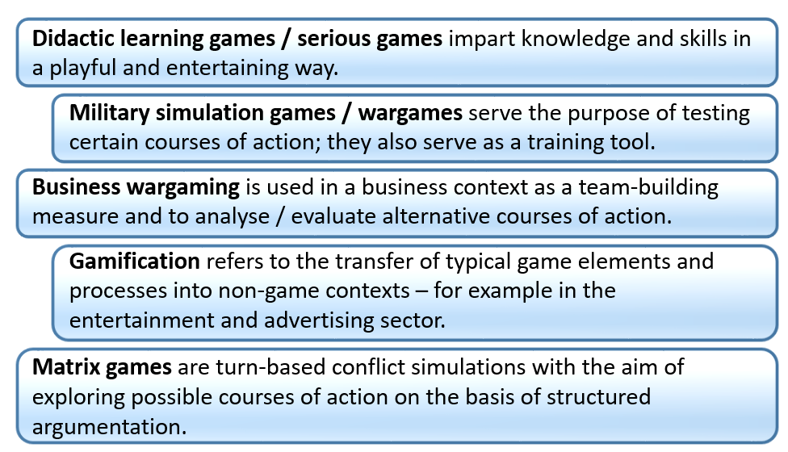
Useful Terms

Slide 5
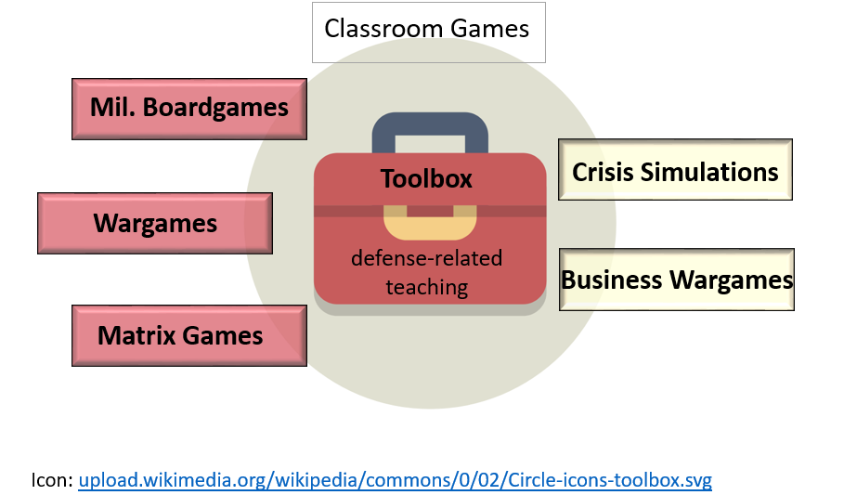
Toolbox

Slide 6
Military Boardgames

Slide 7
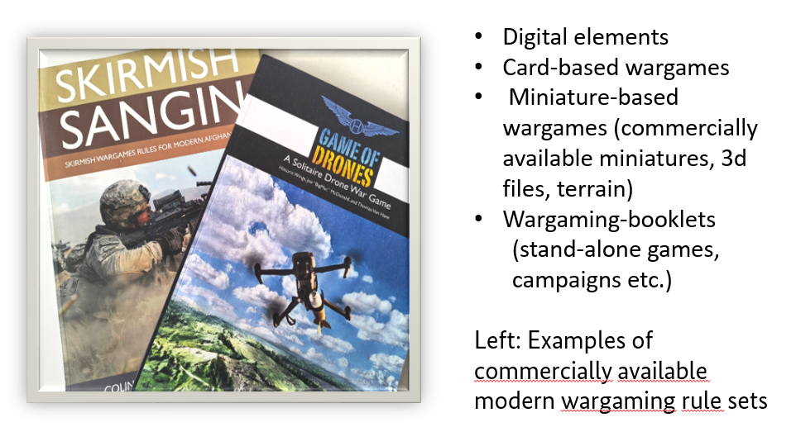
Other Wargames

Slide 8
Matrix Games

Slide 9
Crisis Simulations

Slide 10
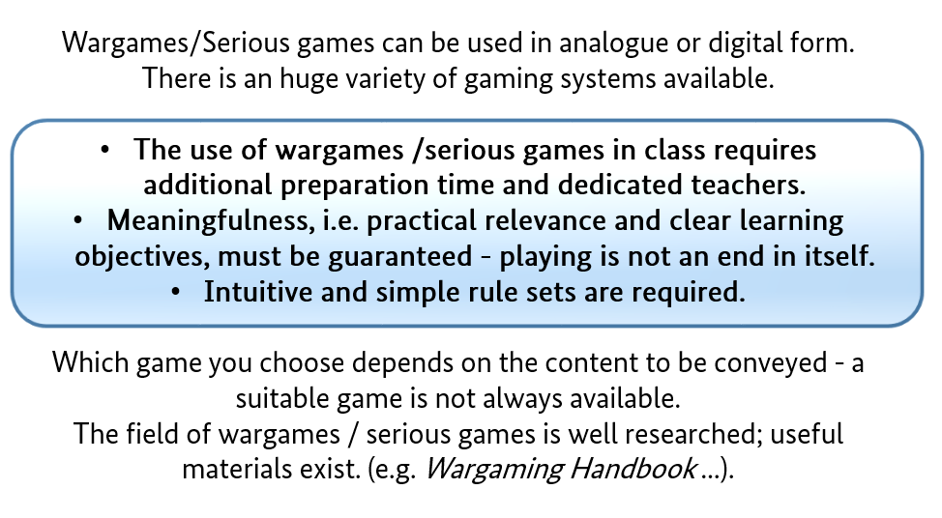
Lessons Learned

Slide 11
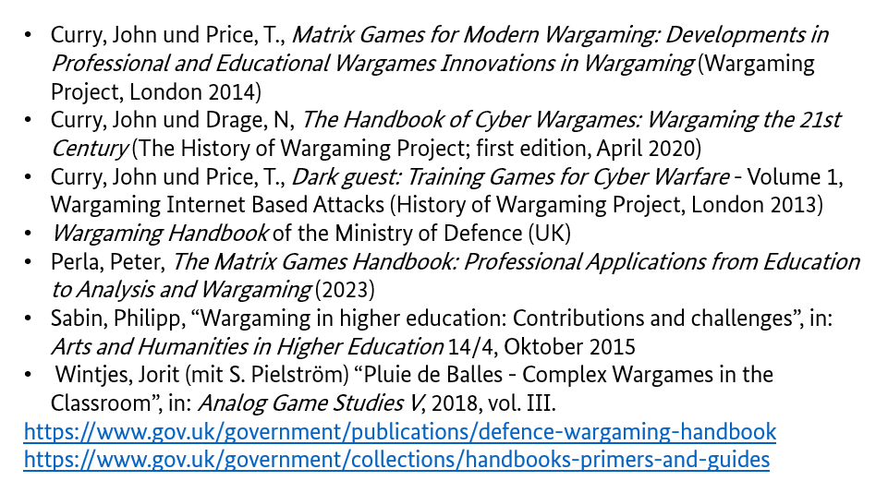
Literature

