Slide 1
Building Standardization and Interoperability through Cooperation: DEEP Perspective
Defence Education Enhancement Programme
Delivery Section
Defence Security Cooperation Directorate
Operations Divisions
NATO IS
BILC Conference, May 2025

Slide 2
What is DEEP?
Flexible, effective and efficient tool to support partner nations in development of their military education.
Through DEEP, the Alliance advises partners on how to build, develop and reform educational institutions in defence and security domain.
Enable, support and sustain any assistance offered by NATO and Allies bilaterally.
Build intellectual interoperability which enables tactical interoperability.
Standardize key takeaways from military education at different levels.

Slide 3
Needs Addressed
Curriculum Development (What to teach?)
Faculty Development (How to teach?)
Institutional Reforms (How to put it into practice?)
English language training and testing IAW STANAG 6001
Advanced Distributed Learning (e-learning)
Peer relationships built through these endeavours enable host institutions to sustain reforms.

Slide 4
What to Teach
In addition to curriculum development, it also develops reference curricula or guidance documents, designed to conform to Alliance education standards, available to all interested nations.
Defence Institution Building
Professional Military Education for Generic Officers
Professional Military Education for Non-Commissioned Officer (NCO)
Non-Commissioned Officer (NCO) Schools Instructor Development
Cybersecurity
Counterinsurgency
Counter-Terrorism
Building Integrity
NCO Corps Professional Development Reference Guidance
DEEP Strategy for Distance Learning Support
Faculty Development Curriculum Guide
RC NCO Instructor Development RC
Russian War Against Ukraine Lessons Learned Curriculum Guide
Leadership and Ethics
Hybrid Warfare
Resilience
NATO Operational Planning

Slide 5
DEEP countries
There are currently fifteen (15) programmes in partner countries, each with a different focus and at a different stage of development:
Armenia (est. 2009) Azerbaijan (est. 2010) Bosnia and Herzegovina (est. 2019) Colombia (est.2022) Georgia (2008; re-launched 2013) | Iraq (2012; re-launched 2019) Jordan (est. 2020/2021) Kazakhstan (est. 2007) Mauritania (est. 2012) Moldova (est. 2009) | Mongolia (est. 2013) Morocco (est.2019) Serbia (est. 2013) Tunisia (est. 2016) Ukraine (est. 2013)

Slide 6
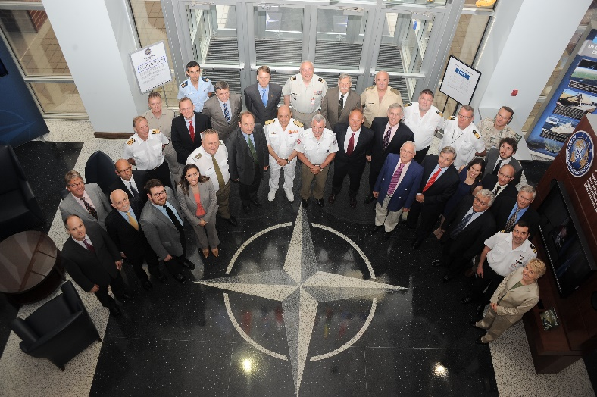
How DEEP country programmes work
Demand-driven tailored programmes embedded in partners' individual programmes of cooperation with NATO.
Through a scoping visit, NATO-led multinational teams of experts agree on objectives and build an action plan to execute activities.
A yearly programme review is carried out to ensure delivery on the needs identified by our partners.
Clearing-House on Defence Education - a vehicle for Allies and Western partners to associate donors’ resources and partners requirements.

Slide 7
Who supports the programme
More than 75 Allied PME institutions
More then 900 officer, NCO and civilian Subject Matter Experts
Partners’ SMEs helping other partners (becoming providers)

Slide 8
Questions?
Branka Petek
DEEP Programme Manager for Colombia, Jordan, Kazakhstan and Mongolia
petek.branka@hq.nato.int

