Slide 1
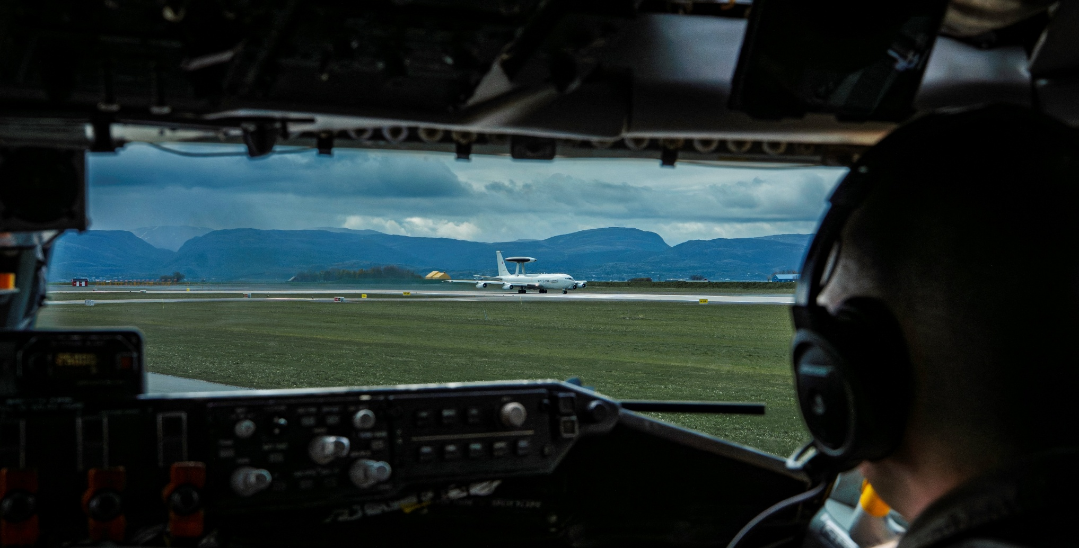
NATO Airborne Early Warning & Control Force
Operational view on writing skills
OF-5 BILC STANAG 6001 Testing Workshop
Henk Kiffen 2 September 2025
DCOM NATO E-3A Component

Slide 2
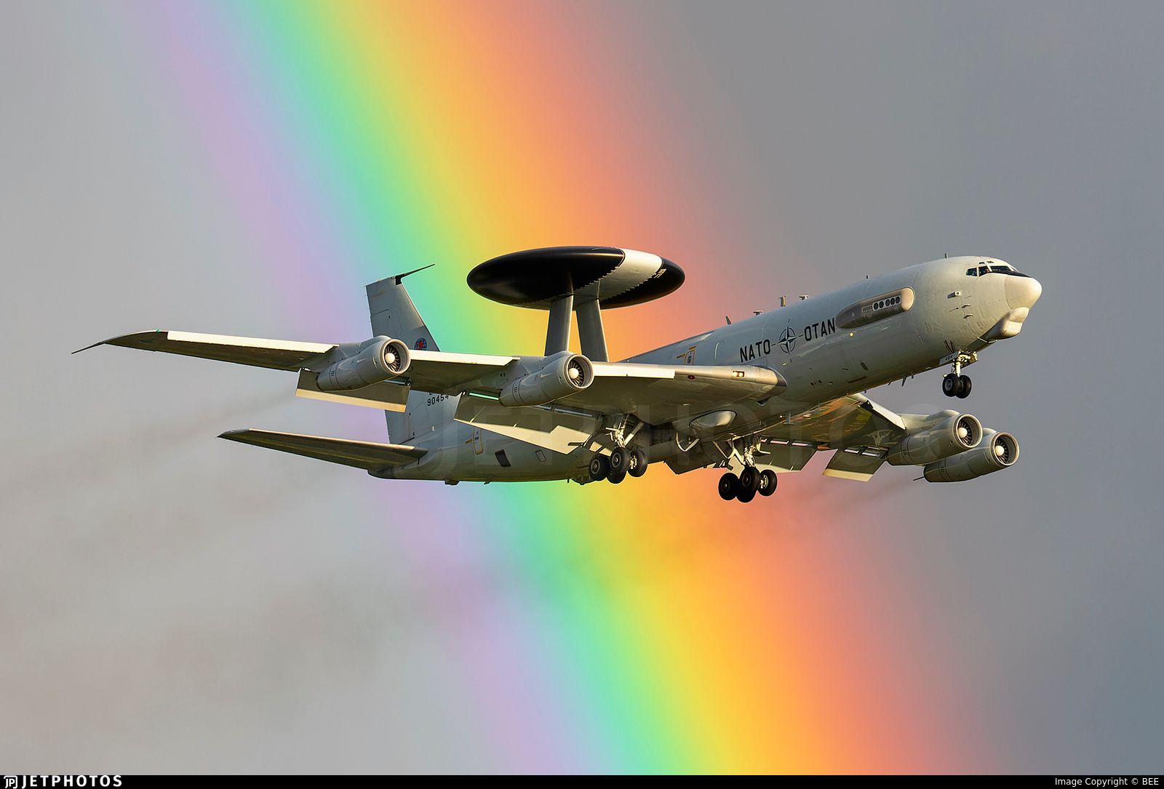
Structure
NAEW&CF Mission
Organisation and Footprint
Capabilities and tasks
Language requirements within NAEW&CF
Considerations
Conclusions

Slide 3
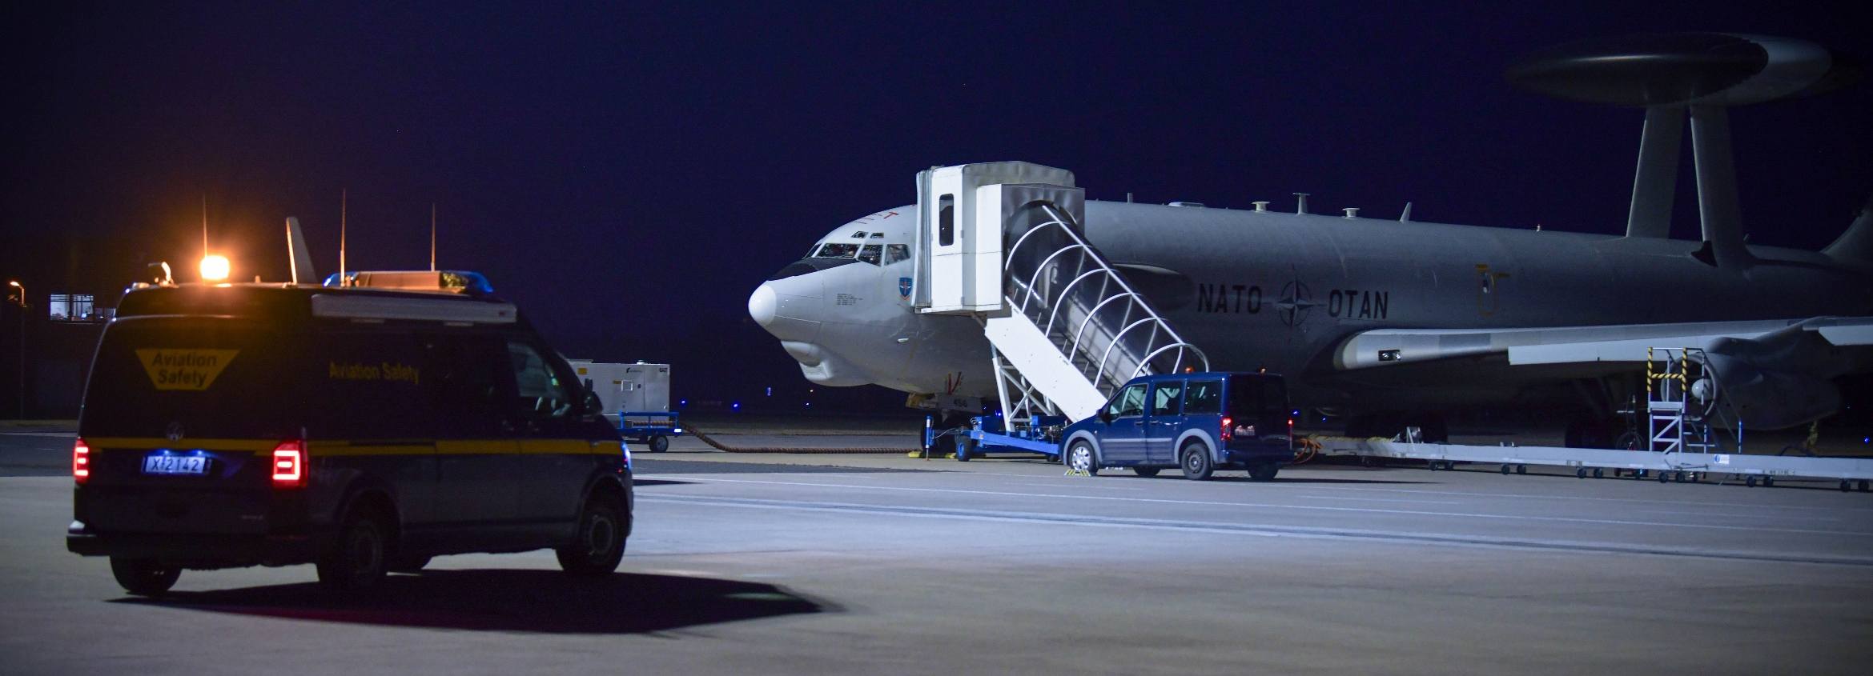
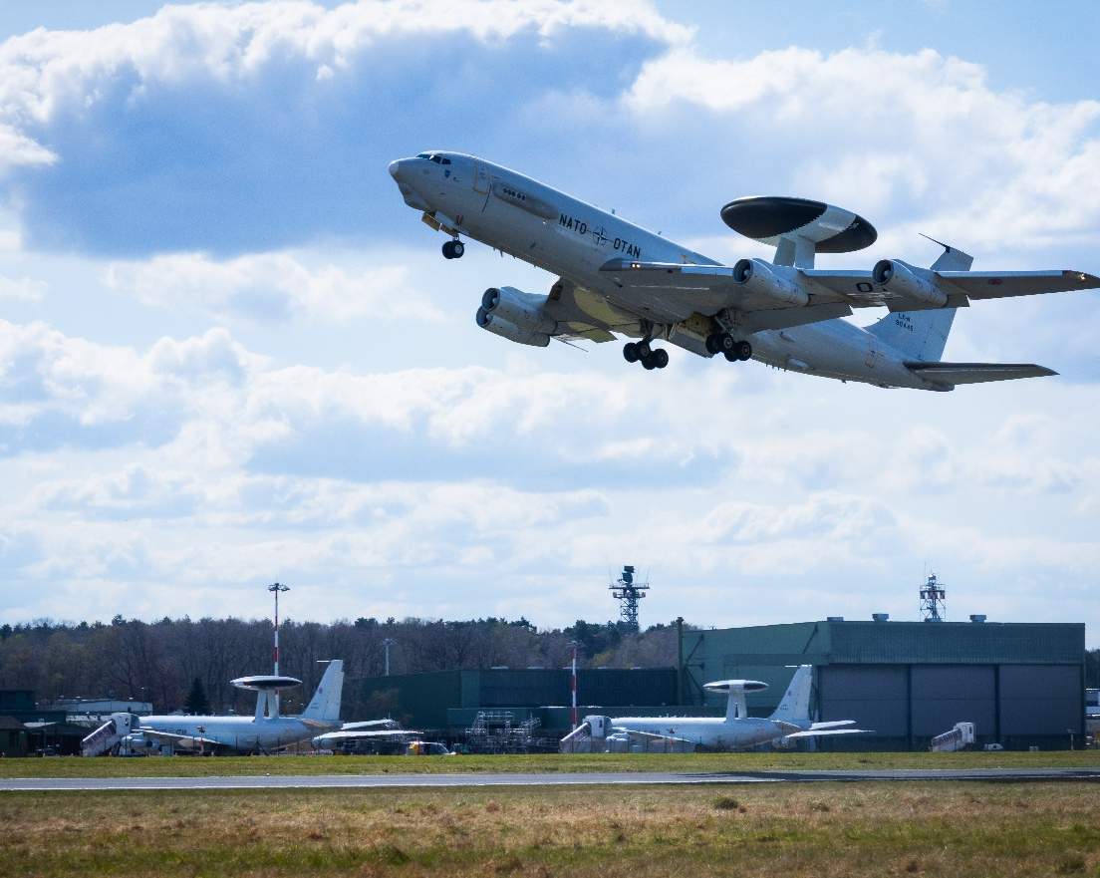
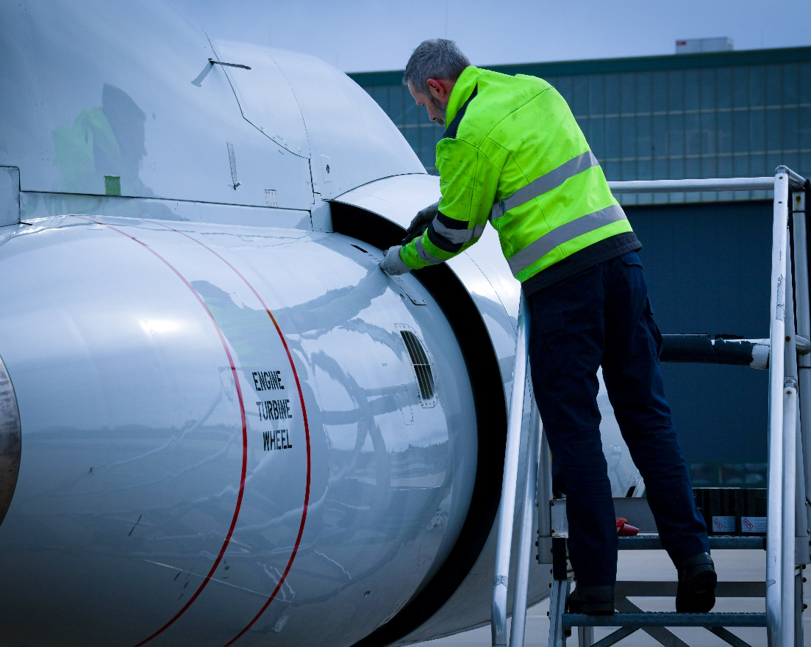
NAEW&CF
Mission Statement
We are NATO’s own Airborne Early Warning and Control Force
We are many nations, one AWACS Force
United to detect, direct and dominate the airspace and defend the Alliance

Slide 4

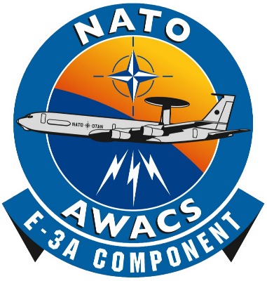





Organisation: NATO Structure
NAC
Sec Gen
SACEUR
SHAPE, BEL
NAPMO
Nations
AIRCOM
Ramstein
NATO Airborne Early Warning & Control Force
(Force Provider to SACEUR)
NAPMA
Brunssum, NLD
NAEW&C HQ
(GK)
E-3F Sqdn (4)
Avord, FRA
MSEC
NSPA
Capellen, LUX
E-7
Starting service 2025
Lossiemouth, GBR
E-3A Component
IAMCO
E-7T Sqdn (4)
Konya, TUR
E-3A
Component (14)
Geilenkirchen, DEU
NCIA
Hague, NLD
ADCON
OPCON
OPCOM
(FOB)
Konya
TUR
(FOB)
Trapani
ITA
(FOB)
Aktion
GRC
(FOL)
Oerland
NOR
Supporting
Agencies
DELIVER DETER & DEFEND DEVELOP
NATO UNCLASSIFIED

Slide 5















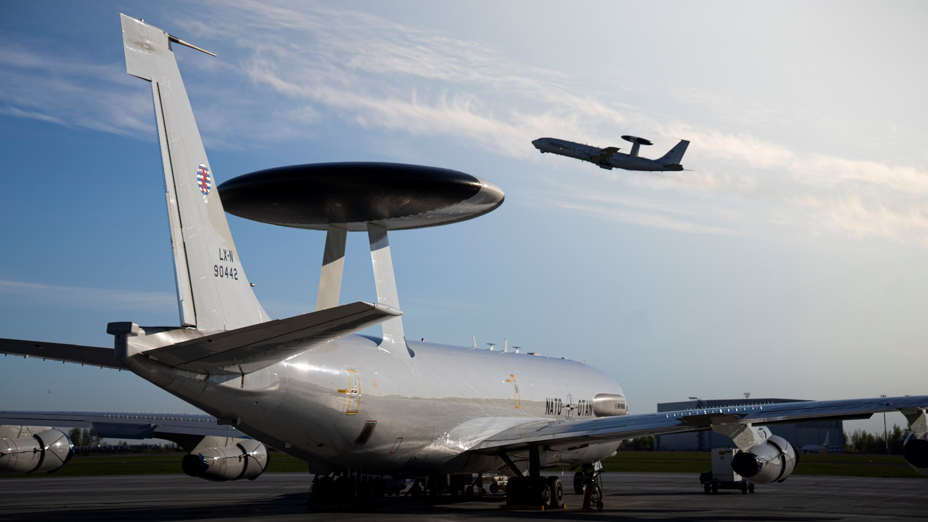

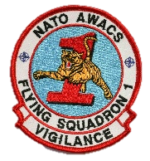

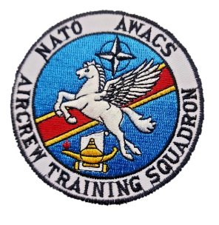









E-3A Component Footprint
NAEW&CF/E-3A Component
Geilenkirchen, DEU
Active Partner Nations:
17x Nations*
AIRCRAFT AVAILABILITY
Geilenkirchen, DEU
BEL
CZE
FLEET SIZE: 14x E-3A
DNK
DEU
GRC
HUN
ITA
LUX
NLD
NOR
POL
PRT
ROU
ESP
TUR
USA
OPS SQS AVAIL: 2x Squadrons
GBR
Contributing Nations:
FRA
CAN
LTU
FIN
1418 posts in total \ 989 military posts \ 429 NATO Civilians
DELIVER DETER & DEFEND DEVELOP
NATO UNCLASSIFIED

Slide 6




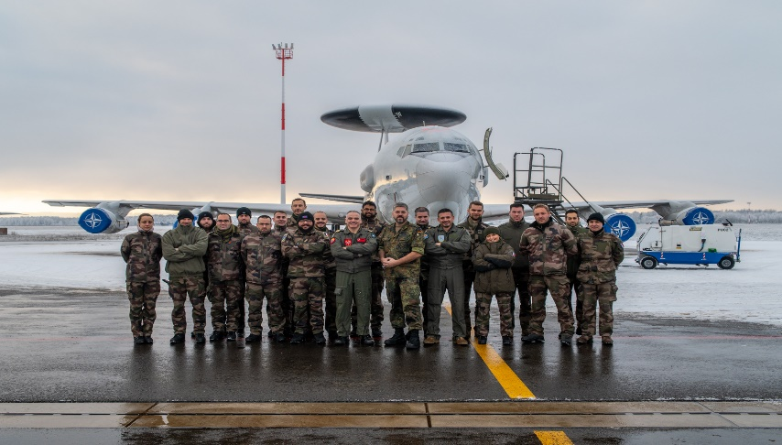

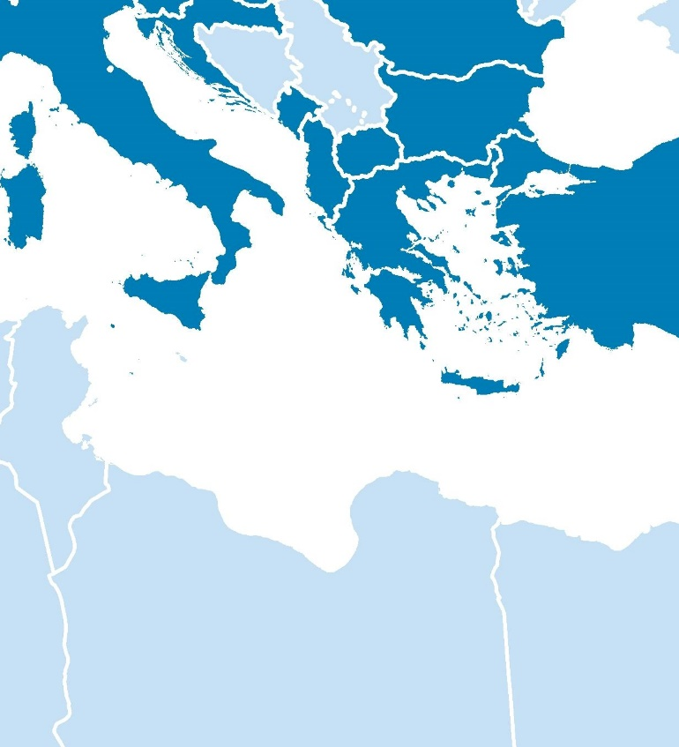
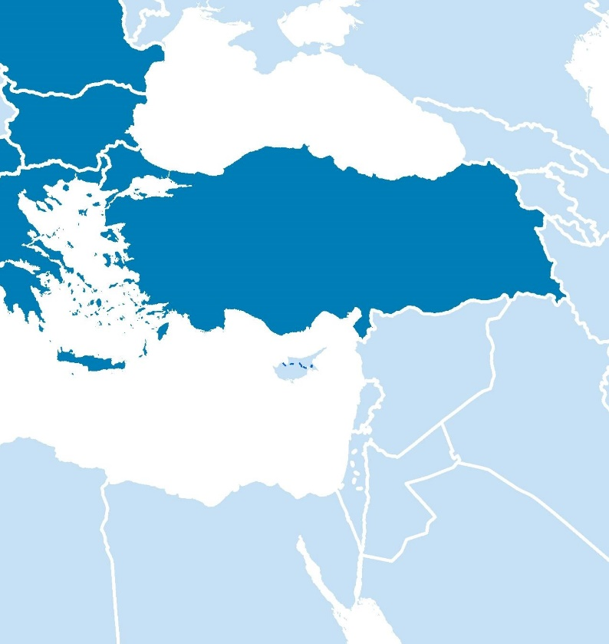
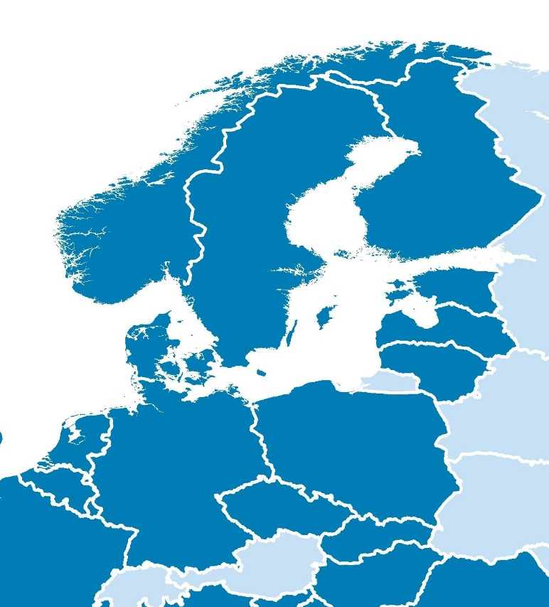
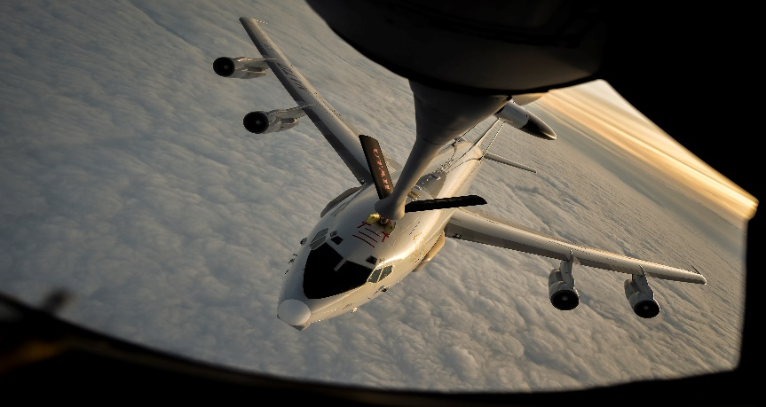
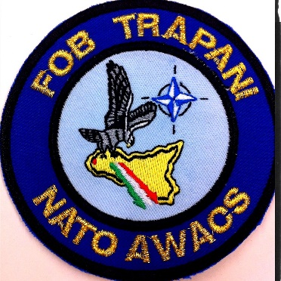
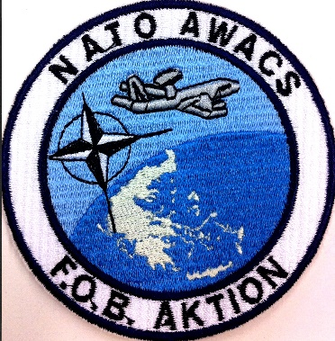
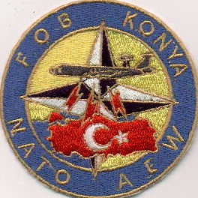
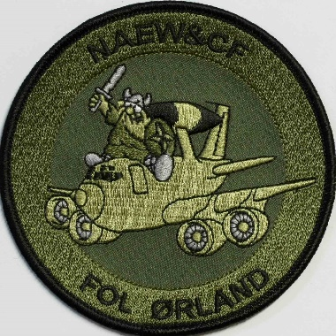
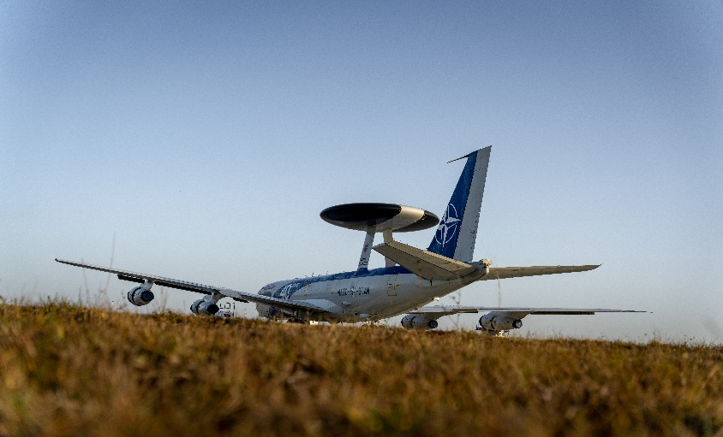
Where We Operate
Deployed Operating Bases
Trapani
Aktion
Konya
Oerland
FOL Orland
FOB Aktion
FOB Konya
FOB Trapani
Šiauliai, Lithuania
Rygge, Norway
Agile combat employment - using our 4 FOB/Ls and numerous deployed bases we enable a rapid response and a sustained airborne early warning presence. Very few large wing C2/ISR/AEW platforms have this flexibility.
Bucharest, Romania
DELIVER DETER & DEFEND DEVELOP
NATO UNCLASSIFIED

Slide 7
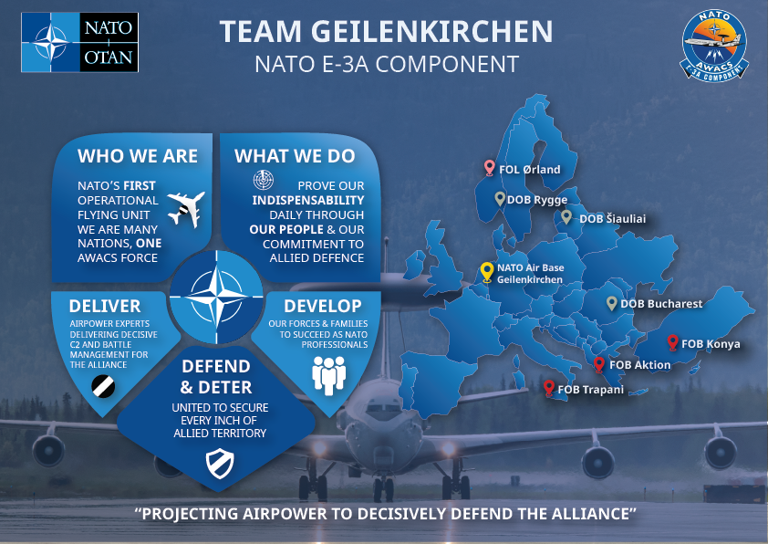
E-3A Component
DELIVER DETER & DEFEND DEVELOP
NATO UNCLASSIFIED

Slide 8
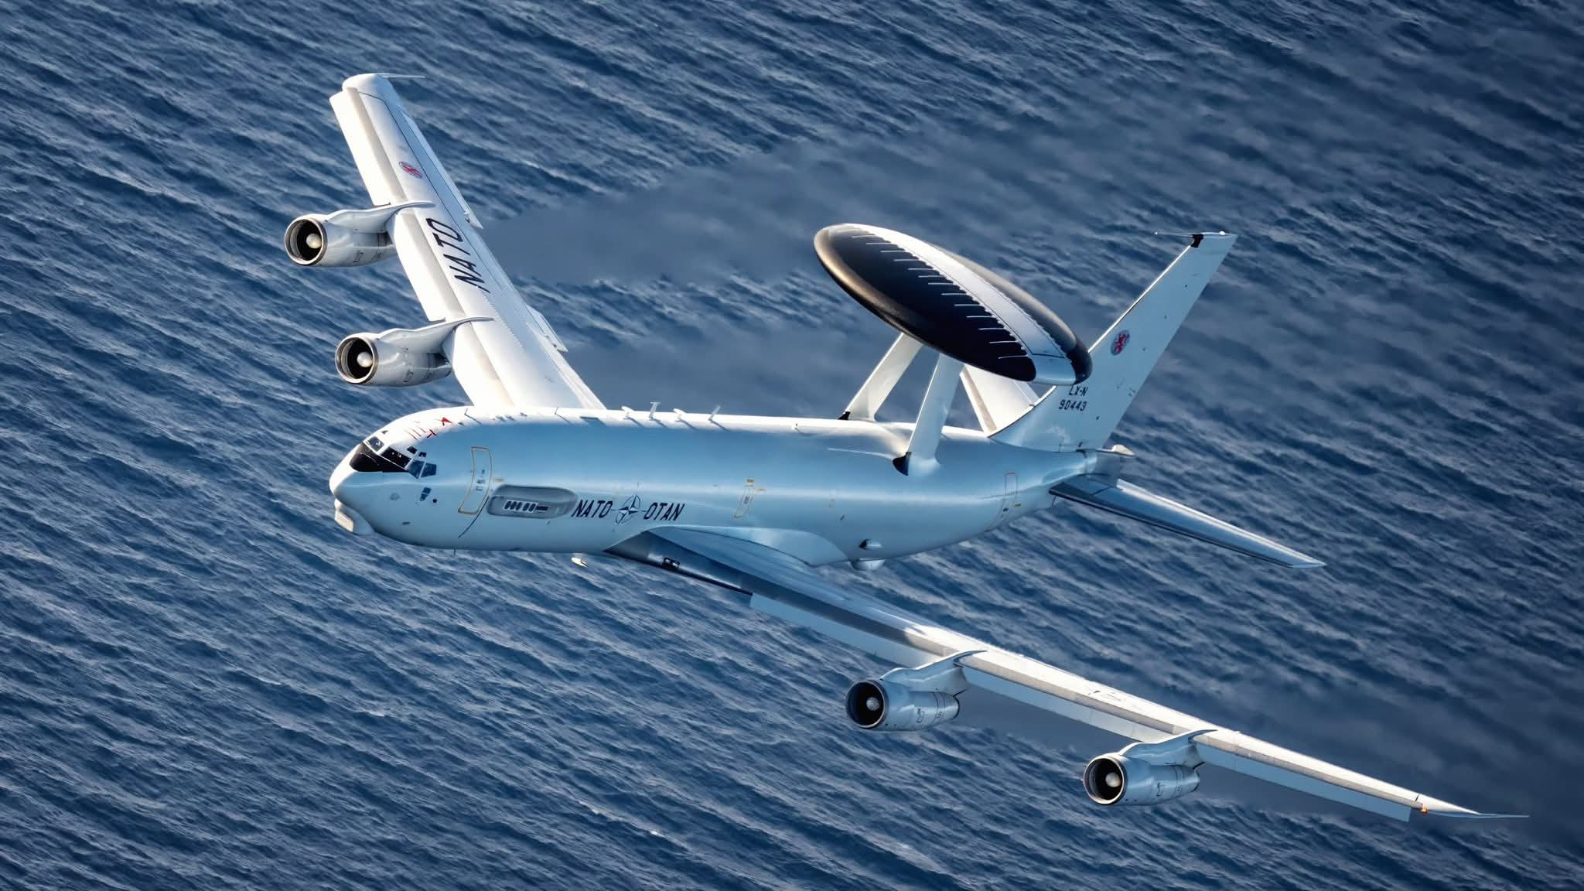
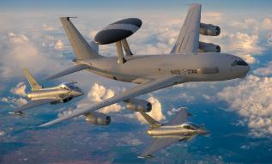
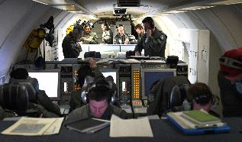
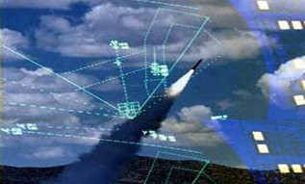
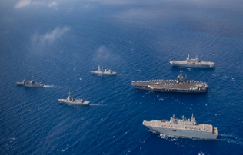
NATO E-3A Capabilities
NATO E-3A Capabilities
Command and Control
Defensive Counter Air
Offensive Counter Air
Air Mobility C2
Air Refuelling C2
Battlespace Management
  Air Surveillance
  Air Mobility C2
  Air Refuelling C2
  PR (e.g. SAR/CSAR)
  BLOS Communication Relay
Joint ISR Operations
  Air Pattern of Life
  Electronic/Surveillance OB
  ISR Cross-cue
  Integrated Air & Missile Defense
  CAS, Tac Recce, Air Drop
  Dynamic/Time Sensitive Targets
Maritime Operations
  Maritime Surface Pattern of Life
  Maritime Surface Surveillance
  Counter-Piracy/Counter-Drugs
  Maritime Counter-Terrorism
  Counter-Smuggling
  Carrier Task Group Defense
DELIVER DETER & DEFEND DEVELOP
NATO UNCLASSIFIED

Slide 9
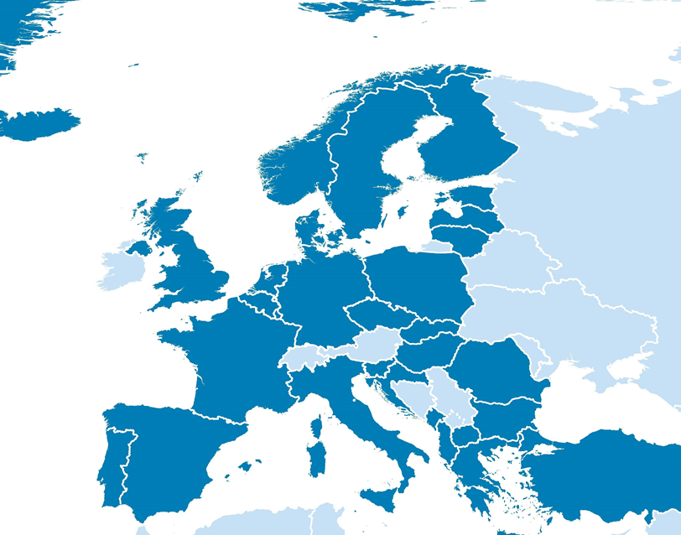


Deter & Defend: Operational Taskings
1. High North - Atlantic Shield
  From ACE location Rygge, NOR, multiple sorties ISO of an AIRCOM-tasked peacetime defense operation over the GIUKN Gap
  Demonstrated Alliance cohesion, and provided Recognized Air and Surface Picture (RASP) to MARCOM and AIRCOM units.
2. Romania - Southern Shield
  E-3A crews from FOB Aktion and MOB GK executed multiple missions in Romanian airspace in response to real-world events.
  Objectives were to monitor for airspace violations, preserve the integrity of NATO airspace, and optimize sensors for low-level drone detection
3. Poland/Romania - enhanced Vigilance Activities/Assurance Measures
4. Turkiye - Tailored Assurance Measures- Turkiye / OPS Task
  E-3A crews deployed ISO deterrence posture on NATO’s southeastern flank.
5. NATO Security Assistance & Training for Ukraine (NSATU)
6. Baltic Sentry (Baltic Sea, Kaliningrad FIR, Poland)
1
1
2
6
5
3
3
5
4
2
5
3
6
4
DELIVER DETER & DEFEND DEVELOP
NATO UNCLASSIFIED
PAGE 9

Slide 10
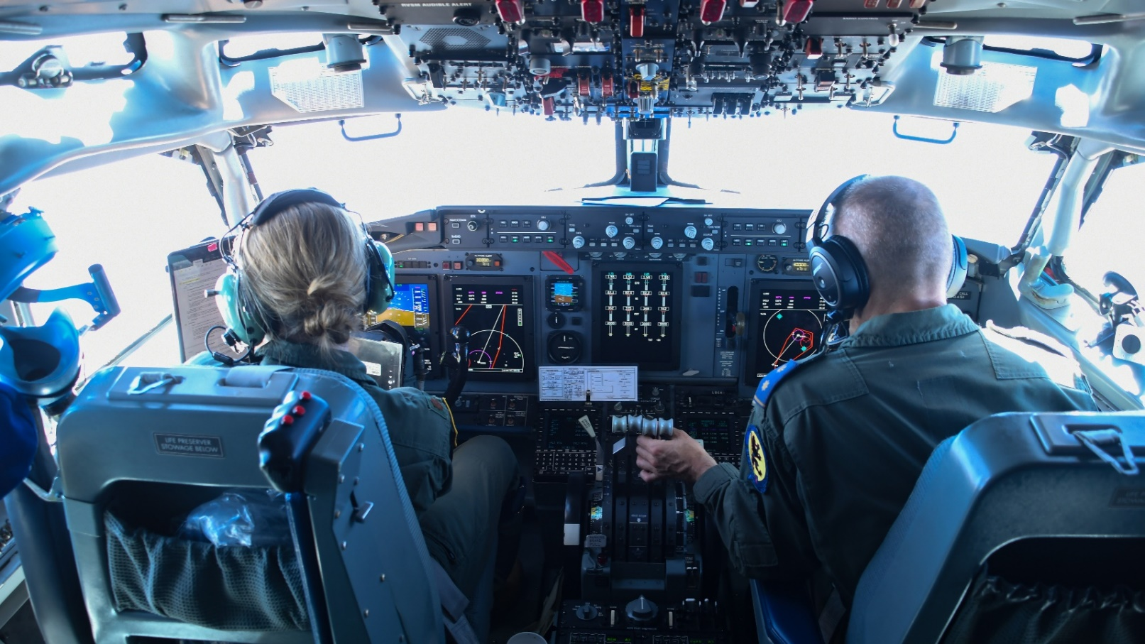
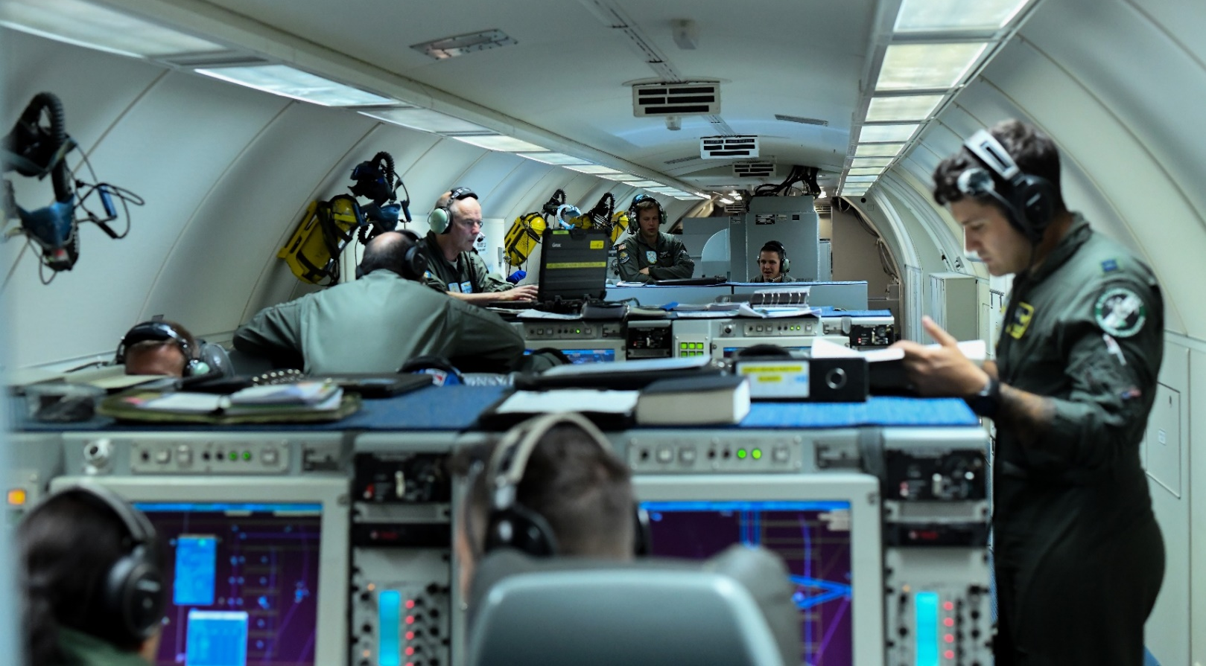
NATO E-3A Crew
Minimum of 15 Crew-members
NATO E-3A Capabilities
NATO E-3A Capabilities
NATO E-3A Crew
Flight Deck
2 Pilots, 1 Flight Engineer
Mission Crew
1 Tactical Director,
1 Fighter Allocator, 2 Weapons Controllers,
1 Surveillance Controller, 3 Surveillance Operators,
1 Passive Controller
1 Communications Technician, 1 System Technician
1 Radar Technician
DELIVER DETER & DEFEND DEVELOP
NATO UNCLASSIFIED

Slide 11
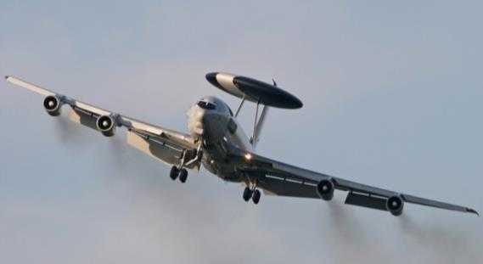
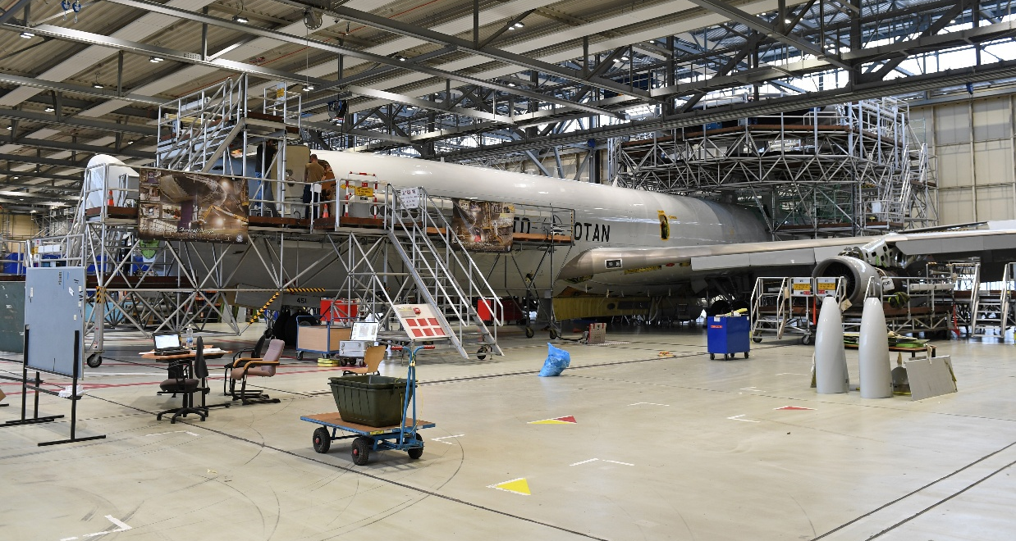
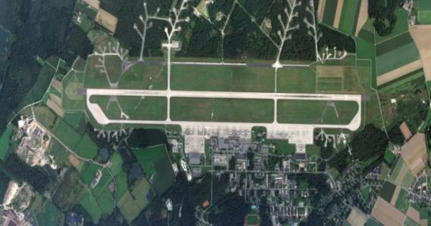
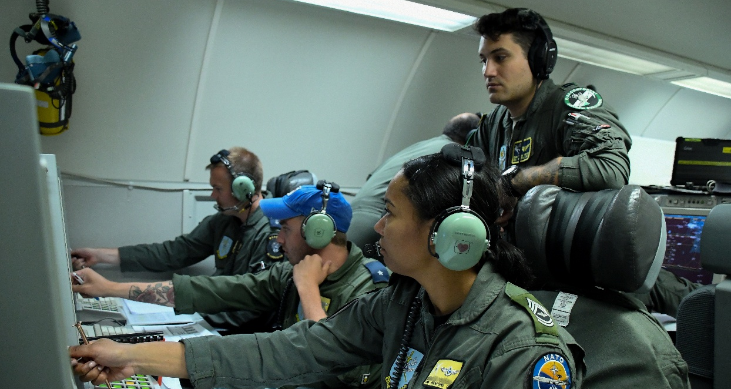
NATO’s own Air Force
NAEW&CF Contains the full spectrum of fleet management functions similar to a National Air Force
  Requirements and Development
  Program Management
  Operational Test and Evaluation
  Air Worthiness
  Logistics
  Maintenance
Provision of Air command and control platforms for NATO’s leadership
Maintenance of the entire fleet of 14 E-3As
OPERATING OF NATO AB GK AND FOB / FOL
Training of crew and maintenance personnel

Slide 12
Language requirements NAEW&CF
Every nation holds dedicated PE-posts across the organisation
Varies between commanders postings, staff officer jobs, and more operationally or logistical-oriented posts.
All have different language requirements formalised in the job descriptions
DCOM (OF-5) English – SLP 4343
Staff Officer (CIS Plans & Policy) (OF-2) English – SLP 4343
OWEC Branch head (OF-4) English – SLP 3333
Control Branch head (tactical director) (OF-4) English – SLP 3333
Pilot (OF-3 or OF-2) English – SLP 3333
Surveillance operator (OR-9) English – SLP 3332
System technician (OR-8) English – SLP 3332
Crew chief (OR-6) English – SLP 3332
Staff Assistant (Main storage (OR-5) English – SLP 3322
Int. Mil Police (OR-8) English – SLP 2222
LSRW
DELIVER DETER & DEFEND DEVELOP
NATO UNCLASSIFIED
PAGE 12

Slide 13
Language requirements NAEW&CF
Of the elements “Listening”, “Speaking”, “Reading”, and “Writing”, the latter is the one that is generally practised to a lesser extent.
For most posts, the writing part is limited to emails, chat (ops), and presentations. Only a limited amount of posts require a level 4 (Commander, staff officer, etc). e.g., for drafting orders, instructions, policy documents, or formal letters.
However, in order to meet the required level for writing, a thorough understanding of all elements of the language is required
DELIVER DETER & DEFEND DEVELOP
NATO UNCLASSIFIED
PAGE 13

Slide 14
Language requirements NAEW&CF
The ways to meet or demonstrate the required level for writing has changed over the years
Automated functions or applications can be of help:
  Specific formats are used,
  Standardised forms are used,
  Control of spelling,
  For non-classified material, translating tools or AI (Chat GPT) could be/are used.
The international environment at GK makes it possible to have the ultimate check for a document performed by a “native” speaker.
DELIVER DETER & DEFEND DEVELOP
NATO UNCLASSIFIED
PAGE 14

Slide 15
Language requirements NAEW&CF
Considering what was mentioned earlier on, are the present requirements stemming from STANAG 6001 still valid?
Yes, it is my opinion that they are still relevant, realistic and appropriate for almost every post within NAEW&CF
                However…..
DELIVER DETER & DEFEND DEVELOP
NATO UNCLASSIFIED
PAGE 15

Slide 16
Language requirements NAEW&CF
Setting standards or imposing levels in a requirement is one, but adhering to those standards or rating individuals in a similar way which should lead to the same level of (individual) performance across nations, is something different.
Fact: although strict adherence to language requirements is practised within NAEW&CF, the actual level of individual skills/performance can vary quite a bit.
DELIVER DETER & DEFEND DEVELOP
NATO UNCLASSIFIED
PAGE 16

Slide 17
Language requirements NAEW&CF
It is perceived that testing the individual skills and issuing the required certificate for meeting those requirements is not or could not be performed in a uniform way by all nations.
In other words: comparable performances may be rated differently across nations, which could be the result of different test designs, rating practices and/or organisational priorities.
Within NAEW&CF standardisation and training is practised to overcome any language level difference which could occur and to guarantee deliverance of the operational product.
DELIVER DETER & DEFEND DEVELOP
NATO UNCLASSIFIED
PAGE 17

Slide 18
Conclusions
STANAG 6001 remains a valid way for language requirements to be standardised within NAEW&CF
NAEW&CF adheres to a strict policy describing the required levels for each post
Individual writing skills vary within NAEW&CF depending on the job content (and have become less relevant because of today’s aids)
Testing individuals on the language requirements is not or could not be performed in uniform way by the nations and leads to different results
NAEW&CF practises standardisation and training to avoid language level differences and to guarantee operational output
DELIVER DETER & DEFEND DEVELOP
NATO UNCLASSIFIED
PAGE 18

Slide 19
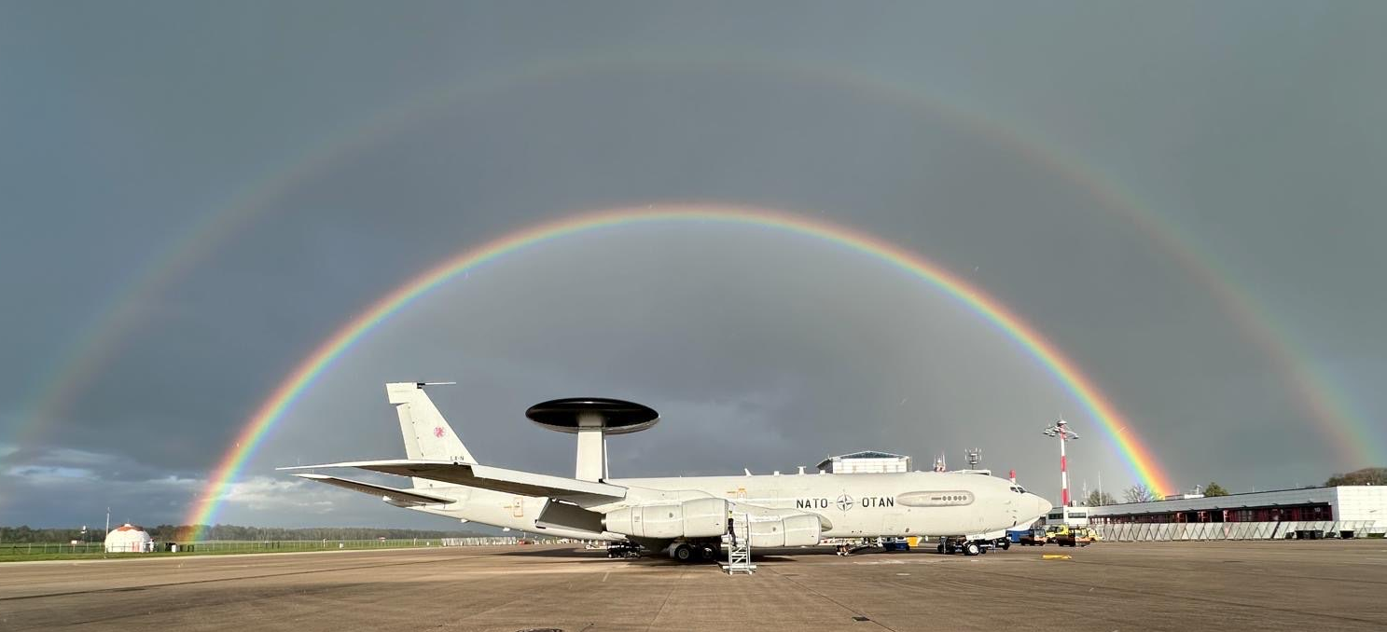
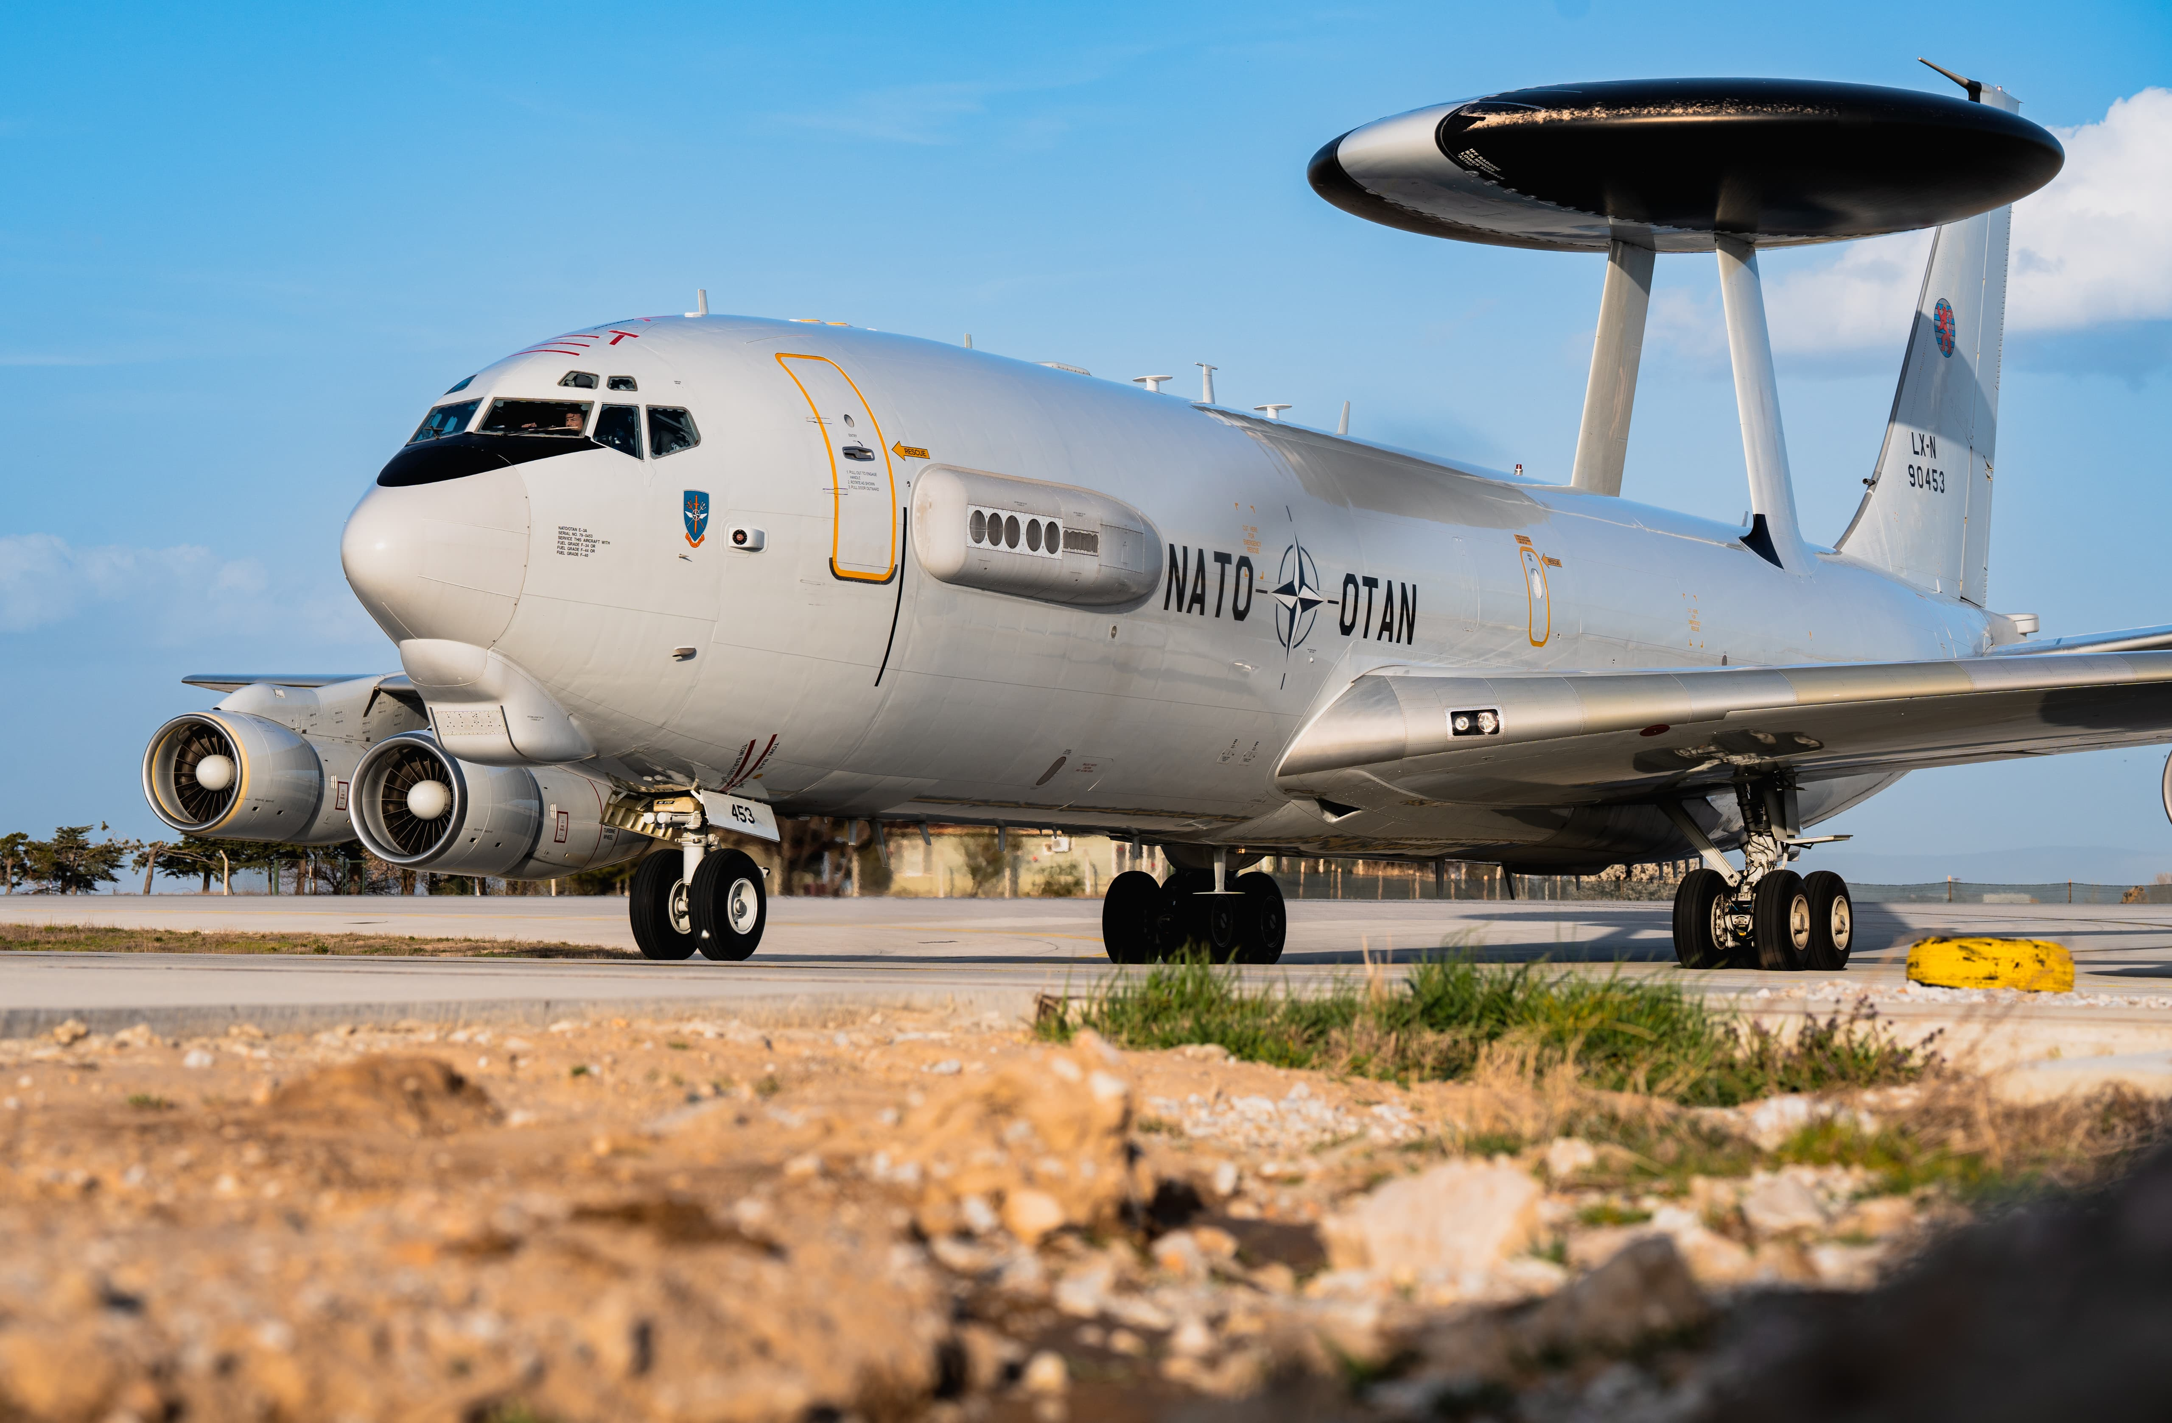
Questions?

