Slide 1


Slide 2

VEnglish for Hydrography –a avocabulary course materials a
A The intricacies of creating an A
A ESP course for studentsA
Daria Łęska-Osiak, PhD
Head of the Language Centre
Polish Naval Academy Gdynia / amw.gdynia.pl

Slide 3
aAgendaa
Polish Naval Academy – Hydrography (field of study)
ESP course – theory behind it
Creating vocabulary course materials – the story behind it

Slide 4
aChapter 1a
Polish Naval Academy – Hydrography (field of study)

Slide 5
aThe Naval Academya
anamed after thea
aHeroes of Westerplattea
aGdynia / Polanda

Slide 6
aCadets during classesa

Slide 7
aORP Arctowskia
aHydrographic Security Unit a
a3rd Ship Flotilla
aGdynia Naval Base a

Slide 8
aChapter 2a
ESP course –
theory behind it

Slide 9
aESP – English for Specific Purposes a
The teacher of language or the teacher of profession?

Slide 10
aConcerns a
General foreign language/ESP
Curriculum – what content to choose? – assistance from an SME
The process of teaching/learning ESP aimed at learners in certain professional situations
The teacher needs to choose communicative situations in which via doing particular exercises a learner will be able to utilize developed skills
Lack of tailor-made materials to be used during the classes

Slide 11
aGeneral English vs ESPa
 | General English | English for Specific Purposes
1. | aA broad goala | aNarrowly defined goala
2. | aEducation planneda afor a long timea | aEducation planned for a shortera aperiod of timea
3. | aDiversity of topicsa | aFocusing on selected situationsa aand key competencies for recipientsa
4. | aThe teacher's knowledgea aof teaching issuesa | aThe teacher’s lack of knowledge ora apartial knowledge of the teaching issuesa
5. | aIndependent work of a teachera | aSME’s assistancea
6. | aAvailability of teaching materialsa | aLack of teaching materialsa

Slide 12
aESP Course – the role of a teachera
The need of constant development – long-time learning
The „sage on the stage” – step down
Assistance of the SME
The culture of a dialogue between a teacher
and his/her learners (mutual understanding
and exchange of knowledge)

Slide 13
aChapter 3a
Creating vocabulary course materials – the story behind it

Slide 14

aThe creative processa

Slide 15
aThe creative processa

Slide 16
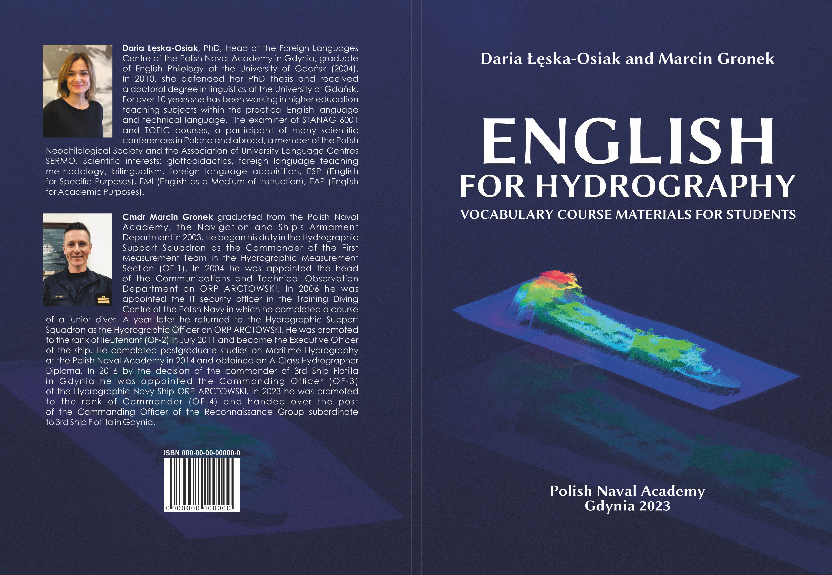
aCovera

Slide 17
aInformationa

Slide 18
aContentsa

Slide 19
aTexta

Slide 20
aExercisesa

Slide 21
aExercisesa

Slide 22
aExercisesa

Slide 23
VThank youV
Vfor your attention!V
Daria Łęska-Osiak, PhD
Head of the Language Centre
d.osiak@amw.gdynia.pl

