Slide 1

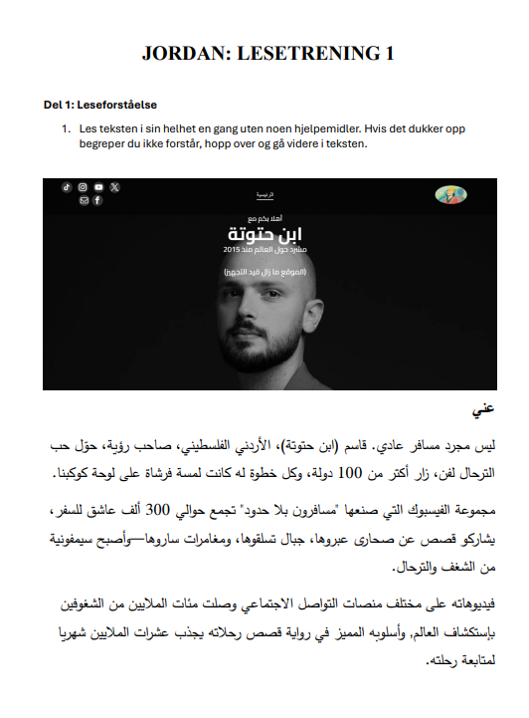
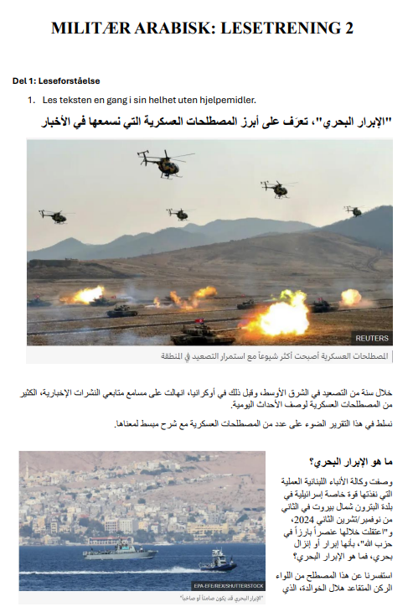
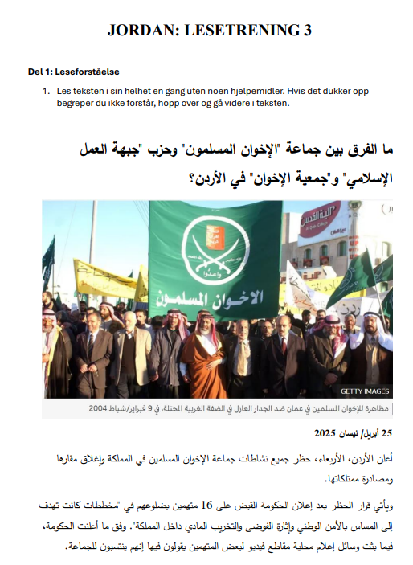
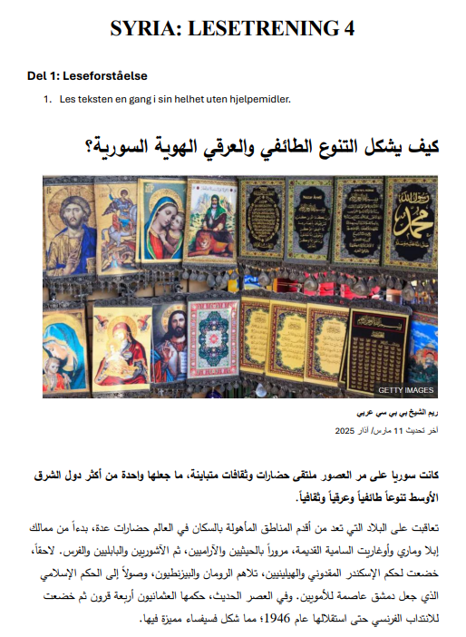

The Norwegian Defence University College
The Norwegian Defence Language and Intelligence Academy
Associate Professor Eva Marie Håland
Assistant Professor Stine Beate Dahle
Multi-Level Continuing Education Courses in Arabic
WHAT?
who?
challenge
Continuing Education Courses in Arabic language
Four courses held yearly
Two-day in person courses
All participants in one classroom
Flexible attendance options
For employees in the defence sector and other authorities
Minimum requirement: At least three semesters of Arabic at higher education level
Participants sign up for each individual course
Maximum 20 participants per course
To successfully create a multi-level one-size-fits-all language course that engages, challenges, and provides learning outcomes for all participants.
HOW?
Group exercises in plenary
4 level-based reading exercise options
4 level-based listening exercise options
Main focus on reading, listening and conveying content
Review exercise across different levels
Possibility to choose learning activities
Day 1
Speed-dating: Warm-up activity
Introduction exercises in groups
  Match pictures and texts
  Find missing words in headlines
Individual reading exercises
Day 2
Speed-dating: Practise new vocabulary
Reading exercises in groups
Individual listening exercises
Joint sum-up
Quiz
why?
developing teaching material
Meets defence sector and other authorities’ needs
A friendly environment for refreshing Arabic knowledge
Participants with different language experience can work together
Room for each individual to achieve distinct learning outcomes
Participants engage in their own learning process
All teaching material is based on authentic sources
Module-based: One main theme for each course, e.g. ‘Military Arabic’, ‘Jordan’, ‘Lebanon’, etc.
Covers current affairs, history, dialects, culture, etc.
Use of Artificial Intelligence for quick transcription of spoken material; facilitates use of new material for each course.
Participants’ feedback
Very engaging. Good adaptation to individual needs and learning ability
I really liked how you could adapt to your own level, while also participating with others
Great that it is facilitated for collaboration and that you can also self-study
I appreciated the mixture of encouraged speaking activities and reading and listening exercises
Nice to be able to do things at your own pace, as well as engaging in the group interactions
THE WAY AHEAD
More use of AI for preparing course material?
Develop a beginner's course?
Publication?
Conduct in other languages?
Contact information:
evhaland@mil.no
stindahle@mil.no

