Slide 1
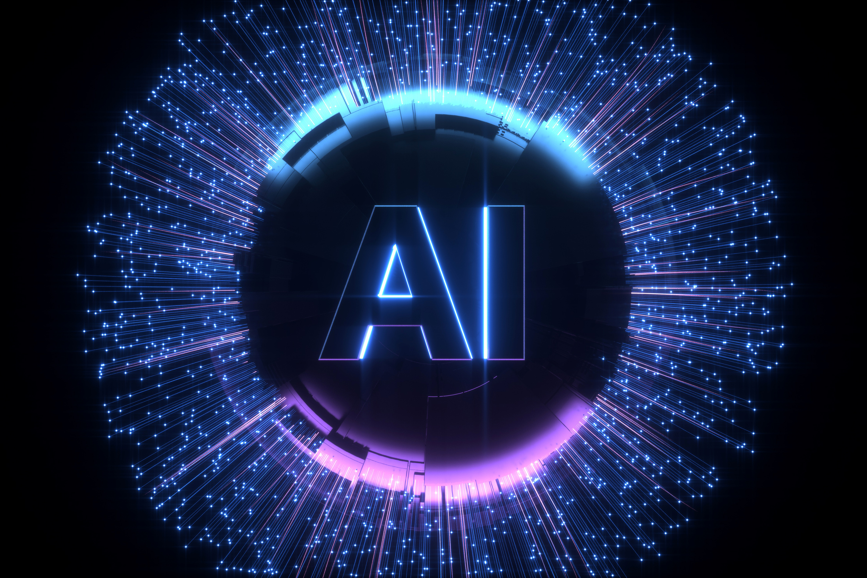




Artificial Intelligence
in Uzbekistan
Driving Digital Transformation
Colonel Umed AHMEDOV

Slide 2

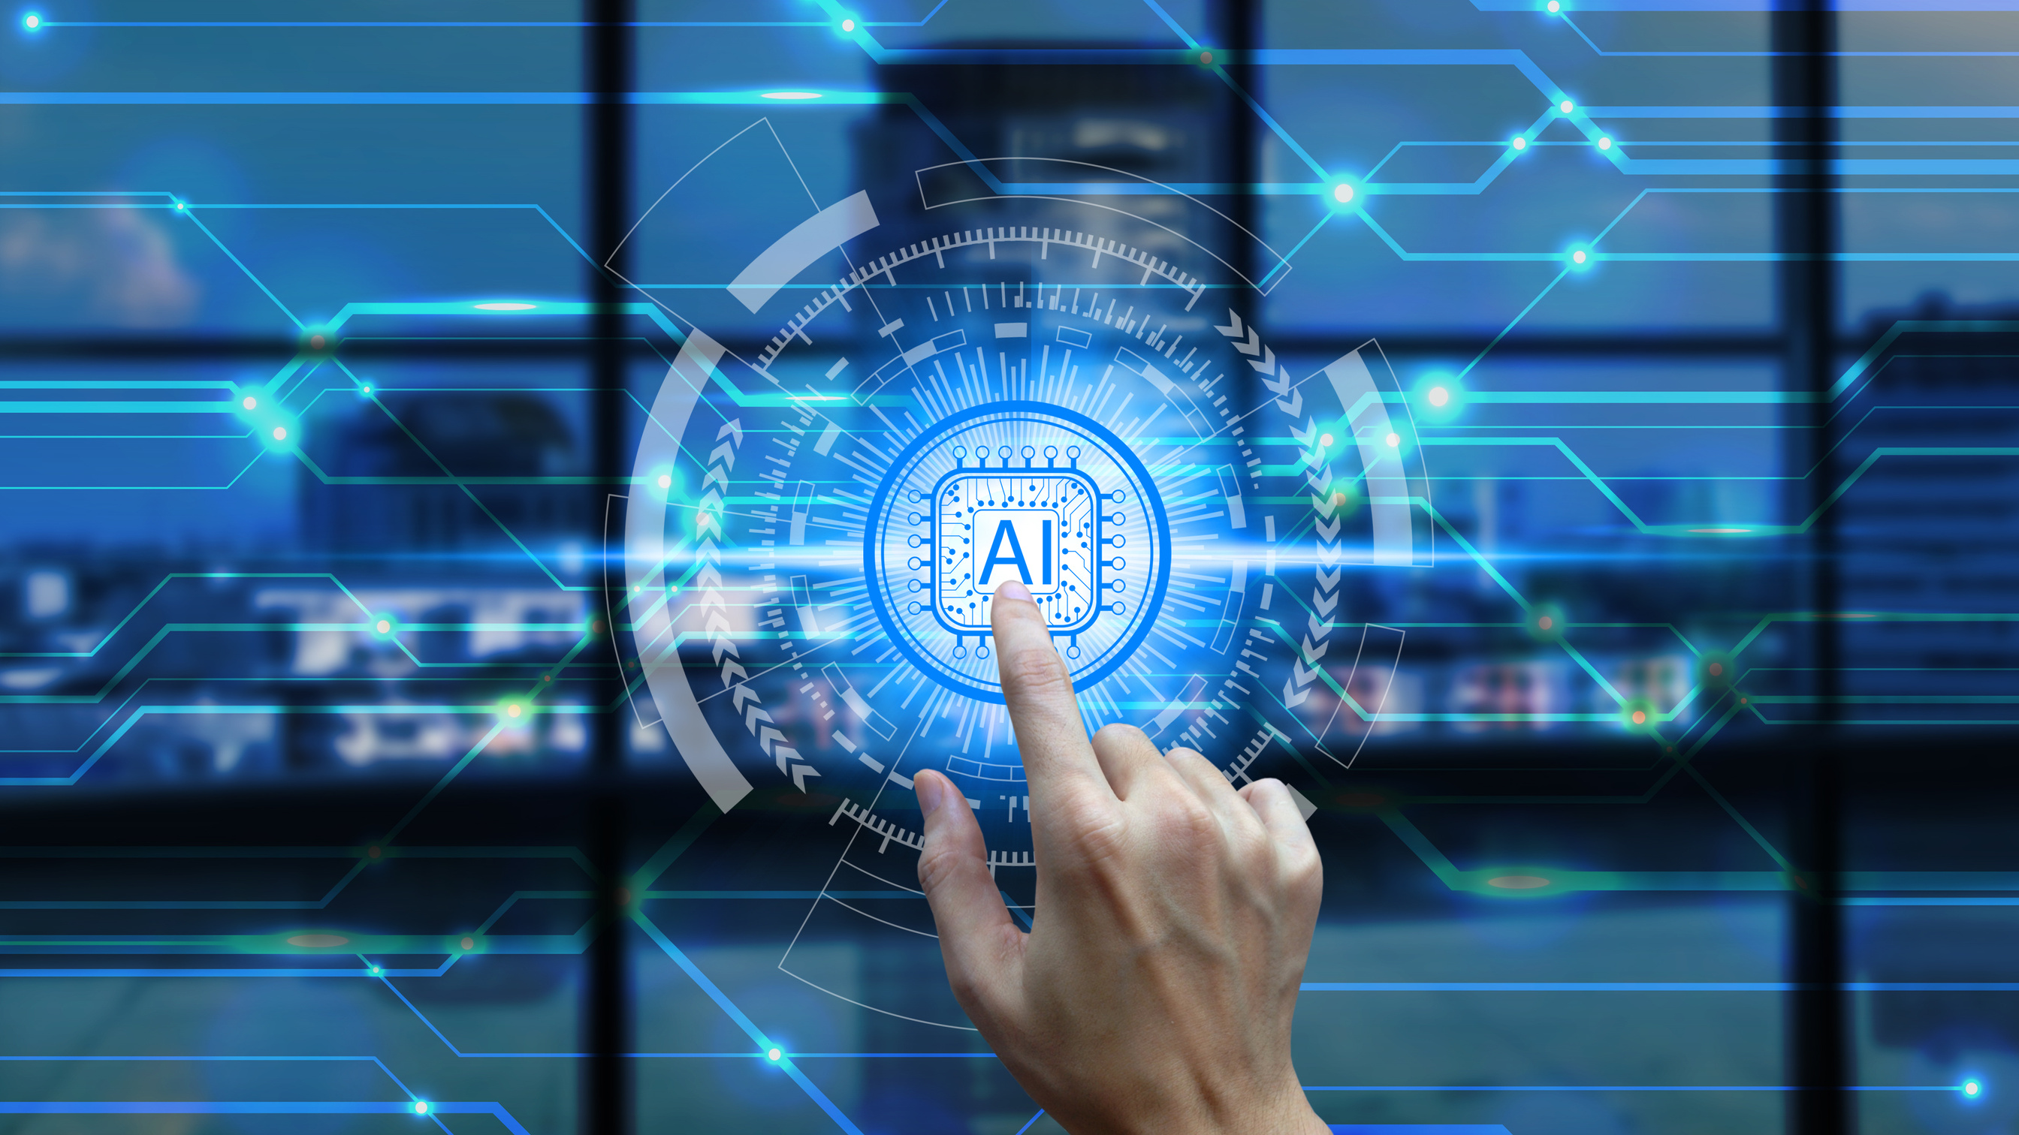

The Digital Era and Uzbekistan
COVID-19 pandemic accelerated digital transformation worldwide;
Highlighted the importance of digitalization, especially for developing nations;
Uzbekistan: integrating digital technologies into national development;
Supported by New Uzbekistan Development Strategy (2022–2026).

Slide 3
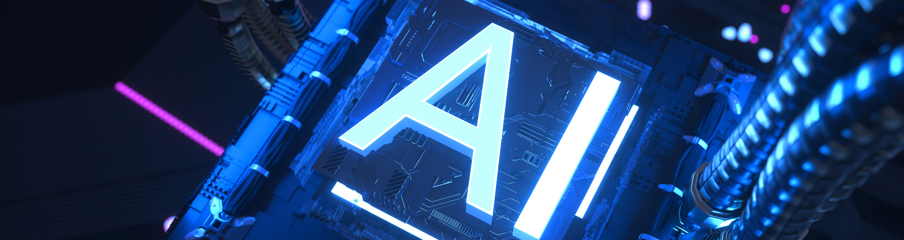


Digital Transformation Goals
Modernize society and economy;
Integrate national economy into global digital processes;
Focus on key sectors: economy, education, healthcare, and security;
Build an inclusive “information society.”

Slide 4



AI now essential across major sectors:
Public administration
Healthcare
Education
Security
Economy
Improves efficiency, resource use, and quality of services.
AI as a Key Driver of Progress

Slide 5


Uzbekistan’s Global AI Progress
Uzbekistan rose 17 positions, now 70th among 188 countries, and 1st in Central Asia.
Systemic reforms boosted international ranking.
AI Development Center established under Ministry of Digital Technologies.
AI Development Strategy 2030 adopted.

Slide 6
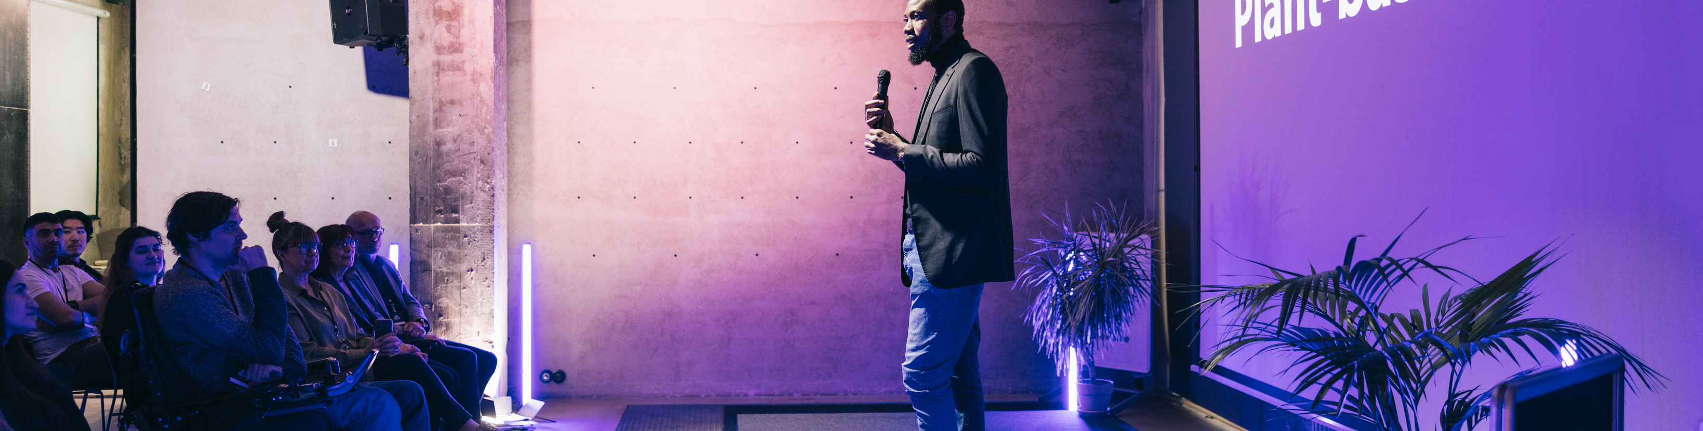
Major Investments and Infrastructure
$50 million allocated for AI-based projects in:
Healthcare, Education, Agriculture, Energy, Transport, Environment, Finance.
Supercomputer cluster being developed for national AI capacity.

Slide 7




Presidential Leadership
President Shavkat Mirziyoyev emphasizes:
October 6, 2025: Presidential presentation on AI priorities.
Studying best international practices
Cooperation with global experts and private sector.

Slide 8
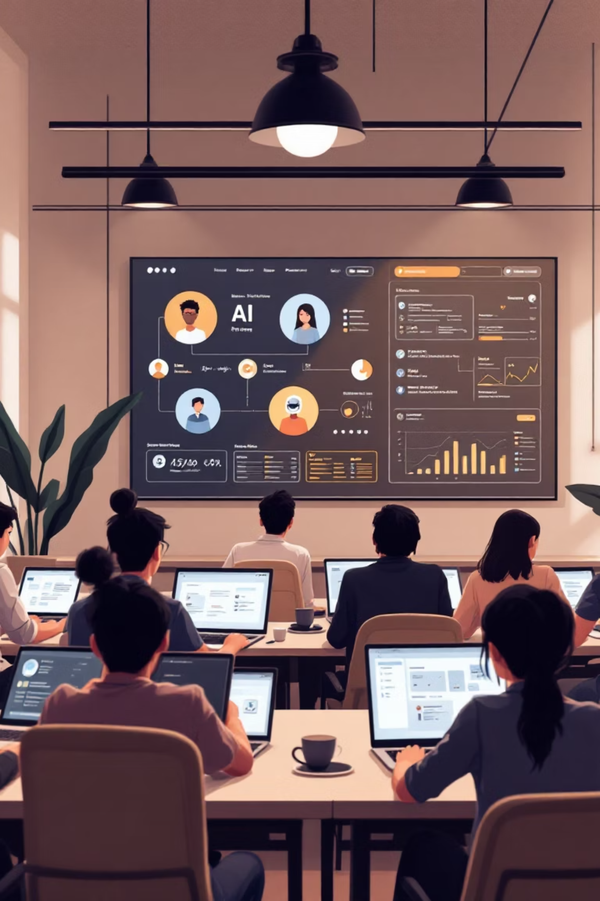



AI Education and Training
National initiative: “One Million Artificial Intelligence Leaders.”
Free online learning platforms:
aistudy.uz and omp.aistudy.uz
Goal: Train 1 million learners by 2027 in AI, programming, and data analysis.
01
02

Slide 9

Higher Education and Research
Cyber University and 12 other universities offer AI-related degrees;
University of New Uzbekistan: national hub for AI research and innovation;
Formation of AI clusters and international collaborations;
Specialized programs in AI, cybersecurity, and robotics.
02

Slide 10

Innovation and Youth Initiatives
AI Hackathons foster innovation in healthcare, education, and business;
President Tech Award: $1 million fund for youth startups;
New AI-focused competitions encouraging creativity and applied solutions.
02

Slide 11
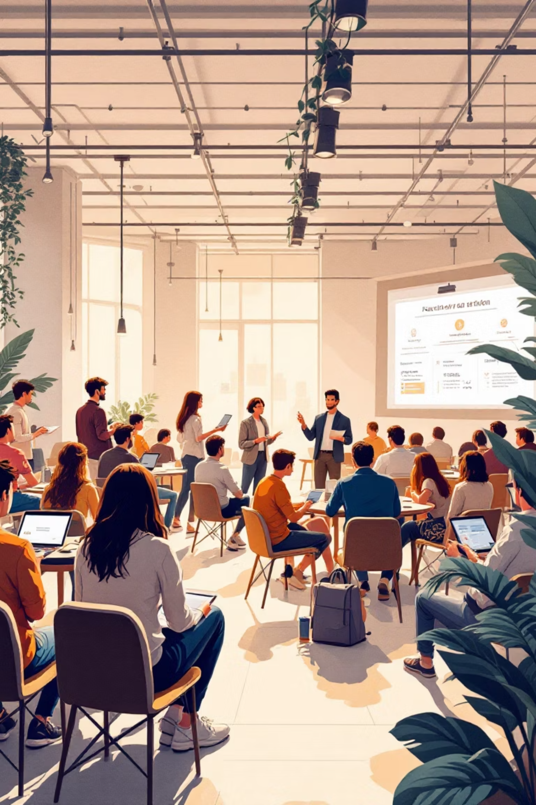
Education as the Core of Digital Future
Education recognized as strategic priority for AI integration.
Government invests in AI literacy for: Students, educators, and administrators.
Building an ecosystem for digital skills and innovation culture
02

Slide 12

Conclusion:
Vision for the Future
Uzbekistan advancing toward a knowledge-based economy;
Combining innovation, education, and ethical technology;
Continuous investment in human capital and AI infrastructure;
Clear path toward becoming a regional leader in AI and innovation.

Slide 13
Artificial Intelligence
in Uzbekistan
Driving Digital Transformation
Colonel Umed AHMEDOV

