Slide 1
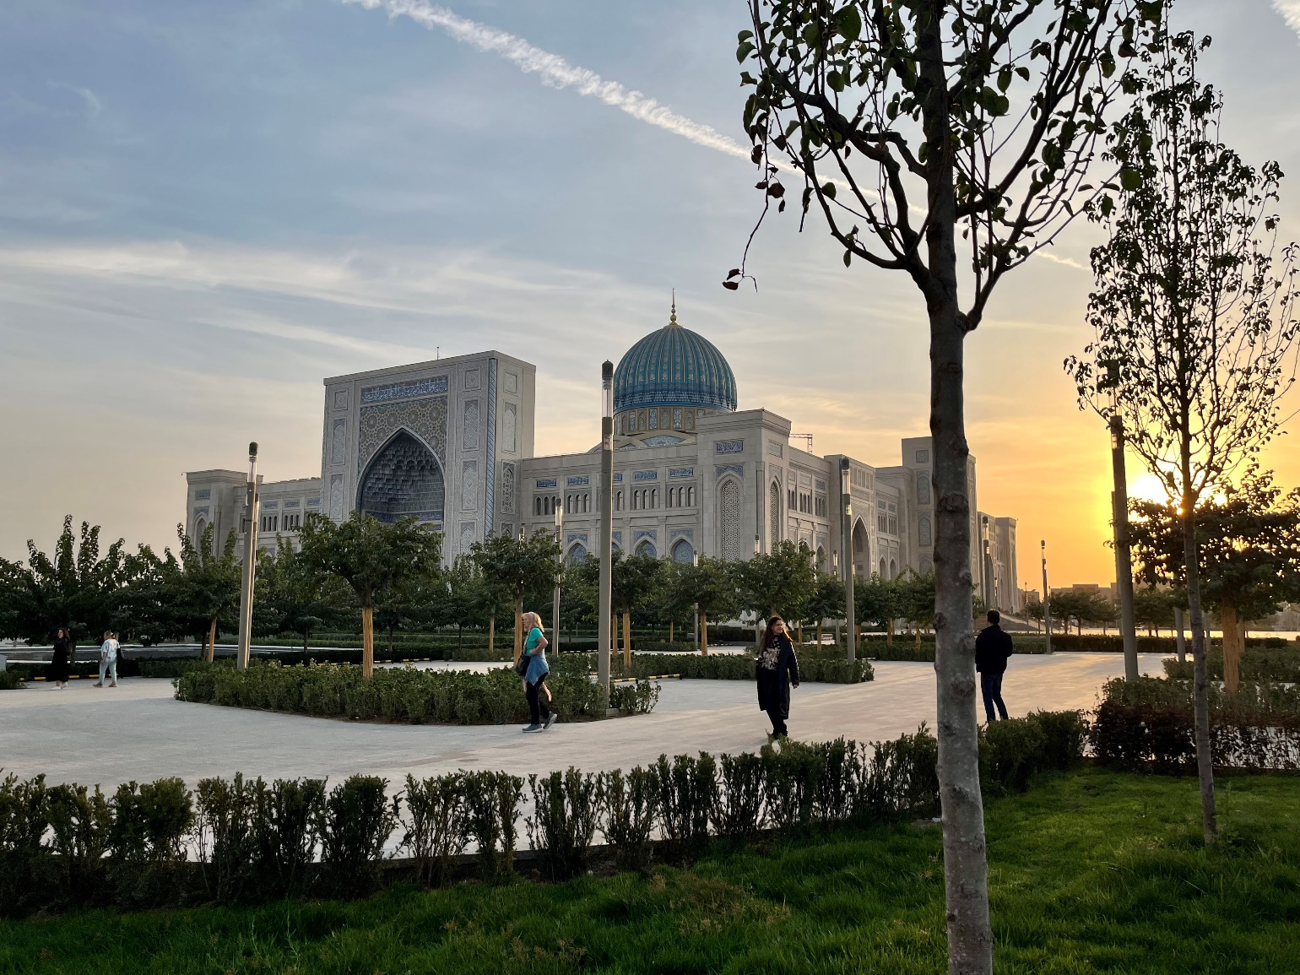
BILC Professional Seminar 2025
Reshaping Educational Methodologies to fit AI
Tashkent, Uzbekistan
Closing remarks 23 OCT 2025,
BILC Chair

Slide 2

30 nations represented
Albania
Armenia
Azerbaijan
Belgium
Bosnia and Herzegovina
Bulgaria
Canada
Croatia
Czech Republic
Denmark
Estonia
Finland
France
Georgia
Germany
Italy
Lithuania
Netherlands
Norway
Poland
Slovakia
Slovenia
Spain
Sweden
Türkiye
Ukraine
United Kingdom
USA
Uzbekistan
Qatar
56 participants

Slide 3

Key figures
Address by UZB Deputy Minister of Defence
16 30-min presentations
6 parallel workshops
6 poster presentations
9/28 contributions by Uzbeks
Please see speaker’s notes for a list of the presentations, workshops and posters
Notes:
30-min PRESENTATIONS NB. These will be available on https://natobilc.org/ from November 2025 onwards
Host nation presentation: COL Umed Ahmedov,Deputy Commandant Uzbekistan PfP
Balancing Healthy competition and Collaboration through AI in Teaching Foreign Languages to Military Personnel: Malika Soatova, Uzbekistan
AI-Powered Feedback in Writing Development: Ivana Mrozková, Czechia
Using AI-Chatbots to Simulate Military Dialogues: Debora Gioni, Albania
Towards Sustainable Language Learning: AI for Vocabulary Development and Teacher Balance: Jolanta Lesiak, Poland
Learner Aptitude, Motivation and AI’s Impact on Language Learning: Ray Clifford, USA
The AI Journey from Old School to Gamification: Jérôme Collin and Priscille Espern,FR
The “Bank-of-Words” Approach to Teaching Descriptive Writing with AI: Daniela Vucheva, Bulgaria
Barriers to AI Integration in Academic Writing Courses: Katri Sirkel, Estonia
English Teaching and Testing through Technology: A case study: Ineke Barbaix, Belgium
The Seven Roles of GPTs in Military Education: Anna Hermans, NL
Applying AI Solutions to Facilitate Grammar and Vocabulary Learning: Masuma Mamliyeva & Ilhama Khasiyeva, Azerbaijan
Beyond the Classroom: What do You Do when AI isn’t so Intelligent? Anat Shpitzer, UK
Maximizing AI for Receptive Skills in English Language Teaching: Teona Kupatadze and Ana Intskirveli, Georgia
Choosing your co-pilot: AI for grammar: Malika Kasimova, Uzbekistan
Intercultural Challenges for Norwegian Shipbuilding Abroad: Anne Linda Løhre, Norway
WORKSHOPS, reiterated 4 times
1. Alesia Locker (Denmark)
2. Malika Soatova (Uzbekistan)
3. Shokhzod Tursunboyev (Uzbekistan)
4. Jonibek Kulmirov (Uzbekistan)
5. Akram Ibragimov (Uzbekistan)
6. Madina Gofurova (Uzbekistan)
POSTERS
1. Eva Marie Håland (Norway)
2. Alesia Locker (Denmark)
3. Keith Farr (Sweden)
4. Jerome Josserand (Sweden)
5. Lucie Růžková (Czechia)
6. Sunbula Mengliyeva (Uzbekistan)

Slide 4
Shared Item Bank Project: reading and listening items
Reading Anchor Item Phase 2020-2022: 14 validated anchor items used in 18 countries with STANAG 6001
Listening Anchor Item Phase 2023-2025: full pre-testing SEP-DEC 2025
For more detail, see Suzana’s ppt natobilc.org / Zagreb Conference
suzana.horvat.ce@gmail.com

Slide 5
Shared Item Bank: future plans
Open the Working Group to new nations
Continuous development of anchor items
Improve standardization and test-score comparability
Encourage broader collaboration and sharing of best practices
Strengthen national testing expertise and resources
Feedback and data sharing for mutual benefit

Slide 6

Notes:
Thank you to the host nation for …
The perfect combination of venue and accommodation
The lovely welcome package – incl. the snazzy phone stand!!
The amazing onsite support – Marieke and Peter!!
The coffee breaks with their abandunt delicacies and fruit
The very interesting host nation presentations delivered by a high-ranking officer
A seriously accomplished and engaging key note speaker
The cultural programmes
The dinners
And not least …
YOUR TIME, EFFORT AND DEDICATION

Slide 7
Future BILC events
Military Terminology Seminar 13–17 April 2026, Warsaw, POL
Annual Conference 11–15 MAY 2026, Budapest, HUN
Testing Workshop SEP 2026, in Europe
Professional Development Seminar 19–23 OCT 2026, Sofia, BUL
Annual Conference MAY 2027, Georgia
Testing Workshop SEP 2027, Germany
Professional Seminar 2027, TBC
Notes:
Budapest fee €270

Slide 8

Annual BILC Conference 2026
11 – 15 MAY 2026
BUDAPEST, HUNGARY

