Slide 1





Choosing Your Co-Pilot:
AI for Grammar
Presenter: Malika Kasimova
State Security Service “Temurbeklar maktabi”
military-academic lyceum, Uzbekistan

Slide 2

Agenda
The role of grammar feedback in student writing development
Mastering the AI prompt for Grammar
Pedagogical rubrics to evaluate the quality of AI-generated feedback
A comparative analysis of feedback generated by three leading AI tools
Findings and limitations

Slide 3
Key Facts
Teachers work an average of 53 hours per week, with much of that time spent on grading and feedback outside contract hours.
(RAND Corporation, 2024; Education Week, 2023)
Only 16% of college students opened online feedback on their assignments.
(Edutopia, 2024)
About 76% of English language teachers worldwide have used AI tools—including ChatGPT-type systems.
(British Council, 2024)

Slide 4


The Critical Role of Grammar Feedback
The Challenge
Teachers spend hours marking grammar — time that could be spent inspiring learners.
The Possibility
AI can deliver instant, data-driven and personalized feedback.
The Partnership
AI and teachers form a new kind of teamwork — where human insight meets machine precision to create feedback that truly supports learning.

Slide 5
🎓
STUDENT PROFILE
_____________________________________
Learners: 16–17-year-olds from “Temurbeklar Maktabi” military-academic lyceum
Level: Intermediate (B1) → Upper-Intermediate (B2)
Goal: Develop General Academic English for university admission
Task Focus: Balanced Argumentative Writing — expressing two sides before giving a final opinion

Slide 6
 | ChatGPT (OpenAI) 💬 | Gemini (Google) 🌐 | Perplexity AI 📘
Purpose | Creates text, lessons, and conversations through generative AI. | Integrates with Google Search, Docs & YouTube for multimodal tasks. | Combines search + chat to deliver real-time, verified information.
Learning Focus | Role-plays, essay prompts, and dialogues. | Uses Google data and visuals for study materials. | Provides up-to-date facts, articles, and references.
Subject Use | Great for English, literature, and creative writing. | Strong in cross-subject projects combining text + data + images. | Effective for factual subjects – history, geography, science.
Main Challenge | May “hallucinate” or give inaccurate info. | Limited outside Google ecosystem. | Possible copyright or summarization issues.

Slide 7

T.R.A.P.F. — A Framework for Crafting Effective AI Prompts
Task - What do you want the AI to do? (e.g., check grammar)
Role - Who do you want the AI to be? (e.g., ESL teacher)
Audience - Who is the response for? (student, teacher, examiner)
Purpose - Why? (to give feedback, to correct, to explain) |
Format - How should it look? (table, paragraph, bullet points)
We must move beyond simple requests like "Check this for grammar" and instead utilize structured frameworks that define the AI's role and expected output.

Slide 8
Prompt Comparison (Two Prompts, Two Outputs)
 | Prompt 1: Minimal | Prompt 2: TRAPF-Based
Prompt | Check for grammar and give feedback. | Write constructive, targeted, and encouraging feedback on a B1 teenage learner's writing to effectively improve their grammar and structure. Review the following learner writing sample for key errors in grammar, (e.g. verb tense, syntax, and clarity, article usage).Demonstrate student's mistakes in the essay by using bold letters. Act as a highly experienced, supportive ESL teacher mentor who specializes in providing actionable feedback for B1 teenage learners. Provide a clear, active task (a "next step") for the learner to perform with their writing.

Slide 9
AI Feedback Example | Generic: “There are some grammar mistakes. Check tenses and articles.” | Specific & human-like: “Good ideas! Watch past tense consistency (‘was go’ → ‘went’). Try adding linkers like however to connect ideas.”
Result | Brief, surface correction | Detailed, pedagogically useful feedback

Slide 10
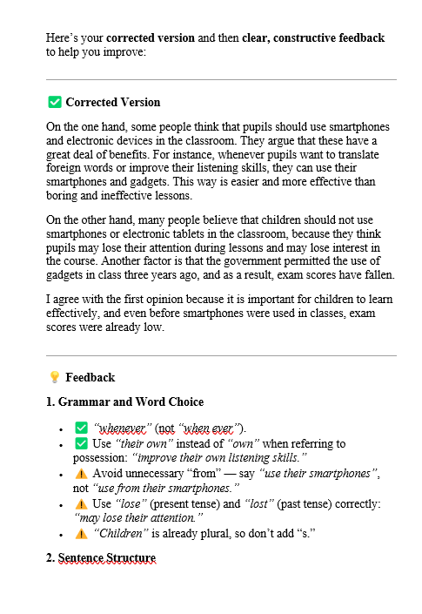
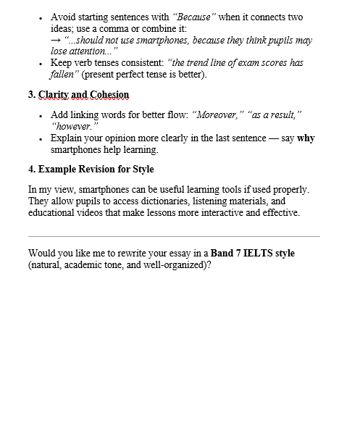

Slide 11
Research Foundations for Our Rubric Design
Researcher | Year | Key Focus | Relevance to Our Rubric
Hyland | 2004 | Contextual & pragmatic feedback | Adapting tone and focus to learner needs
Hattie & Timperley | 2007 | Formative learning & error awareness | Feedback clarity and progress support
Wu et al. | 2025 | AI feedback accuracy & engagement | Precision, scaffolding, transfer
Liu | 2024 | Metalinguistic explanations | Promoting learner self-correction

Slide 12
Rubric 1. Accuracy & Reliability — The Technical Check
Criterion | What it checks | Low | Medium | High
Error detection rate | How many real grammar errors are caught | Misses key errors; inconsistent | Detects most; some misses | Catches nearly all errors
False positive rate (precision) | How often correct grammar is flagged as wrong | Many false alarms | Occasional false alarms | Rare false alarms
Contextual and pragmatic appropriateness | Preserves original meaning and tone | Meaning altered; awkward fixes | Mostly preserved; minor issues | Meaning & tone consistently preserved
Error type coverage | Range of grammar features corrected | Narrow (mainly spelling/punctuation) | Moderate range | Broad range incl. complex syntax/discourse
Metalinguistic precision | Accuracy of grammatical terminology/explanations | Vague/misleading terms | Generally correct but uneven | Clear, accurate, level‑appropriate terms

Slide 13
Rubric 2. Pedagogical Value & Utility — The Learning Check
Criterion | What it checks | Low | Medium | High
Explanation clarity | How clearly the rule or rationale is explained | Generic/unclear; direct correction only | Some rules explained; uneven clarity | Clear, level‑appropriate explanation
Targeted focus (scaffolding) | Focus on key or recurring learner errors | Corrects everything indiscriminately | Highlights several errors without priority | Prioritizes top 2–3 recurring errors
Actionability and engagement | Prompts for reflection and self‑correction | No prompts; just fixes | Some hints; limited engagement | Specific prompts or tasks that guide revision
Transfer potential | Helps learners apply feedback to future writing | Isolated to this instance | States a rule but weak link to pattern | Connects to a general pattern; fosters reuse

Slide 14
Rubric 3. Clarity, Tone & Format
Criterion | What it checks | Low | Medium | High
Tone and encouragement | Supportiveness, politeness, and motivational value | Harsh/mechanical; discouraging | Neutral tone; minimal encouragement | Supportive, motivating, human-like
Interface / presentation quality | Readability and layout accessibility | Poorly formatted; hard to scan | Clear but basic formatting | Visually clear layout; easy to scan
Awareness of higher-order effects | How style and grammar affect flow and coherence | Unnatural or verbose phrasing | Focus only on grammar | Suggests stylistic improvements; improves flow

Slide 15
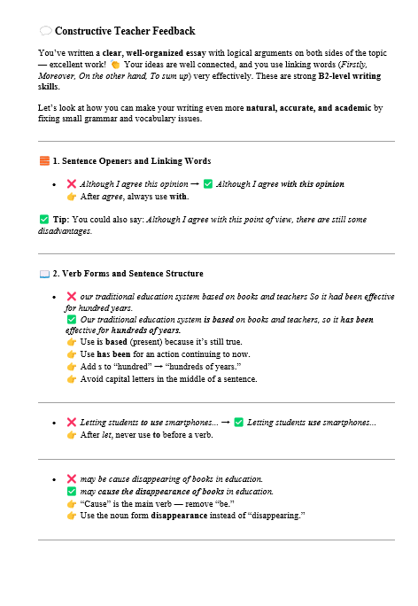
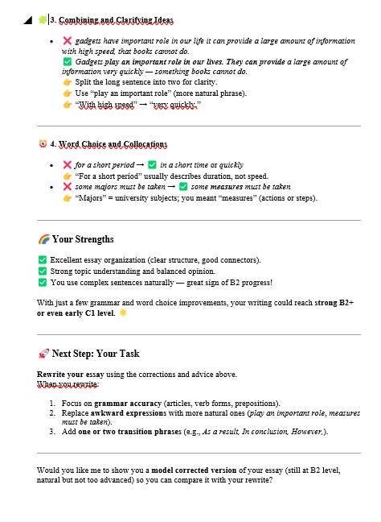

Slide 16
Chat GPT
 | Key Strengths | However...,
Accuracy & Reliability | • Detects almost all grammatical errors accurately • Maintains meaning and tone • Uses precise metalinguistic terms | • Some explanations are brief or lack elaboration: E.g., a great deal of benefits - many benefits
Pedagogical Value & Utility | • Clear and level-appropriate explanations • Focuses on main recurring errors • Promotes reflection and rewriting • Encourages transfer of grammar rules | • Sometimes overgeneralizes rule patterns: E.g., avoid “Because” at sentence start; “use present simple after if” without conditional context; “use –ly for all adverbs”
Clarity, Tone & Format | • Supportive, motivating, human-like tone • Visually organized and easy to follow • Improves coherence and flow

Slide 17
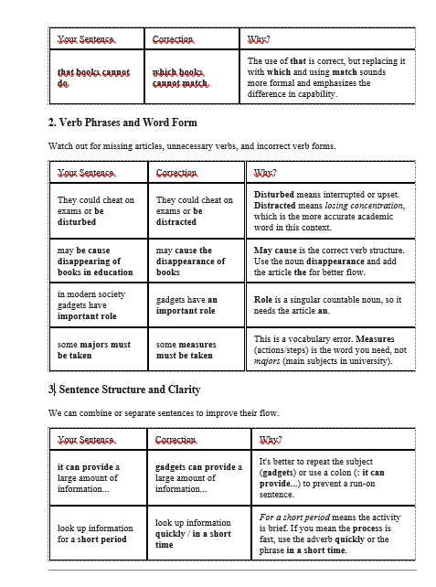
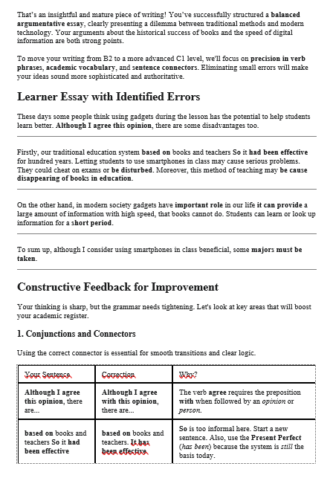
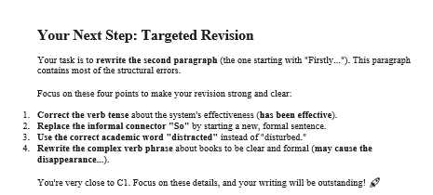

Slide 18
 | Key Strengths | However...,
Accuracy & Reliability | • Comprehensive detection with detailed examples and tables • Consistently preserves meaning and tone •Very precise metalinguistic explanations | • May rely heavily on structured templates;
Pedagogical Value & Utility | • Clear “rule–correction–why” explanation pattern • Prioritizes recurring grammar areas (tense, pronouns, articles) • Strong scaffolding with task-based engagement • Promotes generalization and pattern awareness | • Slightly formulaic phrasing; tone is more academic than conversational
Clarity, Tone & Format | • Polite, professional, and coherent tone • Organized and visually structured layout • Highlights stylistic clarity and coherence | • Less emotionally engaging; might be visually text-heavy for learners

Slide 19
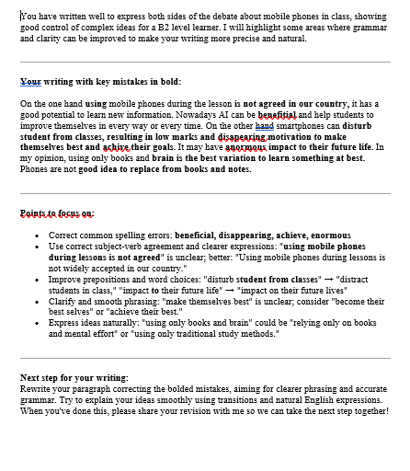

Slide 20
Perplexity AI
 | Key Strengths | However...,
Accuracy & Reliability | • Reliable factual accuracy • Detects common surface-level grammar issues • Produces few false corrections | • Misses complex or context-dependent errors: No fix for “when ever” → “whenever” • Limited metalinguistic explanation“Use the correct articles,” “Watch verb forms,”
Pedagogical Value & Utility | • Concise, fact-oriented feedback • Identifies several grammar points in one text | • Lacks prioritization or scaffolding presents a wide set (articles, connectors, syntax, phrasing) with equal weight • Minimal learner engagement or reflection • Helps correct this text, but not future writing.
Clarity, Tone & Format | • Friendly, clear, and neutral tone • Functional linear layout with verified references | • Feedback lacks personalization or motivation

Slide 21
How AI Feedback Differs for B1 and B2 Learners
Dimension | B1 Learners (Intermediate) | B2 Learners (Upper-Intermediate)
Focus Shift | Builds grammatical accuracy | Develops fluency, style, and academic tone
Nature of Correction | Repairs clear errors | Refines phrasing and cohesion
Depth of Explanation | Rule-based and simple | Metalinguistic and stylistic
Tone and Style | Supportive, instructional | Concise, professional, assumes independence
Task Design | Guided and scaffolded | Encourages self-editing and stylistic choice
Pedagogical Focus | “Fix what is broken” | “Polish what is awkward”

Slide 22

Conclusion
AI feedback quality is directly proportional to prompt quality.
Context from chat history is key to personalization.
AI successfully shifts from Structural Repair (B1 errors) to Stylistic Refinement (B2 errors).
ChatGPT is the leader in motivation, tone, and visual engagement. Gemini is the leader in technical precision and metalinguistic analysis.
Perplexity, on the other hand, remained concise and factual — might be effective for quick grammar checks

Slide 23
Limitations
The analysis was limited to a small number of student essays.
The study focused exclusively on argumentative essays. AI performance might vary significantly when analyzing different genres, such as narrative writing, formal reports, or emails. AI models evolve constantly.
These findings reflect the tools as of today and may quickly change with new updates.

Slide 24
References
Hattie, J., & Timperley, H. (2007). The Power of Feedback. Review of Educational Research, 77(1), 81-112.
Hyland, K. (2004). Genre and Second Language Writing. University of Michigan Press.
Wu, J., Li, J., Ge, Z., Xu, M., Lin, L., & Zhang, R. (2025). Effectiveness of Generative AI in Automated Written Corrective Feedback With Prompting. Journal of Educational Computing Research.
Liu, S. (2024). Effects of metalinguistic corrective feedback on novice EFL writers. British Journal of Educational Technology.

Slide 25
Thank you for your attention!
malika.kasimova89@gmail.com

