Slide 1
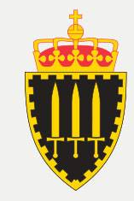
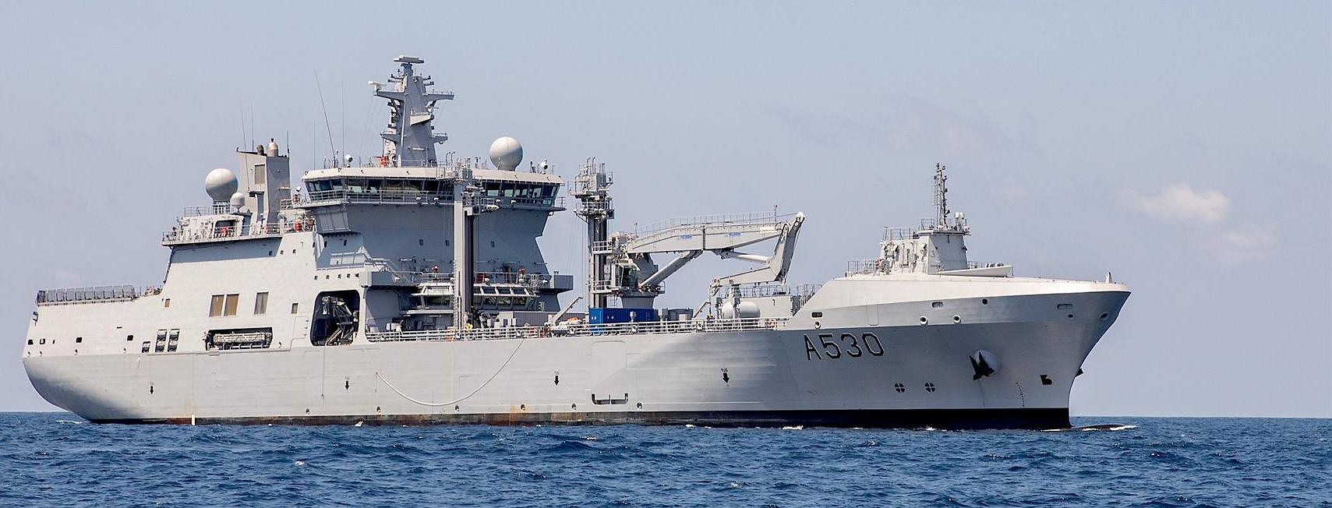
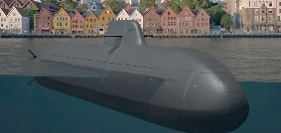

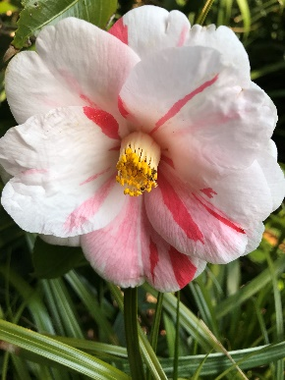
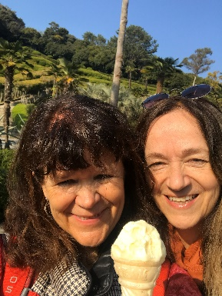
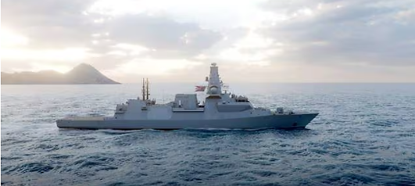

International, intercultural research during large naval procurement projects
Associate professor Anne Linda Løhre, The Royal Norwegian Naval Academy
Delivery 2029
HNoMS Maud. Operational since 2019
Intercultural Challenges in a German-Norwegian
Submarine Building Project
Kristin Rygg (NHH) & Anne Linda Løhre (The Royal Norwegian Naval Academy)
Anne Linda Løhre and Kristin Rygg
Delivery 2030

Slide 2

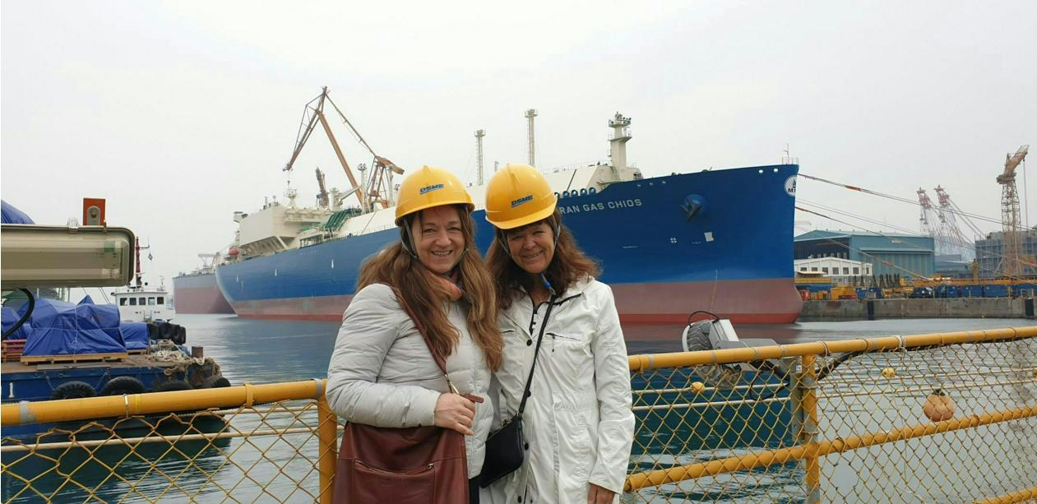
The construction of the auxiliary vessel
HNoMS Maud in South Korea
"A World Championship in misunderstandings”

Slide 3

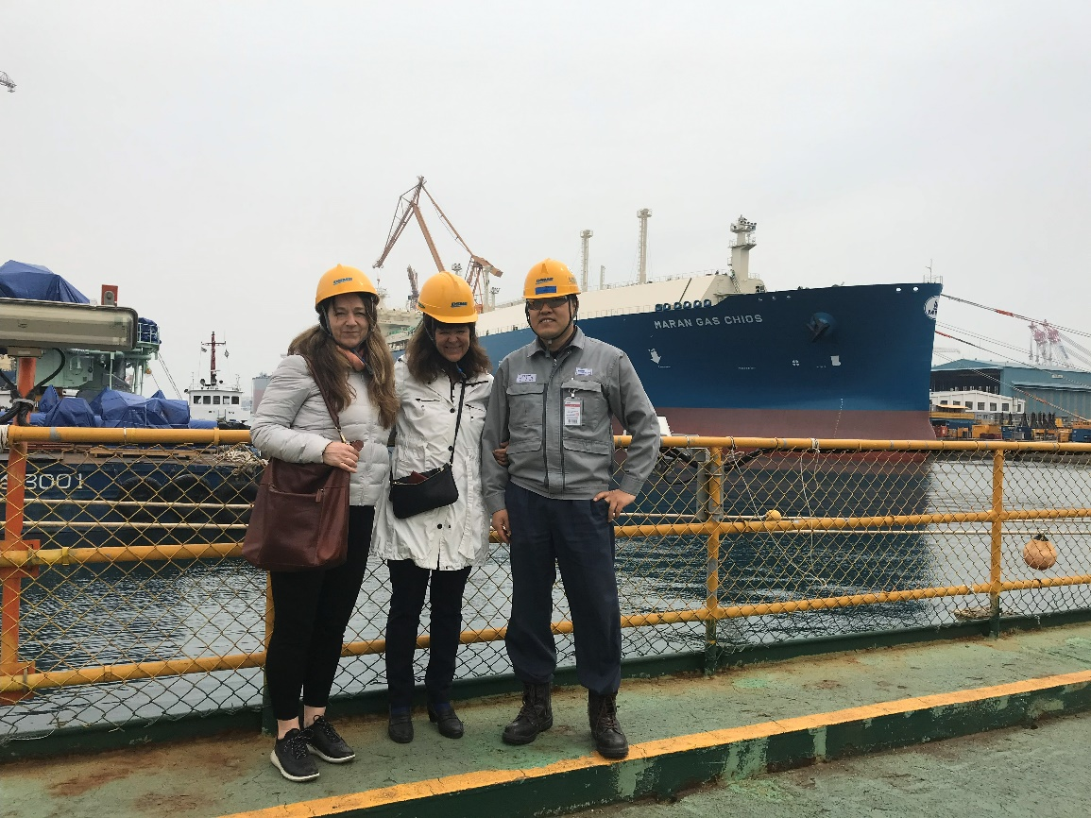
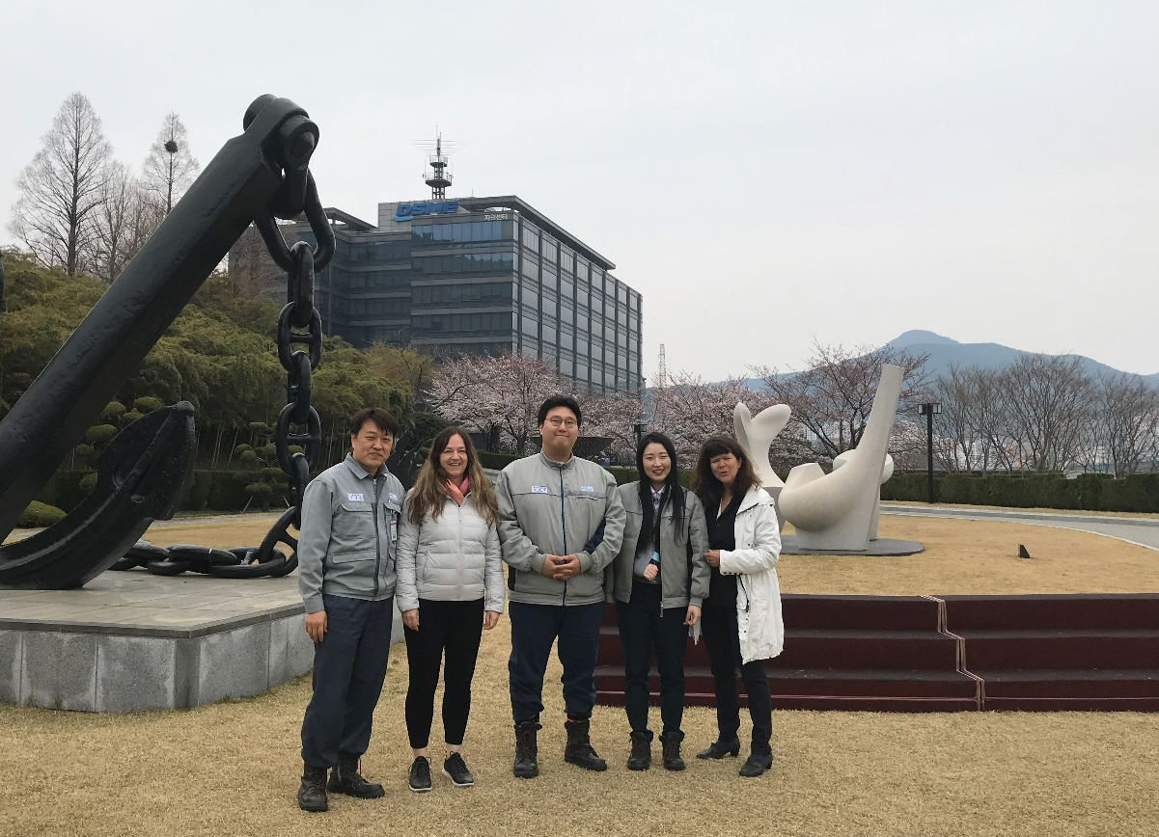
The construction of the auxiliary vessel

Slide 4
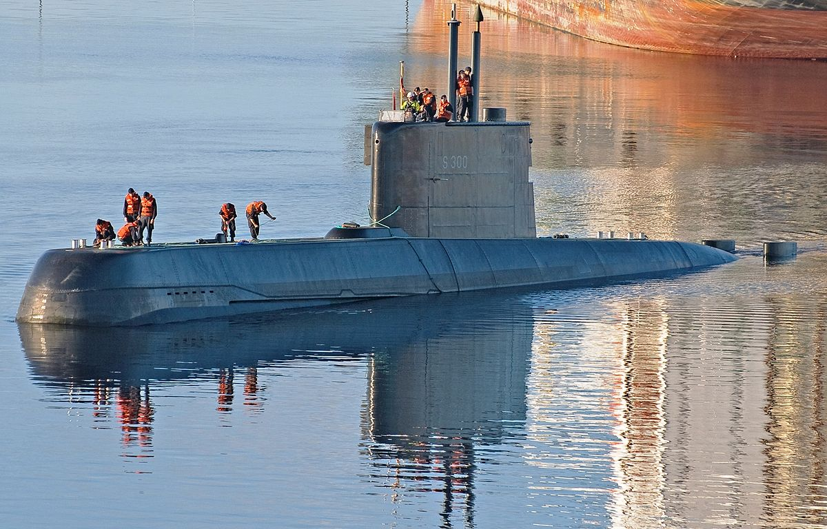

The construction of identical submarines
Norway-Germany
Ula class in service since 1989
2029

Slide 5



The procurement of new frigates
Norway-Great Britain

Slide 6
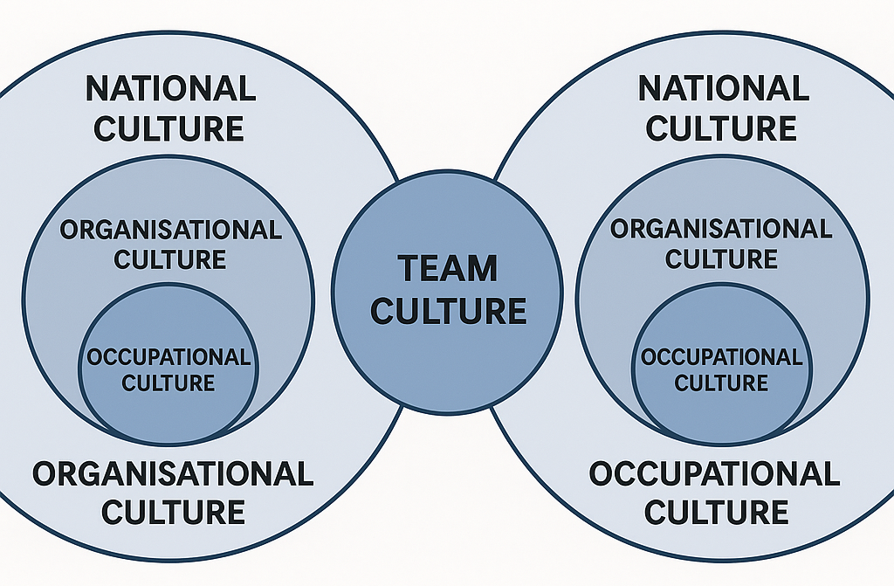
Notes:
However, It is possible that there are other layers of culture at stake

