Slide 1
Learner Aptitude, Learner Motivation and AI’s Impact on Language Learning
Ray Clifford
NATO BILC Professional Development Seminar
Tashkent, Uzbekistan
21 October 2025

Slide 2
Disclaimers
The opinions expressed in this presentation are my own and not the official position of any organization with which I am affiliated.

Slide 3
Disclaimers
The opinions expressed in this presentation are my own and not the official position of any organization with which I am affiliated.
My opinions might be influenced by the fact that I am older than the internet.

Slide 4
Language teachers and learners face an enormous challenge!
Language is the most complex of all human behaviors.
Learning is the most complex of human endeavors.
Language learning is complexity squared.

Slide 5
The Complexity of Language
Language is more than
  Morphology.
  Syntax.
  Pronunciation.
  Orthography.
  Lexicon.
Language is an inherently ambiguous communication system that draws on all of the above features and on shared cultural contexts and societal values.
5

Slide 6
Even “simple” language like headlines isn’t simple.
What level of English proficiency is needed to understand and enjoy the humor in the following headlines?

Slide 7
Headline
Dictator not dead, but in grave condition

Slide 8
Headline
DRUNK GETS NINE MONTHS IN
VIOLIN CASE

Slide 9
Headline
Young Soldiers Make Tasty Holiday Treats

Slide 10
Headline
IRAQI HEAD SEEKS ARMS

Slide 11
The Complexity of Learning
John B. Carroll, in Teachers College Record, 64, pp 723-733 (1963) was one of the first to model what the learning process entails.
Of particular importance for language learning is his “Model of School Learning”.

Slide 12
For language learning, Carroll’s model has four main factors:
The difficulty of the learning task (or the “new” features in the target language that differ from those in the learner’s first language).
The learner’s motivation.
The learner’s aptitude for language learning.
The quality of the instruction provided.
The question to be answered is: What impact will Gen AI have on these 4 factors?

Slide 13
Factor 1: Difficulty of the Learning Task
AI won’t have an impact on Factor 1 because it can’t:
  Change the characteristics of either the learners’ dominant language or of the target language.
  Alter the “distance” between those languages.
AI will likely have an impact on the other factors:
  The Learners’ motivation.
  The learners’ aptitude.
  The quality of the instruction provided.

Slide 14
Factor 2: Learner Motivation
The best operational definition of learner motivation is:
  The amount of time and effort the learner is willing to devote to the learning process.

Slide 15
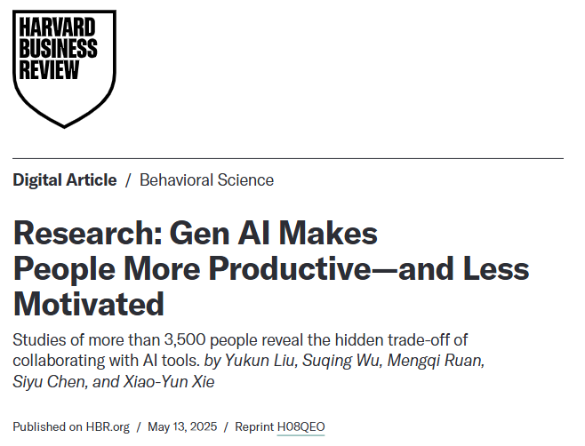
A recent study researched AI’s impact on motivation.

Slide 16
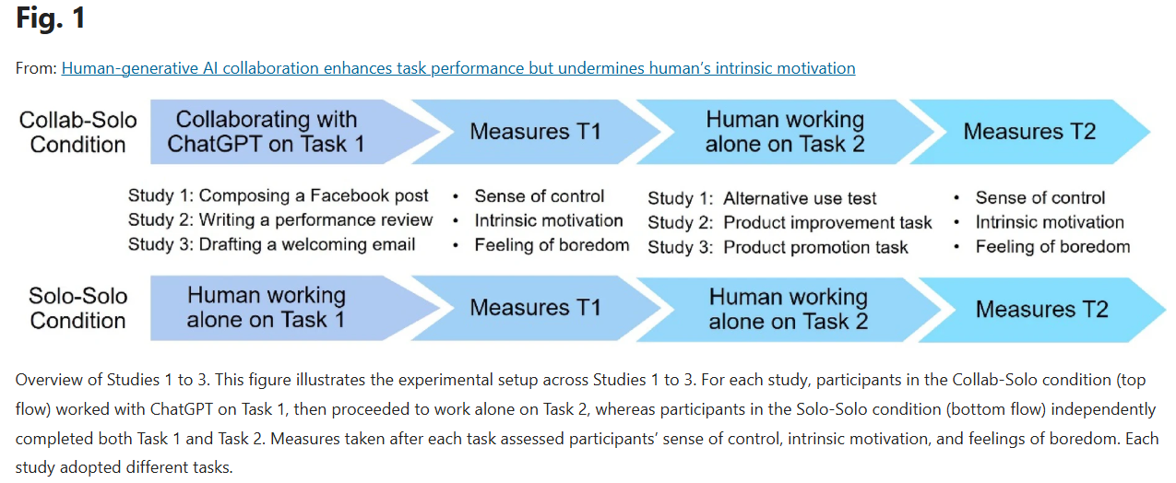
Included 4 Short, two-task studies

Slide 17
Did using AI affect motivation?
Tracked more than 3,500 workers performing common work tasks.
After “collaborating” with ChatGPT on a single task, they found that using AI:
  Boosted workers “performance accuracy.”
  Increased worker “boredom” by 20%.
  Decreased worker “intrinsic motivation” by 11%.

Slide 18
Factor 3: Learner Aptitude
The best operational definition of learner aptitude is:
  The amount of time and effort the learner will need to learn the language to a designated level of mastery.

Slide 19
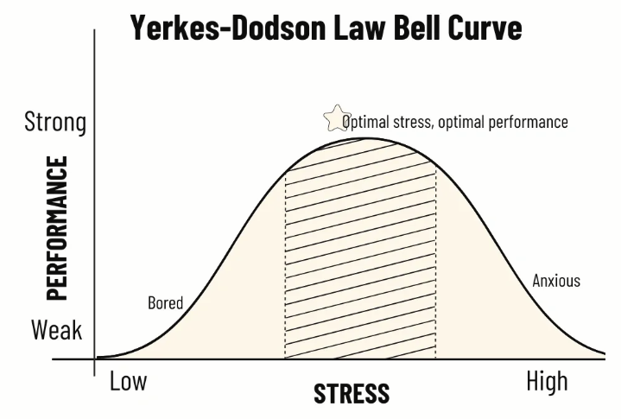
Learning requires focus and effort over an extended period of time!

Slide 20
AI’s Apparent Impact on focus, effort, and learning
“Your Brain on ChatGPT: Accumulation of Cognitive Debt when Using an AI Assistant for Essay Writing Task”
Nataliya Kosmyna, et al
MIT Media Lab, Cambridge, MA
10 June 2025, 206 pages
https://arxiv.org/pdf/2506.08872

Slide 21
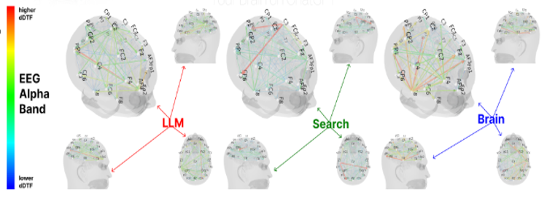
Electroencephalogram (EEG)
Dynamic Direct Transfer Function (dDTF)
Notice the number of high dDTF connection lines under each condition.

Slide 22
EEG revealed significant differences in brain connectivity between the groups.
The research subjects were randomly assigned to one of three groups:
  “Brain-only participants” exhibited the strongest, most distributed networks;
  “Search Engine users” showed moderate engagement;
  “LLM users” displayed the weakest connectivity.
Over the four-month long experiement, LLM users consistently underperformed at neural, linguistic, and behavioral levels.

Slide 23

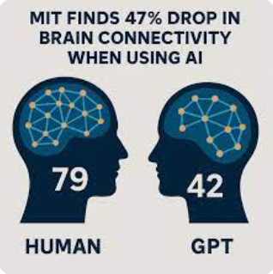
AI reduced brain activity.

Slide 24
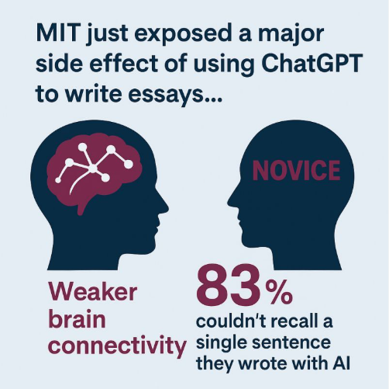
As a result of weaker brain activity, AI influenced learning.

Slide 25
Factor 4: Quality of Instruction
A comprehensive definition of instructional quality that is based on more than a decade of research is found in the book:
Peak: Secrets from the New Science of Expertise, by Anders Ericsson and Robert Pool. Houghton Mifflin Harcourt, New York. 2016, 307 pp.

Slide 26
Peak: Developing a high level of ability/expertise requires purposeful practice, which in turn requires:
  A field where there is accumulated knowledge and objective criteria for superior performance.
  A teacher/coach who provides practice activities designed to help the learner improve her/his performance.
  Near maximal effort on the part of the learner, which is generally not enjoyable.

Slide 27
Peak: Developing a high level of ability/expertise requires purposeful practice, which in turn requires:
  A field where there is accumulated knowledge and objective criteria for superior performance.
  A teacher/coach who provides practice activities designed to help the learner improve her/his performance.
  Near maximal effort on the part of the learner, which is generally not enjoyable.

Slide 28
Peak: Developing a high level of ability/expertise requires purposeful practice, which in turn requires:
  Building or modifying previously acquired skills by focusing on particular aspects of those skills to lead step by step to expert performance.
  Providing correct fundamental skills in order to minimize the need to relearn those skills later.
  Bringing the learner to the point where s/he can monitor her/his own performance.

Slide 29
As highlighted above, developing expert skills requires feedback.
Second language learning requires feedback that is:
  Immediate.
  Accurate.
  Explicit. (Sufficiently informative to enable improved performance.)
  Tailored for each individual learner.
  Structured to incrementally improve performance.
  Motivating.
The following diagram shows why students’ language production and feedback from a teacher or coach are essential components of the language learning process.

Slide 30
The Language Acquisition Process
Yellow background = Teacher
White background = Learner

Slide 31

Note: If the language input received is above the learner’s ability, it will not be correctly perceived and is of no benefit to the learner!

Slide 32
It is mainly through the learner’s output that teachers can determine the accuracy of the learner’s uptake of the language input.

Slide 33
It is mainly through the learner’s output that teachers can determine the accuracy of the learner’s uptake of the language input.
Therefore, effective language learning requires expert teachers to provide feedback that is IMMEDIATE, ACCURATE, EXPLICITE, TAILORED, STRUCTURED, and MOTIVATING.

Slide 34
If the learner bypasses the intake process by using AI to produce the target language output, the learner bypasses essential learning processes – so the output has no diagnostic value.
And learners likely won’t be able to extract a beneficial diagnosis from output responses that beyond their ability level.

Slide 35
3 Conclusions…
As with other technical innovations, AI won’t replace teachers – but teachers who use AI will replace teachers who don’t.
Teachers must understand new technologies so they can use them effectively.
With AI, teachers must:
  Make assignments that prevent learners from circumventing the process of focused, deliberate, effortful learning.
  Not just be “in the loop” -- they must be “in the lead” when designing AI learning activities.

Slide 36
…and a Final Observation
Most technologies hyped as learning shortcuts have proven to be detours – and some have ended up being dead ends.
-=-=-=-=-=-=-=-=-=-=-=-=-=-=-=-=-
Thank you!

