Slide 1
Beyond the Classroom: Pseudo-Immersion Strategies When Real-World Immersion Isn’t Possible
Anat Shpitzer
Defence Centre for Languages & Culture
Defence Academy, UK
Notes:
Exploring how pseudo-immersion can replicate the depth of real-world exposure when physical immersion is not possible.

Slide 2
Introduction & Rationale
Immersion = gold standard for language acquisition
Practical constraints limit access
Pseudo-immersion creates authentic exposure within constraints
Notes:
Immersion accelerates acquisition, but travel, security, and cost limit access. Pseudo-immersion replicates real exposure using design and technology.

Slide 3
What Is Pseudo-Immersion?
Definition: simulated authentic environments
Engages learners cognitively, socially, and emotionally
Examples: VR, role-play, authentic media use
Notes:
Pseudo-immersion replicates immersion-like conditions through active engagement and contextual authenticity.

Slide 4
Theoretical Underpinnings
1985
Krashen (1985) – comprehensible input
1985
Swain (1985) – output hypothesis
1996
Long (1996) – interaction hypothesis
2009
Dörnyei (2009) – motivational engagement
Notes:
Foundational theories emphasise input, output, interaction, and motivation—core components of effective pseudo-immersion.

Slide 5
Design Principles of Pseudo-Immersion
Authentic input sources
Scenario-based communication tasks
Cognitive realism and decision-making
Continuous feedback loops
Notes:
Designing pseudo-immersion involves authentic materials, interactive decision tasks, and strong feedback systems.

Slide 6
Technology as an Immersive Catalyst
Virtual simulations for mission or cultural contexts
AI conversational partners and adaptive tutors
Gamified platforms sustaining engagement
Notes:
Technology bridges gaps between isolation and realism—VR and AI tools sustain engagement and authentic interaction.

Slide 7
Case Study: Defence Context
2-week pseudo-immersion module
Structured lessons, role plays, evening activities, cultural input
Notes:
Defence training with pseudo-immersion improved spontaneous communication, confidence, and cultural responsiveness.

Slide 9

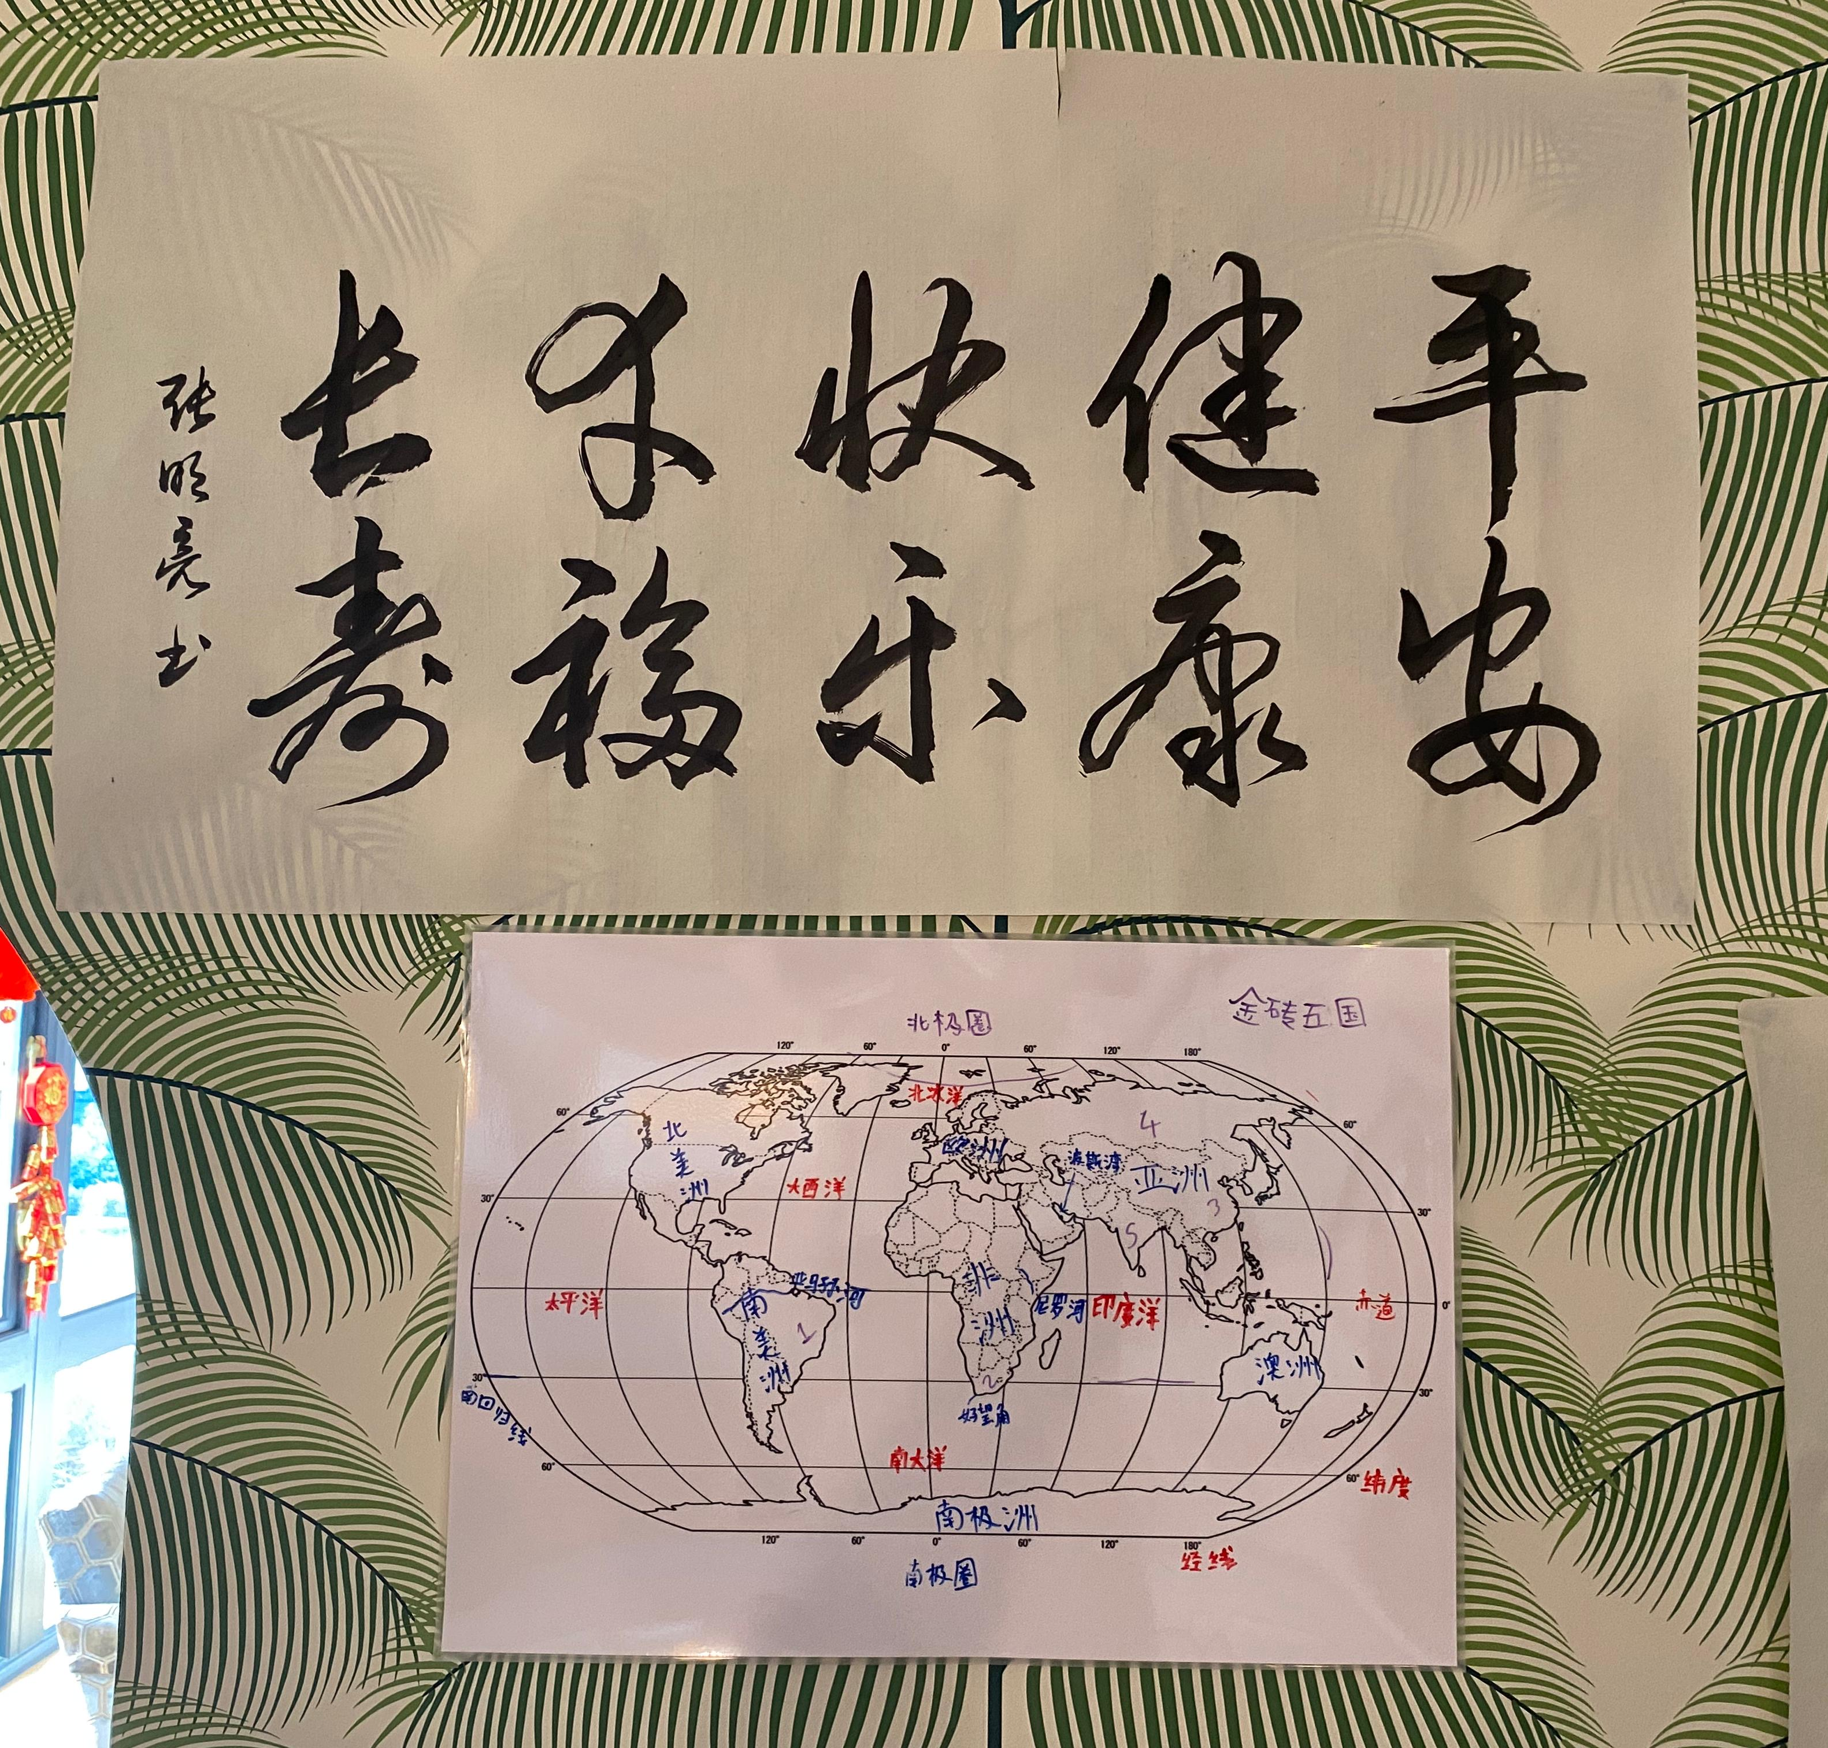
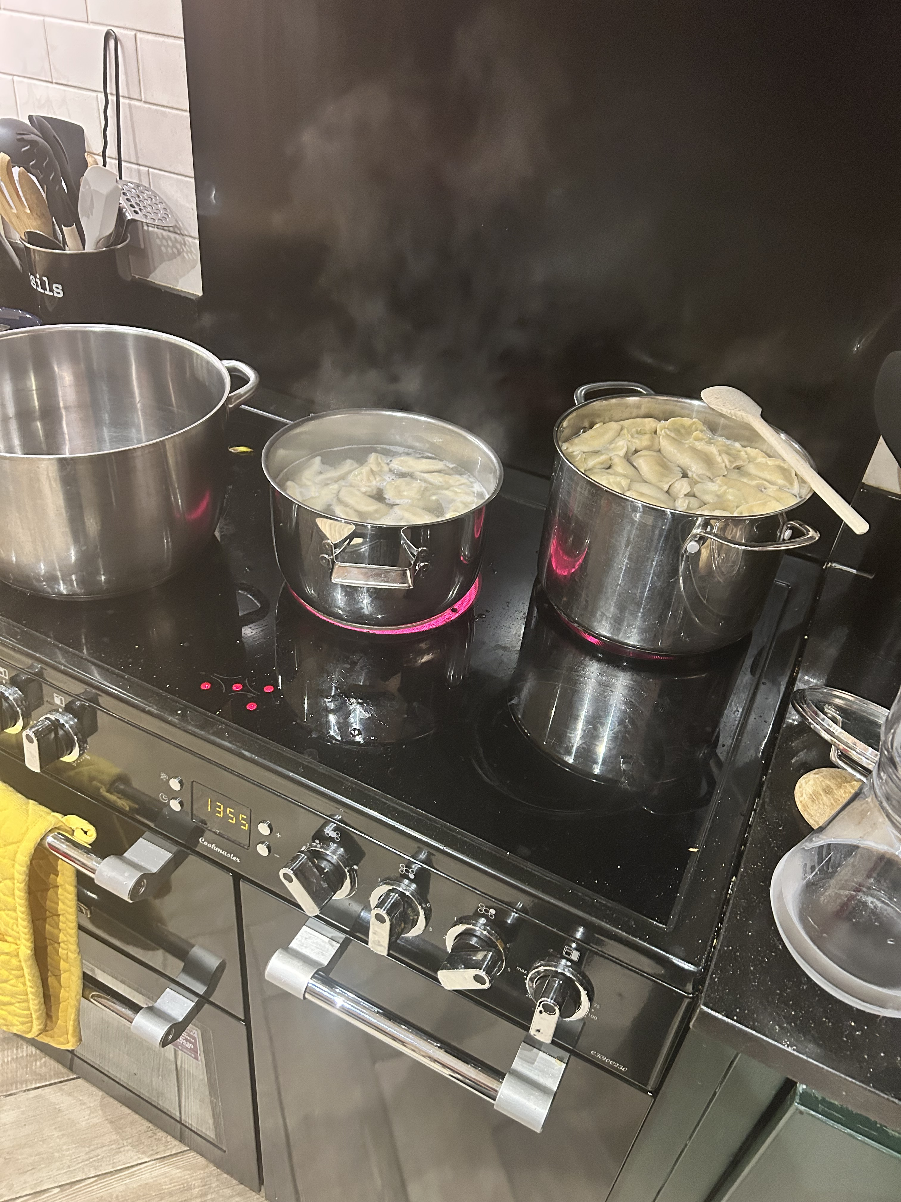
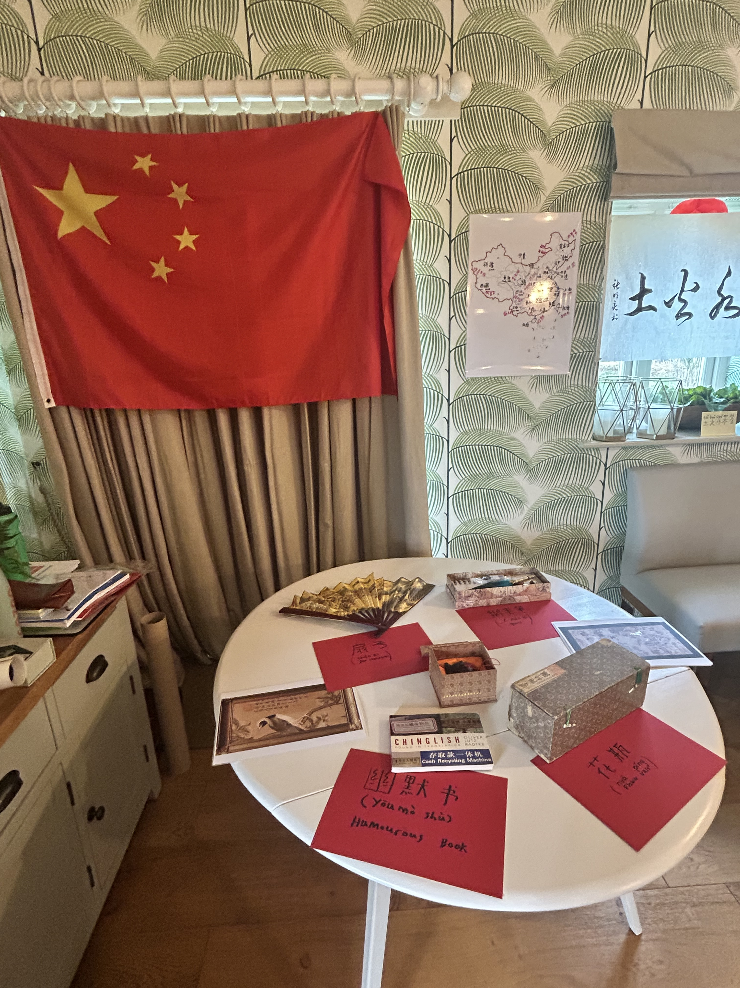
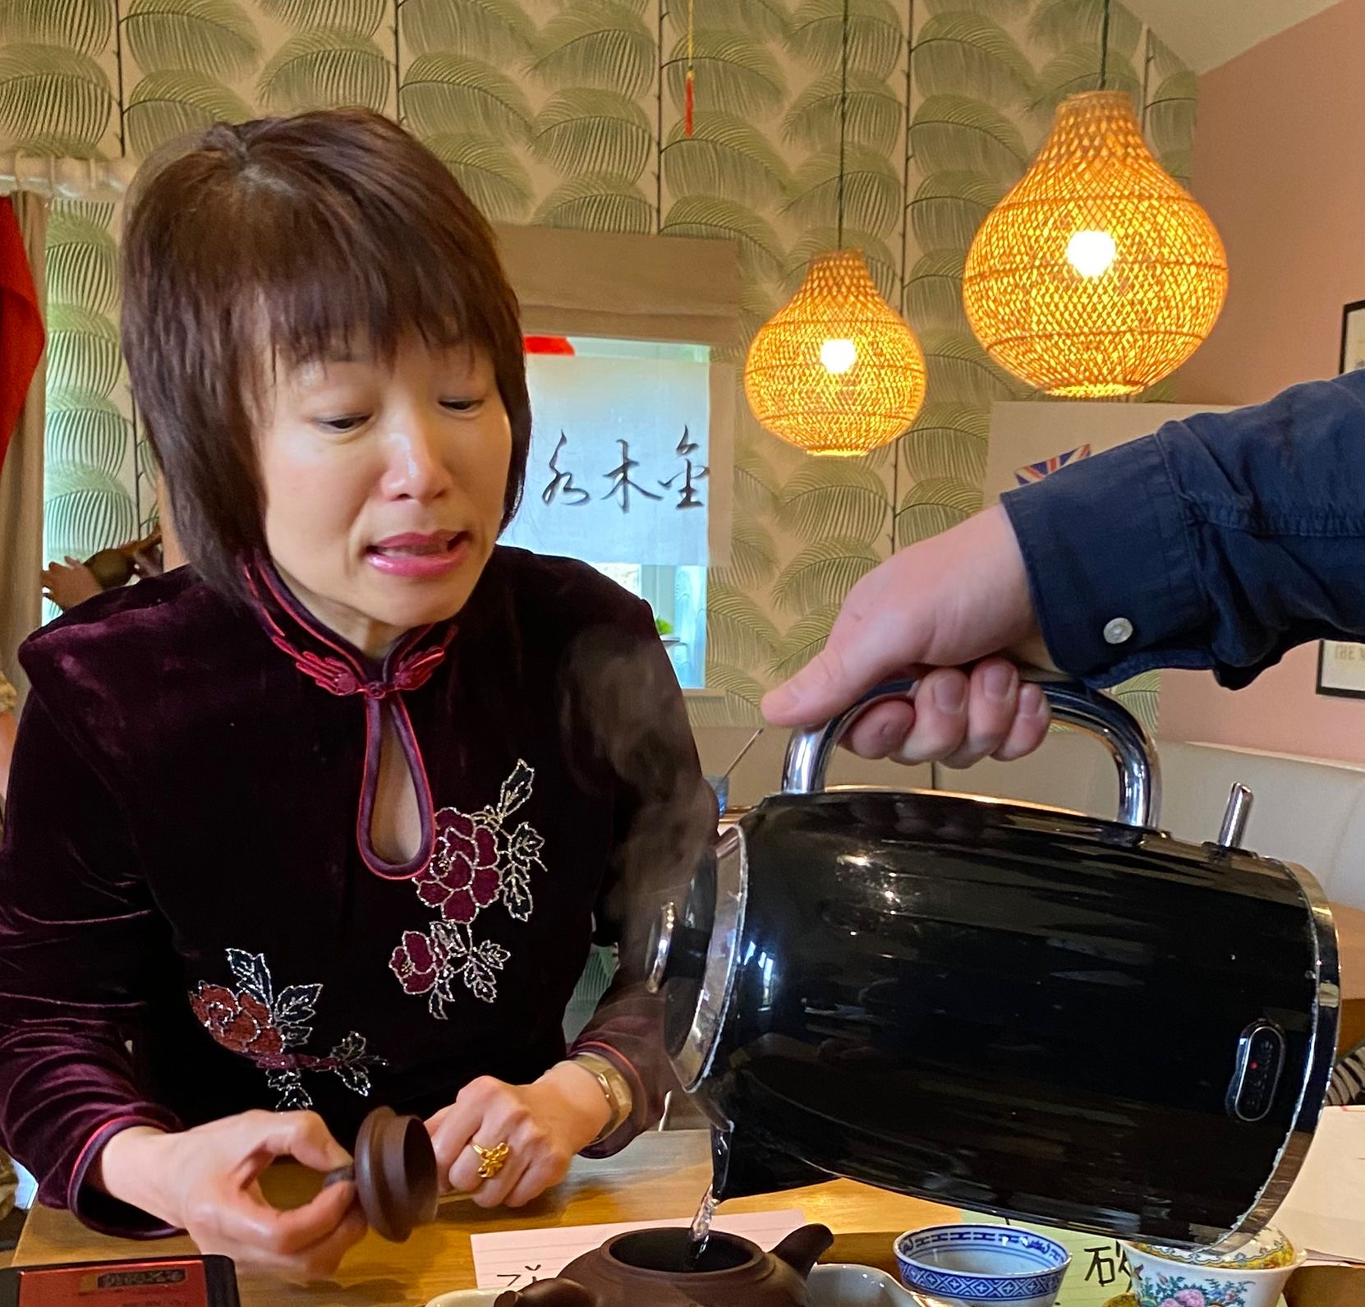

Slide 10
Case Study: Defence Context
Outcomes: fluency, cultural awareness, task accuracy, improved progress test results, overall confidence
Notes:
Defence training with pseudo-immersion improved spontaneous communication, confidence, and cultural responsiveness.

Slide 11
Pedagogical Strategies for Teachers
Create target-language zones
Implement immersion days
Blend asynchronous input with live discussion
Assess immersive engagement
Notes:
Teachers can simulate immersion by enforcing target-language use and assessing engagement, not just correctness.

Slide 12
Limitations & Risks
Limited unpredictability
Overdoing it
Group dynamics
Notes:
While pseudo-immersion lacks real unpredictability, scaffolding and human interaction balance the experience.

Slide 13
Conclusions & Future Directions
Pseudo-immersion = bridge, not replacement
Recreates affective and cognitive benefits
Future: hybrid models and emotional engagement research
Notes:
Pseudo-immersion bridges the gap to real-world immersion and will evolve through adaptive, hybrid training models.

Slide 14
References
Krashen, 1985; Swain, 1985; Long, 1996
Dörnyei, 2009; DeKeyser, 2010
Spada & Tomita, 2010; Collentine & Freed, 2004
Notes:
References supporting pseudo-immersion theory and applied practice.

