Slide 1


Balancing healthy competition and collaboration through AI in teaching foreign languages to military personnel
Malika Soatova
Roman-german Languages
Department Head

Slide 2
  How can we redesign our teaching methodologies through AI to make learning more effective and relevant?

Slide 3
OUR APPROACH
Introduce the Balanced AI Gamification Framework (B-AIGF)
B-AIGF combines competition and collaboration through AI tools
B-AIGF creates sustained engagement and fairness

Slide 4
AGENDA
Challenges in teaching military learners
Sustaining motivation in military adult classrooms
Classroom competition as a teaching tool
Balancing competition and collaboration
AI support in military language classrooms
The balanced gamification framework (B-AIGF)
B-AIGF: four mechanisms overview
Points to consider
Conclusion

Slide 5
CHALLENGES IN TEACHING MILITARY LEARNERS
After years of service, military learners face challenges returning to academic learning.
Their task-oriented mindset values practical results over theory.
Diverse proficiency levels
rank hierarchy can silence lower-ranking learners.

Slide 6
STANDARD INSTRUCTION IS NOT ENOUGH
Teaching should include
motivational strategies
relevant content
balance between individual and group cohesion
Notes:
Teaching should include
motivational strategies
relevant content
balance between individual and group cohesion
This balance reflects real mission-based communication: every role matters, but success is always collective.

Slide 7
How do we design learning environments that motivate individuals without harming unity?
And how do we sustain this motivation over time?
Notes:
So the key question becomes:
How do we design learning environments that motivate individuals without harming unity?
And how do we sustain this motivation over time?
To answer this, we must first understand why motivation is fragile—and how it can be strengthened.

Slide 8
SUSTAINING MOTIVATION IN MILITARY ADULT CLASSROOMS
Motivation is the internal process that initiates, directs, and sustains learning behavior.
One of the strongest predictors of successful language acquisition.
Influences persistence, engagement, and achievement.
Notes:
One of the biggest questions in military adult classrooms is how to sustain motivation, which can be defined as the internal process that initiates, directs, and sustains learning behavior. Motivation is widely recognized as one of the strongest predictors of successful language acquisition because it influences persistence, engagement, and overall achievement.

Slide 9
SUSTAINING MOTIVATION IN MILITARY ADULT CLASSROOMS
According to Deci & Ryan’s Self-Determination Theory (1985): autonomy, competence, and relatedness.
For military adults balancing service duties and study commitments, sustaining high motivation is essential for progress.
Notes:
As Deci and Ryan argue in their Self-Determination Theory (1985), motivation grows when learners feel a sense of autonomy, competence, and relatedness. For adult military learners, whose time are limited by past service demands, maintaining high motivation is critical for progress.

Slide 10
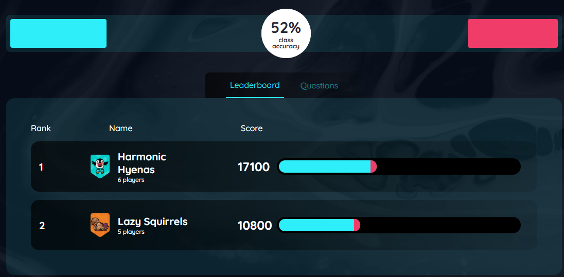
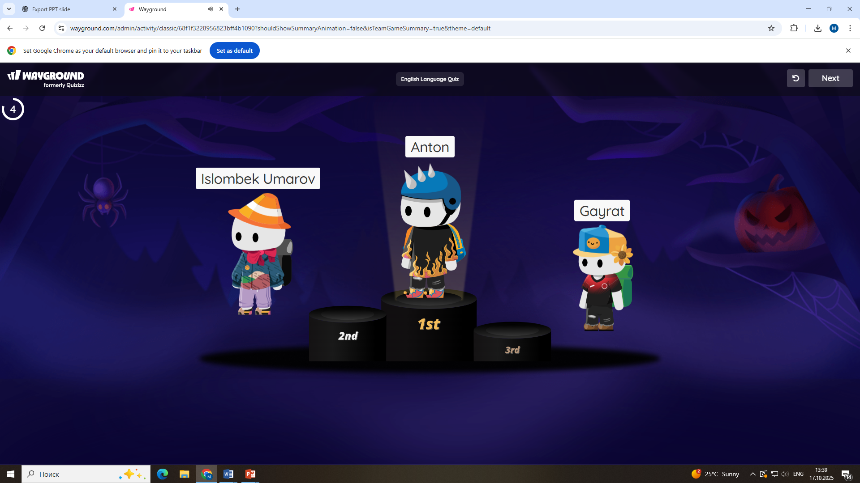
CLASSROOM COMPETITION AS A TEACHING TOOL
Structured rivalry motivates learners
to perform better.
Implemented through points,
leaderboards, and quick-response tasks.
Gamification connects competition
with learning goals.
Notes:
In this context, classroom competition emerges as a valuable pedagogical tool. Competition can be understood as the structured use of rivalry—through points, leaderboards, or quick-response challenges—to encourage learners to perform at their best. One effective way to organize such group competition is through gamification.

Slide 11
CLASSROOM COMPETITION AS A TEACHING TOOL
Research (Sailer & Homner, 2020): gamified tasks + feedback → higher engagement.
Notes:
As demonstrated by Sailer and Homner in their meta-analysis The Gamification of Learning (2020), gamified competition supported by timely feedback and clearly defined goals significantly enhances learner engagement and persistence. In the case of military personnel, this approach resonates strongly with their drill-based training culture, providing a sense of familiarity while infusing language practice with motivation and energy.

Slide 12
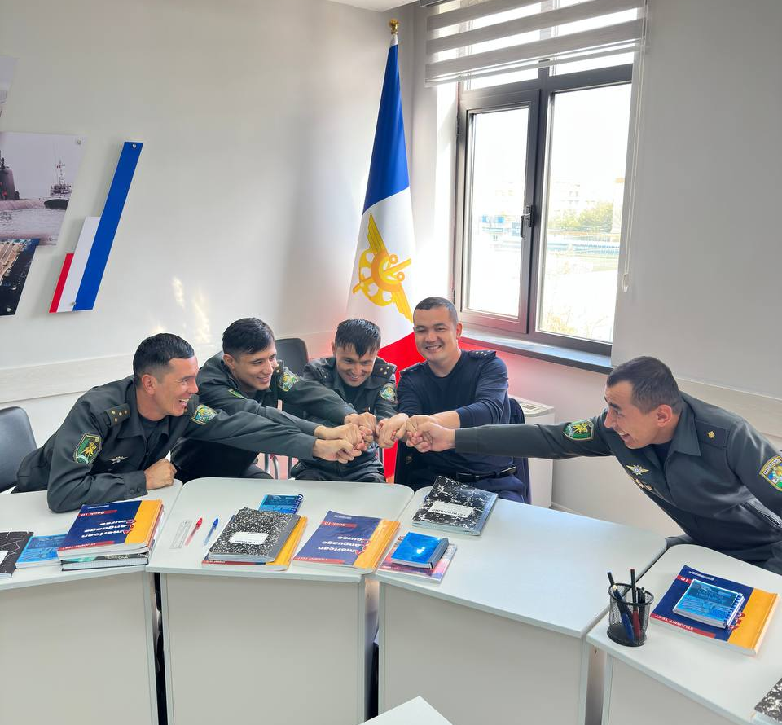
Motivational Driver
For military learners, it mirrors their
training culture and boosts motivation.
Even silent learners become highly
active when the leaderboard appears.

Slide 13
COMPETITION ALONE IS NOT ENOUGH
Pure competition can cause stress and discourage weaker learners (Johnson & Johnson, 2014).
Notes:
But here is the hidden danger.
What happens when the same few learners always win?
What happens when weaker learners always lose?
What happens when competition becomes individualistic, isolating, even humiliating?
This is where competition turns from motivation into demotivation.
According to Johnson & Johnson (2014), purely competitive environments can cause stress, reduce peer support, and silence weaker learners. In military classrooms, the effect is even stronger. Constant individual competition can harm unit cohesion, And this leads to a critical realization:

Slide 14
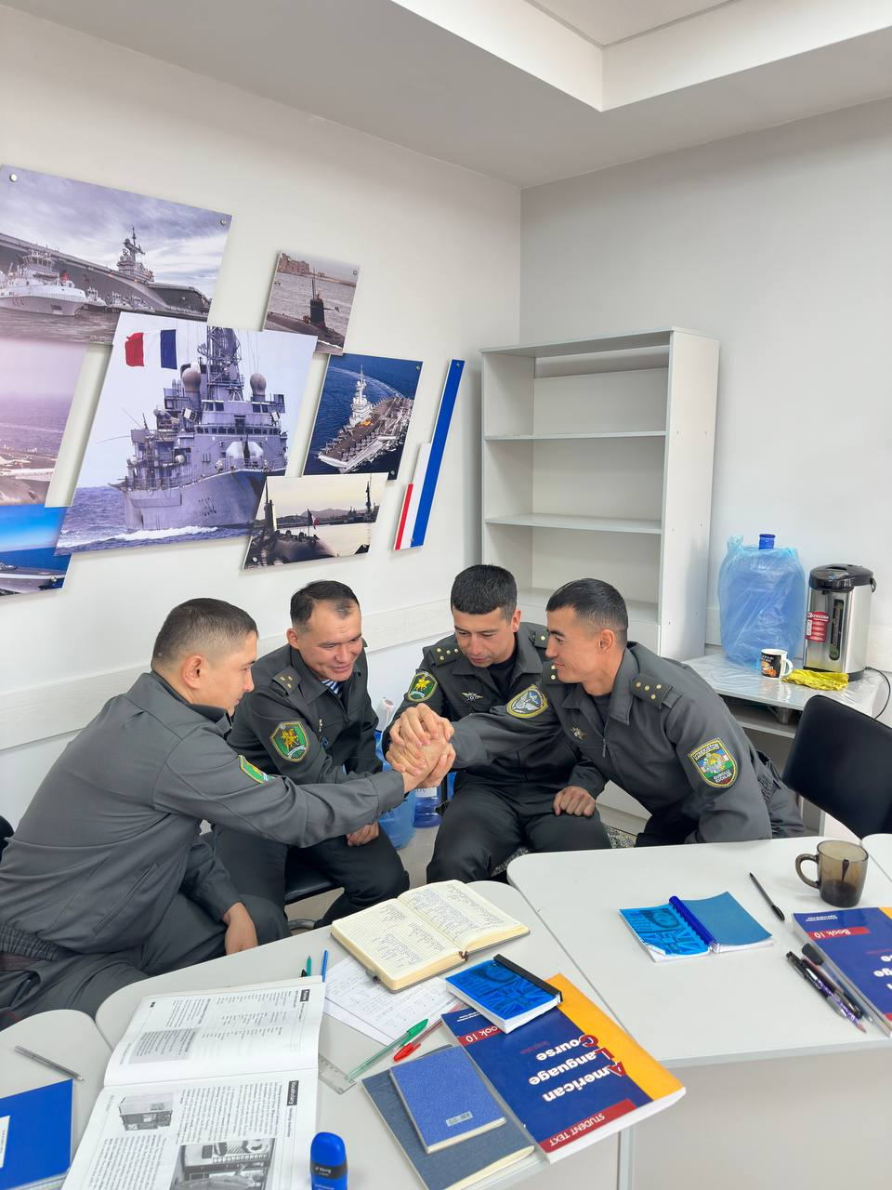
BALANCING COMPETITION AND COLLABORATION
For military learners, collaboration is
not a new concept- it is a core value.
It is shared responsibility, mutual support,
and collective success.
Notes:
Competition alone is not enough. What we truly need is balanced competition.
Collaboration is more than group work.
It is shared responsibility, mutual support, and collective success.
Yang, Yu, and Wang (2023) found that cooperative learning in ESL classrooms improves speaking performance, confidence, and motivation.
Why? Because when learners help each other, they are not just practicing language—they are building trust, competence, and belonging.
For military personnel, collaboration is not a new concept—it is a core value.
Every mission involves teamwork. Every unit depends on cohesion.

Slide 15
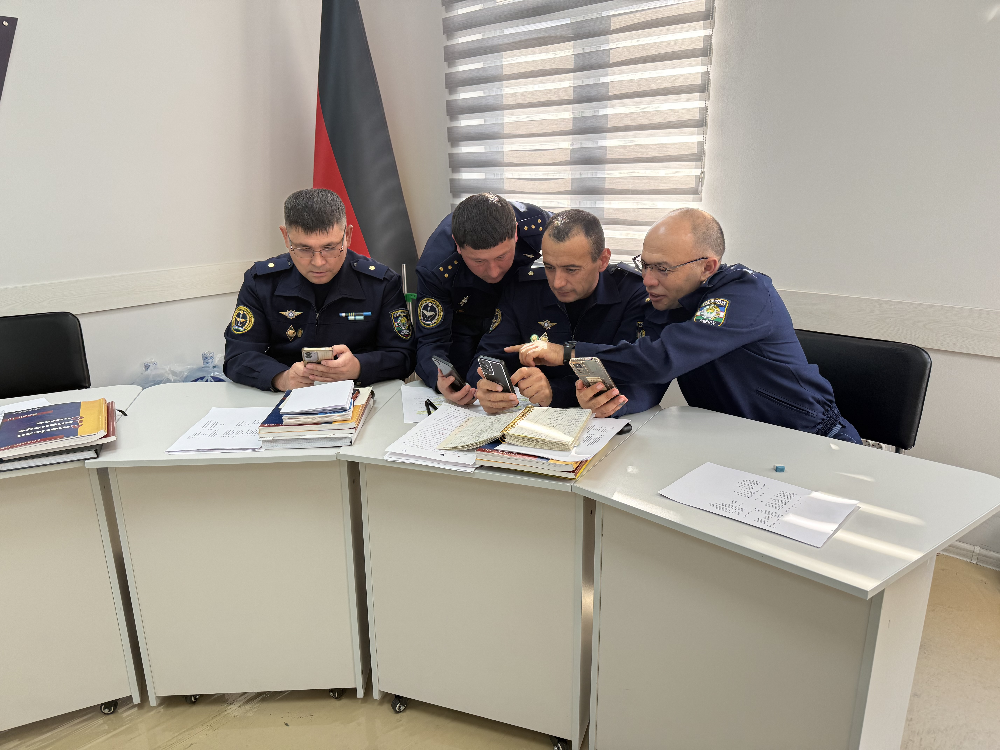
BALANCING COMPETITION AND COLLABORATION
Peer scaffolding builds confidence and
communicative competence
(Yang, Yu & Wang, 2023).
Notes:
Success is never individual—it is collective.
So when collaboration enters the language classroom, something powerful happens:
Lower-level learners receive peer support.
Stronger learners develop leadership and mentoring skills.
Anxiety decreases.
Participation increases.
Cohesion strengthens.

Slide 16
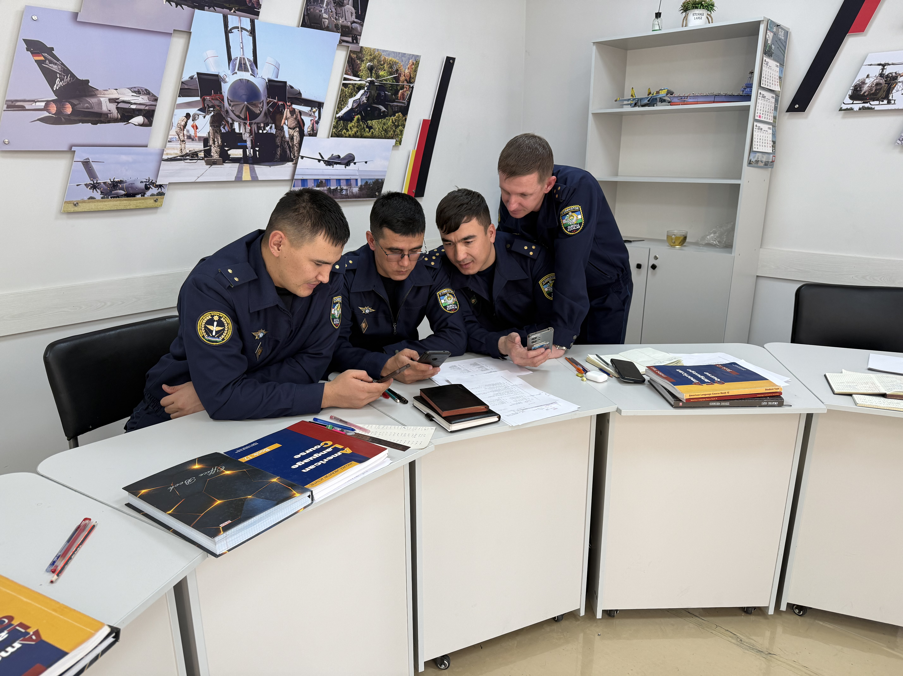
When collaboration enters the classroom
Lower level learners receive peer support.
Stronger learners develop leadership skills.
Anxiety decreases.
Participation increases.
Cohesion strengthens.

Slide 17
How do we maintain this balance every single day in a real classroom full of unpredictable human dynamics?
Notes:
The question is: How do we maintain this balance every single day in a real classroom

Slide 18

Notes:
This is where artificial intelligence enters the stage—not as a replacement for teachers, but as a powerful partner.

Slide 19

AI SUPPORT IN MILITARY ESL CLASSROOMS
It can adapt tasks automatically based
on performance.
It can personalize difficulty levels.
It can ensure fairness in feedback.
It can support both competition
and collaboration—at the same time.
Notes:
Unlike traditional teaching methods, Artificial intelligence offers powerful solutions to many of the challenges teachers face when sustaining motivation in adult military ESL classrooms. Unlike traditional methods, AI systems can process large amounts of learner data in real time, tracking participation, accuracy, and progress for both individuals and teams.

Slide 20
This brings us to the central focus of today’s presentation:
The Balanced AI Gamification Framework (B-AIGF)
Notes:
This brings us to the central focus of today’s presentation:

Slide 21
THE BALANCED AI GAMIFICATION FRAMEWORK (B-AIGF)
The B-AIGF provides a structured model balancing competition and collaboration.
Integrates theory and practice:
- Self-Determination Theory (Deci & Ryan, 1985): motivation through autonomy, competence, relatedness.
- Social Interdependence Theory (Johnson & Johnson, 2014): collaboration and shared success.
Notes:
But theory alone is not enough.
We needed a way to apply these principles in real classrooms… which are messy, and full of human variation.

Slide 22
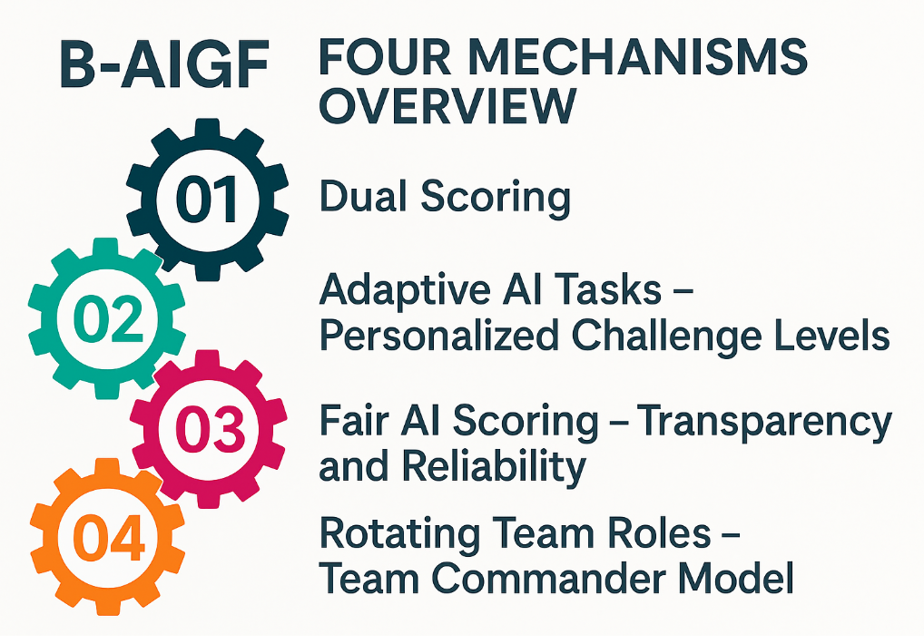
Notes:
The framework rests on four mechanisms, each supported by AI platforms:
Dual Scoring – Individual and Team Success
Adaptive AI Tasks – Personalized Challenge Levels
Fair AI Scoring – Transparency and Reliability
Rotating Team Roles – Team Commander Model

Slide 23
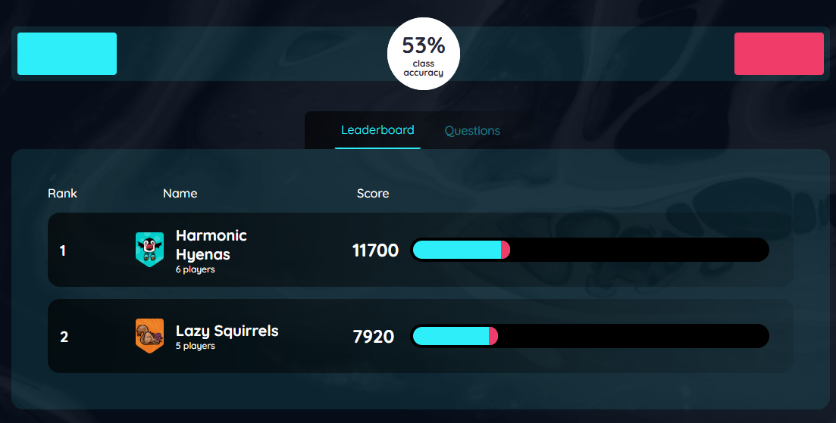
B-AIGF: Dual Scoring –
Individual and Team Success
Notes:
The first mechanism is Dual Scoring.
In many classrooms, we reward only individual performance.
Who answered the most questions?
Who got the highest score?
This motivates strong learners—but it discourages weaker ones.
In other classrooms, we only reward teams.
But then some learners hide while the strong ones carry the group.

Slide 24
B-AIGF: Dual Scoring – how it works
Every learner earns individual points based on their performance.
At the same time, all individual scores contribute to the team total.
So, if one member stops contributing, the team suffers.
If the team wins, every member benefits.

Slide 25

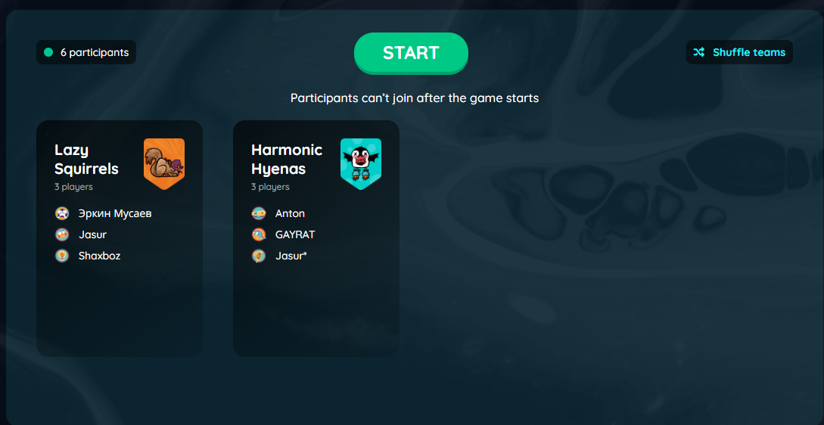
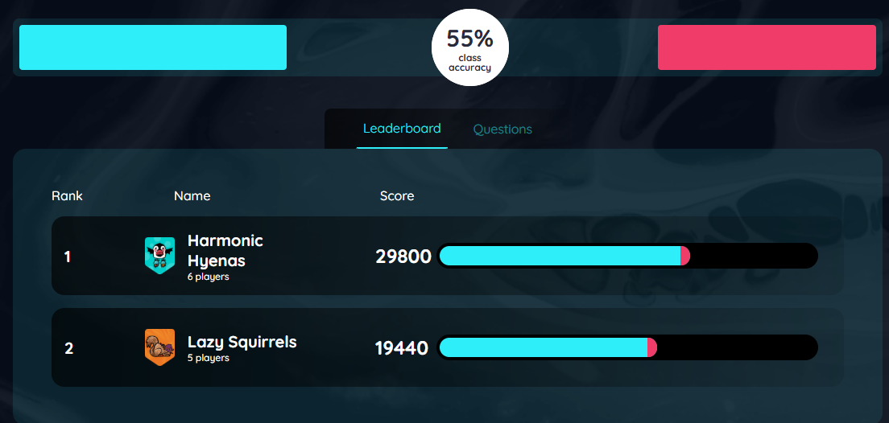
Notes:
Quizizz AI supports this beautifully.
It allows leaderboard views that show both individual rankings and team rankings.
Learners see:
“I must do my best—but I must also help my team.”
This reflects real military culture:

Slide 26

Let’s see the process live

Slide 27
B-AIGF: Dual Scoring – Benefits
This structure promotes:
Personal accountability
Group cohesion
Balanced motivation

Slide 28
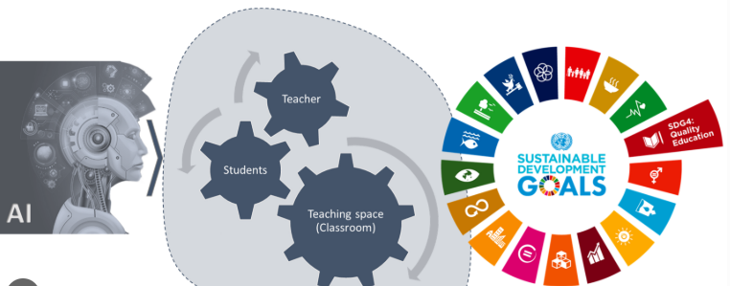
B-AIGF: Adaptive AI Tasks – Personalized Challenge Levels
AI adjusts task difficulty to match learner proficiency.
Notes:
The second mechanism of the B-AIGF is Adaptive AI Tasks, and this is where artificial intelligence becomes truly transformative.
One of the biggest problems in military language classrooms is mixed proficiency levels.
In the same room, you might have:
Someone who speaks fluently,
Someone who still struggles with basic grammar.
Traditional teaching cannot solve this in real time.
But AI can.
AI-powered platforms such as Quizizz AI can analyze performance live and adjust difficulty automatically.
For example:
If a learner answers several questions correctly, the system increases the challenge.
If a learner struggles, the system lowers the difficulty or provides scaffolded hints.

Slide 29
AI-powered platforms -
Wayground Quizizz AI, Edcafe AI
AI can adjust difficulty automatically.
If a learner answers several questions correctly, the system increases the challenge.
If a learner struggles, the system lowers the difficulty.
It can even present different versions of the same concept based on competence.

Slide 30
This approach supports Self-Determination Theory
It maintains competence - not too hard, not too easy.
It supports autonomy - learners feel tasks match their level.
It encourages persistence - they stay in the “learning zone,” not the “panic or boredom zone”.

Slide 31
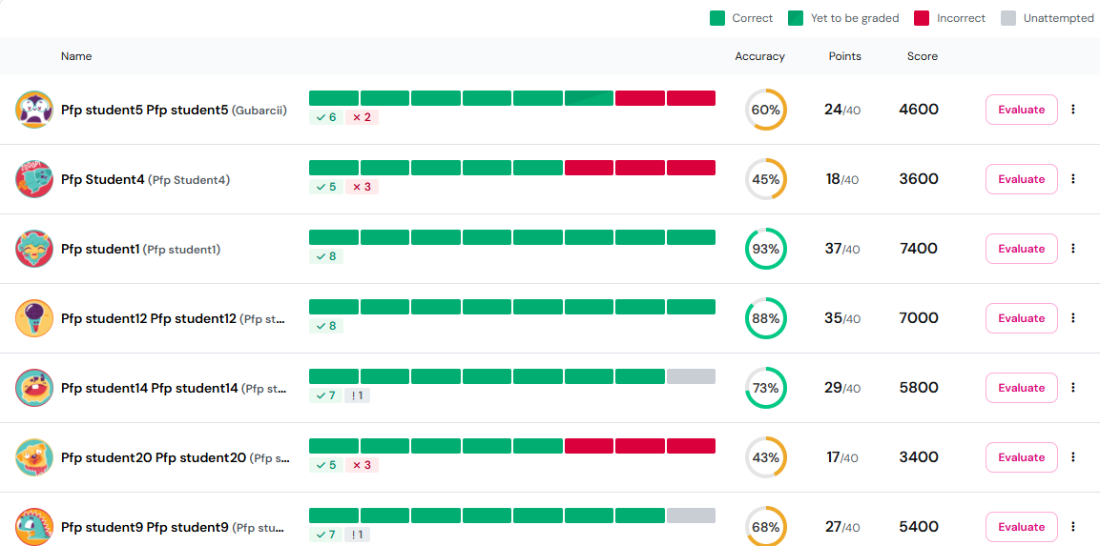
B-AIGF: Fair AI Scoring – Transparency and Reliability
AI can provide:
Instant feedback
Consistent evaluation
Objective scoring
Data transparency

Slide 32
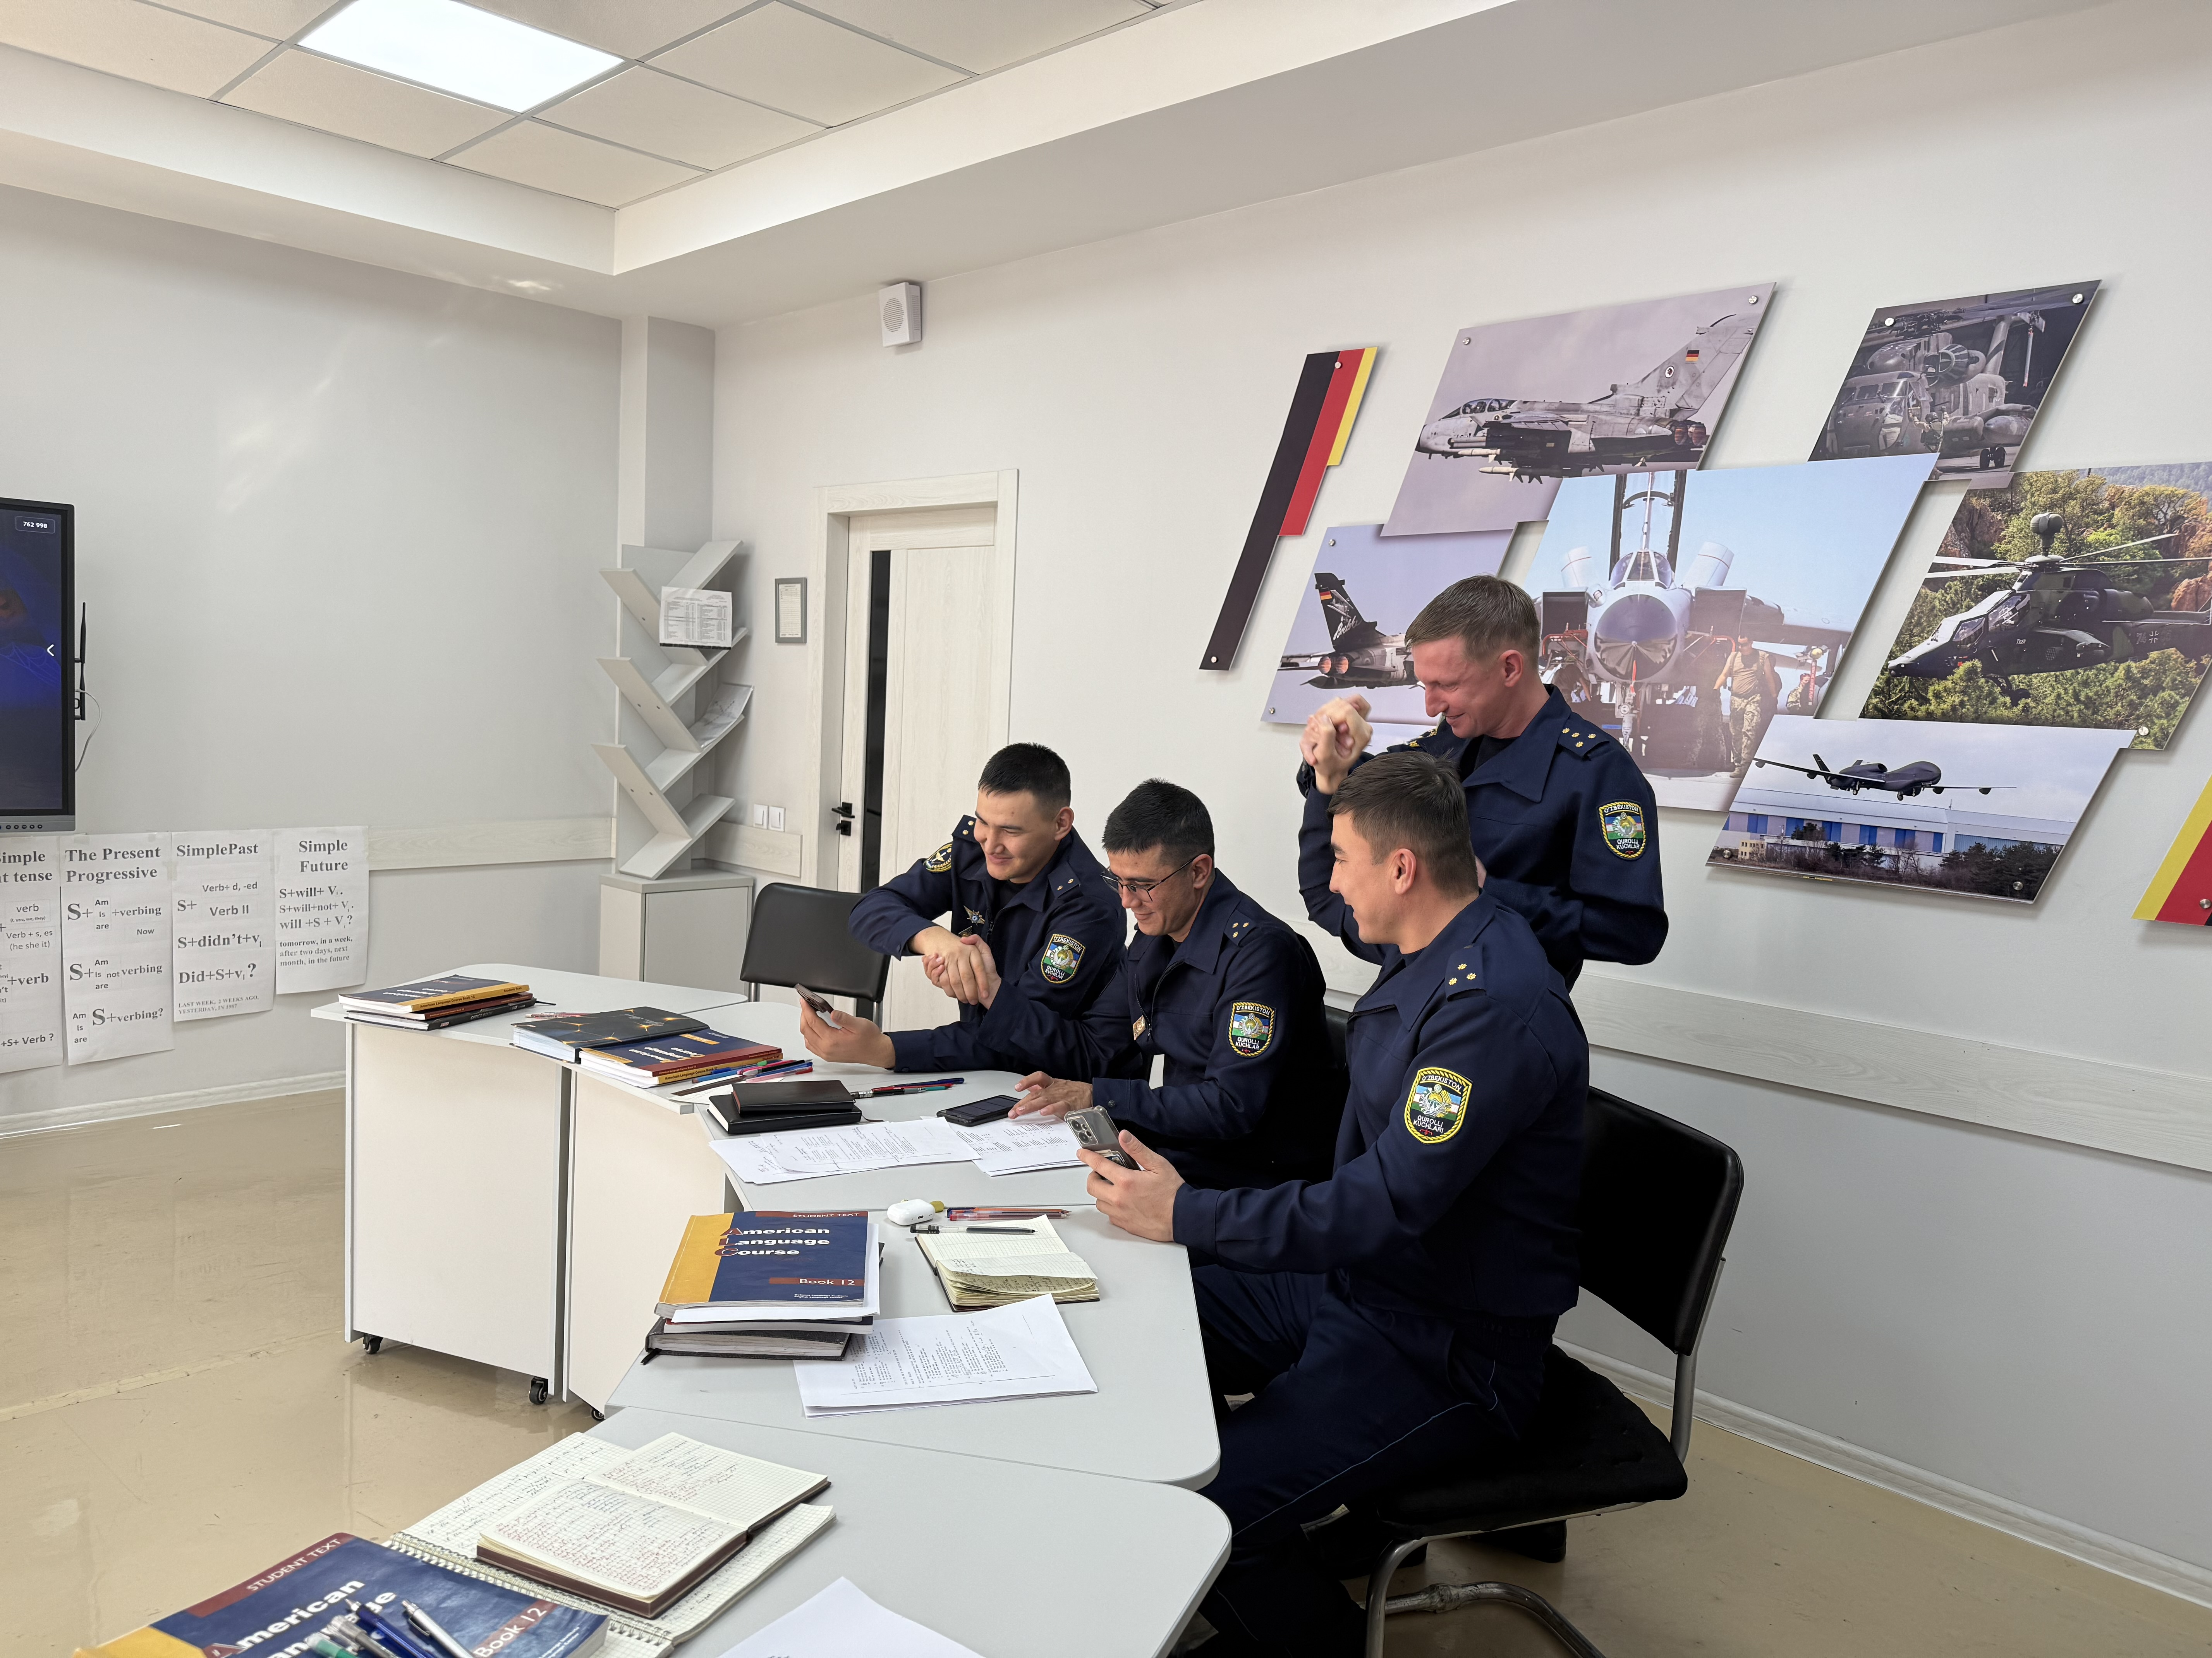
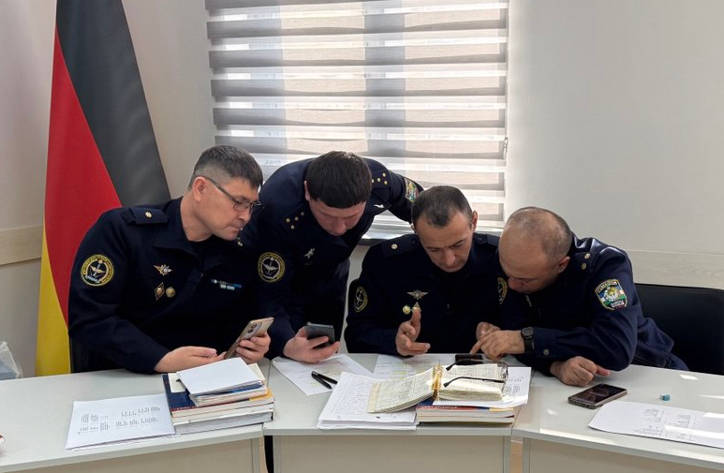
B-AIGF: Rotating Team Roles – Team Commander Model
Prevents domination and passivity within teams.
Notes:
In any classroom competition, the same pattern often appears:
A few confident learners take control, while quieter or lower-ranking learners stay passive.
In the military, this effect can be even stronger due to rank hierarchy.
If we don’t intervene, group work becomes:
One leader,
Two followers,
Several silent observers.
This destroys collaboration and prevents equal participation.
The B-AIGF solves this with a military-inspired solution: the Team Commander model.
Here’s the process:
Teams are formed.
During each activity or round, one learner becomes the “team commander.”
The commander leads discussion, organizes answers, and represents the team.
In the next round, the commander role rotates to another team member.
Over time, every learner experiences leadership.
This is not random.
AI platforms like Quizizz and Kahoot! Team Mode provide participation analytics:
Who speaks the most?
Who stays silent?
Who submits answers?
Who relies on others?
Using this data, instructors can strategically rotate roles—not just randomly, but purposefully.

Slide 33
Team Commander Model
Teams are formed.
During each activity or round, one learner becomes the “team commander.”
The commander leads discussion, organizes answers, and represents the team.
In the next round, the commander role rotates to another team member.
Over time, every learner experiences leadership.

Slide 34
How it works
Quizizz AI and Kahoot Team Mode provide participation analytics:
Using this data, instructors can strategically rotate roles—not just randomly, but purposefully.

Slide 35
What the Framework Achieves
When these mechanisms work together, they create a powerful balance:
Dual Scoring motivates both the individual and the team.
Adaptive AI Tasks keep everyone challenged at the right level.
Fair AI Scoring builds trust in the process.
Rotating Commander Roles develop leadership and unity.

Slide 36
POINTS TO CONSIDER
AI offers benefits, but requires thoughtful application.
Access limits: unequal technology or weak connectivity can affect fairness.
Data security: sensitive information must remain protected.
Over-reliance: AI should support, not replace, effective teaching.
Must ensure fairness, inclusivity, and supervision in every context.

Slide 37
CONCLUSION
AI can transform military ESL classrooms when used wisely.
Enables real-time tracking of learner progress and team performance.
Adaptive algorithms adjust task difficulty to individual proficiency.
Provides instant feedback, objective scoring, data transparency.
AI-empowered tools such as Wayground Quizizz AI, Kahoot Team mode, Factile with Auto-Gen AI not only motivate through competition but also strengthen collaboration.

Slide 38
REMEMBER
When we balance competition and collaboration through AI, we don’t just teach language.
We build confidence, leadership, resilience, and unity.
That is exactly what our learners—military or civilian—need for the future.

Slide 39
THANK YOU FOR YOUR ATTENTION

