Slide 1

Speaking activities for Level 2
Daniela Vucheva

Slide 2
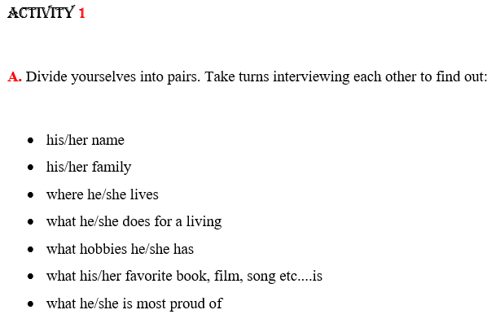



Slide 3

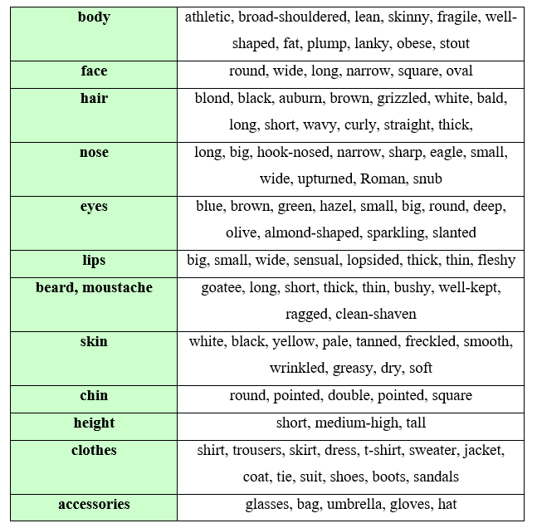




Equip students with the ability to describe. For description apply the Bank of Words approach. It is useful for exams, creative speaking and writing, more precise, richer and easier to construct. Promotes creativity in tasks.

Slide 4
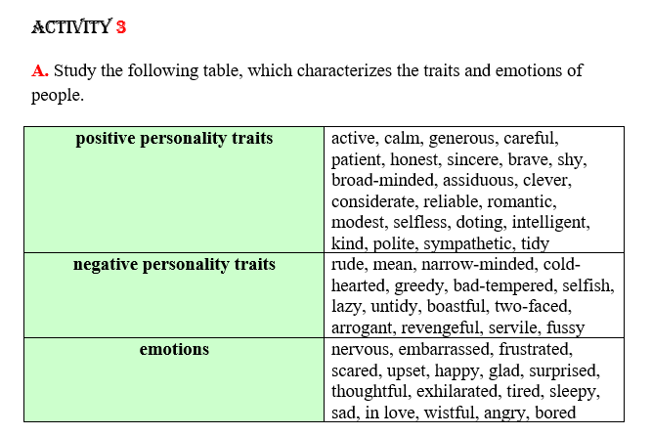




Slide 5
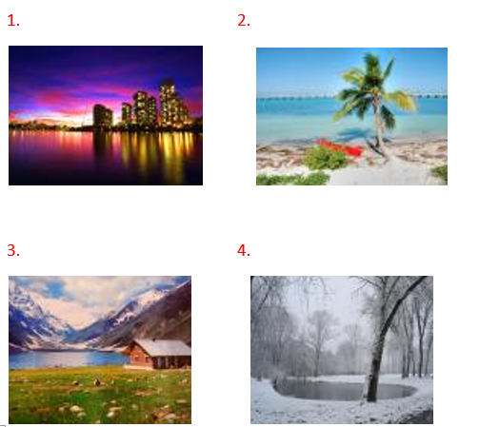
ACTIVITY 4
The role of the teacher is to guide students build their bank of words. It helps students quickly recall descriptive terms, reduces hesitation during timed speaking and writing tasks. For places, it makes the description vivid, with adjectives for atmosphere, serenity and mood.
Choose one of the pictures below and describe it, using appropriate adjectives from the box on the right
coastal, cosmopolitan, historic, industrial, mountainous, agricultural, touristy, tranquil, tropical, magical, fairy tale-like, mystical, harmonious, unique, picturesque, unusual, magnificent, noisy, modern, enchanted, exotic, deserted, colorful, bright, amazing, dry, hot, romantic, rimy, snow-covered, stormy, wild, hilly, urban, rural, flat, fertile, harmonious, calming, unspoiled, panoramic, picture-postcard, misty, quiet, ghostly

Slide 6


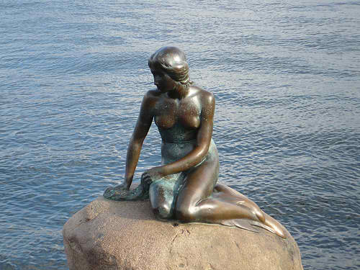

ACTIVITY 5
In pairs, find information and say what you know about one of the world-famous places of interest:

Slide 7
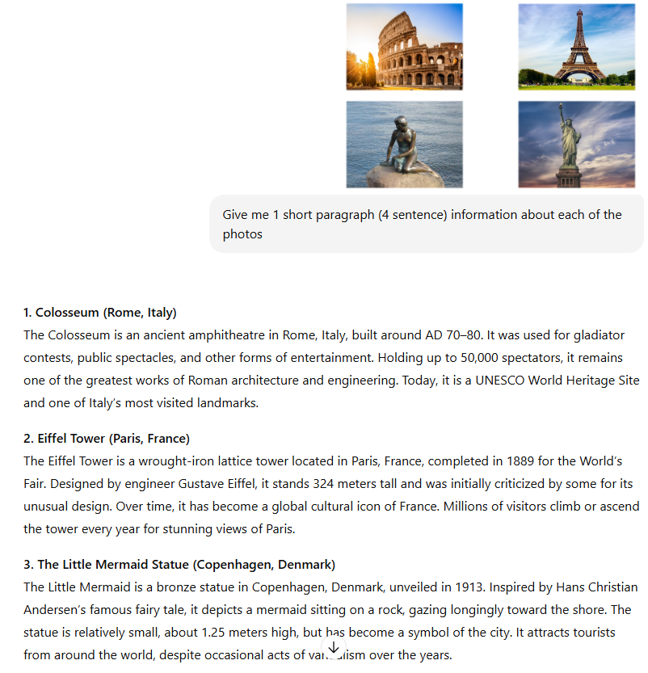

Slide 8
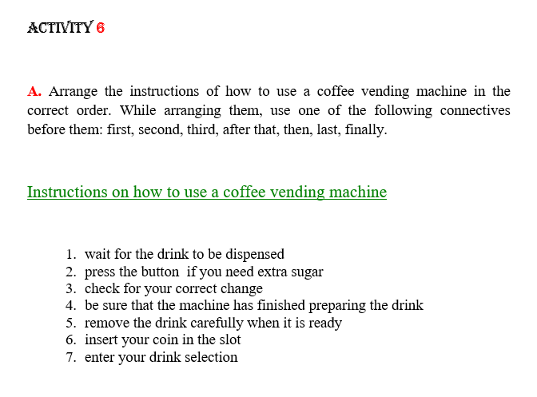


Slide 9
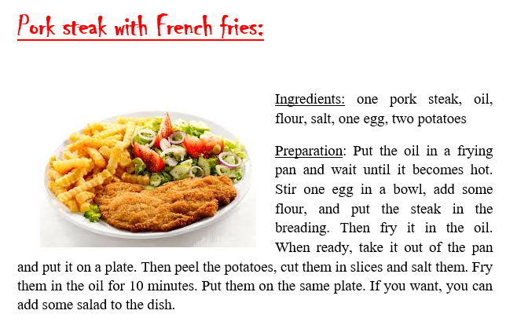
ACTIVITY 7
Choose your favorite dish and describe it to the class. Use two paragraphs: Ingredients and preparation.

Slide 10
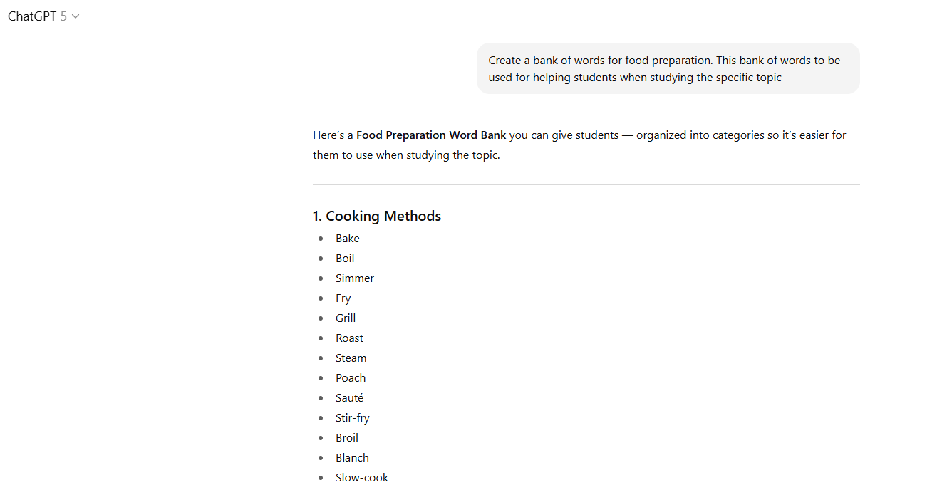
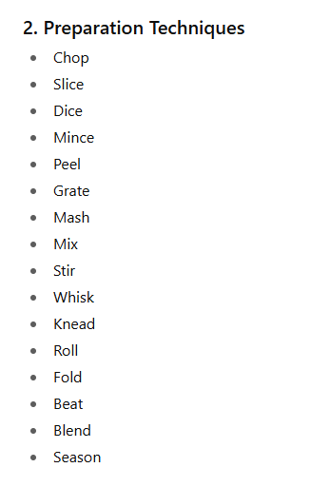

Slide 11

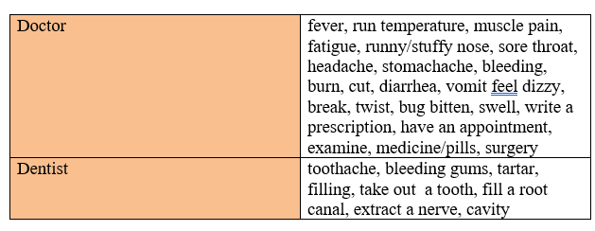

ACTIVITY 8
Ask two of the students to choose one of the pictures and describe what they see:

Slide 12
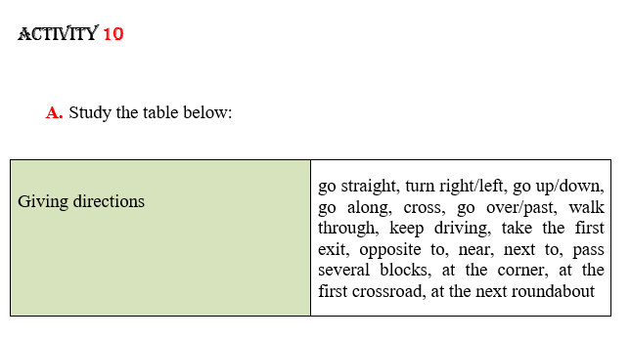
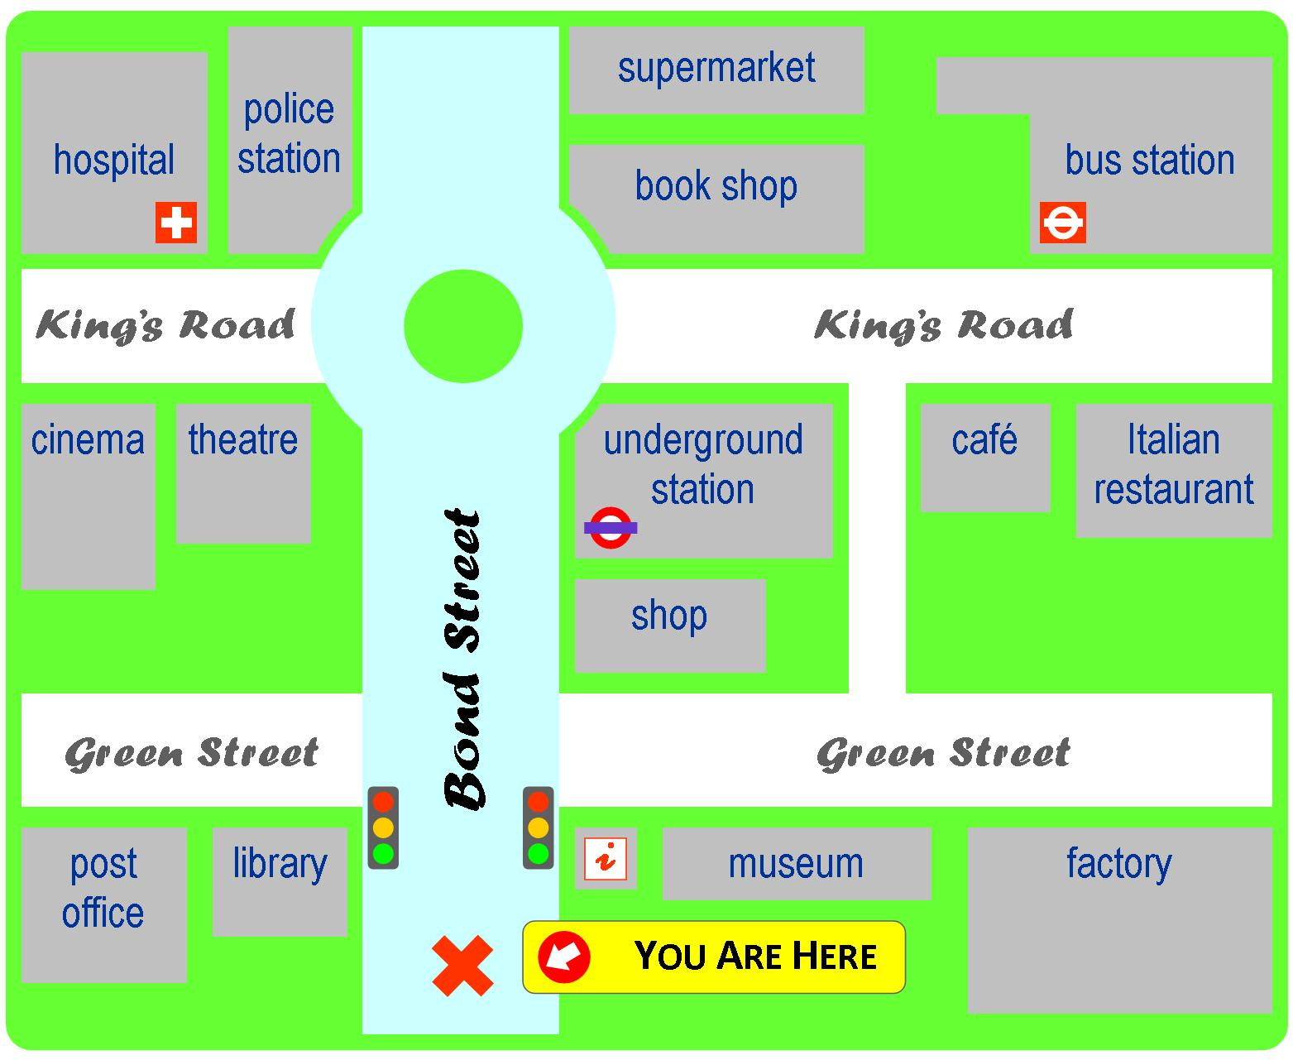
Look at the picture on the right. Choose students and give each a different route. They should go from a starting point to a specific place, using the words from the box above.

Slide 13
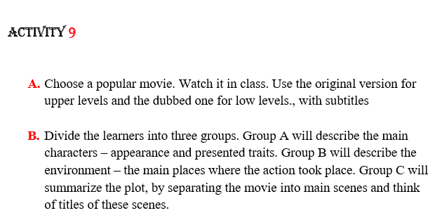




Steps for students:
Identify the subject( person, place…)
Refer to the adjective bank for relevant words
Select synonyms and advanced vocabulary.
Write a paragraph in class using these words.
Speak
Teachers monitor work and encourage students select words, use synonyms and write independently. AI facilitates, assists and saves time, not replace thinking.

Slide 14
THANK YOU FOR YOUR ATTENTION

