Slide 1


TASHKENT 20-24 OCT 2025
BILC PROFESSIONAL SEMINAR
BILC INFORMATION BRIEFING
20 OCT 2025
Please note this update also contains Ms Julie Dubeau’s update on the STANAG 6001 Working Group from slide 19 onwards.
Notes:
Welcome address: Col PETER TEEUW, Commandant Defence Language Centre
Host nation presentation: COL Henk KIFFEN, OPERATIONAL VIEW ON WRITING SKILLS
NATO Airborne Early Warning & Control Force

Slide 2

Briefing outline
BILC briefly
The new BILC Secretariat: who are we?
Memorandum of Cooperation: work in progress
New policy recommendations, now on BILC website
BILC events and their themes, incl. mini quiz
This seminar: main themes
Standardization Efforts: DEEP
Notes:
2

Slide 3
BILC IN A NUTSHELL
NATO’s consultative and advisory body for language training and testing issues
Main responsibility: custodian of STANAG 6001
MISSION
To promote and foster interoperability among NATO and Partner nations by furthering standardization of language training and testing
To support the Alliance's operations through the exchange of knowledge and best practices
VISION
To achieve levels of excellence where progress made by one is shared by all.
Notes:
Since 1966 when it was established, BILC has consistently held a unique position as NATO's advisory body, playing an integral role in the implementation of strategic planning within the organization.
BILC is the custodian of STANAG 6001(Edition5, vr.2)
As the statement captures, our primary mission is to promote interoperability among NATO and partner nations. We achieve this by standardizing training and testing practices, ensuring that all participating nations have a common understanding of language proficiency levels and can effectively communicate in multilingual environments.
The BILC vision is to share progress made with member nations, partner nations, and any nation that wishes to advance in language training for military purposes.
How is this done? Through the secretariat, there are various initiatives that aim to foster these exchanges and promote standardization, which I will discuss later.
MISSION
To promote and foster interoperability among NATO and Partner nations by furthering standardization of language training and testing.
To support the Alliance's operations through the exchange of knowledge and best practices, IAW established procedures and agreements.

Slide 4

BILC Steering Committee
GBR 1966-1981
DEU 1982-1996
USA 1997-2008
CAN 2008-2014
USA 2014-2016
BGR 2016-2019
SVN 2019-2022
HRV 2022-2025
Chair
Laura Murto
Senior Advisor
Dr Ray Clifford
Secretaries
Anne Rivinoja
Satu Patronen
Associate Secretaries
Dr Edelmira Nickels
Peggy Garza
Julie Dubeau
Jana Vasilj-Begovic
Notes:
BILC has three constitutional components: a. Members, b. The Secretariat, and c. The Steering Committee.
Participating nations are represented at BILC through a steering committee consisting of their national representatives.
The Secretariat and Steering Committee run the BILC.
This is our formal structure.
To the left, you can see the countries that have provided the Secretariat over the years. Currently, the Secretariat consists of 8 members.
Associate secretaries and the senior adviser are long-standing members of the BILC who support and assist a presiding nation in various ways.
The BILC Chair presides over the Steering Committee, which holds its annual meeting at the conference. Voting rights are held by NATO national representatives. Partner nations are invited to attend and observe at Steering Committee meetings, but they do not have the right to vote.

Slide 5
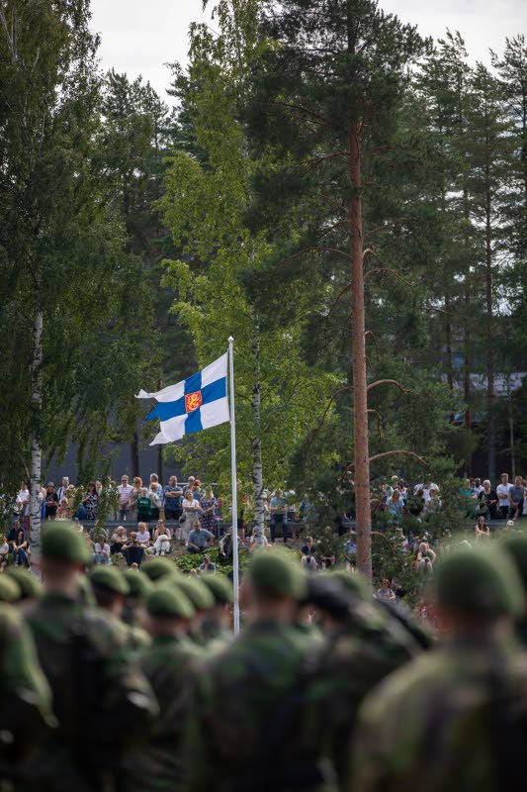

The BILC Secretariat 2025–2028
Finland, Helsinki
National Defence University
Defence Language Centre
Chair Laura Murto: Head of the Language Training Branch, incl. teaching
Secretary Satu Patronen: Director of the Defence Language Centre
Secretary Anne Rivinoja: English Language Specialist, incl. teaching

Slide 6

THANK YOU
BILC Secretariat 2022–2025
Irena Prpić Đurić
Suzana Horvat
Borjana Soldo

Slide 7




It’s (almost) official!
Headquarters Supreme Commander Allied Command for Transformation (HQ SACT)
Deputy Chief of Staff (DCOS)
Multidomain Force Development Directorate (MDFD)
Notes:
From 1978 to 2011, BILC was associated with the NATO Training Group (NTG) through the Joint Services Sub-Group. With the reorganization of NTG, from 2011 until 2023, BILC’s relations with NATO were placed under the auspices of the Supreme Allied Commander Transformation (HQ SACT) and regulated by the Memorandum of Cooperation between Headquarters, Supreme Allied Commander Transformation and the Bureau for International Language Co-ordination. Thus, BILC became better aligned as a strategic rather than tactical element while retaining its status as an independent advisory body.
BILC’s involvement is integral to the implementation of strategic planning in NATO.
In 2024, as you know, the NTG was dissolved, and five organizations/entities were left out without any organizational connection. We were informed that the NATO Military Committee Joint Standardisation Board would meet to decide where we should be aligned. Since then, the members of the Secretariat have been trying to reestablish the contacts with ACT HQ and renew the MOC. The efforts have paid off. We have been informed that the majority of our activities are still in the domain of the Deputy Chief of Staff (DCOS) of the Multidomain Force Development Directorate (MDFD) at the Headquarters of the Supreme Commander Allied Command for Transformation (HQ SACT). The POC for this process has been appointed on behalf of SACT. At the moment we are finalizing the new MoC.
Update from Irena Prpic-Djuric 19 AUG 2025

Slide 8
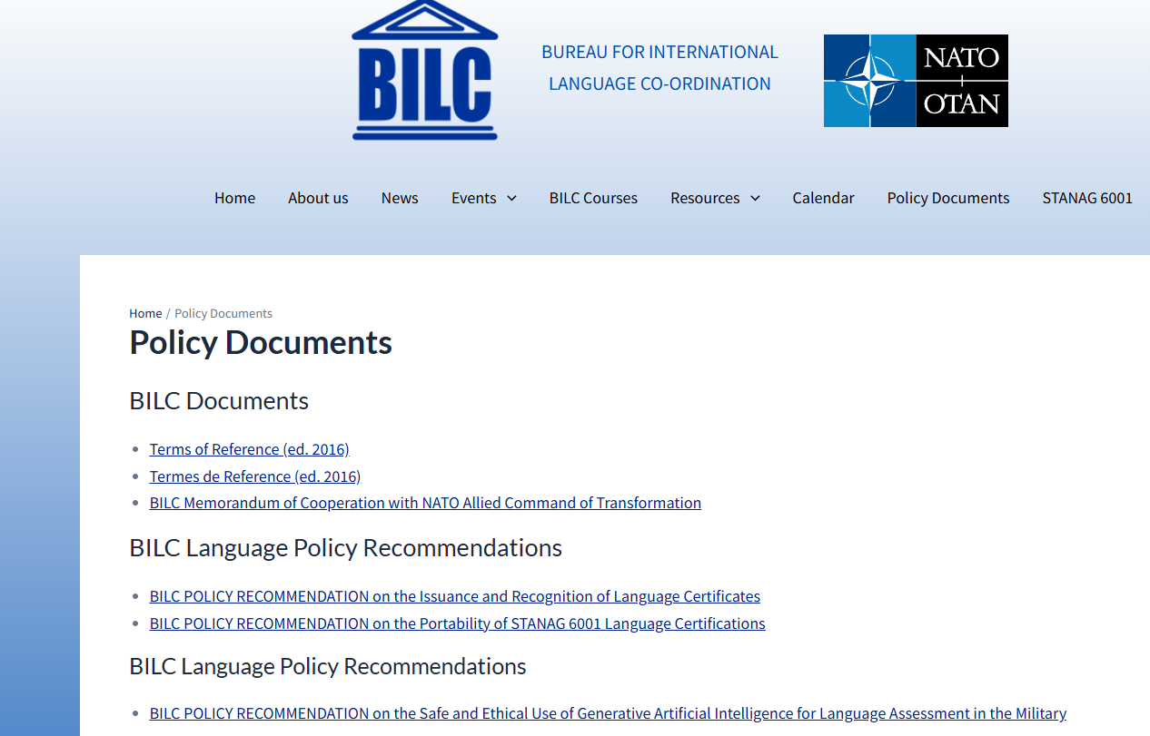
Policy Documents – BILC
TESTERS … BUT TEACHERS TOO:
IMPORTANT
NEW POLICY RECOMMENDATIONS!

Slide 9
MAIN EVENTS
Every year
BILC Conference (May)
STANAG 6001 Testing Workshop (September)
BILC Professional Development Seminar (October)
Every second year
Military Terminology Seminar (April)
Notes:
Tashkent Uzbekistan 20-24 October 2025
Terminology: Military University of Technology in Warsaw 13-17 April 2026

Slide 10
The first … ?
Conference …
Professional Seminar …
STANAG 6001 Testing Workshop …
Military Terminology Seminar …
UK 1967
Hürth in 1994
Sarajevo 2010
Ljubljana 2022

Slide 11

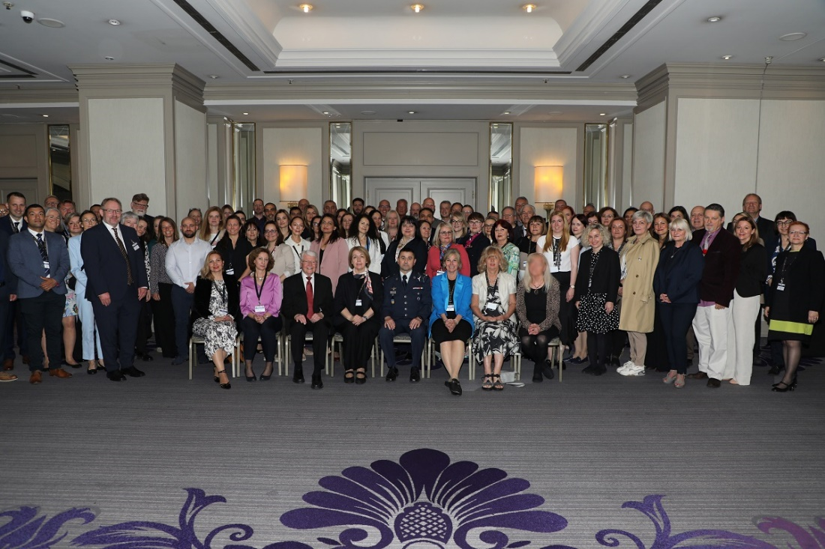

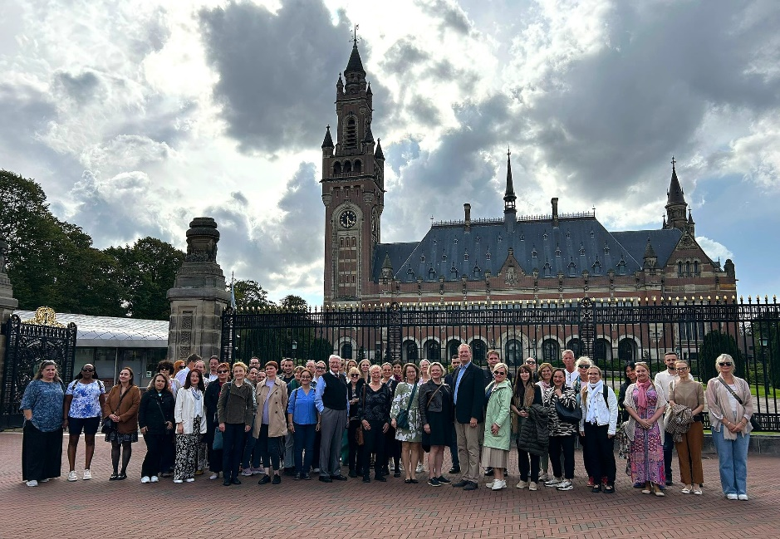


Past three events 2024-2025

Slide 12
Seminar themes over the years
Authenticity in training and testing: Making it real
“The 21st Century Classroom – Keeping up with the Times!
Back to Basics: Recipes for Instructional Success
Sustainability and continuity in modern language education
Budapest 2016
Copenhagen 2009
Bled 2012
Tallinn 2006
Source: BILC’s new website! BILC

Slide 13

Past themes 2024-2025
Rethinking the Language Training and Education: Keeping Pace with Change (Professional Development Seminar, Prague)
The Future of Military Language Training: Embracing Innovation, Adaptation and Collaboration (BILC Conference, Zagreb)
Assessing Writing Proficiency in an AI Era: Validity Challenges and Future Directions (STANAG 6001 Testing Workshop, the Hague)
Common thread: How do we use AI to our best advantage?

Slide 14
BILC Professional Seminar 2025
Reshaping Educational Methodologies to fit AI
Sub-themes
Aligning AI tools with curriculum objectives to enhance targeted learning outcomes
Faculty development for effective implementation of Intelligent Technology-Enhanced Language Learning solutions
Exploring learner and teacher perspectives on the impact of AI in language education
Enhancing classroom engagement through gamification and AI-driven instructional approaches
Identifying and addressing barriers to AI integration in language education
Effective teaching practices for maximizing the benefits of AI in language skill development
Applying AI solutions to facilitate grammar/vocabulary learning
56 participants
30 nationalities
+ LOTE opportunities …

Slide 15

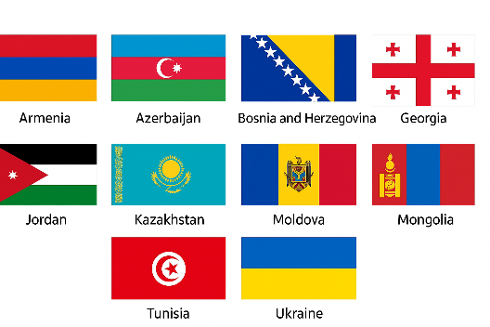




DEEP language assistance 2025
Language Training
STANAG 6001 Testing
Notes:
https://www.nato.int/cps/en/natohq/topics_139182.htm
Mauritania Morocco Serbia

Slide 16













BILC support to DEEP from 2024 onwards
ARMENIA
BOSNIA-HERZEGOVINA
COLOMBIA
GEORGIA
JORDAN
KAZAKHSTAN
MOLDOVA
UKRAINE
Notes:
LSAS – Armenia – early October 2025

Slide 17


Contact details
BILC site https://natobilc.org
Email: BILCteam.fin@mil.fi
Aerial photo of Santahamina, Helsinki
Notes:
Images:
Slide 6: KUMEPA – reproducing forbidden
BILC family photos from previous BILC update ppts
Delft: free image online
Prague : Martin Krchnacek /Unsplash (online)
“Tsunami” (Okinami): Tiedosto:Tsunami by hokusai 19th century.jpg – Wikipedia

Slide 18
Images
Please note: All images are intended for the 2025 BILC Professional Seminar only. BILC does not engage in commercial activities.
Cover photo of Tashkent*: Farhodjon Chinberdiev / Unsplash / downloaded 17 OCT 2025
BILC logo on cover slide: Chat GPT_17 OCT 2025 (intended for Tashkent Seminar only)
Slides 5-7 icons: Noun Project under license / do not reproduce
BILC family photos from previous BILC update ppts
Prague : Martin Krchnacek /Unsplash (online)
“Tsunami” (Okinami): Tiedosto:Tsunami by hokusai 19th century.jpg – Wikipedia
Contact slide, aerial photo of Santahamina: Kysymys Santahaminan tulevaisuudesta | Uusi Suomi Puheenvuoro (accessed 1 SEP 2025)
* A view from the Alisher Navoi monument to the Istiqlol (Xalqlar Do'stligi) Concert Hall. Tashkent, Uzbekistan.

Slide 19




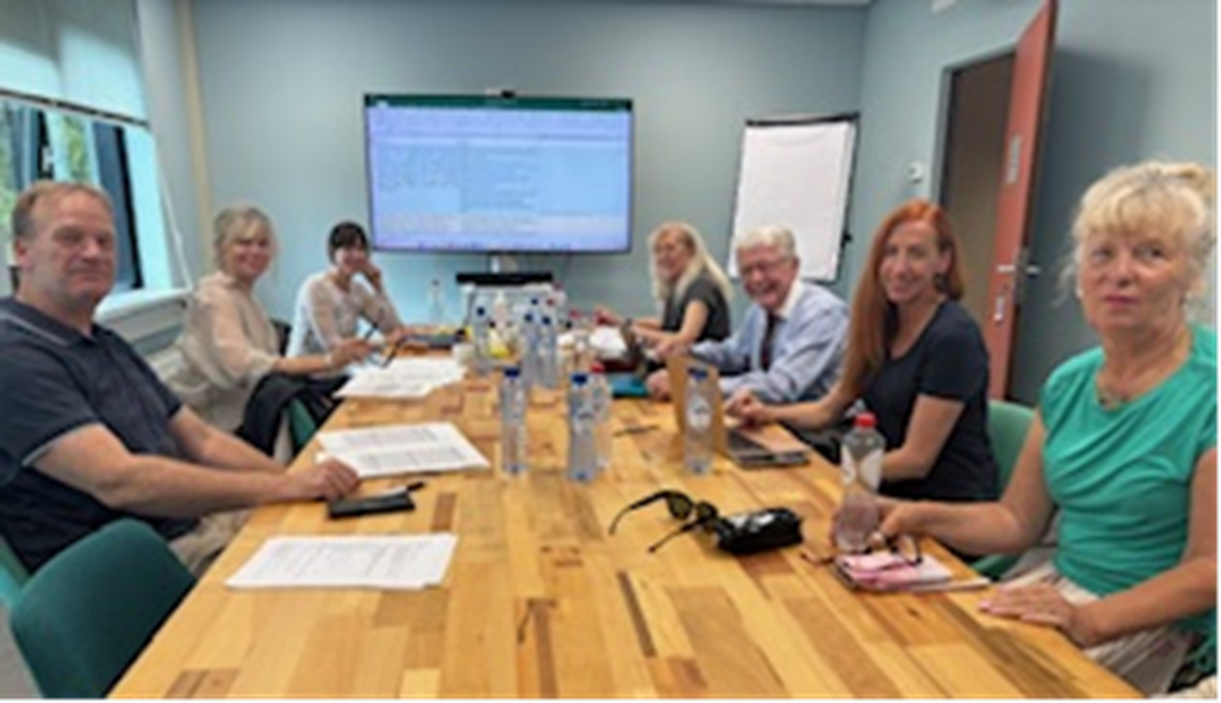
STANAG 6001 Working Group
U
P
D
A
T
E
Prof.
Dev.
Seminar
UZB
20
Oct
2025
The Hague, NDL, 1-3 Sept. 2025

Slide 20
STANAG 6001 Working Group
Background:
Periodic reviews of STANAGs are expected by NSO
Inconsistencies in French STANAG led to opportunity to review both Eng. & Fre
Need to modernise contexts of language use, genres (social media, etc.)
Ongoing discussion on the NS as reference point at BILC & in academia
General military, multi-national contexts of target language use
Focus Group was formed; survey sent out to all POCs
SC in Vienna approved WG status (May ’24);
WG met Vienna ‘24, Bergen ’24, Paris ’25, Zagreb ‘25, and Delft ‘25

Slide 21
STANAG 6001 Working Group
Approaches and decisions taken so far:
No major changes to levels, to tasks or functions
Defining threshold performance at each level & working only on base levels
Attempt at removing overlap: CTA + Text Type in stand-alone bands
Re-sequencing statements in ‘regular’ order from skill to skill & level to level
Attempt at using plain language to have clear meaning
No NS, reader, etc. reference: only high-proficiency language use / mastery
Adding general military & multi-national flavour
NATO Context, but scale useable for LOTE-F

Slide 22
STANAG 6001 Working Group
Program of Work:
Phase 1: Review of speaking descriptors at all levels
Review of level 2 in all skills (AKA the cross)
Phase 2: The cross to be reviewed by a selected number of expert reviewers.
WG adjusts and drafts full base levels at all skills
Phase 3: Full draft sent for revision by a small committee of experts and internal stakeholders. WG adjusts and finalises draft for SC.

Slide 23
STANAG 6001 Working Group
Listening | Speaking | Reading | Writing
 | 0
 | 1
2 | 2 | 2 | 2
 | 3
 | 4
 | 5
The “cross”

Slide 24
STANAG 6001 Working Group
Now in Phase 1:
Review of speaking descriptors is near complete
Review of listening level 2 has begun
A full week of work is being planned for April 2026
WG meetings prior to and during Annual Conference and Testing Workshop ‘26
Goal in 2026 is to complete the “cross” and have it reviewed by experts.

Slide 25
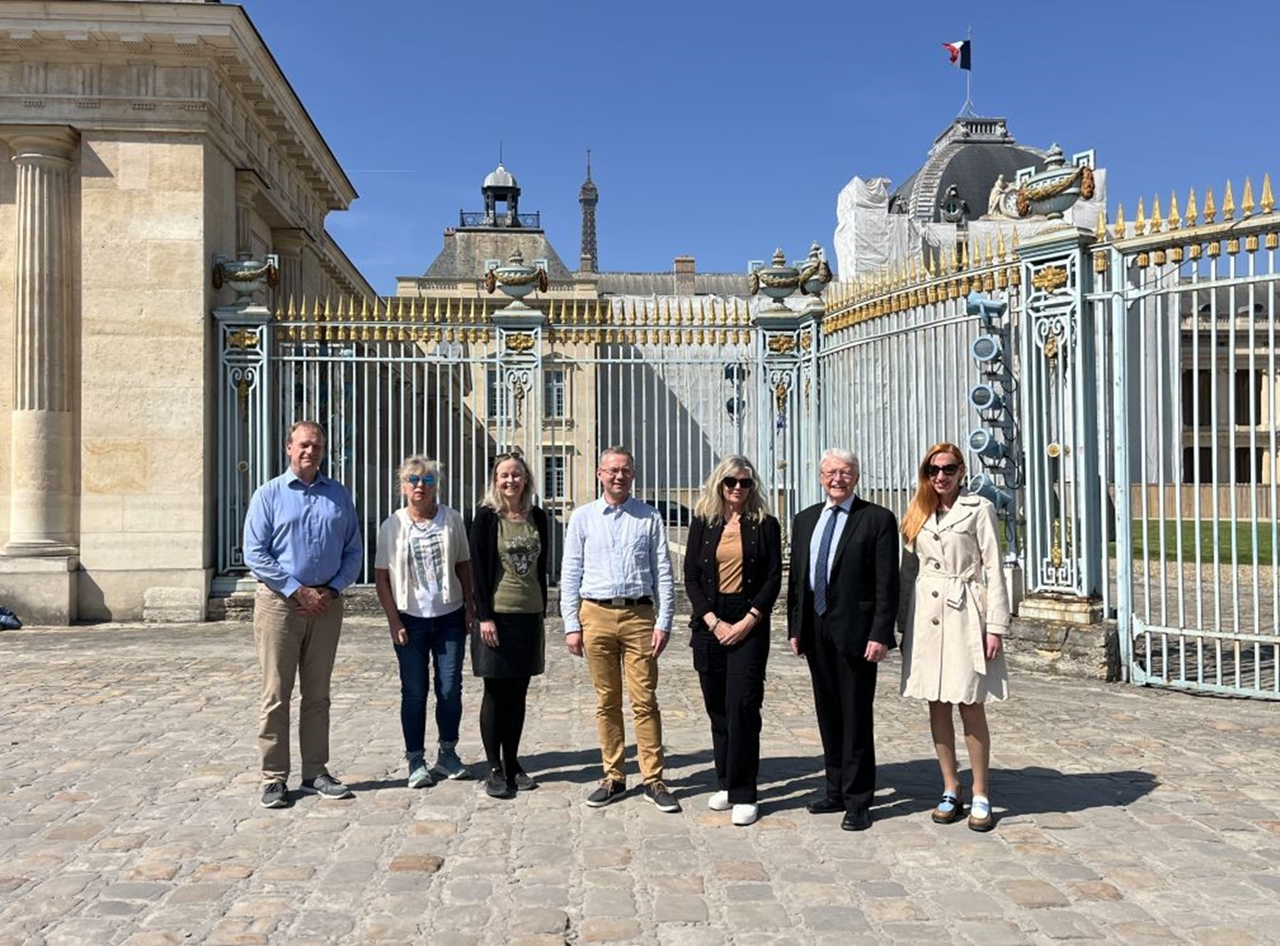


STANAG 6001 Working Group
École de Guerre
Paris
7-11 avril, 2025

