Slide 1






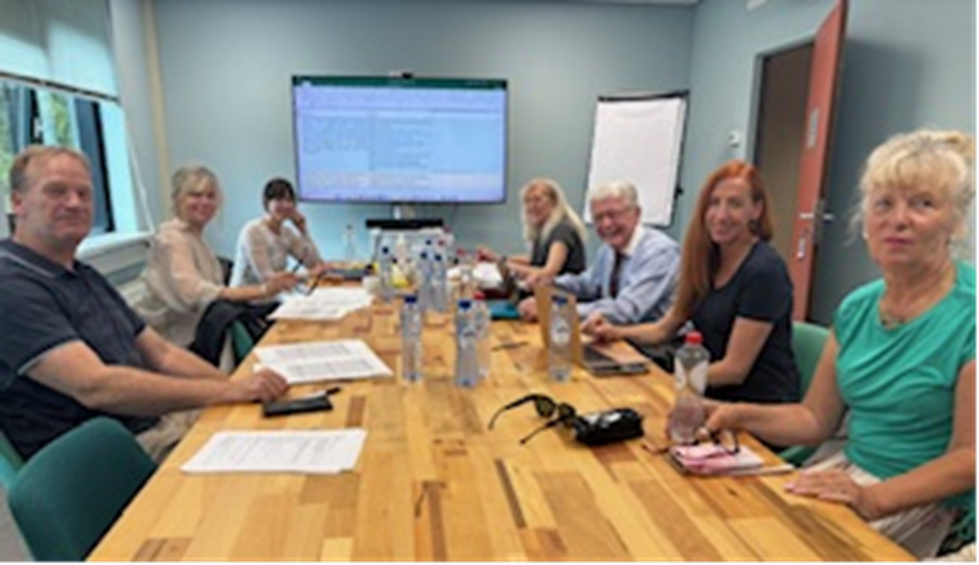
STANAG 6001 Working Group
U
P
D
A
T
E
Prof.
Dev.
Seminar
UZB
20
Oct
2025
The Hague, NDL, 1-3 Sept. 2025

Slide 2
STANAG 6001 Working Group
Background:
Periodic reviews of STANAGs are expected by NSO
Inconsistencies in French STANAG led to opportunity to review both Eng. & Fre
Need to modernise contexts of language use, genres (social media, etc.)
Ongoing discussion on the NS as reference point at BILC & in academia
General military, multi-national contexts of target language use
Focus Group was formed; survey sent out to all POCs
SC in Vienna approved WG status (May ’24);
WG met Vienna ‘24, Bergen ’24, Paris ’25, Zagreb ‘25, and Delft ‘25
Notes:
Every few years, the NATO STANDARDISATION OFFICE, asks STANAG custodians to review their standards. For all intents and purposes, BILC has not reviewed the content of STANAG 6001 in approximately two decades.
Over the years, BILC community members have commented that STANAG 6001 should be modernised as some contexts of language use are deemed obsolete and new ones have emerged.
There has also been much discussion on English as a Lingua franca, as well as on the concept of the native speaker as the reference. These discussions have taken place at BILC and in academic literature. The NS reference has been removed from some well-known scales
The BILC community has also asked the secretariat to address our multinational context of language use, and to add general military, defense or NATO examples and contexts to the scale, to distinguish it from other scales.
Therefore, in 2023, the secretariat formed a Focus Group with the purpose of assessing the extent of the review and proposing the way-ahead.
The Focus Group began by developing a survey asking nations to make suggestions on the potential improvements. Feedback from more than two dozen nations showed that respondents were in favour of updating the scale, and that they were overwhelmingly in favour of removing the native speaker concept and replacing it with a reference to exceptionally high proficiency regardless of how it was acquired. Respondents were also in favour of adding some military contexts but cautioned us not to modify the general proficiency nature of the scale.
After briefing the SC on these findings at the Annual BILC Conference in Vienna, in May 2024, the Steering Committee approved the change of status from Focus Group to Working Group.

Slide 3
STANAG 6001 Working Group
Approaches and decisions taken so far:
No major changes to levels, to tasks or functions
Defining threshold performance at each level & working only on base levels
Attempt at removing overlap: CTA + Text Type in stand-alone bands
Re-sequencing statements in ‘regular’ order from skill to skill & level to level
Attempt at using plain language to have clear meaning
No NS, reader, etc. reference: only high-proficiency language use / mastery
Adding general military & multi-national flavour
NATO Context, but scale useable for LOTE-F
Notes:
It was decided that:
There would be NO major changes to the levels; the standards would remain the same, and the tasks would remain the same.
We would define the threshold performance at level –. This will allow training to be consistent in interpreting the minimal performance required at each threshold.
We are only working on the base levels – we will have future consultations on the plus levels, and the use of descriptors for plus levels.
We would remove overlap as much as possible so that the tasks, content/context, text type, and accuracy statements are independent from each other.
The scale will be in a quatro-section format, as well as a full narrative, organised format.
Removing jargon – attempt at using plain language and to have clear meaning
Our methodology is allowing us to re-order the statements in a ‘regular’ sequence from level to level and skill to skill. We are also resequencing each statement within each criterion so that there is a hierarchy of difficulty, to make the scale more user-friendly, as the pattern will apply to all skills and levels.
Our goal is to define proficiency in terms of a ‘speaker’ who demonstrates exceptional mastery of the language, without reference to ‘nativeness’. Want to define language progression from none or little proficiency to exceptional mastery
We have begun adding some general military contexts and lexical elements to the contexts, while being very careful not to turn the scale into a performance or narrow military purpose scale.
While orientation is mostly NATO ELF language context, scale can still be used for Languages Other Than English & French

Slide 4
STANAG 6001 Working Group
Program of Work:
Phase 1: Review of speaking descriptors at all levels
Review of level 2 in all skills (AKA the cross)
Phase 2: The cross to be reviewed by a selected number of expert reviewers.
WG adjusts and drafts full base levels at all skills
Phase 3: Full draft sent for revision by a small committee of experts and internal stakeholders. WG adjusts and finalises draft for SC.
Notes:
Review is in 3 phases -
Phase 1: Review of speaking descriptors at all levels – and Review of level 2 in all skills (AKA the cross)
Once a solid draft of Speaking at all levels, and level 2 at all skills is ready, for Phase 2, WG will request input from several selected expert reviewers. These are people who have worked extensively with the scale, trained testers, who produce tests, are facilitators at the LTS and ALTS, etc. In phase 2, the WG adjusts and drafts full base levels at all skills
At phase 3: the WG will set up a committee made up of the same reviewers, and possibly some external reviewers, and BILC stakeholders who will represent the entire BILC community. They will provide the last round of input, before the WG finalises the draft which will go out for general viewing and SC approval.

Slide 5
STANAG 6001 Working Group
Listening | Speaking | Reading | Writing
 | 0
 | 1
2 | 2 | 2 | 2
 | 3
 | 4
 | 5
The “cross”

Slide 6
STANAG 6001 Working Group
Now in Phase 1:
Review of speaking descriptors is near complete
Review of listening level 2 has begun
A full week of work is being planned for April 2026
WG meetings prior to and during Annual Conference and Testing Workshop ‘26
Goal in 2026 is to complete the “cross” and have it reviewed by experts.
Notes:
Review of speaking descriptors is near complete with work having started on listening level 2.
We now have enough experience to know that while we can remotely prepare for our meetings, we must be F2F to review and co-draft.
The estimated timeline for a completed draft update of STANAG 6001 (Base Levels) has been tentatively planned within the next couple of years
As I’ve said before, while this timeline may appear to be somewhat unambitious, one must consider that all work is performed through voluntary national contributions (VNC), by professionals who have other full-time functions.

Slide 7
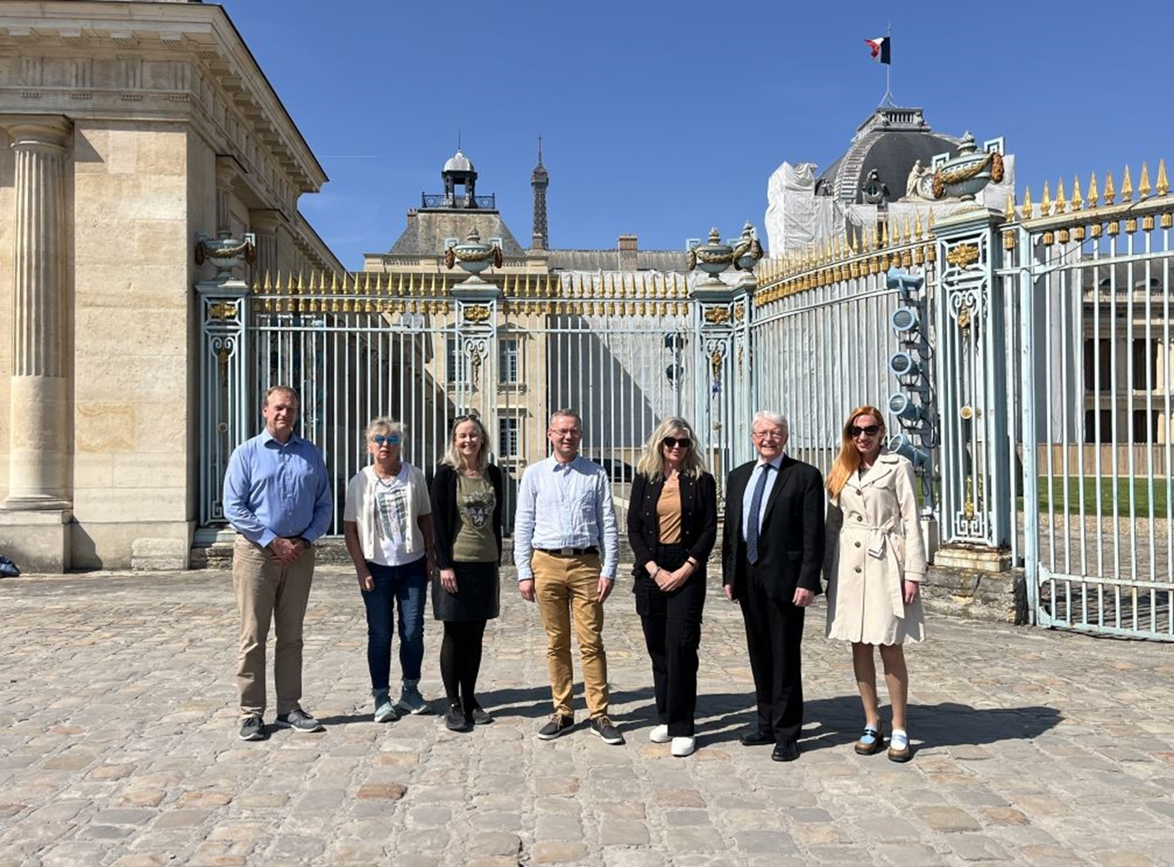


STANAG 6001 Working Group
École de Guerre
Paris
7-11 avril, 2025
Notes:
Now, I would like to thank WG members for their hard work and dedication to this endeavour:
French co-leader, Jerome Collin, Jana Vasilj-Begovic from Canada, Merit Kompus from Estonia, Gerard Seinhorst from the Netherlands, Birgitte Grande from Norway, our Senior advisor, Ray Clifford, and our dear American colleagues from PLTCE: Peggy Garza and Andrea Gjorevski who were unfortunately unable to attend this Seminar.
Thank you for your attention.

