Slide 1


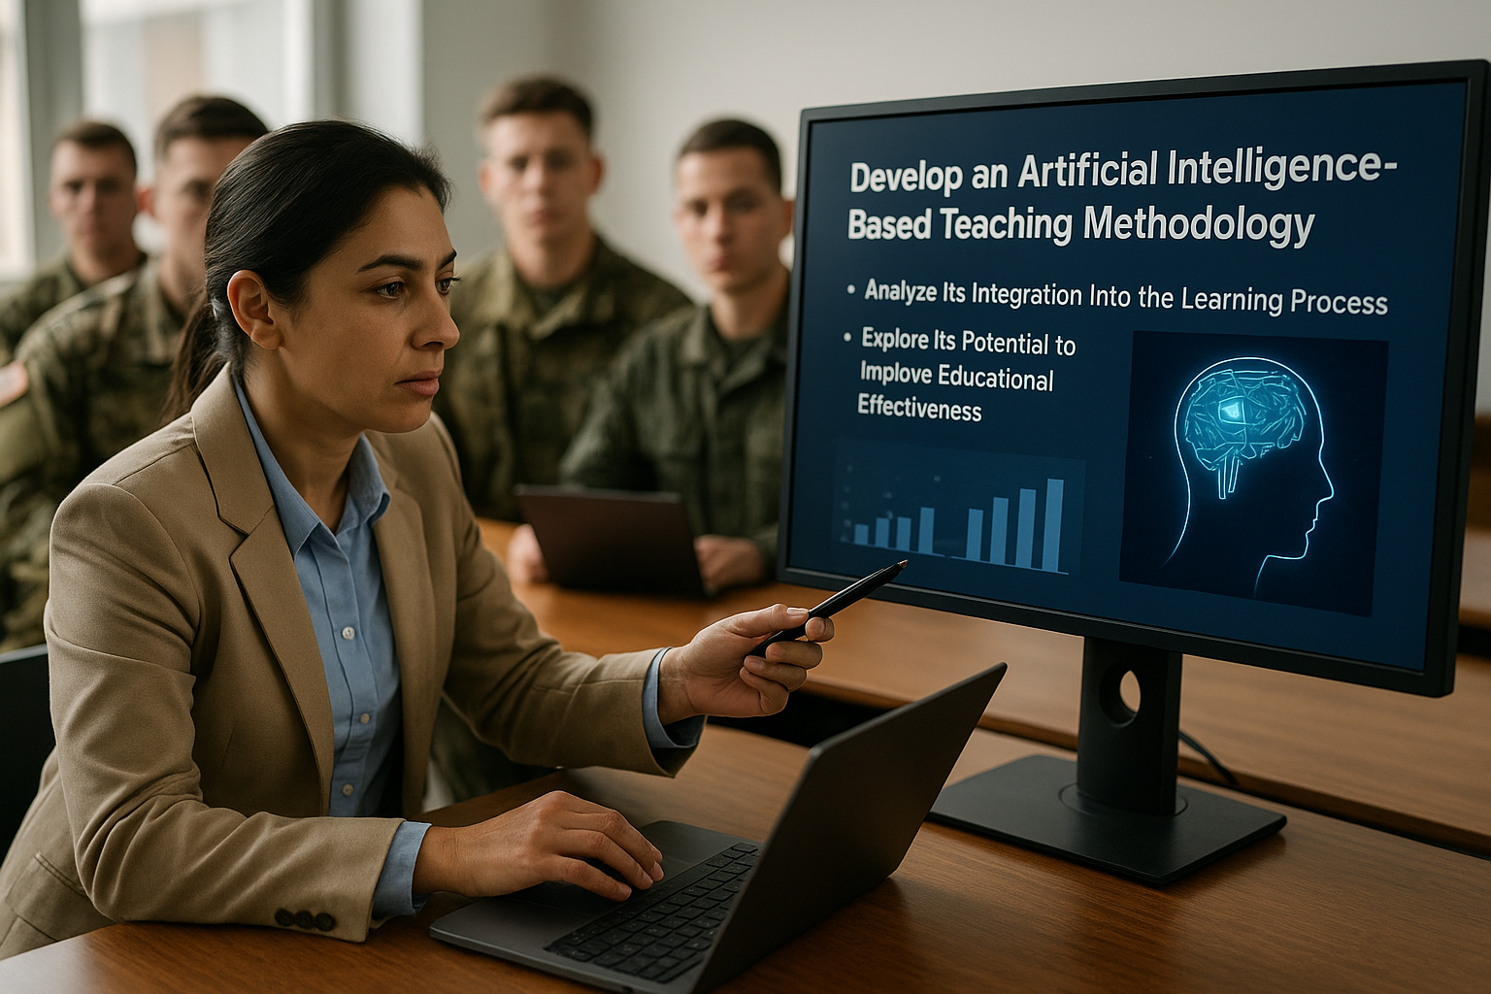
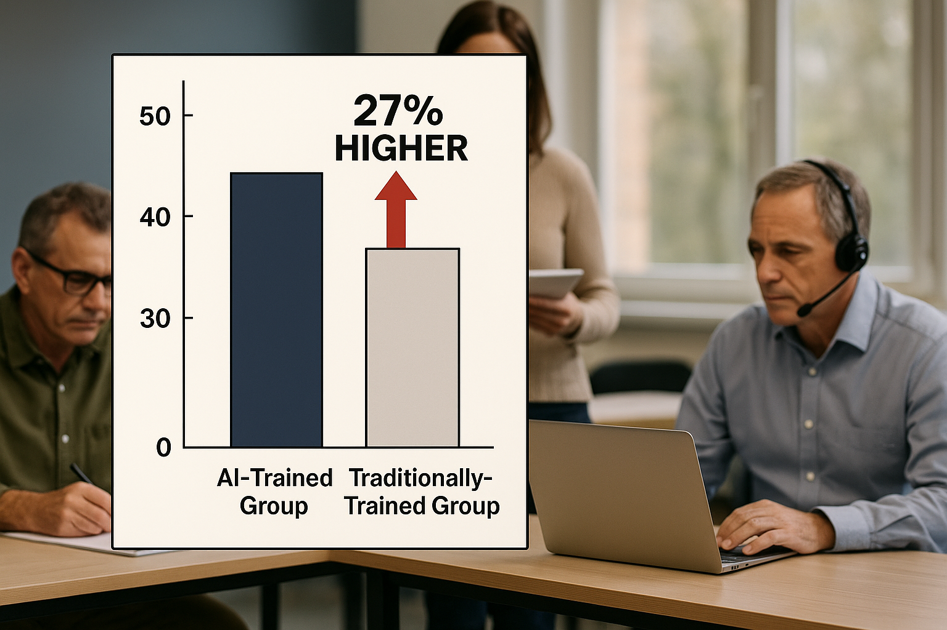
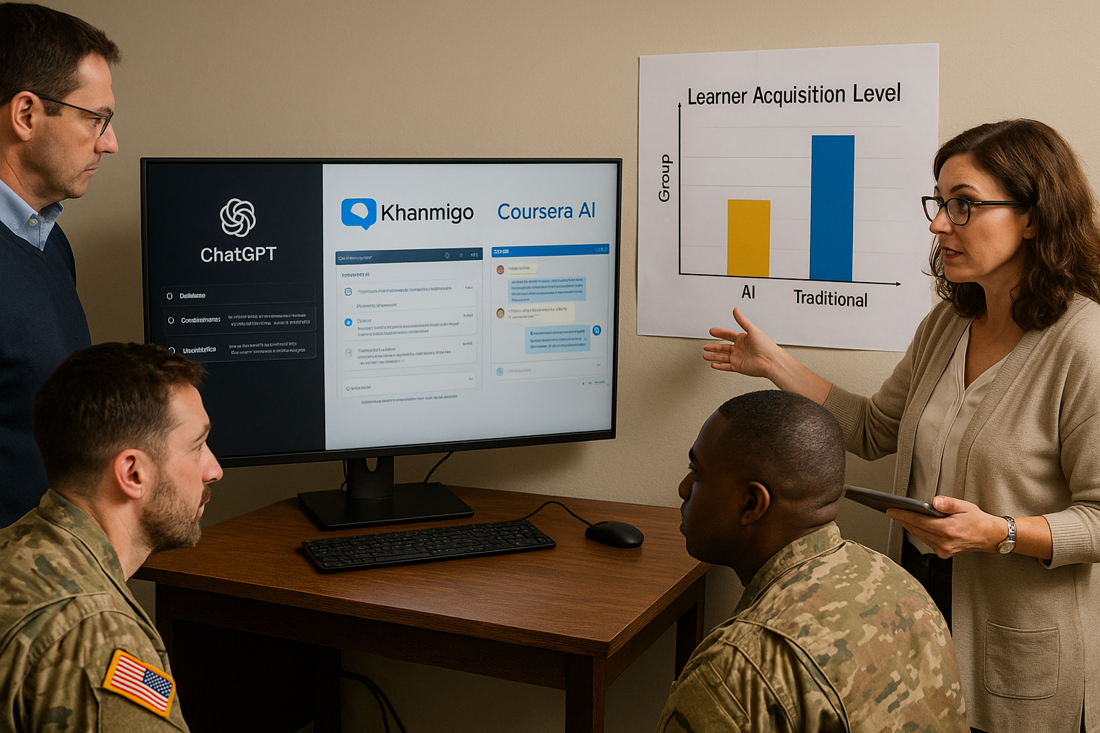
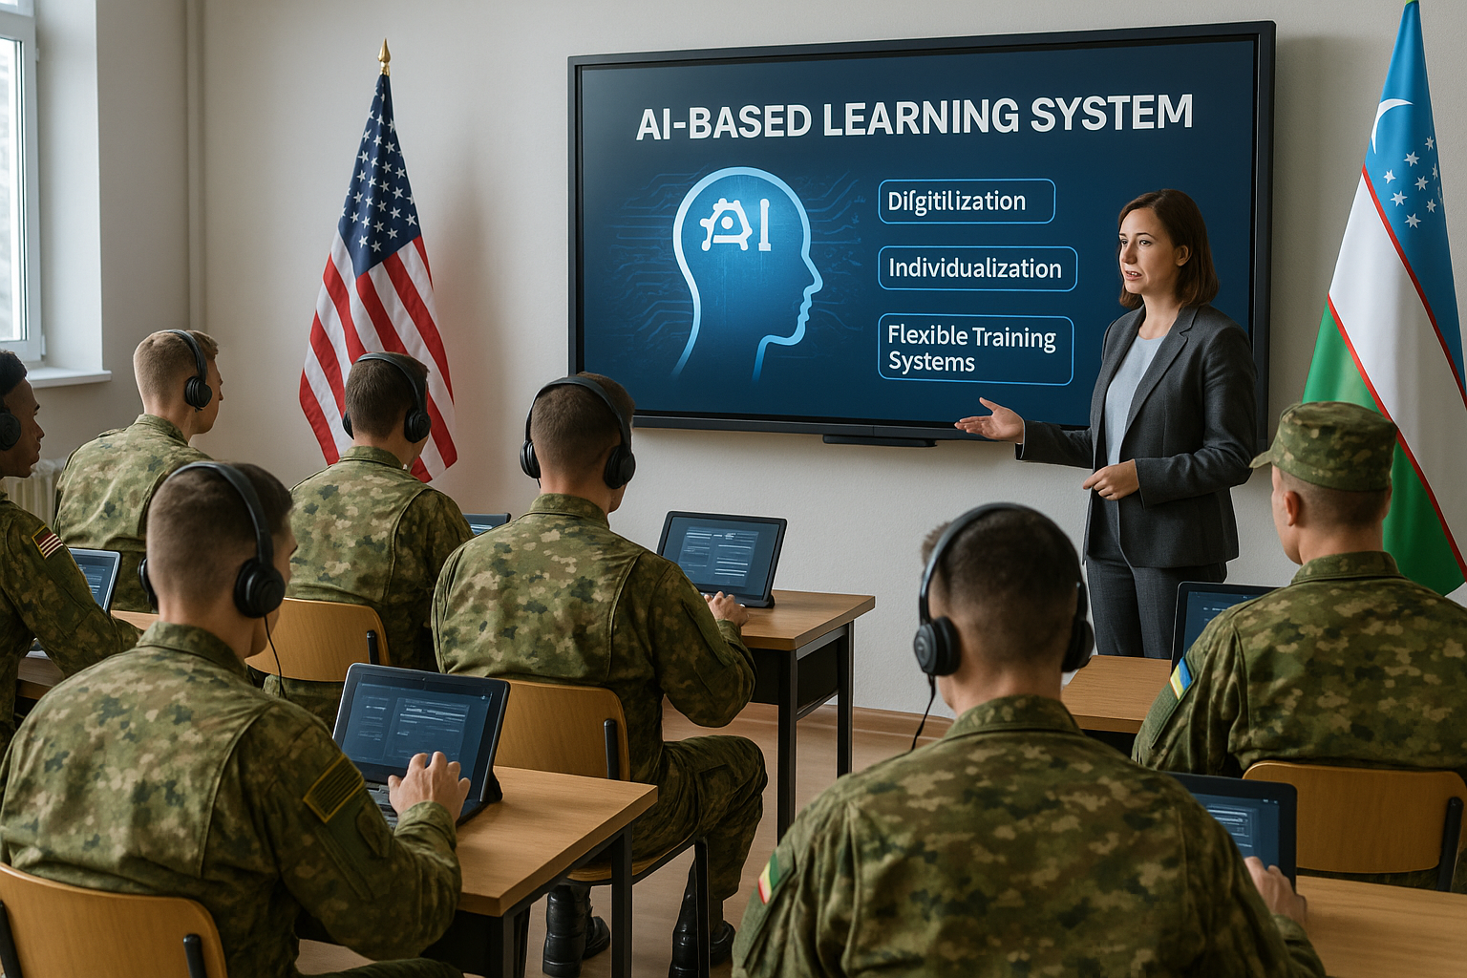




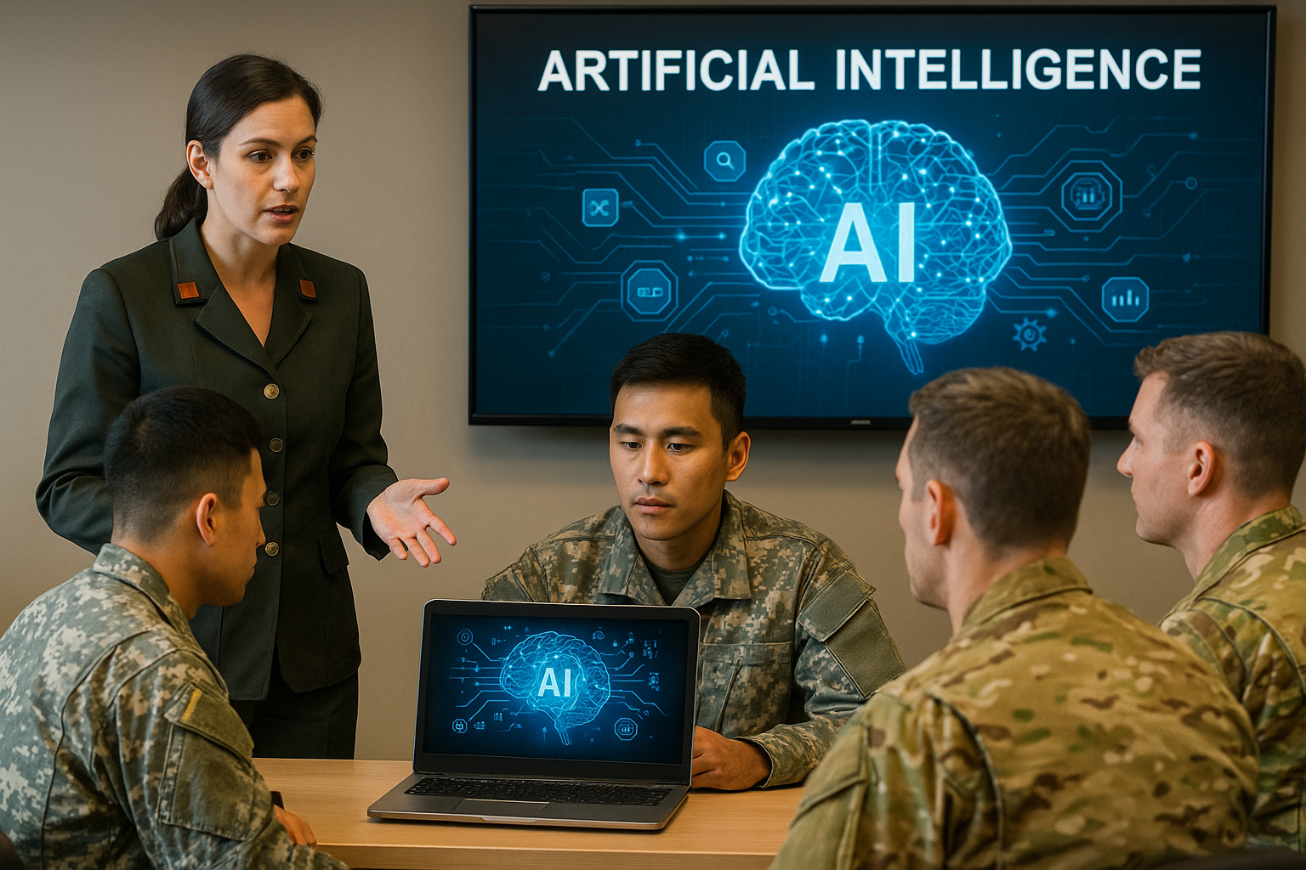



TEACHING MILITARY TERMINOLOGY WITH AI
🧭
1.Introduction
🔬
2. Purpose
3. Methods
📈
4. Results
⚙️
The modern educational system is radically changing under the influence of artificial intelligence technologies. Traditional teaching approaches can no longer fully meet the individual needs of cadets. Therefore, it is necessary to update the educational methodology in accordance with AI technologies through digitization, individualization and flexible training systems.
Develop an artificial intelligence-based teaching methodology, analyze its integration into the learning process, and explore its potential to improve educational effectiveness.
Analytical method: studying existing AI-learning platforms (ChatGPT, Khanmigo, Coursera AI).
Experimental approach: test sessions for teachers on the use of AI-assistants. Statistical analysis: comparison of learner acquisition levels in AI and traditional group.
In a group trained by using AI, the level of mastering is 27% higher. There has been an increase in motivation and independent thinking. Teachers have created time-saving and personalized assessment opportunities.
💡
5. Conclusion
🔗
6. Recommendations
Driving change: A vision for AI in learning
Traditional
Individualisation
The application of AI to the educational process requires updating not only the technological, but also the pedagogical approach. In the future, the role of teachers will shift to more mentoring and intellectual orientation. The development of AI competencies in the educational system should be the main priority.
Introduction of AI-literacy courses for teachers. Adaptation of AI-based adaptive learning platforms to the national education system. Changing curricula to an” AI-friendly " model.
Instructor-led classroom training
Personalised learning paths with AI
Digitisation
Future-Ready
Convert materials to digital
formats
Cadets equipped for modern demands
👩‍🏫
Author: Mengliyeva Sunbula University of Public Safety of the Republic of Uzbekistan
This transition is essential to move from static to dynamic, adaptive systems that produce
optimally skilled cadets.
📧
еmail: sunbulamengliyeva.@gmail.com

