Slide 1
English vs. Second Foreign Language:
What Should we Focus on?
COL (GS) Assoc. Prof. Vladan Holcner, Ph.D.
11th May 2026

Slide 2
Outline
1. Introduction
2. Context of L2 and L3 Education in the Czech Armed Forces
3. Case Study: Russian Language Military Terminology Courses for Non-Intepreters
4. Key Lessons Learnt
5. Conclusion
COL (GS) Assoc. Prof. Vladan Holcner, Ph.D.
11th May 2026

Slide 3
Outline
1. Introduction
2. Context of L2 and L3 Education in the Czech Armed Forces
3. Case Study: Russian Language Military Terminology Courses for Non-Interpreters
4. Key Lessons Learnt
5. Conclusion
COL (GS) Assoc. Prof. Vladan Holcner, Ph.D.
1th May 2026

Slide 4
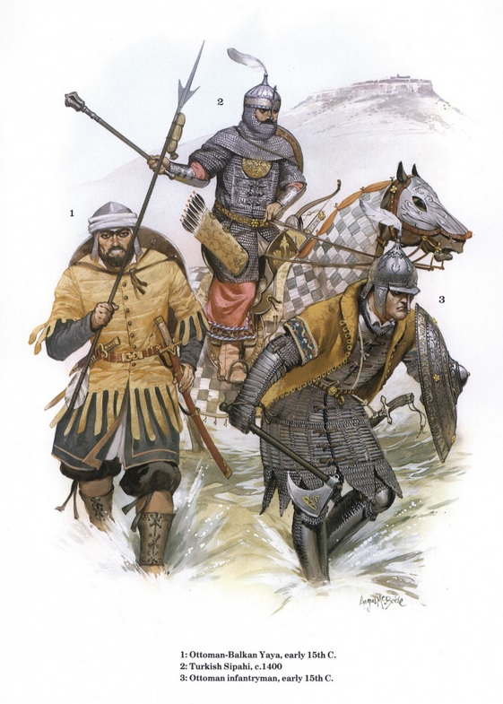
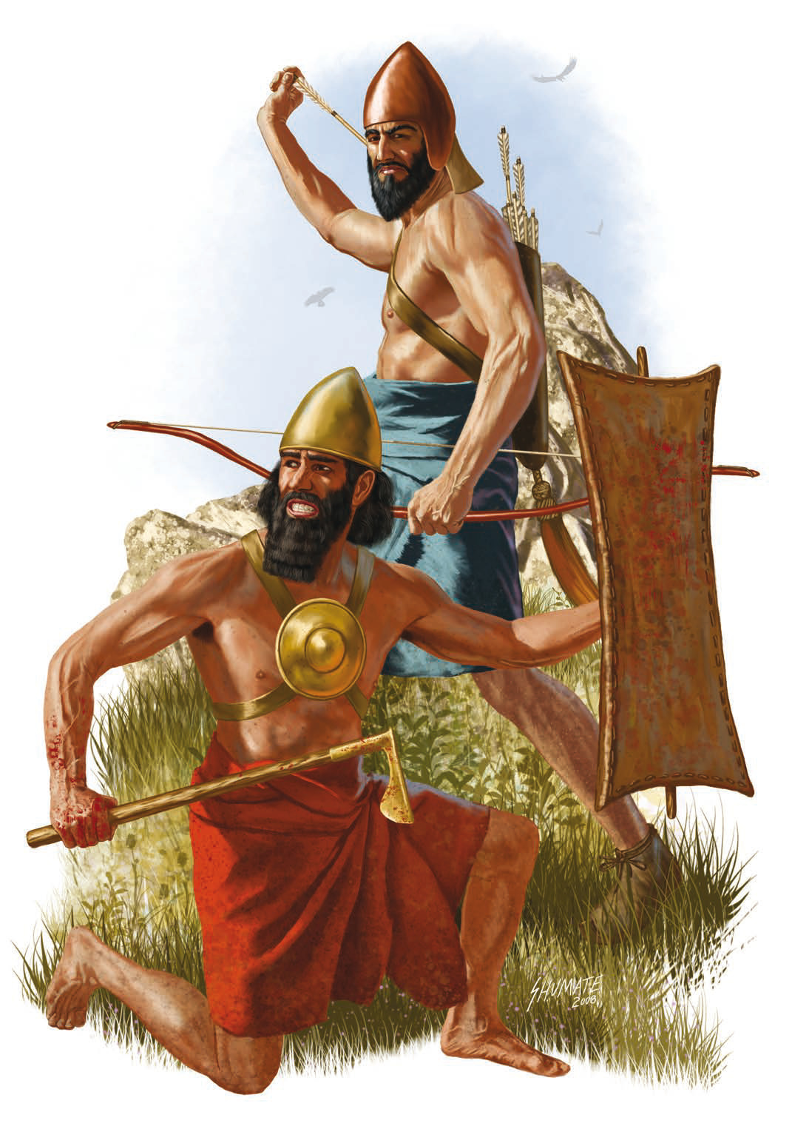
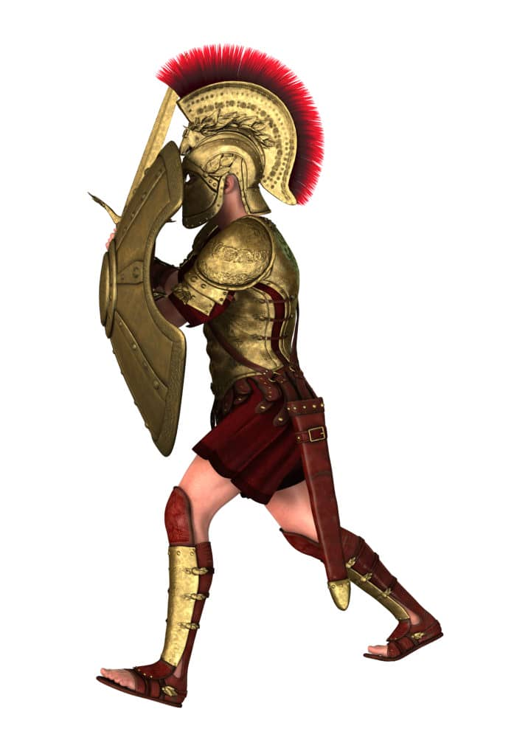
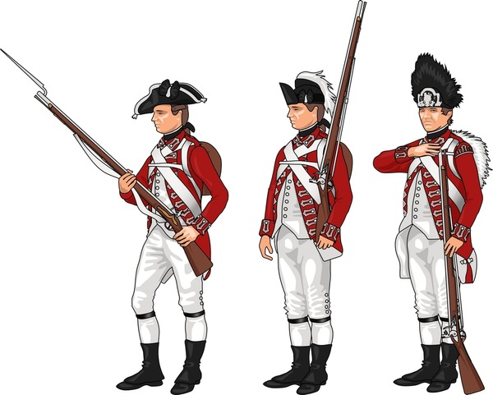
1. Introduction
Is single foreign language as lingua franka sufficient?
COL (GS) Assoc. Prof. Vladan Holcner, Ph.D.
11th ?ay 2025
Notes:
A lingua franca is a common bridge language that people with different native languages use so they can communicate with each other. It’s not necessarily anyone’s mother tongue — it’s the shared language that makes trade, diplomacy, travel, or cooperation possible.
A lingua franca is:
A shared communication language — used between groups who don’t share a native language
A practical tool — chosen for convenience, not identity
Often tied to power or trade — empires, religions, and markets spread them
Not always the dominant group’s language — sometimes nobody speaks it as a mother tongue
The term itself comes from medieval Mediterranean trade, where merchants used a mix of Italian, French, Arabic, Greek, and Spanish — called “Lingua Franca” or “Frankish language.”

Slide 5
1. Introduction
What is lingua franka?
Common bridge language that people with different native languages use so they can communicate with each other. It’s not necessarily anyone’s mother tongue — it’s the shared language that makes trade, diplomacy, travel, or cooperation possible.
A shared communication language — used between groups who don’t share a native language
A practical tool — chosen for convenience, not identity
Often tied to power or trade — empires, religions, and markets spread them
Not always the dominant group’s language
COL (GS) Assoc. Prof. Vladan Holcner, Ph.D.
11th ?ay 2025
Notes:
A lingua franca is a common bridge language that people with different native languages use so they can communicate with each other. It’s not necessarily anyone’s mother tongue — it’s the shared language that makes trade, diplomacy, travel, or cooperation possible.
A lingua franca is:
A shared communication language — used between groups who don’t share a native language
A practical tool — chosen for convenience, not identity
Often tied to power or trade — empires, religions, and markets spread them
Not always the dominant group’s language — sometimes nobody speaks it as a mother tongue
The term itself comes from medieval Mediterranean trade, where merchants used a mix of Italian, French, Arabic, Greek, and Spanish — called “Lingua Franca” or “Frankish language.”

Slide 6
1. Introduction
Is single foreign language as lingua franka sufficient?
Antiquity:
Sumerian,
Middle Ages:
Arabic,
Early Modern Period:
Ottoman Turkish,
Modern Era:
English,
Modern Standard Arabic,
French,
Spanish,
Swahili,
Mandarine Chinese
Portuguese,
Spanish,
French,
Russian
Persian,
Sanskrit,
Classical Chinese,
Turkic languages
Swahili,
Akkadian,
Egyptian,
Aramaic,
Classical Greek,
Latin
COL (GS) Assoc. Prof. Vladan Holcner, Ph.D.
11th May 2026
Notes:
A lingua franca is a common bridge language that people with different native languages use so they can communicate with each other. It’s not necessarily anyone’s mother tongue — it’s the shared language that makes trade, diplomacy, travel, or cooperation possible.
A lingua franca is:
A shared communication language — used between groups who don’t share a native language
A practical tool — chosen for convenience, not identity
Often tied to power or trade — empires, religions, and markets spread them
Not always the dominant group’s language — sometimes nobody speaks it as a mother tongue
The term itself comes from medieval Mediterranean trade, where merchants used a mix of Italian, French, Arabic, Greek, and Spanish — called “Lingua Franca” or “Frankish language.”

Slide 7
Outline
1. Introduction
2. Context of L2 and L3 Education in the Czech Armed Forces
3. Case Study: Russian Language Military Terminology Courses for Non-Interpreters
4. Key Lessons Learnt
5. Conclusion
COL (GS) Assoc. Prof. Vladan Holcner, Ph.D.
11th May 2026

Slide 8
2. Context of L2 and L3 Education in the Czech Armed Forces
Czech society:
34% Czech active English speakers but just 11% fairly good (13 % Russian, 20% German), English language competence tend to improve;
1/3 of the Czech population speaks just Czech;
Multilingualism lower than in Western European countries;
Limited exposure to authentic language (society diversity, mass media);
According to some comparisons Czechs belong among the 3 EU members with the lowest level of foreign language competences.
Czech military:
English language competences an integral part of formal requirements link to majority of military appointments;
SLP focused language training included in curricula for cadets (English + L3);
Adequate teaching capacity (90+% focused on English language, 90+% not focused on language for specific purposes);
Robust testing capacity (recruits, cadets, courses, others).
COL (GS) Assoc. Prof. Vladan Holcner, Ph.D.
11th May 2026

Slide 9
Outline
1. Introduction
2. Context of L2 and L3 Education in the Czech Armed Forces
3. Case Study: Russian Language Military Terminology Courses for Non-Interpreters
4. Key Lessons Learnt
5. Conclusion
COL (GS) Assoc. Prof. Vladan Holcner, Ph.D.
11th May 2026

Slide 10
3. Case Study: Russian Language Military Terminology Courses for Non-Interpreters
Since 1990s, language education has been developed in the Czech military as a part of national ambitions to join NATO and later to be interoperable ally.
Gradual decline of Russian language education in the society as well as in the military.
Language Centre of the University of Defence represents the key component of the language education in the Czech military responsible for cadets' language education, armed forces personnel language education testing IAW NATO STANAG 6001 and placement testing.
LC language portfolio: English, German, French, Russian, Czech + Ukrainian (since 2024).
Since 2022, Czech society and Czech military focused on supporting Ukrainian defense against Russian aggression including military training of Ukrainian soldiers in the Czech Republic.
Need to ensure mutual understanding Czech instructors vs. Ukrainian recently drafted soldiers.
COL (GS) Assoc. Prof. Vladan Holcner, Ph.D.
11th May 2026
Notes:
(

Slide 11
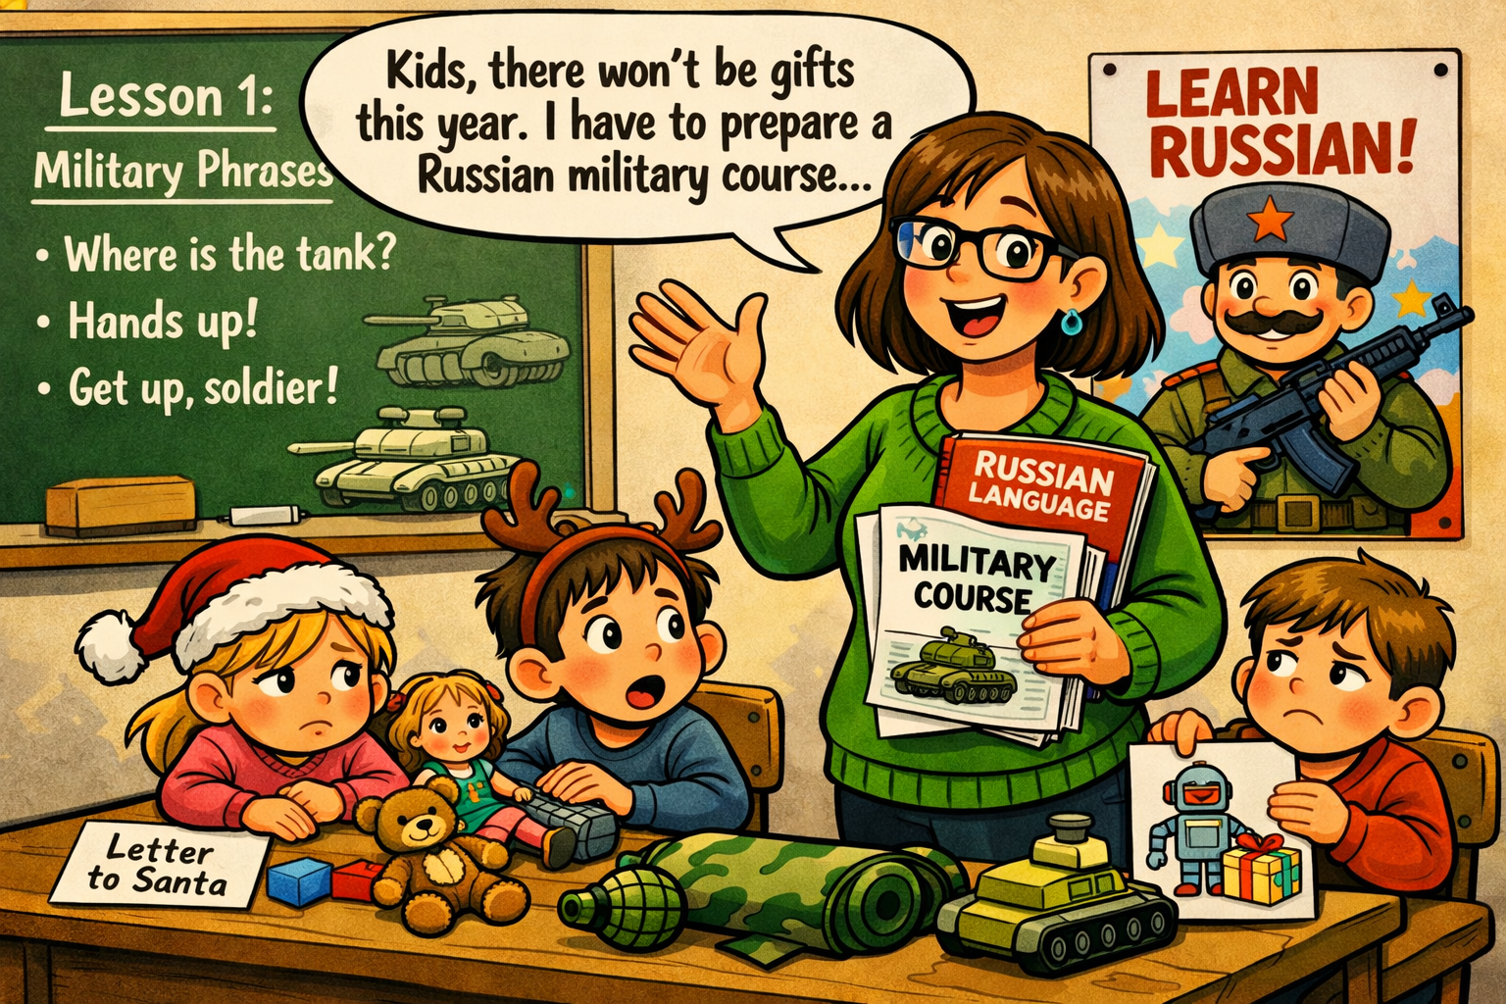
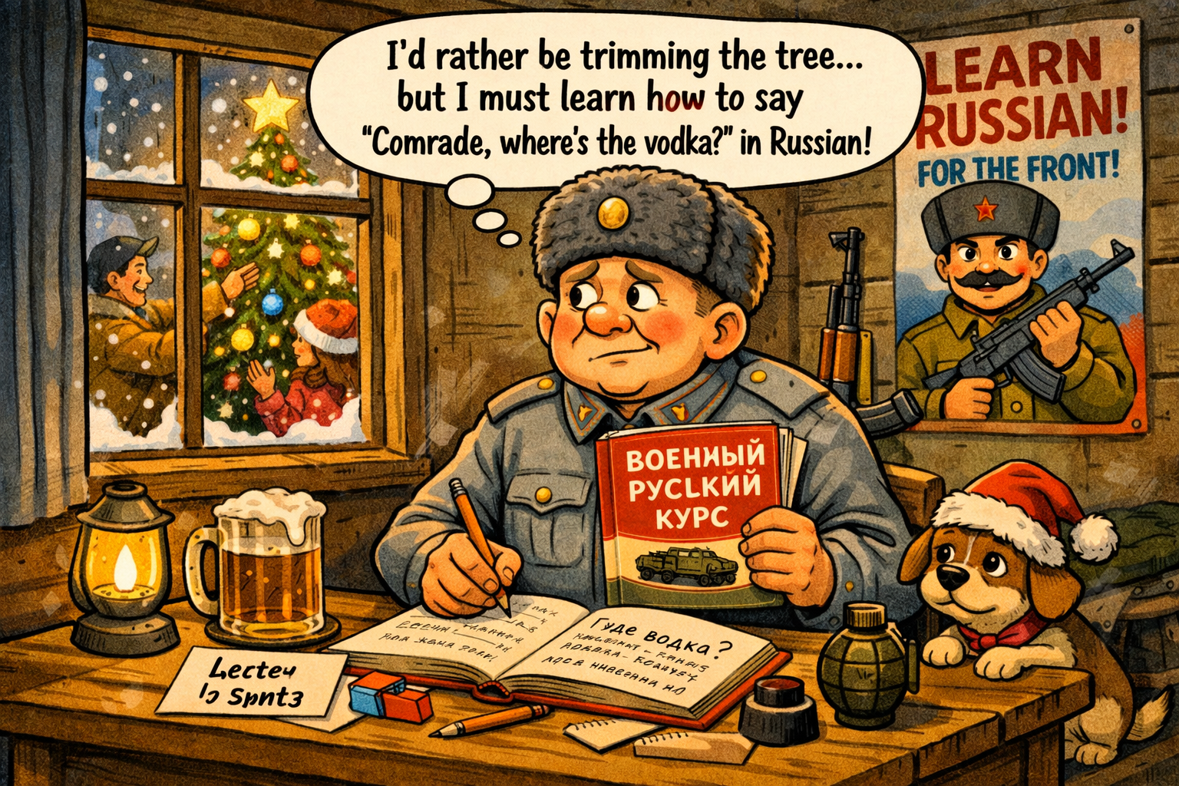
3. Case Study: Russian Language Military Terminology Courses for Non-Interpreters
21st December 2023:
UoD Language Centre receives a request from the MoD to organize Russian language terminological courses for personnel of the Czech Armed Forces selected to support as interpreters training of Ukrainian forces.
COL (GS) Assoc. Prof. Vladan Holcner, Ph.D.
11th May 2026

Slide 12
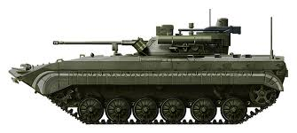
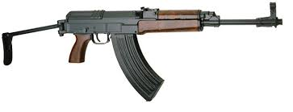
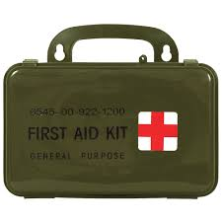
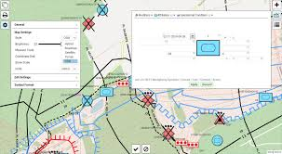
3. Case Study: Russian Language Military Terminology Courses for Non-Interpreters
What was known then:
Term of the course: January 17 – 26, 2023 (just 13 working days available for preparation of the course);
Number of participants;
Requested areas of military terminology (first aid, engineering, topography, firing commands and principles, small arms design, essentials of BMP2 design).
What was unknown then:
Level of Russian language competences of participants;
Level of military expertise of participants;
Participants motivations/attitudes;
How to fit so much contents in such a short time;
How many similar courses will be requested in the future.
COL (GS) Assoc. Prof. Vladan Holcner, Ph.D.
11th May 2026

Slide 13
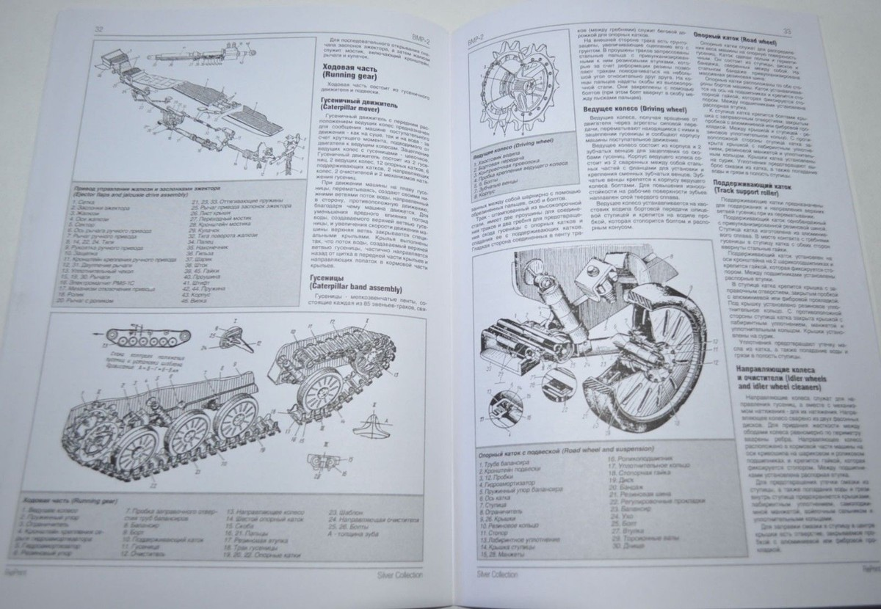
3. Case Study: Russian Language Military Terminology Courses for Non-Interpreters
What was available:
2 senior Russian language instructors with some experience of teaching military terminology in the past.
3 junior Russian language instructors with no experience of teaching military terminology.
Textbooks in Russian language published before 1990, covering some of the requested terminology areas (e.g. BMP2 or small arms design).
COL (GS) Assoc. Prof. Vladan Holcner, Ph.D.
11th May 2026

Slide 14
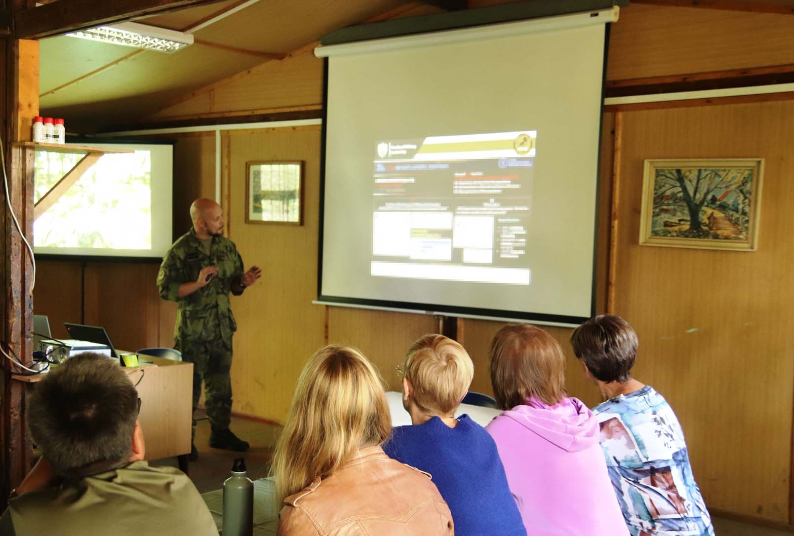
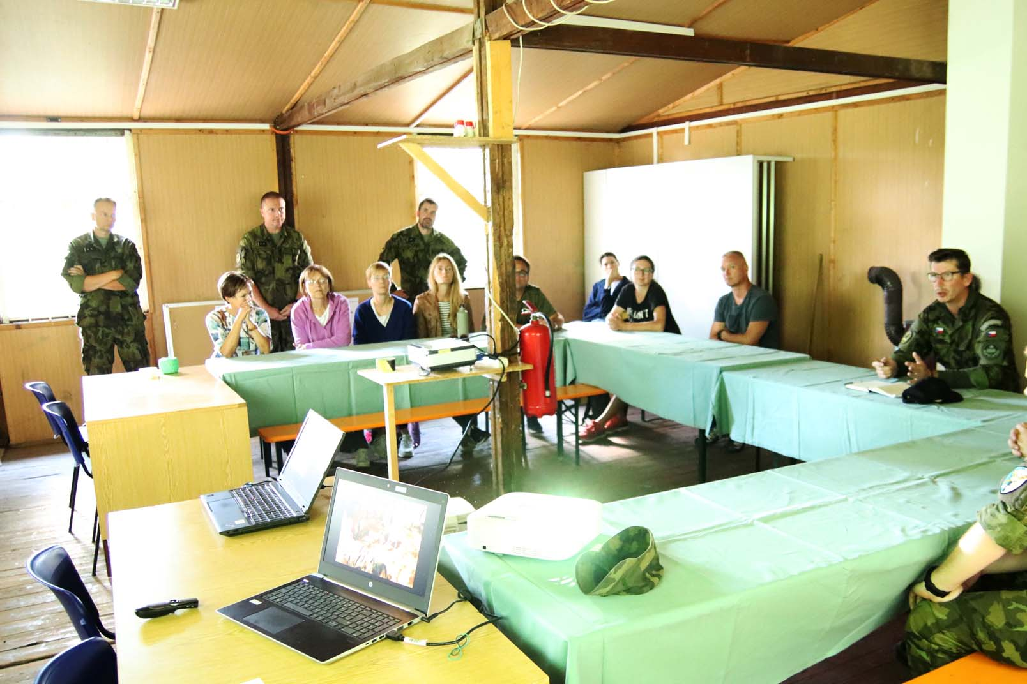
3. Case Study: Russian Language Military Terminology Courses for Non-Interpreters
Pilot course 17 – 26 January 2023:
Large audience (19 participants of the course - necessary to split the group);
Substantial differences (not only) in Russian language competences (native speaker up to beginner-to-intermediate);
Substantial differences in learning motivation resulting from different information among course participants;
Few course participants were able to assist Russian language instructors (their language competences and/or their subject-matter expertise);
Focus on introducing to individual terminological areas and preparing/sharing e-learning materials for further self-study;
Feedback from the course participants after the course and after they assisted training of Ukrainian soldiers;
Field trip of Russian language instructors to military training area (personal observations of the training activities and performance of course participants);
Numerous amendments in the course structure and contents – preparation for next runs.
COL (GS) Assoc. Prof. Vladan Holcner, Ph.D.
11th May 2026

Slide 15
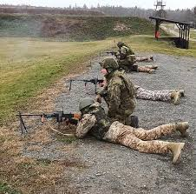
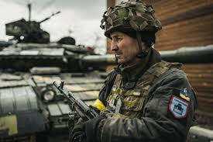
3. Case Study: Russian Language Military Terminology Courses for Non-Interpreters
Four further runs of the course (March 2023 through September 2024)
Altogether for 57 participants;
Courses continuously modified;
Participants of previous runs with actual experience from interpreting during the training involved as co-faciltators;
Continuing focus on producing and sharing learning materials ;
After 2024 just 4 different Russian language courses implemented
Fr 39 participants in total
Consisting of 2x terminological, 1x level 1 and 1xlevel 2 courses)
COL (GS) Assoc. Prof. Vladan Holcner, Ph.D.
11th May 2026

Slide 16
Outline
1. Introduction
2. Context of L2 and L3 Education in the Czech Armed Forces
3. Case Study: Russian Language Military Terminology Courses for Non-Interpreters
4. Key Lessons Learnt
5. Conclusion
COL (GS) Assoc. Prof. Vladan Holcner, Ph.D.
11th May 2026

Slide 17
4. Key Lessons Learnt (1)
Dominant (strictly formally required) focus on English crowded out interest and capacities of L3 education.
No motivation of personnel to increase/maintain their L3 language competences.
Russian language was especially impacted because in the past it was the language “we had to learn“.
Dominant focus on SLP crowded out capacities for teaching languages for specific purposes.
NATO staff officers “communication illusion“ overshadowed the need to communicate with regular soldiers, local population etc.
Defense policy expected regions of interest of the Czech military were not translated in requirements/need for communication capabilities in languages talked in these regions.
COL (GS) Assoc. Prof. Vladan Holcner, Ph.D.
11th May 2026

Slide 18
4. Key Lessons Learnt (2)
Political decision and orders must be followed but:
Enhancing language competences needs time;
Terminology does not work without general language competences;
Teaching staff required to teach terminology needs time and support;
Lack of understanding (due to insufficient language competences) affects training effectiveness;
Lack of understanding (due to insufficient language competences) affects combat effectiveness.
It is always worth trying your best to provide as much „language service“ as possible to help the learners instead of being frustrated that you cannot do it perfect!
Despite all the adverse circumstances, it’s possible to do a solid job when you have such a great team as I do at the Language Centre (lucky me)!!
COL (GS) Assoc. Prof. Vladan Holcner, Ph.D.
11th May 2026

Slide 19
Outline
1. Introduction
2. Context of L2 and L3 Education in the Czech Armed Forces
3. Case Study: Russian Language Military Terminology Courses for Non-Interpreters
4. Key Lessons Learnt
5. Conclusion
COL (GS) Assoc. Prof. Vladan Holcner, Ph.D.
11th May 2026

Slide 20
5. Conclusion
Should we focus on English or second foreign language?
This question is irrelevant.
It seems to be necessary to focus on English as lingua franka while maintaining capabilities in languages spoken in regions that are in long-term perspective relevant for expected activities of the armed forces.
Therefore, we have to focus on English as well as on second foreign language(s).
COL (GS) Assoc. Prof. Vladan Holcner, Ph.D.
11th May 2026

Slide 21
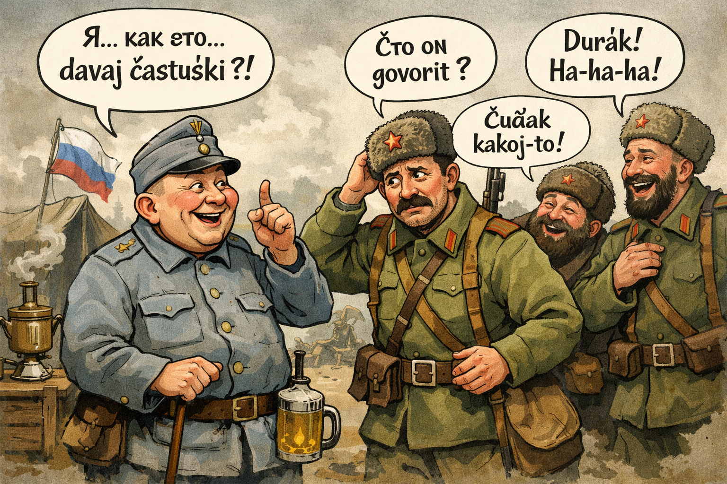
Thank you for your attention.
COL (GS) Assoc. Prof. Vladan Holcner, Ph.D.
11th May 2026

