Slide 1




2026
NATO BILC Conference
Budapest, Hungary
BILC Chair Update
Monday 11 MAY 2026

Slide 2


In this update …
BILC: What it is and its history (very briefly)
The BILC organogram
The current BILC Secretariat
BILC’s vision
BILC’s three Ts: testing, teaching and terminology
BILC website – new address!
BILC and Partner Nations (DEEP)

Slide 3
BILC
Bureau for International
Language Coordination

Slide 4
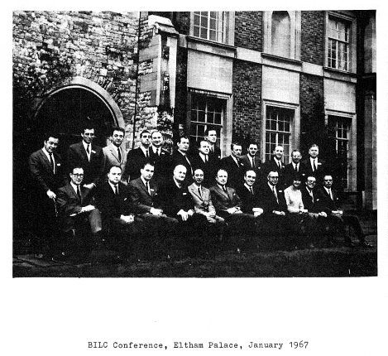








In the beginning… in 1966
Notes:
“There have always been profitable contacts between interested countries in the field of language training. The simple aim of the Bureau is to make these contacts even easier and more profitable in the future, and to extend their benefits more widely.”
BILC Bulletin 1967, Editorial, p. 5

Slide 5

HOST NATION
HOST NATION
Steering Committee
BILC Secretariat
Laura Murto
Satu Patronen
Anne Rivinoja
Senior Advisor
Dr Ray Clifford
BILC Associate Secretariat
Julie Dubeau
Jana Vasilj-Begovic
Edelmira Nickels
Peggy Garza
HOST NATION

Slide 6
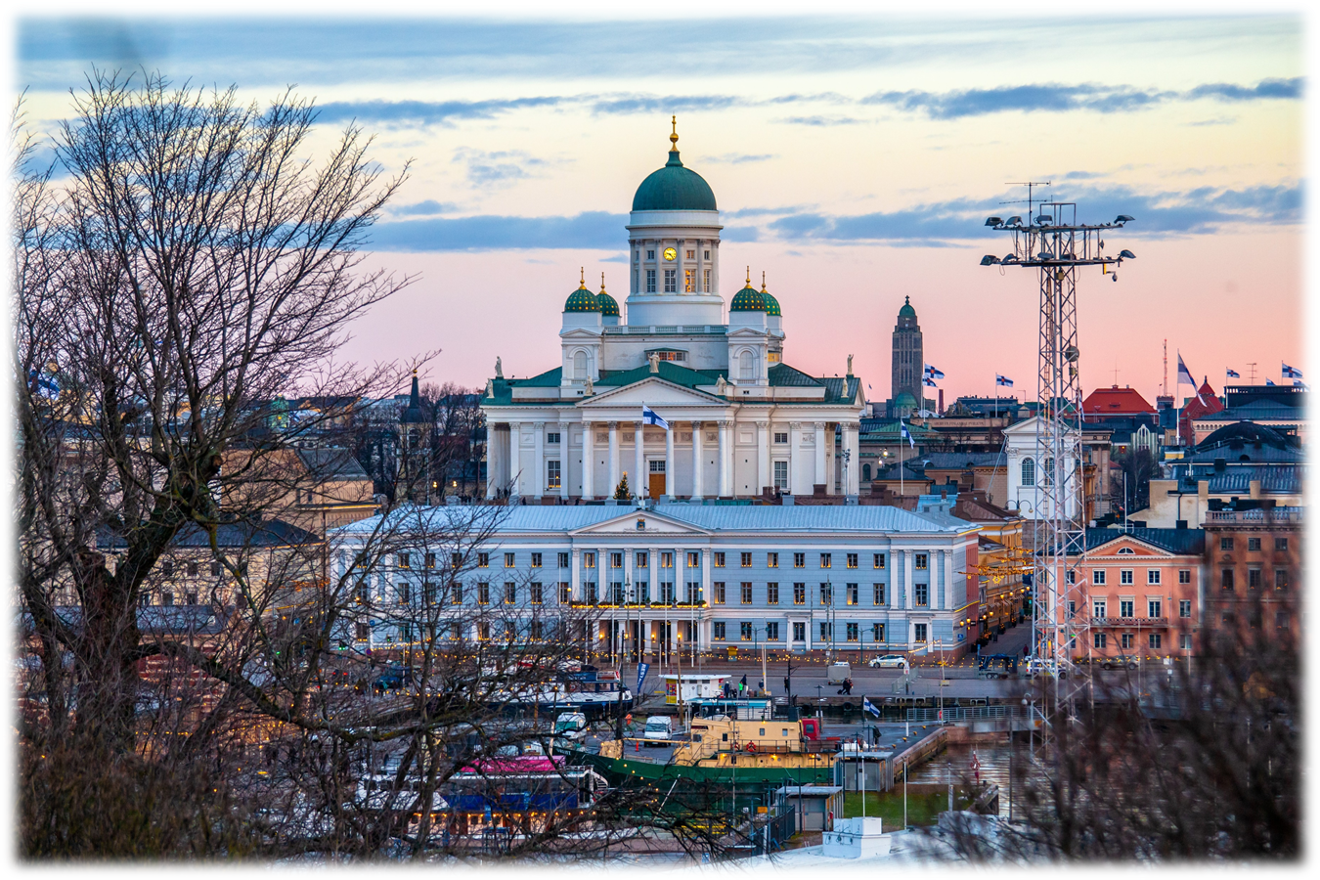

B
I
L
C
S
E
C
R
E
T
A
R
I
A
T
2
0
2
5
-
2
0
2
8

Slide 7
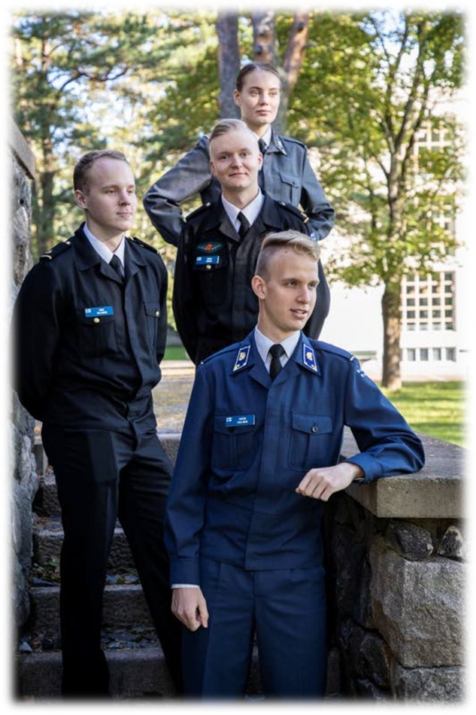
Finnish Defence Language Centre
Personnel: 14 language specialists (civilian), all with a Master’s Degree or more
Languages: Swedish, English, French, German and Russian
Language Services: interpreting, translating, terminology management, proofreading, language training for personnel
Language Training: teaching future officers (Bachelors and Masters)
STANAG 6001 Testing Centre FIN

Slide 8
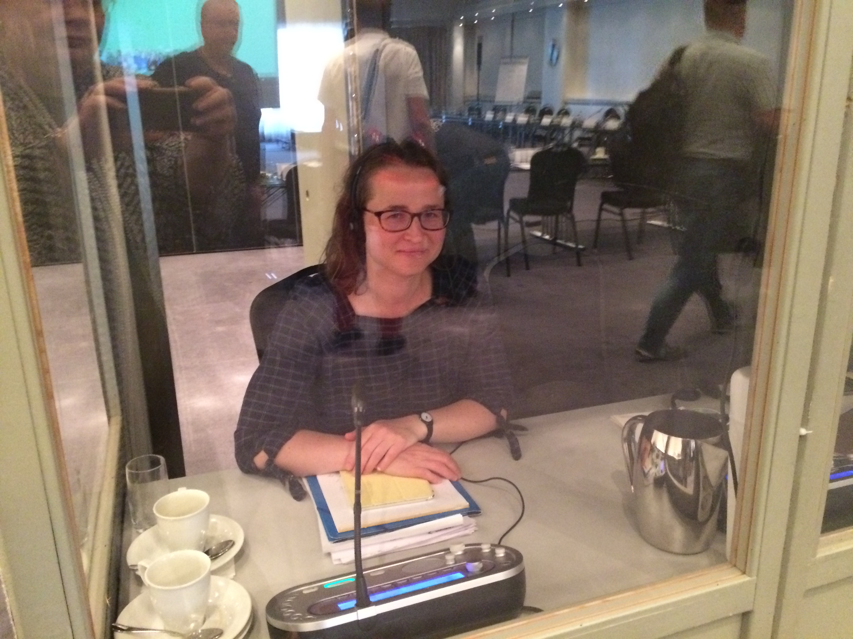
BILC Chair
MA in Politics and Translation Studies
Post-Grad. in conference interpreting
EU ACI 2005 - present
FDF translator, proof-reader, and interpreter 2006-2017
Head of Language Training Branch 2017- present
Areas of interest: plain language, English as a Lingua Franca, pedagogy
Speaks fluently Finnish, English, French, and Swedish
Understands some Spanish and German
Started Japanese as a hobby in 2023

Slide 9

BILC vision:
To achieve levels of excellence where
progress made by one is shared with all.

Slide 10

BILC’s three Ts
Testing
Teaching
Terminology

Slide 11
Language testing in NATO = STANAG 6001
BILC is the custodian of STANAG 6001
Partner Language Training Center (PLTCE) the only authorized training center for STANAG 6001 testers
Only testing centers within an armed forces are recognized as STANAG 6001 testing centers.
Language testing is a national responsibility
However, STANAG 6001 scores must align…

Slide 12
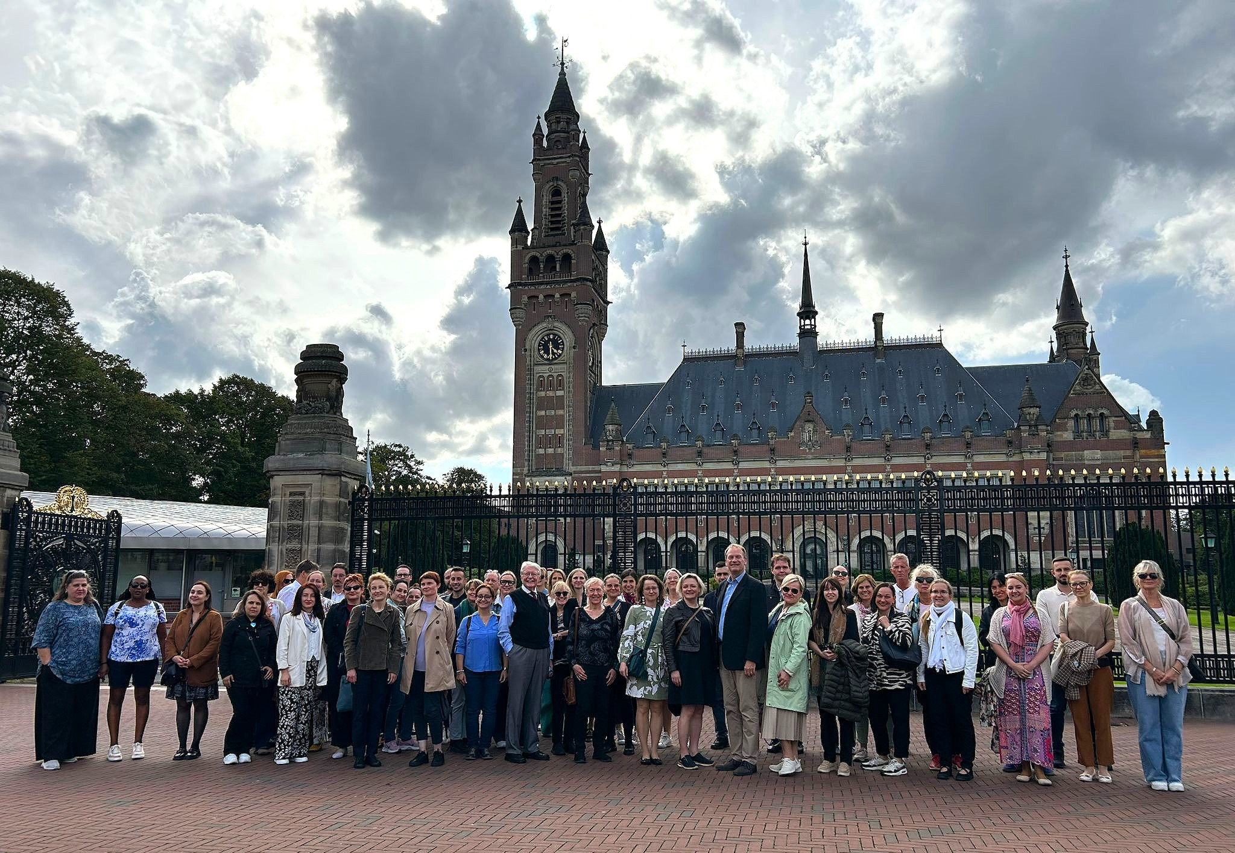
STANAG 6001 Testing Workshop and PLTCE courses
Language Testing Seminar (LTS)
Advanced Language Testing Seminar (ALTS)
The Hague, NL, 2 – 4 SEP 2025

Slide 13
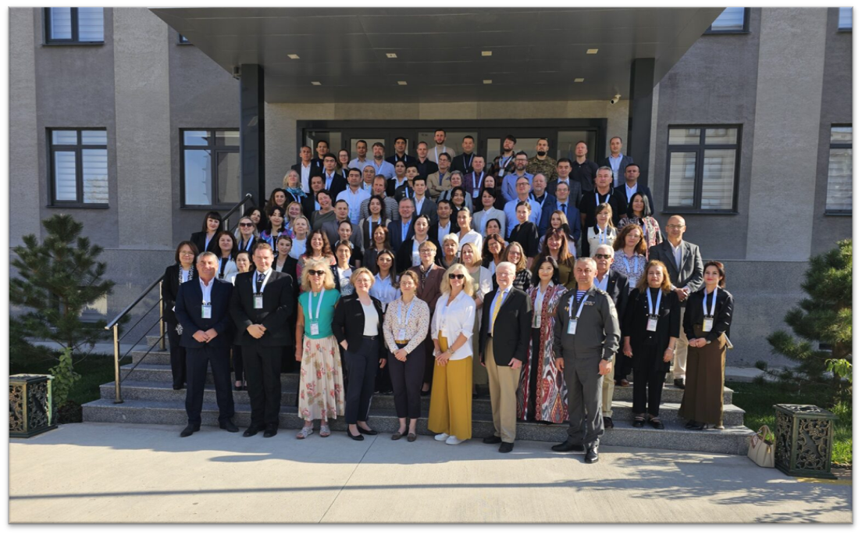
Professional Development Seminar and PLTCE courses
Faculty Development Workshop (FDW)
Language Standards and Assessment Seminar (LSAS)
Tashkent, Uzbekistan, 20 – 23 October 2025

Slide 14
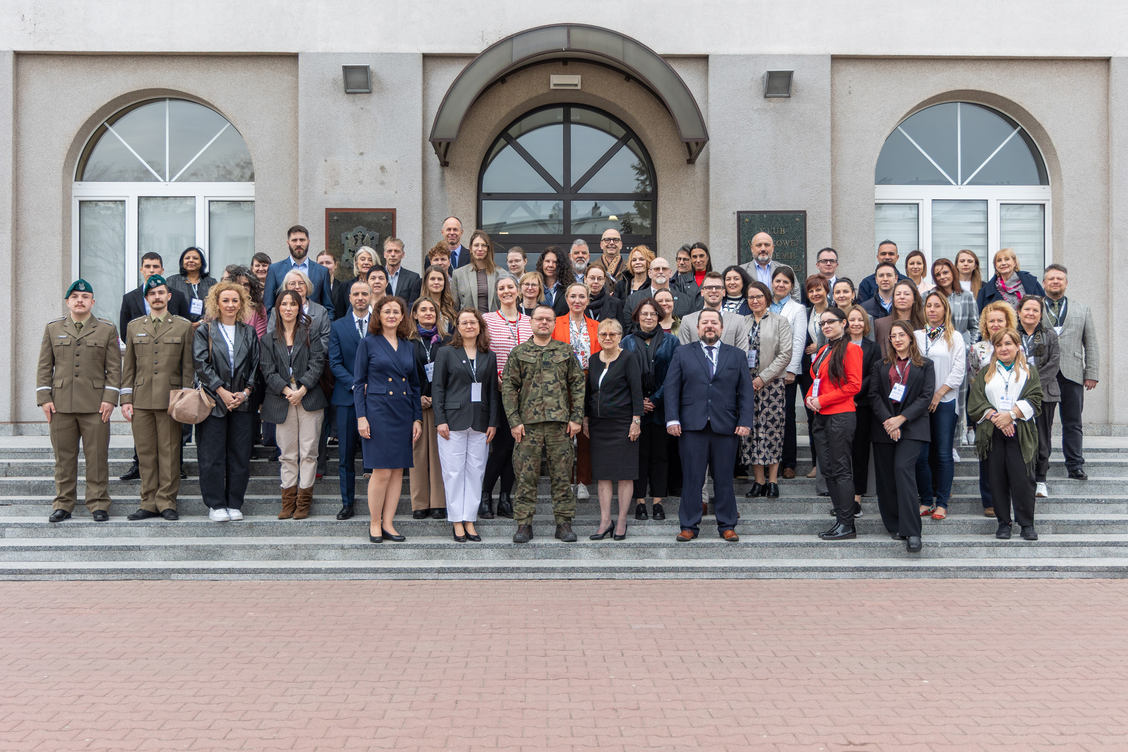
Military Terminology Symposium
In the pipeline:
SME webinars
Warsaw, Poland, 14 – 16 April 2026

Slide 15
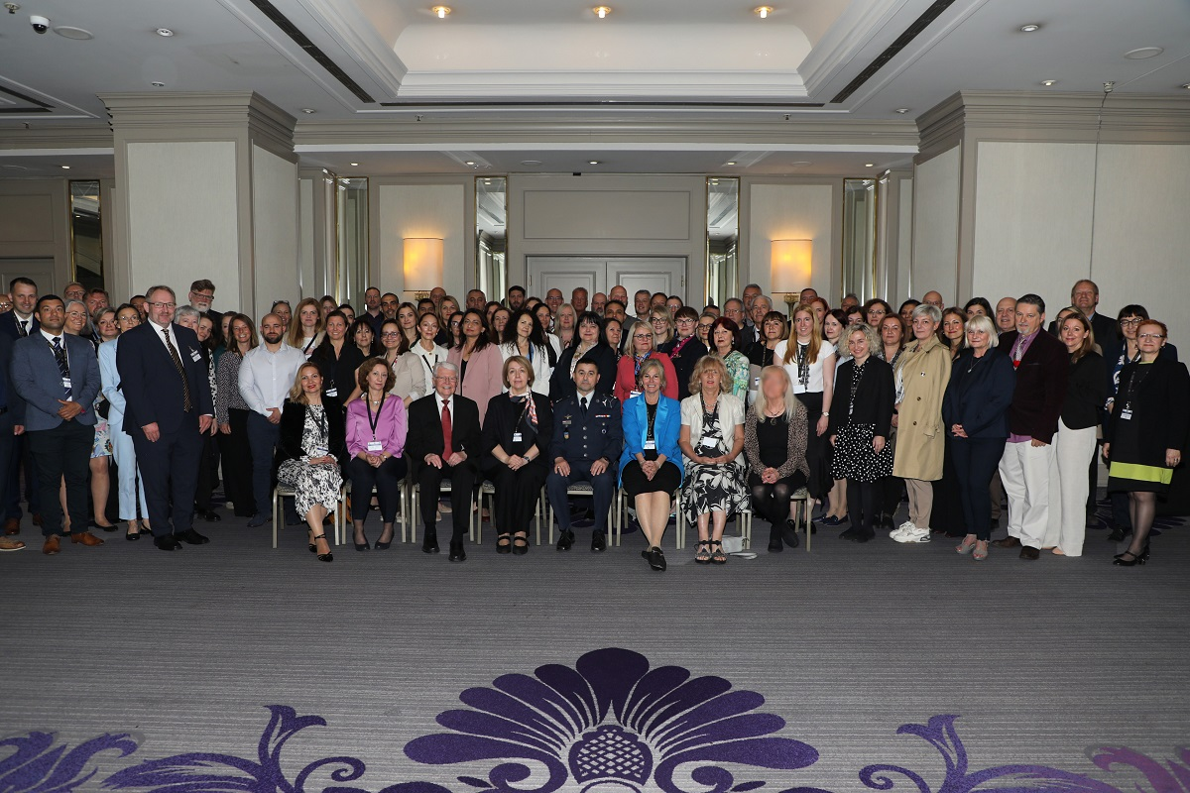
NATO BILC Conference
Study groups
Working groups
Steering Committee
Zagreb, Croatia, 26 – 29 May 2025

Slide 16

nato-bilc.org
Croatian BILC Secretariat and NATO DEEP eAcademy completed redesigned the BILC website in spring 2025
Summer 2026: Polish Association for Security (PAS) → Institute for Research and Social Education Foundation (IRSEF)
DEEP eAcademy covers all costs
Information on past BILC events, policy documents, calendar = BILC’s online archive

Slide 17
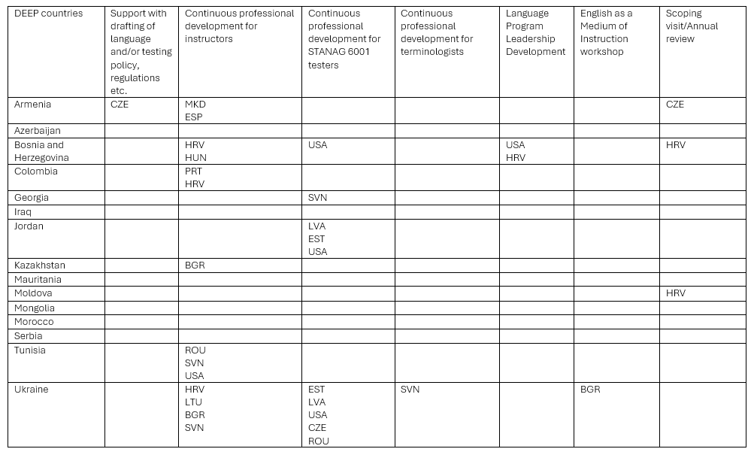
BILC and NATO’s Defence Education Enhancement Programme (DEEP) 2025 stats

Slide 18
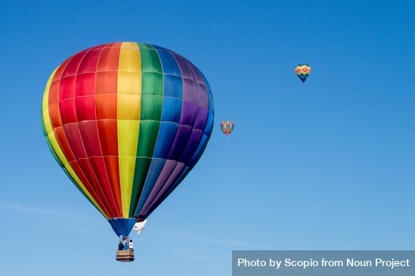

“There have always been profitable contacts between interested countries in the field of language training. The simple aim of the Bureau is to make these contacts even easier and more profitable in the future, and to extend their benefits more widely.”
BILC Bulletin 1967, Editorial, p. 5

Slide 19

60 years!

Slide 20
Images
Photos from BILC events from nato-bilc.org except Warsaw picture from https://www.wojsko-polskie.pl/wat/en/articles/muts-news/3rd-military-terminology-conference-in-warsaw-language-as-a-foundation-of-interoperability/
All icons from noun project, do not reproduce
BILC icon emulating Coat of arms of the Republic of Hungary: based on model from https://dailynewshungary.com/national-symbols-of-hungary/, designed by Chatgpt on 6 MAY 2026. Do not reproduce.
Fisherman’s Bastion in Budapest by Scopio / Noun Project
Chocolate cake on white ceramic plate by Scopio from <a href="https://thenounproject.com/photo/chocolate-cake-on-white-ceramic-plate-5wgnZR/" target="_blank" title="Chocolate cake on white ceramic plate Photo">Noun Project</a> (CC BY-NC-ND 2.0)
Helsinki image: https://pixabay.com/users/tap5a-12431592/
People in colorful hot air balloon in sky by Scopio from <a href="https://thenounproject.com/photo/people-in-colorful-hot-air-balloon-in-sky-0goD80/" target="_blank" title="People in colorful hot air balloon in sky Photo">Noun Project</a> (CC BY-NC-ND 2.0)
Kid having fun with balloons in nature by ADDICTIVE STOCK from <a href="https://thenounproject.com/photo/kid-having-fun-with-balloons-in-nature-5r9rM7/" target="_blank" title="Kid having fun with balloons in nature Photo">Noun Project</a> (CC BY-NC-ND 2.0)

