Slide 1

CULTURAL INTELLIGENCE (CQ) and ITS ROLE IN MULTI-NATIONAL ENVIRONMENTS
mgr Adam Markowski
Lecturer
Foreign Languages Department
General Tadeusz Kościuszko
Military University of Land Forces, Wroclaw, Poland
Notes:
1. Good morning everyone. Today I want to explore a capability that has quietly become one of the most important drivers of success in global operations: cultural intelligence, or CQ.
To start us off, Take a moment to recall a situation where cultural differences caused confusion. What happened? What assumptions were at play? Let me help you with the question.
1 Perhaps overseas colleagues started talking business too quickly. Or the opposite – the small talk took them ages.
2 Perhaps they sent a long email using expressive highly polite language. Or they wrote short, very direct email.
3 Perhaps they gave feedback openly & bluntly. Or they were cryptically indirect with feedback or remained silent.
4 Perhaps during a meeting they discussed topics off the agenda. Or they refused to discuss topics that were off the agenda.
You know In my country we have the saying: ‘Every country has its customs.’ , which beautifully illustrates my point: these things are culture specific. What works fine in one culture may not work in another. Misunderstandings arise when we interpret the other side through our own cultural lens.

Slide 2

PRESENTATION AIMS & OVERVIEW
AIMS
To discuss major frameworks for anticipating cultural differences
To increase effectiveness in multinational operations
OVERVIEW
- Why CQ matters today
- Understanding CQ
- Major cultural frameworks and dimensions
- CQ in multinational operations – Good practices
- Risks of low CQ
- Developing CQ
- Conclusions / Takeaways
Notes:
2. My goal today is to deepen your understanding of CQ and help you become more effective in multinational operations.

Slide 3
Why Cultural Intelligence matters today
🌍 Global Reality
  Multinational teams
  Diverse customers / colleagues
  Cross‑cultural decisions
When CQ Is Missing
  Misread behaviors
  Failed market entries / weakened partnerships
  Team friction
CQ = Advantage
  Adapt → Collaborate effectively
CQ turns cultural differences into performance strength
Notes:
3. Why CQ matters. We live in a world where multinational operations are no longer the exception—they’re the norm.
Teams stretch across continents, colleagues come from every cultural background, and decisions are made in environments shaped by diverse expectations and norms. & yet, despite all our technology, cultural misu’standings still derail negotiations, weaken partnerships, & create friction inside global teams. Here’s one example: A few years ago, a major US retailer expanded into Germany. They trained employees to greet every customer with a big smile and friendly small talk — standard American customer service. But German customers found it intrusive & insincere. Sales dropped, and the company eventually withdrew from the market. This wasn’t a product failure. It was a cultural intelligence failure.
Or consider a global team meeting where the American manager asks for “honest feedback.” The Dutch team members give very direct criticism — which is normal in Dutch culture — but the Japanese team members remain silent, because in their culture, public disagreement = disrespectful. The manager misinterprets the silence as agreement.
This is why cultural intelligence matters. It’s not just about being “aware” of differences—it’s about being able to work effectively across them. CQ is becoming a core competency for leaders, teams, and organizations that operate internationally.

Slide 4
Why CQ matters today – key research
- Team‑level CQ improves coordination and reduces misunderstandings, Eisenberg & Mattarelli (2017)
- CQ enables culturally diverse teams to outperform homogeneous teams, Lisak & Erez (2015)
- CQ predicts effective cross‑cultural communication, reduces misinterpretation, Ang et al. (2007)
- CQ accelerates trust formation in global teams, Rockstuhl et al. (2011)
- High‑CQ teams shift conflict from relational to task‑focused, enabling constructive debate,
Chen, Liu & Portnoy (2012)
- CQ enhances collaboration between HQ and subsidiaries, joint ventures, and cross‑border project teams, Ang & Van Dyne (2015)
BOTTOM LINE: CQ - a reliable predictor of success in multinational teams.
Notes:
4. Why CQ matters - Key research.
Here’s what key research tells us about why CQ matters in multinational teams.
These studies show that culturally intelligent teams communicate more clearly, collaborate more effectively across borders, innovate more, resolve conflict more constructively, build trust more quickly & consistently deliver better outcomes.
Bottom Line. CQ is one of the most reliable predictors of success in multinational teams.
CQ enhances team performance, innovation, global leadership effectiveness, & operational efficiency.
CQ is not a soft skill. It is a strategic capability, a measurable driver of global performance.

Slide 5
What is Cultural Intelligence?
„The capability to function effectively in culturally diverse settings.” (P. Christopher Earley & Soon Ang)
Drive: motivation to engage across cultures
Knowledge: understanding how cultures differ
Strategy: ability to plan
Action: ability to adapt
Notes:
5. Understanding Cultural Intelligence So what exactly is cultural intelligence? CQ = the capability to function effectively in culturally diverse settings.
It’s a framework developed by researchers who wanted to understand why some people thrive in cross-cultural situations while others struggle.
CQ is made up of 4 components:
Drive -This is your motivation to engage across cultures—your interest and confidence in working with cultural differences.
For example, an engineer volunteering for an overseas project because they’re curious about how colleagues in India work — that’s CQ Drive. Do you enjoy learning about other cultures? Are you willing to step outside your comfort zone? If your answer is YES…
Knowledge -This is your understanding of how cultures differ. It includes norms, values, communication styles, leadership expectations, & social systems. Ex:, knowing that in China, business cards are exchanged with both hands & examined respectfully — not shoved into a pocket — shows CQ Knowledge.
Strategy - This is your ability to plan for intercultural interactions.
It’s the mental process of anticipating differences, checking assumptions, and adjusting your approach. Imagine preparing for a negotiation in Brazil and anticipating that relationship‑building will take time before business begins. That’s CQ Strategy.
Action -your ability to adapt your behavior. It includes adjusting your communication style, your body lang, your decision-making pace, & even your approach to conflict.
A great example is a British manager who normally uses indirect language (“perhaps we could consider…”) but switches to a more direct style when working with Dutch colleagues who value straightforward communication.

Slide 6
Cultural Dimensions that Shape Behaviour
Major cultural dimensions that shape behavior:
Hall – Context Culture Theory
Hofstede – Cultural Dimensions Theory
the GLOBE project - Culturally Endorsed Implicit Leadership Theory (CLT)
Notes:
6. Cultural Dimensions That Shape Behavior
To understand how CQ works in practice, it helps to look at some of the major cultural dimensions that shape behavior.
Researchers like Hofstede, Hall, and the GLOBE project have identified patterns that appear across societies.
These aren’t stereotypes—they’re broad tendencies that influence how people interpret the world.
Here are a few that matter most in multinational operations:

Slide 7



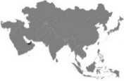

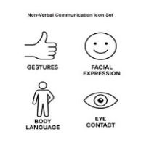

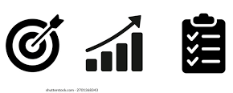
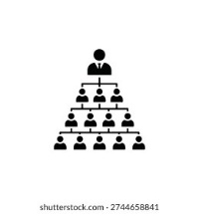
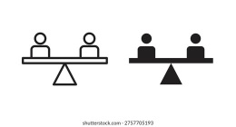
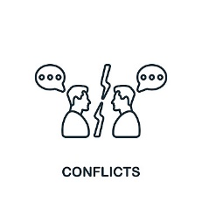
HIGH-CONTEXT VS. LOW-CONTEXT CULTURES
Notes:
7. Communication Style: High vs. Low Context
Hall’s Context Culture Theory differentiates between high-context and low-context cultures, highlighting their implications for communication styles & business negotiations. It’s the single biggest predictor of communication style.
High-context cultures, mainly many Asian & African nations, are relationship-based cultures & rely on implicit communication, reading between the lines.
Low-context cultures, mainly Anglo countries, many EU nations, are task-based cultures & value directness & clarity.

Slide 8
Hall’s High-Context vs. Low-Context Cultures
High-Context Communication
More implicit, indirect,
shared context and assumptions, nonverbal cues
relationships, trust, group harmony
Clear authority, highly centralized
Conflict: avoided to protect harmony & „save face”
Read between the lines (‚Maybe later’ can mean No)
Low-Context Communication
explicit, direct, literal
relies on clear verbal expression, minimum nonverbal cues
goals, individual achievements
Authority decentralized
Conflict: addressed openly, task-oriented
Say what you mean, mean what you say (No = No)
They are impolite.
They are evasive.
Notes:
! It is worth stressing is that No society is completely high context or low context – all societies contain elements of both.
Example: in the low context U.S. communication within family units is often high context.

Slide 9
What is „good communication”?
What Makes a “Good Communicator” Depends on Culture
- The Dutch: indirect speakers seem untrustworthy.
“If you don’t say it straight, we don’t think you are trustworthy.”
- Americans: indirectness can feel deceptive.
“If you don’t say what you mean, then you are lying.”
- High‑context cultures: explicitness can feel condescending.
“You talk to us like we are children.”
- High‑context cultures: directness can feel rude or insensitive.
“You didn’t have to say it — we all understood.”

Slide 10
High-context vs. Low-context Cultures
LOW-CONTEXT vs. HIGH-CONTEXT
Clear, literal, explicit implicit, implied
US Netherlands Finland Spain Italy Singapore Iran China Japan
Australia Germany Denmark Poland Brazil Mexico France India Kenya Korea
Canada UK Argentina Russia Saudi Indonesia
Arabia
Adapted from: Meyer, E. (2015) The Culture Map. PublicAffairs
Notes:
10. Diagram: Scale: High-context; Low-context cultures
at this point I’d like to stress the importance of Cultural perspective. What matters is NOT so much the absolute positioning of a culture on the scale, but rather its relative positioning in comparison to other cultures.
an example. Both Americans and British are low-context cultures. But the British speak more between the lines than Americans, which is especially apparent with understatement or British humour. Many British people have a liking for ironic or sarcastic jokes.
As a result, an American may find British communication vague or overly cautious, while a Brit may find American communication blunt or overly literal. Americans are simply more low-context than the British.
… Now compare the British to Spanish people. The Spanish tend to rely far more on context, shared understanding, and non‑verbal cues, rather than precise wording. To a Brit, this can sometimes feel overly emotional or indirect, while to a Spaniard, British communication may appear cold, restrained, or excessively polite. In other words, the British sit somewhere in the middle: more implicit than Americans, but far more explicit than Spaniards. So, all is relative.

Slide 11


Time is cultural, not universal
Hall’s Time Orientation
Concept | Monochronic | Polychronic
View of time | Linear, highly regulated | Fluid, cyclical
Scheduling/Agenda | Fixed | Flexible
Punctuality | Essential | Secondary
Task approach | One thing at a time | Many things at once
Work/personal boundary | Clear | Blended
Typical regions | U.S., Germany, Scandinavia | Middle East, Latin America, Mediterranean
Notes:
11. Hall’s Time orientation
Hall argues that cultures experience time in fundamentally different ways.
Monochronic cultures (like the U.S. & Germany) see time as linear, value punctuality & efficiency, and focus on one task at a time.
Polychronic cultures (like the Middle East & Latin America) treat time as flexible, prioritize relationships over strict schedules, & handle multiple activities at once.
Hall’s work shows that time is a cultural language. Understanding whether a culture is monochronic or polychronic helps prevent miscommunication, improves collaboration, & deepens cross‑cultural respect.

Slide 12
Hofstede’s Cultural Dimensions
Dimension | Description | Example: High: Low:
Power Distance | How people feel about hierarchy and inequality | H: Slovakia, Malaysia L: Austria, Denmark
Individualism vs. Collectivism (“I” vs. “WE”) | autonomy, personal achievement vs. group harmony, shared responsibility | IND: Anglo countries COL: Guatemala, S. Korea
Masculinity vs. Femininity | Competition / Assertiveness vs. Cooperation / Quality of life | H: Slovakia, Japan L: Sweden, Norway
Uncertainty Avoidance | In / Tolerance for ambiguity, risk, change | H: Greece, Portugal L: Denmark, Sweden
Long Term Orientation | Societies’ time horizon; Future rewards vs.Tradition, present moment, short‑term results | H: Korea, Japan, Germany L: Puerto Rico, Egypt
Indulgence vs. Restraint | How freely people express emotions, enjoy life | H: Venezuela, Mexico L: Pakistan, Egypt
Notes:
12. Let’s move on to Hofstede’s Cultural Dimensions — one of the most widely used frameworks for understanding how culture shapes communication, leadership, and cooperation.
First I’ll discuss all the dimensions briefly, then I’ll elaborate on some of them.
a. Power Distance is about how people in a society feel about hierarchy & inequality. In high PD cultures, people accept strong hierarchies. In low PD cultures, people prefer equality.
b. IND / Col: This dimension describes whether people see themselves mainly as individuals or as part of a group. Individualistic cultures value autonomy, personal achievement, collectivist cultures value group harmony, loyalty.
c. Masculinity vs. Femininity: this dimension is NOT about biological sex, but about cultural priorities. It describes how a society values certain traits, roles, and behaviors. Masculine cultures value competition, achievement, assertiveness. Feminine cultures value cooperation, quality of life, care for others.
d. Uncertainty avoidance. Life is unpredictable, future uncertain. This dimension describes how comfortable people are with ambiguity, risk, and the unknown.
e. LTO. This dimension describes how cultures think about time, tradition, and future goals. It measures Societies’ time horizon; How much a society focuses on future rewards vs. tradition, the present moment, short term results.
In long term oriented cultures people focus on the future. They value: persistence, saving.
In short term oriented cultures people focus more on the present or the near future. They value: quick results, respect for tradition, stability, immediate rewards.
f. Indulgence vs. restraint: This dimension describes How freely people express emotions, desires, enjoy life.
In indulgent cultures people feel free to enjoy life. They value: personal happiness, expressing emotions, having fun. People often smile more.
In restrained cultures people believe that desires should be controlled. They value: self discipline, duty, social rules, modesty, limited emotional expression. People may appear more serious or reserved.
Hofstede’s Cultural Dimensions Theory describes how cultures deeply affect various aspects of professional and social life such as Communication style, Decision making, Leadership, Time management, Emotional expression, Risk taking. It influences how individuals behave and expect others to act.
Hofstede’s Cultural Dimensions Theory describes how cultures deeply affect various aspects of professional and social life such as Communication style, Decision‑making, Leadership, Time management, Emotional expression, Risk‑taking. It influences how individuals behave and expect others to act.

Slide 13






High vs. Low Power Distance
What are the instructions?
Hey boss! What if we do it this way?
Decision making: Hierarchical top-down autocratic | Decision making: Egalitarian collaborative decentralized
Notes:
13. Power Distance
In high PD cultures, where decisions flow from the top, hierarchical, top-down, & autocratic management is expected and accepted.
In low PD cultures, people expect equality and open dialogue. Decision-making is egalitarian, collaborative, & decentralized.
In Malaysia (high PD), employees may wait for explicit instructions from leaders.
In Denmark (low PD), employees expect to challenge decisions and contribute equally.
A multinational manager who doesn’t recognize this difference may misinterpret silence as lack of initiative.

Slide 14

Power Distance
Impact on communication:
In high power‑distance cultures, communication is more formal, indirect, and deferential. People avoid openly challenging authority.
In low power‑distance cultures, communication is more informal, direct, and egalitarian. Questioning a superior is acceptable.
Why it matters:
This dimension shapes tone, assertiveness, who speaks first, and how disagreement is expressed.
Notes:
14. how this dimension shapes how people communicate
In high PD cultures, communication is more formal, indirect, deferential. People avoid openly challenging authority.
In low PD cultures, communication is more informal, direct, egalitarian. Questioning a superior is acceptable.
Why it matters: This dimension shapes tone, assertiveness, who speaks first, and how disagreement is expressed. It is especially relevant in the military.
Think about mission command, which requires initiative & decentralized decision‑making. Soldiers from high‑PD cultures may hesitate to act without explicit orders. In multinational operations, this can create friction.
15. World map PDI

Slide 15
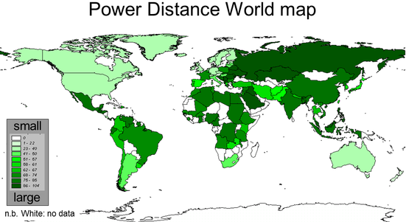
Source: https://geerthofstede.com
Power Distance

Slide 16





Individualism vs. Collectivism
Look at me! I’ve made it!
We’ve made it!
I > WE autonomy, self-reliance, personal achievement, initiative Tasks ≻ Relationships | WE > I group harmony, shared responsibility, loyalty Relationships ≻ Tasks
Notes:
16. Individualism vs. Collectivism
This dimension looks at whether people see themselves primarily as individuals or as part of a group.
Individualistic cultures value autonomy, self-reliance, personal achievement & initiative.
Collectivist cultures emphasize group harmony, loyalty and shared responsibility.
In the US, employees may highlight personal achievements during performance reviews.
In Japan, employees may emphasize team accomplishments to avoid appearing self‑promoting.
Without CQ, both sides may see the other as disrespectful.

Slide 17
Individualism vs. Collectivism
Impact on communication:
Individualist cultures value clarity, self‑expression, directness.
Collectivist cultures prioritize harmony, group cohesion, and indirect communication to avoid conflict or embarrassment.
Why it matters: This is one of the strongest predictors of whether communication will be explicit and direct or implicit and context‑dependent.
Notes:
how this dimension shapes how people communicate:
Individualist cultures value clarity, self‑expression, and directness.
Collectivist cultures prioritize harmony, group cohesion, indirect communication to avoid conflict or embarrassment.
Why it matters: This is 1 of the strongest predictors of whether communication will be explicit & direct or implicit & context‑dependent.
18. World map

Slide 18
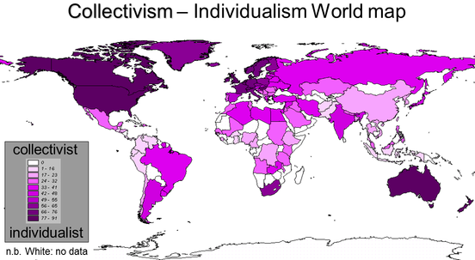
Source: https://geerthofstede.com
Individualism vs. Collectivism

Slide 19
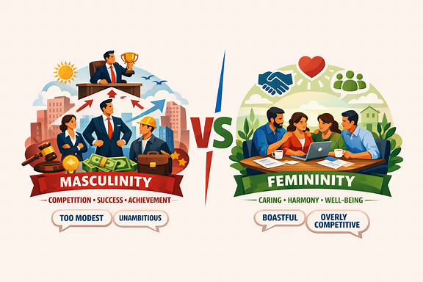




Masculinity vs. Femininity
competition, achievement, success, recognition, being the best, KPIs Live to work | cooperation, care, consensus, empathy, modesty, equality Work to live
Notes:
19. Masculinity vs. Femininity
Masculine cultures (Japan, US and Germany) value competition, achievement, success, recognition, and being the best.
Feminine cultures (Sweden and the Netherlands) value cooperation, care, consensus, empathy, modesty.
In the U.S.: Employees may proudly highlight personal accomplishments, seek challenging tasks, & expect recognition for strong performance. Pride in working hard
In Sweden: Employees may emphasize team cohesion, avoid appearing overly boastful, competitive, and focus on maintaining balance & well‑being. Avoid gloryfying overwork
Without CQ: Americans might see Swedes as unambitious or too modest. Swedes might see Americans as boastful or overly competitive.
Misunderstandings arise …

Slide 20
Masculinity vs. Femininity
Impact on communication:
Masculine cultures: assertive, competitive, task‑oriented communication. Conflict seen as normal.
Feminine cultures: consensual, modest, relationship‑oriented communication. Conflict seen as disruptive.
Why it matters:
It shapes whether communication feels direct and results‑driven or collaborative and people‑oriented.
Notes:
how this dimension shapes how people communicate:
Masculine cultures tend toward assertive, competitive, and task‑oriented communication.
Feminine cultures emphasize consensual, modest and relationship‑oriented comm.
Why it matters: It shapes whether communication feels direct, blunt, confrontational & results‑driven or collaborative, softer & people‑oriented.
21. World map

Slide 21
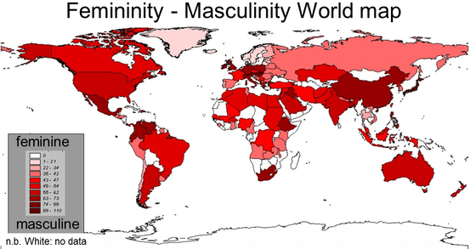
Source: https://geerthofstede.com
Masculinity vs. Femininity

Slide 22
Uncertainty Avoidance
HIGH UA | LOW UA
Uncertainty – threat, stress Prefer: strict rules & regulations, detailed instructions, stability, long‑term planning, predictable situations. Avoid taking risks. May worry more about mistakes. | More relaxed about the unknown. Accept: flexible rules, changing plans, improvising, innovation, taking risks. More comfortable with trying new things and adapting quickly.
Notes:
22. Uncertainty Avoidance -
High UA. Uncertainty – threat, stress. Prefer: strict rules & regulations, detailed instructions, clear schedules, stability, long‑term planning, predictable situations. Avoid taking risks. May worry more about mistakes. Low UA. More relaxed about the unknown. Accept: flexible rules, changing plans, experimentation, innovation, taking risks. More comfortable with trying new things and adapting quickly.

Slide 23
Uncertainty Avoidance
Impact on communication:
High UA cultures prefer structured, detailed, unambiguous communication.
Low UA cultures are comfortable with flexible, less formal, more exploratory communication.
Why it matters:
It influences how much detail people expect, how they handle ambiguity, and how they interpret “open‑ended” messages.
Notes:
22. Uncertainty Avoidance -Impact on communication
High uncertainty‑avoidance cultures prefer structured, detailed, unambiguous communication.
Low UA cultures are comfortable with flexible, less formal, more exploratory communication.
Why it matters: It influences how much detail people expect, how they handle ambiguity, and how they interpret “open‑ended” messages. Military Implications. This affects planning cycles, interpretation of ROE, and reactions to last‑minute changes. High‑UA soldiers may become stressed when plans shift suddenly.
[23] World map

Slide 24
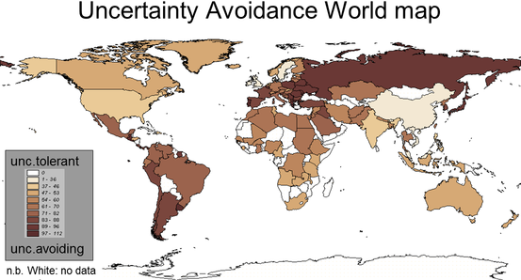
Source: https://geerthofstede.com
Uncertainty Avoidance

Slide 25
CQ in MN Operations – Good Practices
Leaders with high CQ:
Create inclusive environment
Adjust Pace
Build trust: competence 🛠️ or relationships ❤️
Tailor Communication & Feedback
Encourage open dialogue
Support Virtual Global Collaboration:
  Set clear communication norms
  Clarify decision-making
  Structure meetings
  Encourage informal check-ins
Notes:
CQ in MNO: Practical Applications & Good Practices - Now let’s look at how cultural intelligence plays out in real multinational operations.
Leaders with high CQ know how to create an environment where everyone feels valued. They adapt their leadership style—sometimes being more directive, sometimes more collaborative—depending on the cultural expectations of their team. Ex: A global tech company found that its Indian team members rarely spoke up in meetings with senior leaders. The manager assumed they lacked ideas. In reality, they were showing respect for hierarchy. Once the manager invited written input before meetings, participation skyrocketed.
Adjust Pace - Negotiations can fail simply because one side expects fast decisions while the other needs time to build consensus. CQ helps negotiators read the room & interpret signals correctly.
A US company negotiating in China pushed for quick decisions. The Chinese partners interpreted this as aggressive & untrustworthy. When the US team slowed down & invested time in dinners and informal conversations, the deal moved forward.
Build Trust Across Cultures - Trust looks different around the world. In some cultures, trust is built through competence; in others, thru relationships. CQ helps you u’stand which approach matters most.
In Germany, trust is task-based, built through competence — “show me you can do the job.”
In Mexico, trust is relationship-based, built through personal connection — “show me who you are.”
Tailor Communication and Feedback
Managers in different parts of the world are conditioned to give feedback in drastically different ways. For instance, in the Netherlands giving negative feedback directly & bluntly in public meetings is considered honest & professional but in South Korea or Thailand as rude, arrogant or even humiliating. In these cultures you give negative feedback only in private, use positive messages to wrap negative ones & use subtle, soft, diplomatic lang. Direct feedback may be appreciated in one culture & considered rude in another.
- Encourage open dialogue - to let team members share their cultural perspectives, which can enhance mutual understanding.
A global team with members in Brazil, Poland, & South Korea struggled with email tone. The Brazilian team used warm, expressive lang; the Polish team wrote very directly; the Korean team used highly polite forms. Once the team discussed these differences openly, misunderstandings dropped dramatically.
Support Virtual Global Collaboration - Virtual settings can make people more hesitant to speak up—esp. across cultures. Virtual work strips away contextual cues. It also amplifies confusion as Cultures vary widely in comfort with hierarchy, consensus, & direct disagreement. To make remote, multicultural collaboration smoother & compensate for the loss of non‑verbal cues CQ leaders:
-Set Clear Communication Norms, meeting etiquette, expectations for response times
-Clarify Decision‑Making, Define who decides and how
-Structure meetings, send agendas in advance, set up clear turn‑taking to avoid dominanc by outspoke
-Encourage informal check‑ins, or “virtual coffee chats”, create cross‑cultural buddy pairs

Slide 26
Risks of Low CQ
Frequent Miscommunication – misinterpreted instructions
Conflict or disengagement - reduced cooperation.
Productivity drops - people don’t feel understood.
Ethical mistakes - local norms, regulations misinterpreted
Breakdown in trust — perceived disrespect
Cultural offense — unintended insults
Command friction — over leadership style or decision process
Notes:
25. Risks of Low Cultural Intelligence - What happens when cultural intelligence is low?
Miscommunication becomes frequent.
Teams experience conflict or disengagement.
Productivity drops because people don’t feel understood.
Ethical mistakes occur when local norms or regulations are misinterpreted.
Operational Miscommunication — conflicting interpretations of orders or protocols.
Cultural misalignment — partners misread intent or priorities
Breakdown in trust — perceived disrespect or misunderstanding
Cultural offense — unintended insults to partners or local communities
Command friction — disputes over leadership style or decision processes
These aren’t small issues — they affect revenue, relationships, and reputation.

Slide 27
Developing CQ
At the individual level:
Exposure to diverse cultures (assignments, exchange programmes)
Reflective practices
Language learning
Mentorship from culturally experienced colleagues
Formal CQ assessments and training programs
Notes:
26. Developing Cultural Intelligence in Organizations
The good news is that CQ is trainable — & here are examples of how.
At the individual level:
Exposure to diverse cultures, Reflective practices, Language learning, Mentorship from culturally experienced colleagues, Formal CQ assessments and training programs
At the organizational level:

Slide 28
Developing CQ
At the organizational level:
Embedding CQ into leadership development
Creating diverse teams and inclusive policies
Encouraging cross-border assignments
Designing onboarding programs that prepare employees for global work
Notes:
26. Developing Cultural Intelligence in Organizations
At the organizational level:
Embedding CQ into leadership development, Creating diverse teams and inclusive policies, Encouraging cross-border assignments, Designing onboarding programs that prepare employees for global work
These investments pay off in stronger global performance

Slide 29
Conclusions / Takeaways
1. CQ is not just a soft skill — it’s a strategic advantage.
High CQ Leaders / Teams / Organizations …
collaborate better, avoid costly misunderstandings,
build trust across borders,
turn cultural differences into strengths.
2. No single good [leadership] style
Global leaders adapt to get the desired results.
Notes:
27. Conclusions - To conclude, The two key takeaways from the presentation are:
1/ cultural intelligence is not just a soft skill — it’s a strategic advantage.
Organizations with high CQ collaborate better, innovate faster and avoid costly misunderstandings.
Leaders with high CQ build trust across borders.
Teams with high CQ turn cultural differences into strengths rather than obstacles.
In a world where multinational operations are the norm, CQ is essential for success.
2/ There’s no single good – leadership style, - communication style, - trust-building style, - decision-making style, - giving feedback style: these things are culture-specific. To be a good global leader is to know the difference between your own culture & the local culture & to adapt your style to the culture you’re working with in order to get the desired results.

Slide 30
THANK YOU

Slide 31
BIBLIOGRAPHY
Meyer, E. (2015) The Culture Map. PublicAffairs
Livermore, D. (2024) Leading with Cultural Intelligence. The Real Secret to Success. Amacom
Gwiazda-Rzepecka, B. (2017) Cross-Cultural Communication Insights.
Hofstede G., G.J. Hofstede, M. Minkov. (2010) Cultures and Organizations: Software of the mind. Intercultural Cooperation and Its Importance for Survival. McGraw Hill, New York.
Online resources:
https://worldpopulationreview.com/country-rankings/high-power-distance-countries?
https://geerthofstede.com
https://www.theculturefactor.com/country-comparison-tool

