Slide 1
From the global spread of English to the reconceptualization of language testing constructs
NATO BILC Conference
The Human Link: Language Competence for NATO Interoperability and Strategic Communication
Budapest, Hungary
10-15 May 2026
Tamar Shavlakadze
Head of Foreign Language Testing Division
Training and Military Education Command
MOD Georgia

Slide 2
Outline
The Global Spread of English (Models)
Modernist and Postmodernist Globalization
From Standard English to World Englishes
Conceptualization of ELF (challenges & future models)
Implications for Language Test

Slide 3



Models of English Language Spread
Demographic model: Driven by population movement & migration
Political Model: Spread through political &
administrative control
Econocultural Model: Facilitating technology,
science, & military cooperation

Slide 4
Globalization & Changing Communication
Globalization: The Shift
"The Old World“: Modernist Globalization (Post-war phase)
Rigid nation-state structures. Excl usive cultural identities (aligns with WE)
"The Connected World“: Postmodern Globalization
Digital, mobile, and decentralized. Dynamic cultures identities are less confined by geography or tradition.

Slide 5
From Standard English to World Englishes
Kachru's Three Concentric Circles (1985)
Inner Circle – Norm-providing; EN is the primary native language (UK, US,CA,AU,NZ)
Outer Circle – Norm-Developing; EN used as Second Language; plays central institutional role ESL
Expanding Circle – Norm-dependent; EN taught as a Foreign language for communication

Slide 6
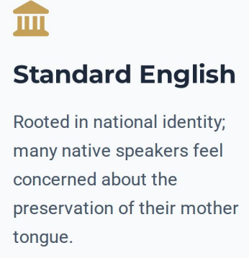

From Standard English to World Englishes & ELF
Standard English vs WE

Slide 7
Conceptualization of ELF
ELF - 'any use of English among speakers of different first languages for whom English is the communicative medium of choice, and often the only one’.
Seidlhofer (2011)
Concept of Accommodation
Shift from Grammatical accuracy to Communicative intelligibility
Focus on mutually supportive, cooperative, and consensus-oriented interaction
Adoption of "let-it-pass principle“

Slide 8
The Delicate Balance: Precision & Fluency.
While the "Let-it-pass" principle aids social cooperation, military contexts require rigid precision
The Pilot Paradox: Letting a misunderstanding pass in the cockpit leads to accidents.
Operational precision is non-negotiable.
No room for misunderstanding
Balance: flexibility vs clarity

Slide 9
Conceptualization of ELF
Current perspectives and Challenges for Assessment
Challenge 1
The Benchmark
Who are we measuring against?
Rethinking the "Ideal Speaker."
Focused on effectiveness
Challenge 2
The Nature of Language
What is language today?
Flexible and adaptable vs. Fixed and stable.
Reconceptualizing proficiency as fluid communication.

Slide 10
Conceptualization of ELF
Future Models of ELF Testing
The "Soft" Approach
Tailored Standard English for ELF users. Focus on effectiveness rather than lowering standards. A trade-off for real-world access.
The "Code" Approach
Establishing an independent ELF construct. Prioritizing strategic competence over absolute linguistic accuracy.

Slide 11
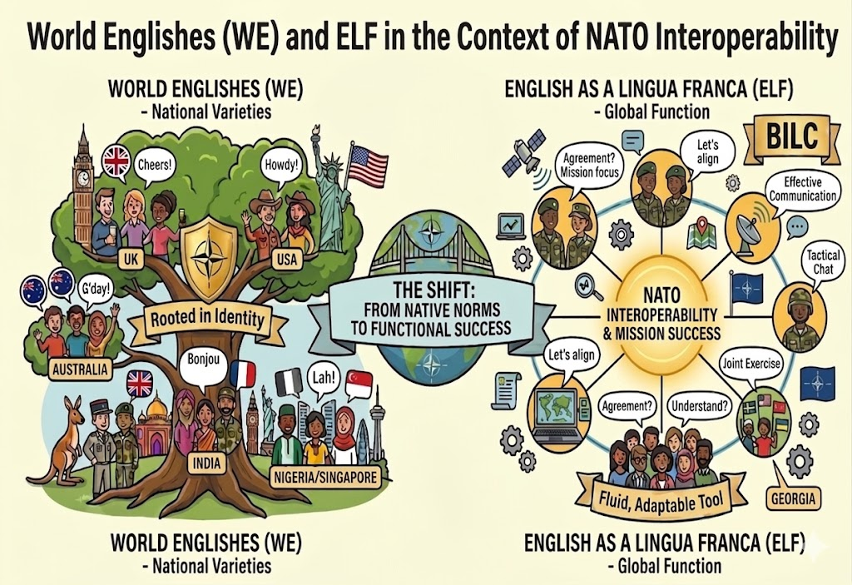
Thank You for Attention !

Slide 12
References
Al-Mutairi, M. A. (2020). Kachru’s three concentric circles model of English language: An overview of criticism & the place of Kuwait in it. English Language Teaching, 13(1), 85–88. https://doi.org/10.5539/elt.v13n1p85.
Canagarajah, S. (2006). Changing communicative needs, revised assessment objectives: Testing English as an international language. Language Assessment Quarterly, 3(3), 229–242. https://doi.org/10.1207/s15434311laq0303_1
Crystal, D. (2003). English as a global language. Cambridge University Press.
Elder, C., & Davies, A. (2006). Assessing English as a lingua franca. Annual Review of Applied Linguistics, 26, 282–304. https://doi.org/10.1017/s0267190506000146
Hall, S. (1997). The local and the global: Globalization and ethnicity. In A. D. King (Ed.), Culture, globalization, and the world system (pp. 19–40). Minneapolis: University of Minnesota Press.
Harding, L., & McNamara, T. (2018). Language assessment: The challenge of ELF. In J. Jenkins, W. Baker, & M. Dewey (Eds.), The Routledge handbook of English as a Lingua Franca (pp. 570-582). Routledge.
Jenkins, J., & Leung, C. (2014). English as a lingua franca. In A. Kunnan (Ed.), The companionto language assessment (Vol. 4, pp. 1607–1616). Malden: Wiley.
Jenkins, J.(2017) ELF and WE: competing or complementing paradigms? In, Low, E.L. and Pakir, A. (eds.) World Englishes: Re-thinking Paradigms. (Routledge Studies in World Englishes) London. Routledge. (doi:10.4324/9781315562155)
Kachru, B. B. (1990). World Englishes and applied linguistics. World Englishes, 9(1), 3–20.
NATO Standardization Office. (2016, May 19). ATrainP-5: Language proficiency levels (Edition A, Version 2). North Atlantic Treaty Organization. https://natobilc.org/wp-content/uploads/2024/11/ATrainP-5-EDA-V2- E.pdf
Quirk, R. (1988). The question of standards in the international use of English. In, Lowenberg, P. H. (ED.) Language Spread and Language Policy. (pp. 229-241) Georgetown University Press.
Seidlhofer, B. (2011). Understanding English as a lingua franca. Oxford University Press.

Slide 13
The Global Spread of English
“Language exists only in the brains and mouths and ears and hands and eyes of its users. When they succeed on the international stage, their language succeeds. When they fail, their language fails”
(Crystal, 2003, p.7)
Language is a social tool rather than an autonomous or mystical entity

