Slide 1
Language Education for Future Military Leaders
Cadet warrant officer Márk Szőnyegi

Slide 2
Table of Contents
Interoperability gap
Why it matters?
From classroom to mission
Current state of language education
Innovation and the future of language
Language competence and cultural awareness developed together
The future leader
Lessons from the field

Slide 3
’’Everything in war is simple, but the simplest thing is difficult.’’
- Carl Von Clausewitz

Slide 4
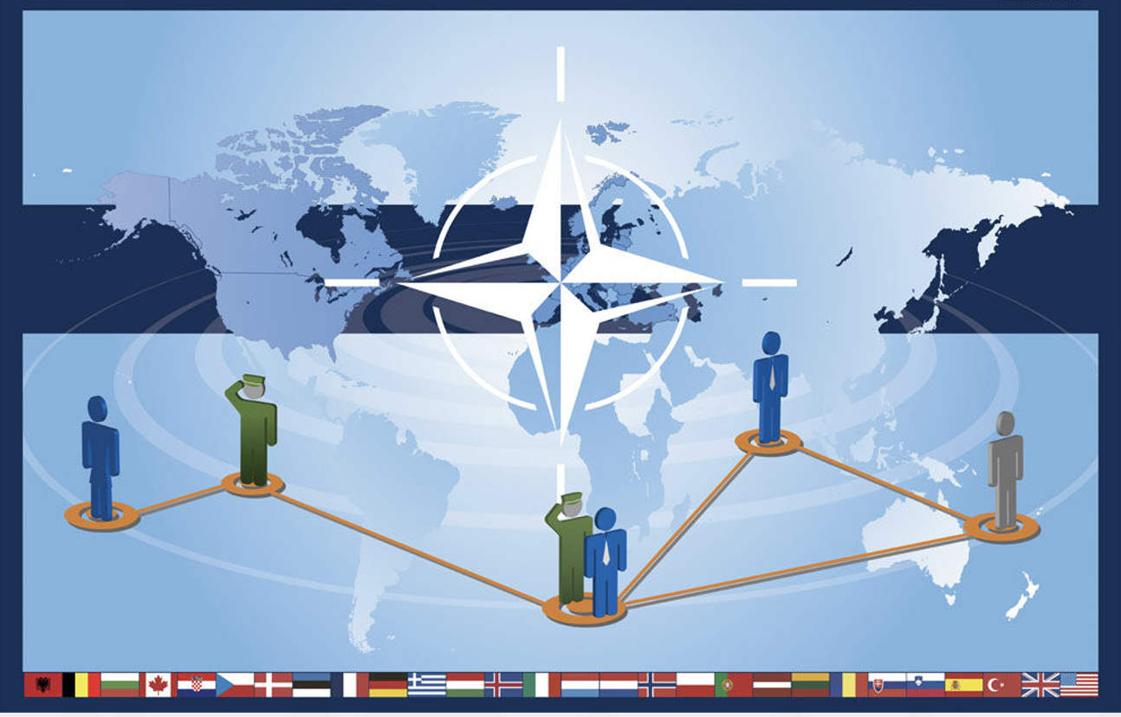
Interoperability Gap
Technical interoperability
Procedural interoperability
Human interoperability

Slide 5
Language must be treated as part of operational readiness!

Slide 6
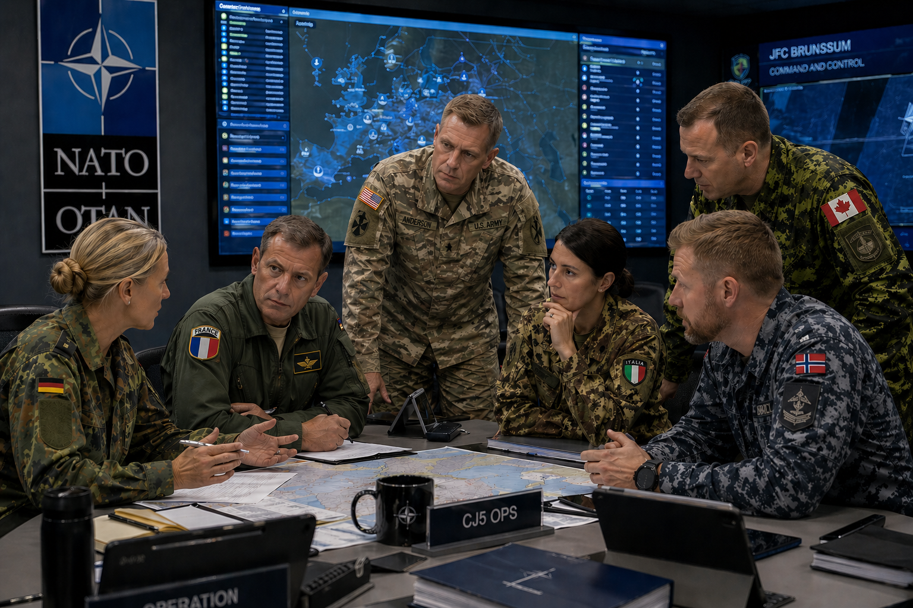
Why It Matters?
Decision-making
Shared intent
Speed of coordination
Trust between nations

Slide 7
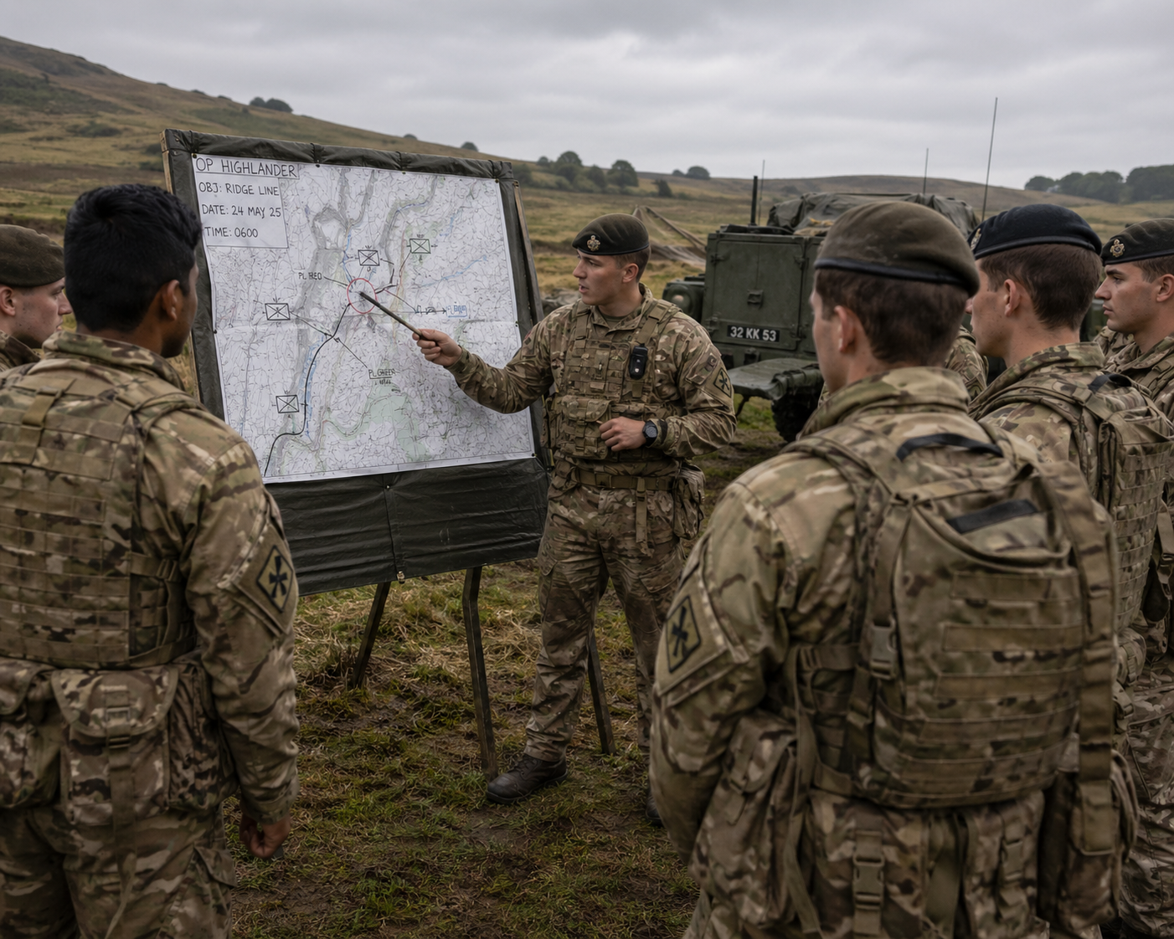
From Classroom to Mission
Train language as you fight
Mission-based learning:
Briefings
Military roleplay
Radio communication
- Multinational scenarios

Slide 8
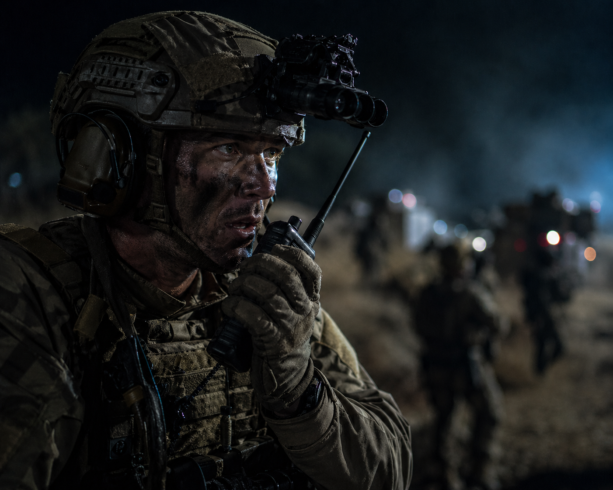
Pressure
Time constraints
Incomplete information
Rapid decision-making
Clarity under stress

Slide 9
How Could Language Education Be Improved:
What helps cadets learn:
Practice, real-life use of language
Recognition and rewards (certificates, opportunities abroad)
Group learning, teamwork builds motivation
What inspires long-term growth:
Linking language to career opportunities
Making learning fun, not a burden
Show language as a bridge to leadership, not just a requirement

Slide 10

Current State of Language Education
Traditional classroom focus
Drills, grammar, and mandatory hours
Standardized exams (STANAG levels)
Often viewed as a requirement, not as a tool

Slide 11
Current State of Language Education
Strengths:
Clear structure and objectives
Access to professional instructors
Standardized testing ensures comparability
Challenges:
Motivation drops: “just another subject”
Lack of real-life, mission-based practice
Perception: exam-focused, not skill-focused

Slide 12

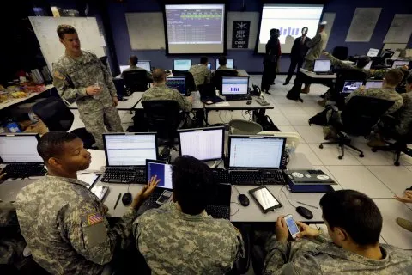

Innovation and The Future of Language:
AI tutors and chatbots: instant feedback, personalized drills
Speech recognition tools: accent and clarity feedback
Gamification: challenges, competitiveness
Immersion: exchange programs, native speakers
VR/AR simulations: NATO missions, sitreps (situation report)
Adaptive apps: personalized progress and smart challenges

Slide 13
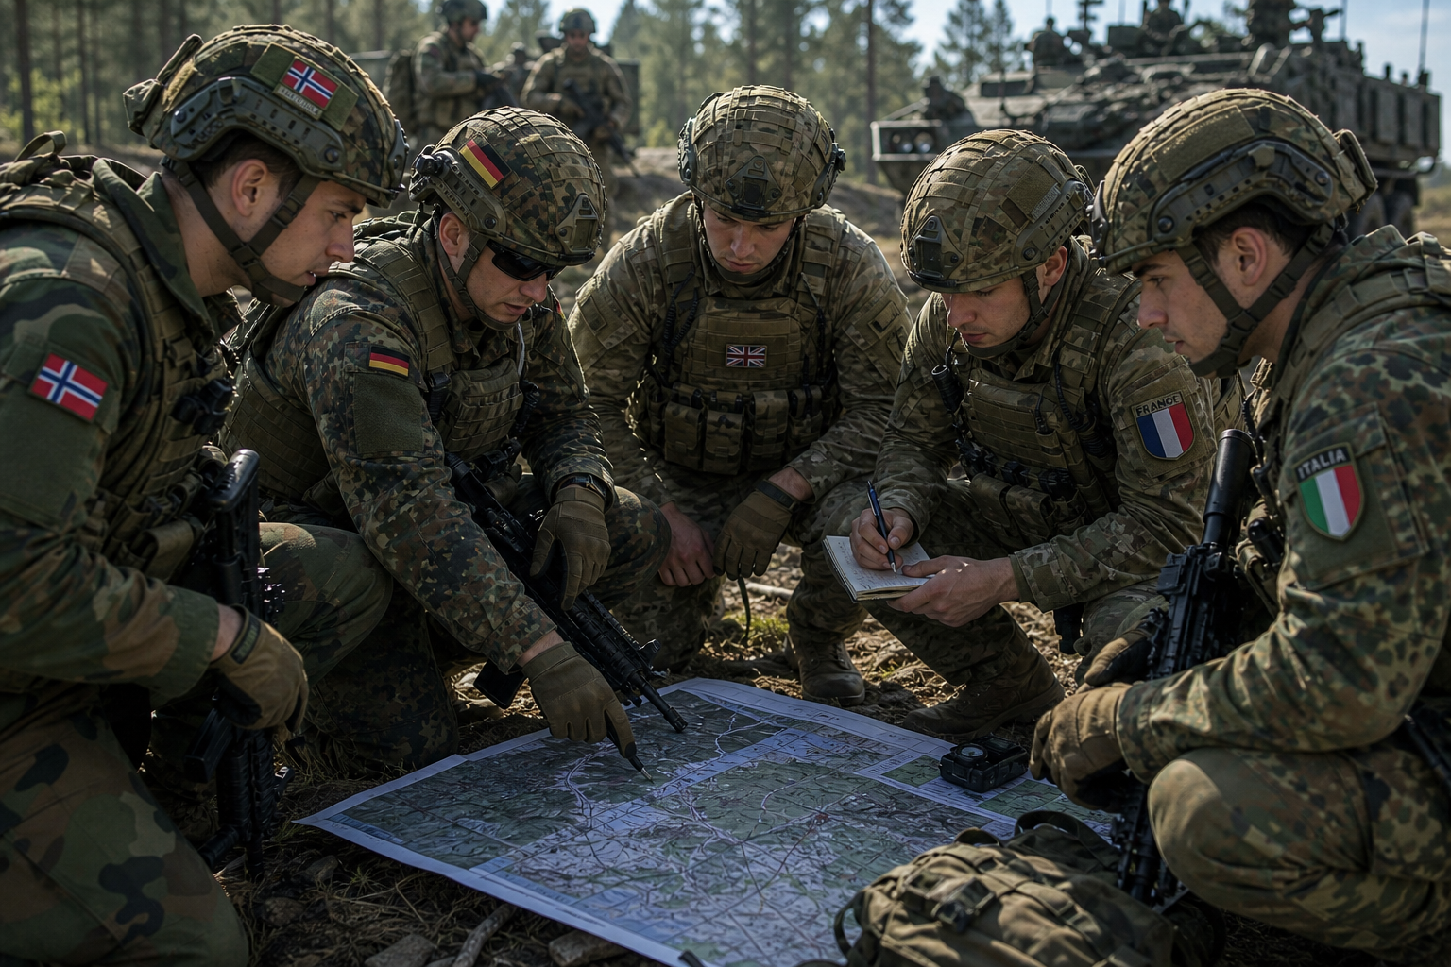
Language Competence and Cultural Awareness Developed Together
Beyond words
Integraded into language training
Scenario-based learning
Reflection and feedback

Slide 14

The Future Leader
Communicator
Negotiator
Integrator across cultures

Slide 15
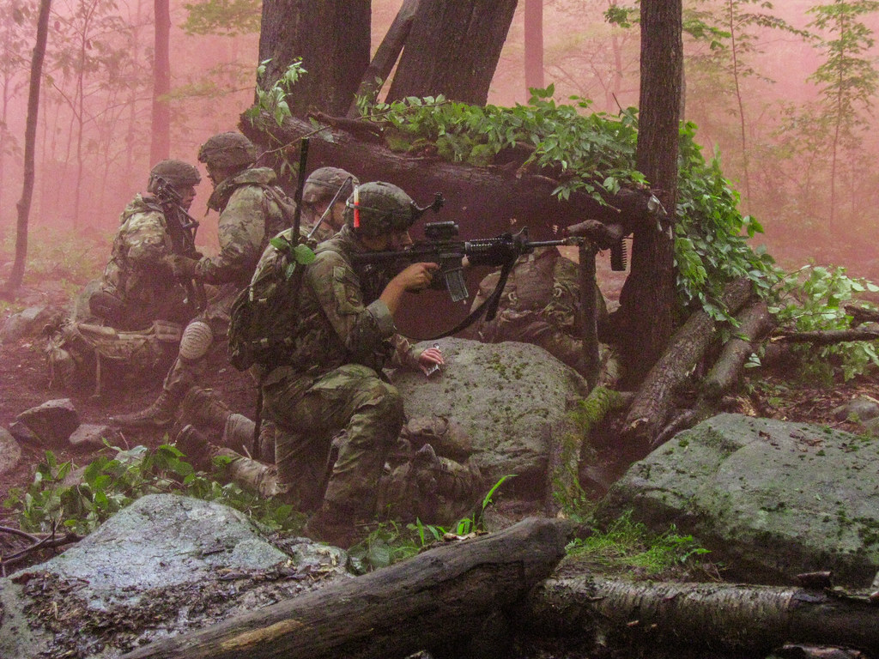
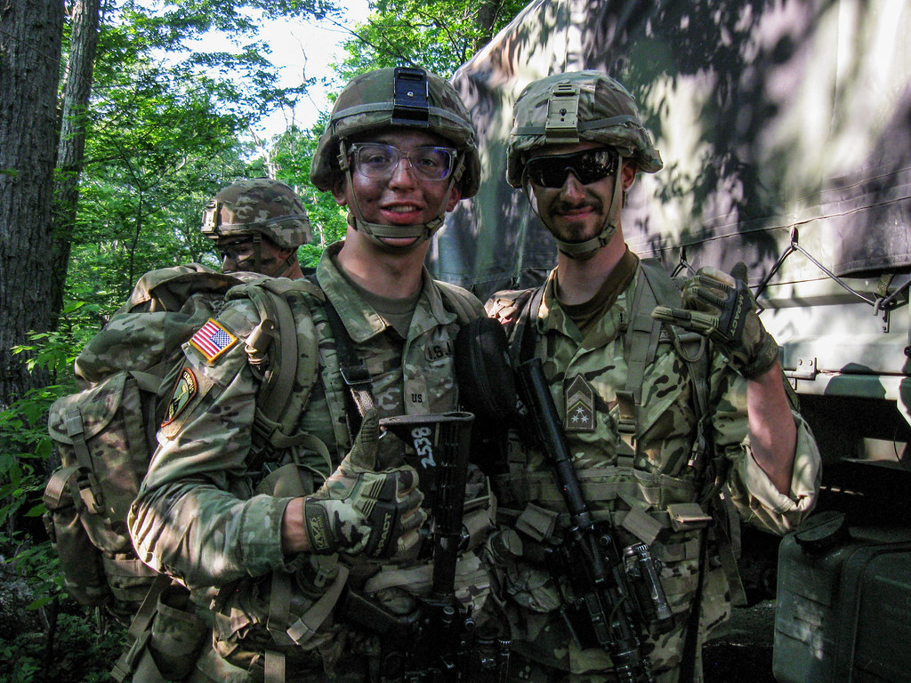
Lessons From the Field:
Language = operational skill, not just classroom subject
Effective communication built trust and leadership
Experience proved: “no English = no mission”
Investing in English today = better officer tomorrow

Slide 16
THANK YOU FOR YOUR ATTENTION!

