Slide 1
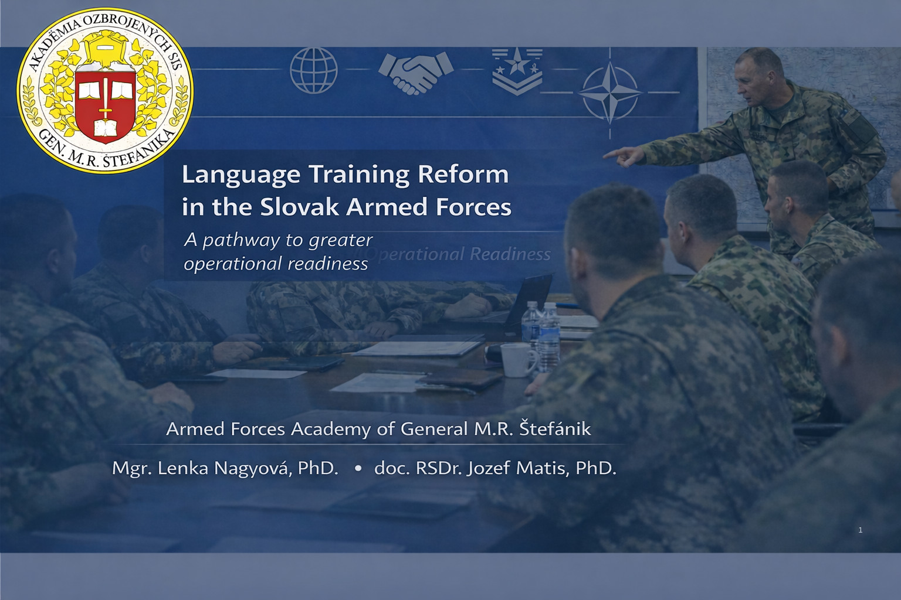

Slide 2

Contents
INTRODUCTION
1 THEORETICAL BACKGROUND AND OBJECTIVE OF THE PAPER
2 THE NEW CONCEPT FOR LANGUAGE TRAINING OF OFFICERS OF THE SLOVAK ARMED FORCES
3. CONCLUSIONS AND PROPOSED MEASURES
CONCLUSION

Slide 3
Introduction
Change of security environment
New security environment architecture – features:
From bipolarity to multipolarity
From individual security to national security and to international security
Differentiation of security by perspective and types of threats
Creation of new (or modernisation of) security institutions
The growing importance of language proficiency
Language skiills
Interoperable communication
Faster decisions
Mission effectiveness
The reform is based on three principles:
• Officers need English not only for exams, but also for administrative work, briefings, coordination, and international interaction;
• Language training must therefore be tailored to specific tasks and must continue throughout an officer’s career;
• Better language skills enhance the credibility and employability of Slovak officers abroad.
“Knowledge of foreign languages and cultural expertise are key skills that today’s military needs in order to meet the challenges of the current security environment …”
(Patesan – Zechia, 2018)

Slide 4
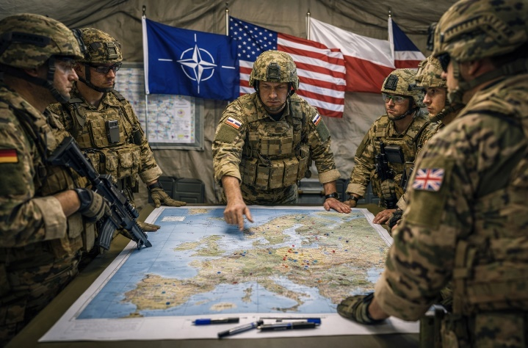
Language development throughout an officer’s career
Training should evolve in line with role and responsibility
0
1
2
3
Entry
Career start
Basic training
Specialised training
Maintenance
General English
foundation
STANAG-focused
preparation
Military / role-specific
English
Sustainment for
staff and leadership roles
Notes:
“

Slide 5
Officer language competence model
Four mutually reinforcing dimensions
The proposed concept must link general English, military English and role-specific English to real operational tasks.
Lexical
Grammatical
military terminology
NATO vocabulary
accuracy
clarity under pressure
Assessment reference:
NATO STANAG 6001
Operational
readiness
Communicative
Sociocultural
briefings
reports
staff interaction
multinational etiquette
local interaction

Slide 6
1 Theoretical background and objective of the paper
1. Definition of basic terms
2. Analysis of existing knowledge on the subject in domestic
and international scientific and specialist sources
Partial conclusions for the Ministry of Defence of the Slovak Republic
Positive aspects:
Implementation of STANAG 1–3 language courses.
Availability of specialised language courses.
Existence of intensive, blended and distance learning language courses.
A language proficiency testing system has been introduced.
Negative aspects:
Discrepancy between language proficiency requirements and the actual language skills of officers.
Unsystematic and incomplete practical solutions for the language training of Slovak Armed Forces officers within the Ministry of Defence.
Previous approaches to addressing the issue of language training have failed to address:
the need for differentiated language training for OS SR officers according to their roles at national and international levels,
the absence of a lifelong learning system,
the existence of a comprehensive document setting out specific requirements, methods for delivering language training and measures for improvement.
Failure to draw on experience in the field of language training in the V-4 countries.
an analysis of the existing language training system and a proposal for a new concept.

Slide 7
Research design
Multiple methods informed the proposed concept
Expert interviews
Case studies
insights from practitioners and decision-makers
Slovak Republic, Czech Republic, Poland and Hungary
Document analysis
Survey (n = 102)
requirements, courses and institutional arrangements
views of officers from career courses and mission training units
Output: evidence-based recommendations for a differentiated, career-long language training system.

Slide 8
Survey findings: the roles of officers in foreign military missions

Slide 9
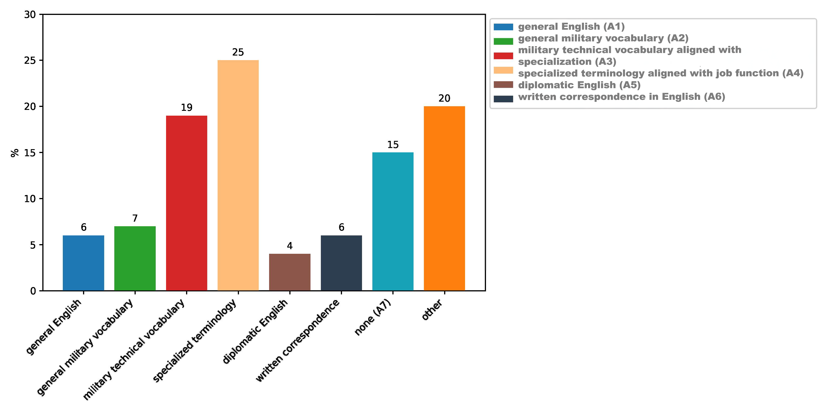
Survey findings: what officers need
Percentage of respondents selecting each option
Areas perceived as lacking
Training demand - vocabulary

Slide 10
Survey findings: readiness gap
Language preparedness is often lower than professional preparedness
The biggest single challenge is not general English; it is specialised vocabulary and function-specific communication.
Communication difficulties during deployment

Slide 11
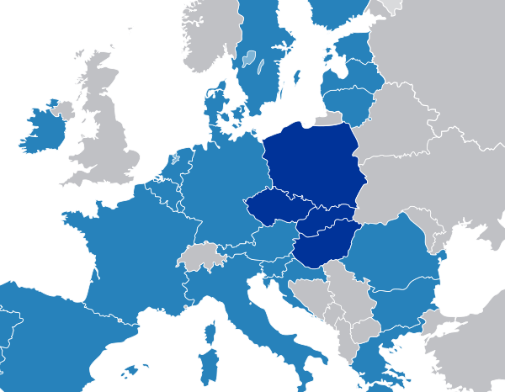
Case studies: comparison of V4 countries
Slovakia is broadly similar in structure, but weaker in terms of progress and sustainability
Across the V4 case studies:
• a similar number of institutions involved
• similar function-based language expectations
• a stronger provision of non-intensive and maintenance courses in neighbouring systems
• Slovakia has the lowest requirements for some higher levels

Slide 12
2 The new concept of language training of officers of the Slovak Armed Forces
Three pillars link education policy with operational requirements
Differentiate by role
Build a career-long system
Focus on operational tasks
Output
Higher readiness
for multinational
operations
Match content to rank, function and multinational exposure
Move beyond one-off courses to progression, refresher courses and maintenance
Prioritise briefings, staff work, reporting, NATO terminology and intercultural interaction
This is the bridge from language education to operational employability.

Slide 13
2 The new concept of language training of officers of
the Slovak Armed Forces

Slide 14
3 Conclusions and proposed measures
From concept to practice
Set clearer SLP targets
cadets 2222; lieutenant–captain 2222; majors 2+2+2+2+; lieutenant colonel–general 3333
add maintenance, preparatory and upgrade formats alongside intensive courses
Expand course formats
Strengthen governance
create a methodological unit to oversee quality and external instructors
Language is not a support skill. It is an operational capability.

Slide 15
3 Conclusions and proposed measures
From concept to practice
Phase implementation (2026 – 2030). These measures have been in place since 2026:
Social science seminars in English (to enhance distant learning)
Organisation of extensive language courses including a methodological training for external lecturers (at the selected military units)
Establishment of SLP2+ course
Establishment of a specialised course in language skills
Establishment of an individual maintenance course
Establishment of advanced military courses
Increase in the testing capacity
Increase in the number of tutors
Improvement of material and technical equipment for the Language Institute of the General Staff of the Slovak Republic
Application the proposed conception can also be applied to other armed, security, and rescue forces
Language is not a support skill. It is an operational capability.

Slide 16
Thank you for your attention
Questions ?

Slide 17
BIBLIOGRAPHY
1. ATrain P-5, 2016, Language Proficiency Levels. Edition A. Version 2. NATO Standardisation Office (NSO). [online]. 2016. 32 pp. Available at: https://www.natobilc.org/files/ATrainP-5%20EDA%20V2%20E.pdf.
2. HILA, Stefan-Ioan. 2020. Multinational military operations: The Role of English Language in Global Coordination. [online]. In: SECOSAFT 2020 – The 25th International Student Conference. Available at: https://www.armyacademy.ro/sesiuni/secosaft2020/sectiuni/SECTION%207%20FOREIGN%20LANGUAGES.pdf.
3. KOŠECKÝ, Stanislav, 2017. On the image of international linguistic communication in the European Union. In: Linguistic Journal, Ľudovít Štúr Institute of Linguistics, Slovak Academy of Sciences. Vol. 68/2017. [online]. pp. 71–87. Available at: https://sciendo.com/pdf/10.1515/jazcas-2017-0018.
4. NATO STANAG 6001, 5th ed., 2014. Language proficiency levels. [online]. Bureau for International Language Coordination (BILC). Available at: https://www.natobilc.org/en/products/stanag-60011142_stanag-6001.
5. NAGYOVÁ, Lenka and Jozef Matis, 2023. Language Training of Members of Dispositional Groups. [online]. In: Security Dimensions. SD 2023; 45 (45). pp. 107–142. DOI: 10.5604/01.3001.0054.2504. Available at: https://securitydimensions.publisherspanel.com/resources/html/article/details?id=617789&language=en
6. Nye, J. S. (2004). Soft Power: The Means to Success in World Politics. New York, NY: PublicAffairs. ISBN:978-1586482251 / 1586482254
7. PATESAN, Marioara and Dana ZECHIA, 2018. Foreign Language Education in the Military. [online]. In: International conference Knowledge-based organization. Vol. 24, no. 2. pp. 351–355. Available at: https://sciendo.com/article/10.1515/kbo-2018-0114. DOI:10.1515/kbo-2018-0114.
8. Service Regulation No. 111/2015 on the requirements for military rank and professional requirements for the performance of duties, on the level of foreign language proficiency required for military rank and the performance of duties, on the method of acquiring them, and on the conditions for recognising requirements for military rank and professional requirements for the performance of duties achieved prior to the entry into force of Act No. 281/2015 Coll. on the civil service of professional soldiers and amending and supplementing certain acts. Bratislava: Central Service Office. 2015.
9. Directive on the selection, personnel, financial and medical support, personnel security and assessment of the readiness of professional soldiers when deployed to perform tasks outside the territory of the Slovak Republic. 2016. No. SCKM-102/2016. Bratislava: General Staff of the Armed Forces of the Slovak Republic. 2016.
10. Act No. 321/2002 Coll. on the Armed Forces of the Slovak Republic. 2002. [online]. Available at: https://www.slov-lex.sk/pravne-predpisy/SK/ZZ/2002/321/.
11. Van Dijk, T. A. (2008). Discourse and Power. Basingstoke, UK: Palgrave Macmillan. ISBN: 978-0230574724.
Notes:
1717

