Slide 1


2026 NATO BILC CONFERENCE
STUDY GROUP #5
BILC’s Institutional Development

Slide 2
On its 60th anniversary, BILC has the opportunity to reflect on its founding principles and values, its vision and mission, and on its achievements over the last decades. Are there policies, programs, structures, or practices that no longer fit the purpose of BILC constituents? Do emerging political, technological, and other trends require a different kind of forward-thinking process? How can we best improve knowledge sharing across BILC nations, on the website and beyond?
AIM – make recommendations that will define BILC’s future priorities and shape the next decade of communal efforts.
Notes:
‹#›
Purpose: Anchor the Study Group in the official task: review BILC’s founding principles, values, mission, vision, achievements, structures and knowledge-sharing practices.
Facilitator action: Make clear that the Terms of Reference are the reference point, not the boundary. Participants should use the document and national experience to test whether current policies, programmes and practices still serve BILC constituents.
Aim: Produce recommendations that define future priorities and shape the next decade of communal effort, especially through better knowledge sharing, continuity between events and practical support to nations.

Slide 3
HOW WE WORKED
22 participants → 3 groups of four, and 2 groups of five
5 short tasks → group discussions → one written conclusion per group
Pre-conference task – possible discussion points, the 2016 ToR, and its summary containing most important facts about BILC and its MO
1st Day – introduction, review of BILC’s vision, mission and principles, subgroup discussions on three areas important for BILC’s institutional development – founding principles, users, and fitness for purpose, conclusions at the end of each discussion
4

Slide 4
HOW WE WORKED (cont’d)
3. 2nd Day – subgroup discussions on two areas important for BILC’s institutional development – knowledge sharing and dealing with emerging trends, conclusions at the end of each discussion, drafting recommendations for actions on the part of the BILC Secretariat and the Steering Committee
4

Slide 5
TASK 1: WHAT MUST REMAIN ESSENTIAL?
Starting point from the Terms of Reference:
• interoperability through language training and testing
• standardization and harmonized policy
• exchange of knowledge and best practices
• STANAG 6001 custodianship
• voluntary national contributions
Question: Which of these are non-negotiable for the next decade?
BILC must preserve [principle/principles] because [reason], while ensuring that [modernization need].
6

Slide 6
TASK 4: IMPROVE KNOWLEDGE SHARING
Core challenge: information must become actionable knowledge.
Questions:
1. What should be curated on the website, not just uploaded?
2. Which national policies, resources or templates can be shared?
3. What should Points of Contact do beyond forwarding documents?
Knowledge sharing should change by [mechanism], so that [target users] can [practical benefit].
11

Slide 7
TASK 6: DRAFT RECOMMENDATIONS
Every recommendation must answer:
WHAT should BILC do?
WHY is it needed?
WHO should lead or coordinate?
WHAT is the first practical step?
HOW will success be visible within 12 months?
13

Slide 8
RECOMMENDATION TEMPLATE
Recommendation:
BILC should…
Rationale:
This matters because…
First step:
Within 12 months…
Owner / coordination:
Secretariat / Steering Committee / lead nation / community of practice
Evidence of success:
A visible output is produced and used by nations.
15

Slide 9
PROPOSED RECOMMENDATION SET
1. Define the roles and responsibilities of national POCs
2. Improve communication among community members
3. Launch a biannual newsletter (1-2 pages)
4. Organize online workshops for language specialists
5. Keep updated on emerging trends to be included in presentations by developing targeted sub-topics
Detailed report on the recommendations to follow.
14

Slide 10
PARTICIPANTS
Agata Jagiełło Tondera (POL)
Albena Vasileva (BGR)
Ana Maria Bertilsson (SWE)
Andrew Pickles (DEU)
Angela Ruth Logue (ITA)
Angelica R. Silva (USA)
Besa Hashani (ACO/SHAPE)
Branka Petek (NATO)
Daria Łęska-Osiak
Eddy Carter (GBR)
Edelmira Nickels (USA/PLTCE)
Hajrudin Bakaran (BIH)
Irena Katauskiene (LTU)
Jurgita Kuzaité (LTU)
Katri Sirkel (EST)
Maja Gjurovikj (MKD)
Monika Myrto (ALB)
Nataliia Vasiukova (UKR)
Pablo Rodriguez-Cuesta (ESP)
Ruslan Isseyev (KAZ)
Satu Patronen (FIN)
Sophie Normandin (CAN)

Slide 11
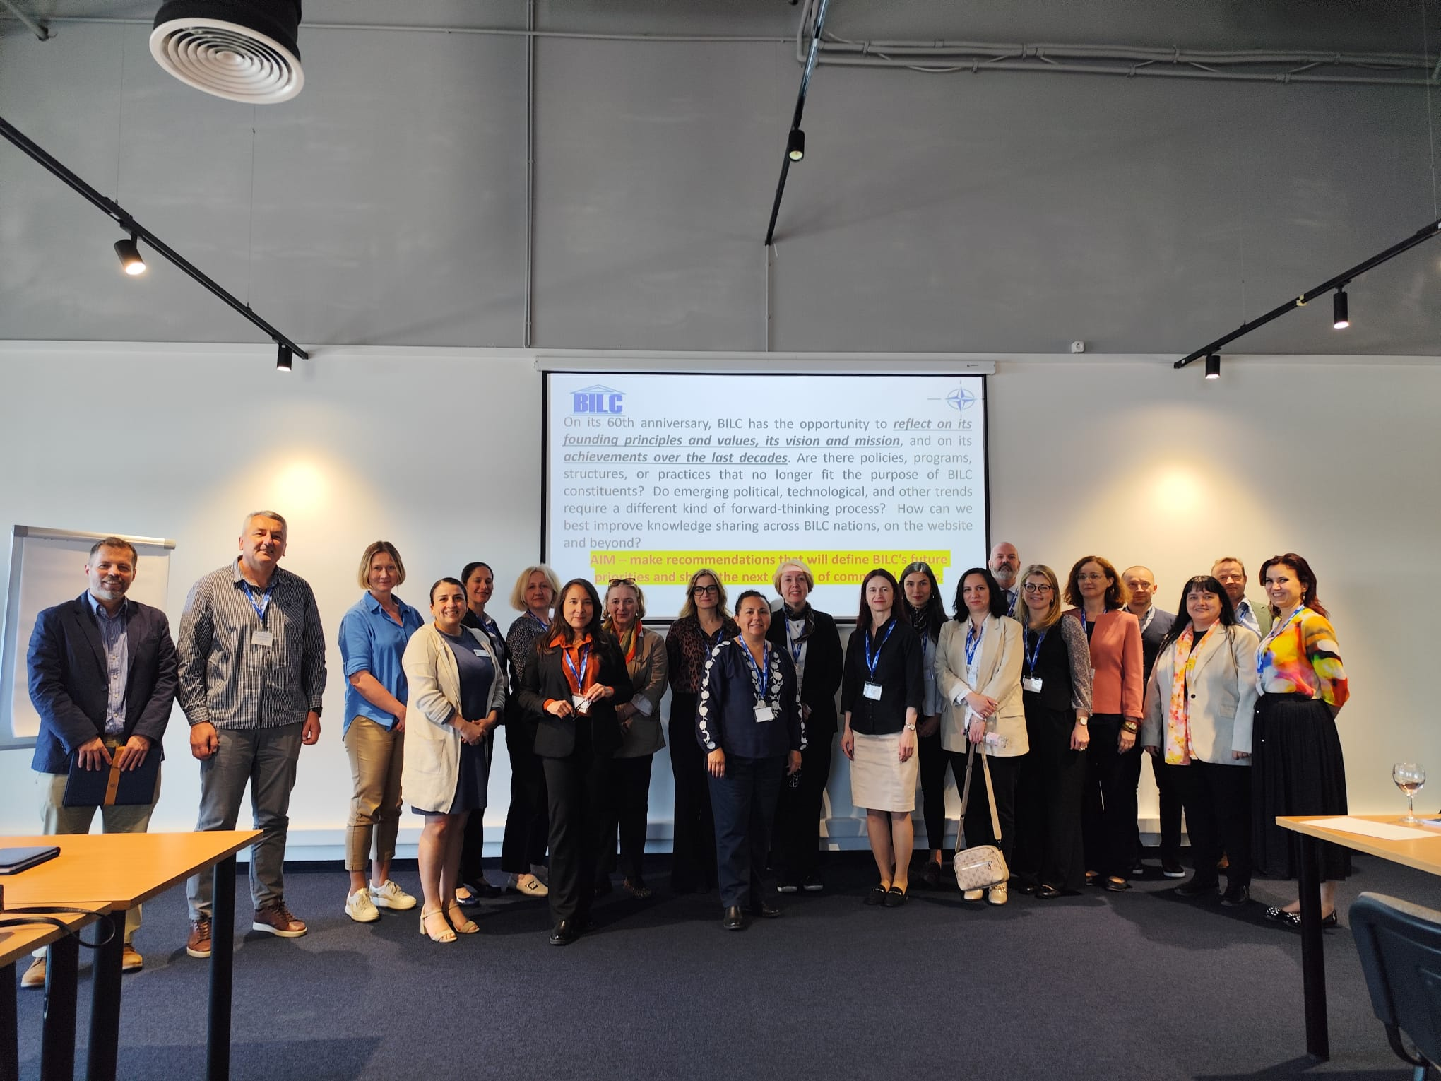
THANK YOU!!!

