Slide 1






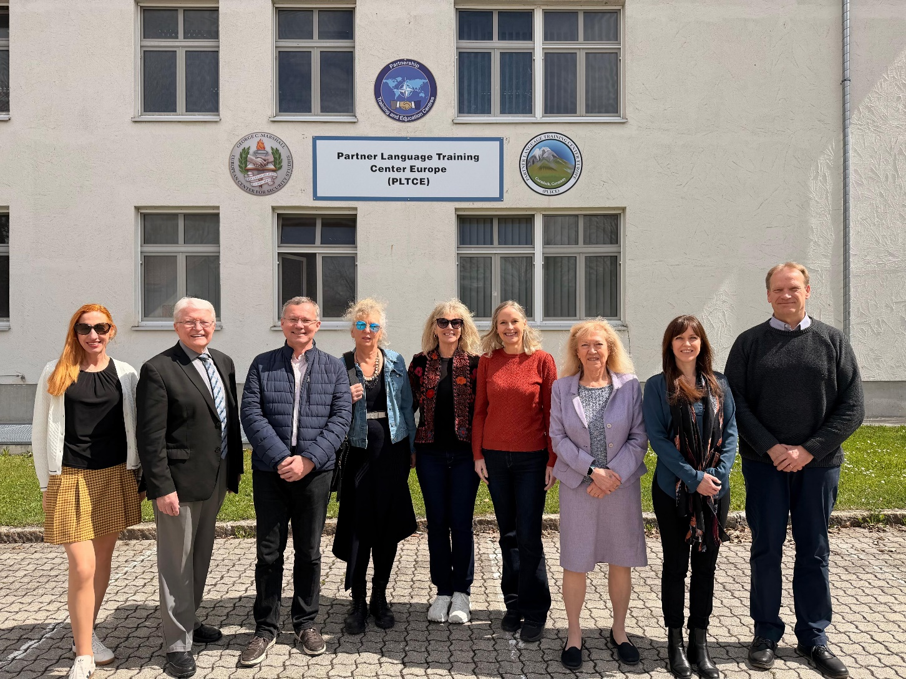
STANAG 6001 Working Group
U
P
D
A
T
E
NATO- BILC Annual
Conference
Budapest,
HUN
11 May
2026
PLTCE, 6-10 April 2026
Notes:
A NATO BILC Working Group (WG) is undertaking the first comprehensive review of the STANAG 6001 language proficiency descriptors in approximately 20 years.
STANAG 6001 Ed 5 version 2 remains the foundational framework for NATO language training and assessment; however, longstanding concerns within the BILC community have highlighted the need for modernization, clarification, and improved relevance to contemporary multinational military contexts.
A Focus Group established in 2023 confirmed broad multinational support for addressing these issues.
Based on survey feedback from over two dozen nations, the BILC Steering Committee formally approved a full review and established the WG, which began work in 2024.

Slide 2
STANAG 6001 Working Group
Rationale for Review
Feedback from BILC member nations identified several critical issues with the current scale:
  Some outdated language-use contexts and insufficient coverage of modern environments.
  Ambiguous descriptors that reduce usability and consistency across nations.
  Limited representation of multinational, NATO-specific language use.
  An inadequate French version, currently based on translation rather than original design.
  Over-reliance on the “native speaker” as a proficiency benchmark, which is no longer considered pedagogically appropriate.

Slide 3
STANAG 6001 Working Group
Levels, tasks, and functions unchanged from STANAG Ed 5
Threshold performance defined (Base levels only)
C/T/A and discourse features separated to eliminate overlap
Descriptors sequenced across skills and levels
Plain, operationally precise language throughout
No native‑speaker reference; focus on demonstrated proficiency & mastery
Military, joint, multinational operational context incorporated
NATO lingua franca- based but applicable to LOTE‑F
Notes:
It was decided that:
There would be NO major changes to the levels; the standards would remain the same, and the tasks would remain the same.
We would define the threshold performance at level –. This will allow training to be consistent in interpreting the minimal performance required at each threshold.
We are only working on the base levels – we will have future consultations on the plus levels, and the use of descriptors for plus levels.
We would remove overlap as much as possible so that the tasks, content/context, text type, and accuracy statements are independent from each other.
The scale will be in a quatro-section format, as well as a full narrative, organised format.
Removing jargon – attempt at using plain language and to have clear meaning
Our methodology is allowing us to re-order the statements in a ‘regular’ sequence from level to level and skill to skill. We are also resequencing each statement within each criterion so that there is a hierarchy of difficulty, to make the scale more user-friendly, as the pattern will apply to all skills and levels.
Our goal is to define proficiency in terms of a ‘speaker’ who demonstrates exceptional mastery of the language, without reference to ‘nativeness’. Want to define language progression from none or little proficiency to exceptional mastery
We have begun adding some general military contexts and lexical elements to the contexts, while being very careful not to turn the scale into a performance or narrow military purpose scale.
While orientation is mostly NATO ELF language context, scale can still be used for Languages Other Than English & French

Slide 4
STANAG 6001 Working Group
Programme of Work
The review is structured in three phased stages:
Phase 1 (2024–2026): Revision of speaking descriptors at all levels and Level 2 descriptors across all skills.
Phase 2 (2026–2027): Iterative expert review and drafting of full base-level descriptors across all skills.
Phase 3 (2028): Broader consultation with the BILC community, external experts, and stakeholders, leading to a final draft for Steering Committee approval (2028–2029).
Notes:
Review is in 3 phases -
Phase 1: Review of speaking descriptors at all levels – and Review of level 2 in all skills (AKA the cross)
Once a draft of Speaking at all levels, and level 2 at all skills is ready, for Phase 2, WG will request input from several selected expert reviewers. These are people who have worked extensively with the scale, trained testers, who produce tests, are facilitators at the LTS and ALTS, etc. or Heads of national testing teams.
In phase 2, the WG adjusts and drafts full base levels at all skills
At phase 3: the WG will set up a committee made up of the same reviewers, and possibly some external reviewers, and BILC stakeholders who will represent the entire BILC community. They will provide the last round of input, before the WG finalises the draft which will go out for general viewing and SC approval.
The estimated timeline for a completed draft update of STANAG 6001 (Base Levels) has been tentatively planned within the next couple of years
As I’ve said before, while this timeline may appear to be somewhat unambitious, one must consider that all work is performed through voluntary national contributions (VNC), by professionals who have other full-time functions.

Slide 5
STANAG 6001 Working Group
Listening | Speaking | Reading | Writing
 | 0
 | 1
2 | 2 | 2 | 2
 | 3
 | 4
 | 5
The “cross”

Slide 6
STANAG 6001 Working Group
STATUS: Now in Phase 1:
Review of speaking descriptors is complete
Review of listening, reading and writing level 2 is underway
Phase 2 coming soon:
WG gathers feedback and readjusts as needed from “selected” expert reviewers
Once cross is validated, WG drafts the remaining skills and levels.
This iterative process will be repeated as needed
Notes:
Current Status
The WG has met extensively, with three meetings in 2025 and one week in April 2026.
Phase 1 is nearing completion.
Planning is underway for systematic collection and analysis of expert reviewer feedback for Phase 2.
Although the primary drafting effort focuses on English, a parallel, purpose-built French version is being developed.
We now have enough experience to know that while we can remotely prepare for our meetings, we must be F2F to review and co-draft.

Slide 7
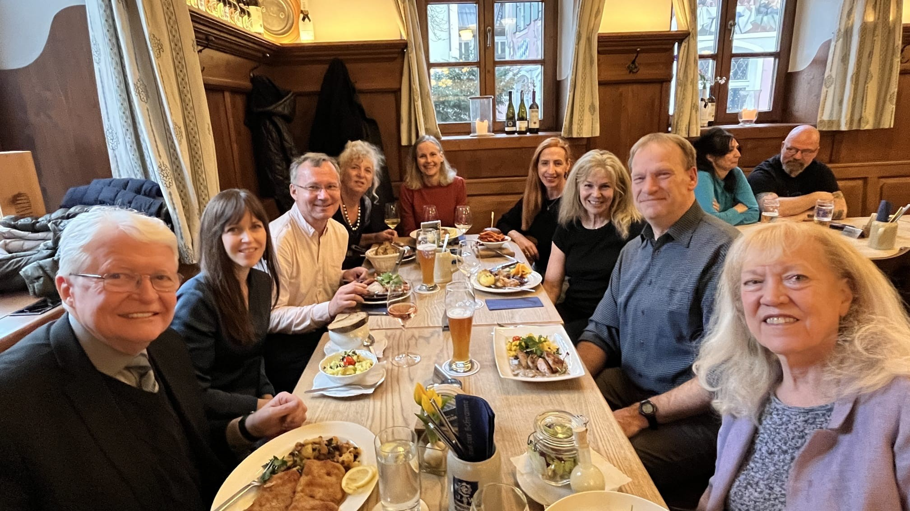
STANAG 6001 Working Group
Merci!
Notes:
Outlook
The review is on track and aligned with BILC priorities to modernize STANAG 6001, increase clarity and usability, strengthen NATO relevance, and ensure linguistic equity across official languages. Once finalized, the revised scale is expected to enhance consistency, validity, and operational relevance of language proficiency assessment across NATO nations.
Now, I would like to thank WG members for their hard work and dedication to this endeavour:
My French co-leader, Jerome Collin, Jana Vasilj-Begovic from Canada, Merit Kompus from Estonia, Gerard Seinhorst from the Netherlands, Birgitte Grande from Norway, BILC Senior advisor, Ray Clifford, and our American colleagues from PLTCE: Peggy Garza and Andrea Gjorevski who hosted us at PLTCE last month.
Thank you for your attention. Julie Dubeau, BILC Associate Secretary, May 2026

