Slide 1
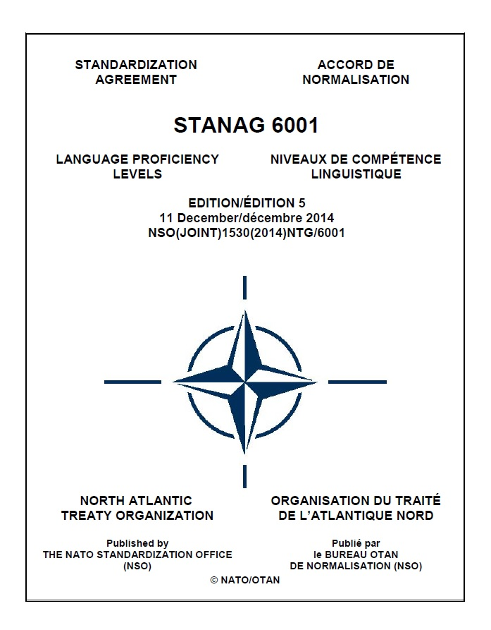
STANAG 6001 at 50
BUREAU FOR INTERNATIONAL
LANGUAGE COORDINATION
The Story of
Standardising Language Proficiency in NATO
Gerard Seinhorst
Netherlands Defence Language Centre

Slide 2
INTRODUCTION
STANAG 6001 in NATO
Standardization Agreement (STANAG) on language proficiency
Developed by BILC in the 70s; first adopted in 1976
Ratified by all NATO nations, used in many Partner Nations
Part of the 6000-series:
  personnel & administration
  training and education
  reporting standards
  language policy
Nowadays, it is one of the most widely used STANAGs in NATO

Slide 3

STANAG 6001 in NATO
How did STANAG 6001 become NATO’s trusted language standard?
Why and how was it created?
How did it evolve?
Why did NATO continue relying on it?
How was trust in the standard developed?
Why does it still matter today?

Slide 4

A TRIBUTE
Dr Martha Herzog
Principal author of the current STANAG 6001 level descriptors
Key figure in the BILC Working Group on Testing and Assessment
Her work continues to shape NATO language testing today

Slide 5
THE EVOLUTION OF STANAG 6001
1960s-1975
1991-1999
2000-2014
1976-1990
FOUNDATIONS
LIMITED USE
RENEWED URGENCY
EXPANSION
CONSOLIDATION
2015-2026
Cold War
PfP Assistance
Interoperability
Professionalisation

Slide 6
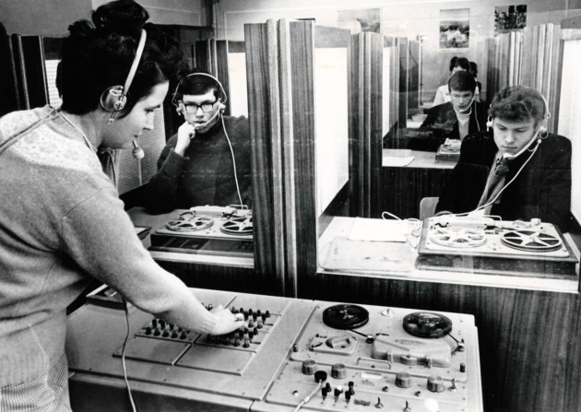
THE PRE-STANAG YEARS (1960s-1975)
The situation before STANAG 6001
No common NATO language standard
Different national systems and testing traditions
Emphasis on new teaching methods (e.g. audio-lingualism), not proficiency scales
No shared definition of language proficiency
Increasing multinational cooperation
What meant “working proficiency in English” or “fluent in French”?
 Need for comparable proficiency levels

Slide 7

TOWARDS A COMMON STANDARD
Syndicate on Foreign Language Proficiency Levels (BILC Conference 1972):
0 No knowledge
A Limited or elementary
B Adequate or working
C Full or near native
first step toward a structured scale
➔ aim: to produce a table of language levels, not detailed descriptors
Few existing models
mostly examination-based grading systems
focus on grammar mastery, vocabulary size
norm-referenced (how well someone performed on a test)
BILC CONFERENCE 1972 (GBR)

Slide 8
EXTERNAL INFLUENCE
Influence of the 1968 FSI proficiency scale (U.S. Foreign Service Institute)
FSI is the key origin point for functional proficiency scaling as we know it
first widely institutionalised scale with systematic, extended, functionally oriented descriptors
strongly influenced the ILR scale, ACTFL Proficiency Guidelines, STANAG 6001, and later the CEFR
originally centred on speaking and tied to the “FSI” speaking test format (later OPI)

Slide 9
A HYBRID CONSTRUCT
BILC “borrowed” from the 1968 FSI scale:
6-point structure, with descriptive labels for each level
  Level 0: No practical proficiency
  Level 1: Elementary
  Level 2: Fair (Limited working)
  Level 3: Good (Minimum professional)
  Level 4: Very good (Full professional)
  Level 5: Excellent (Native/bilingual)
focus on functional language use
similar terminology – Levels 0 and 5 were identical, although other levels and skills were sometimes worded differently

Slide 10
A HYBRID CONSTRUCT
BILC’s own contributions:
4-digit “Standardised Language Profile” (SLP) L/S/R/W, e.g. SLP3232
“test-neutral” framework − independent of teaching methodology or test format
higher ambition - intended as formal NATO-wide standard
From the 1973 report of the Working Group on Proficiency Levels:

Slide 11
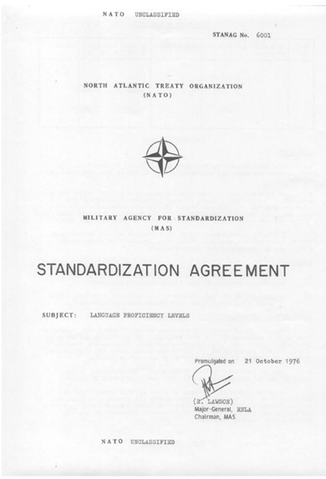
STANAG 6001 – EDITION 1 (1976)
From the 1978 BILC Report (Working Group on Testing)

Slide 12
STANAG 6001 – EDITION 1 (1976)
Only after 1999, BILC increasingly assumed a central role in the interpretation, development, and standardisation of STANAG 6001.

Slide 13
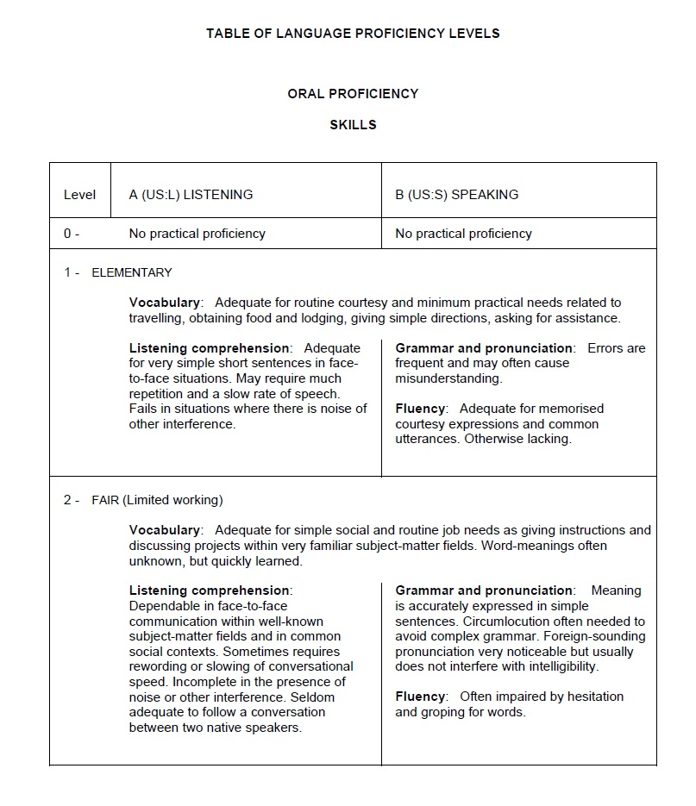

Slide 14
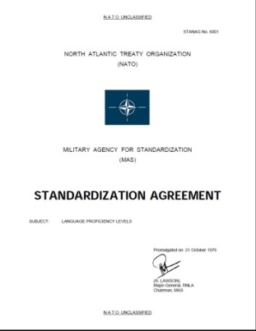
TIMELINE
1960s-1975
1991-1999
2000-2014
1976-1990
FOUNDATIONS
LIMITED USE
RENEWED URGENCY
EXPANSION
CONSOLIDATION
2015-2026
Cold War
PfP Assistance
Interoperability
Professionalisation
2003: Edition 2
1976: Edition 1

Slide 15
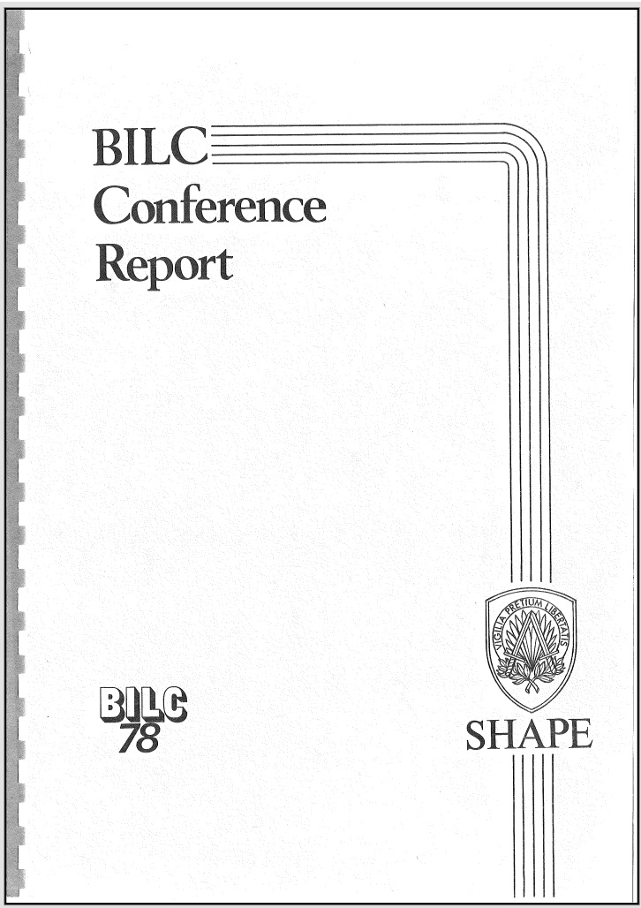
LIMITED USE (1977-1990)
Edition 1 ratified by all NATO nations by spring 1977
Focus on international staff appointments
Interpretation varied
Many nations continued to use their own national classification system
 Limited operational use
From the 1978 BILC Report:
“It has always been recognised that the levels themselves are of limited value without appropriate measuring instruments (tests).”

Slide 16
TIMELINE
1960s-1975
1991-1999
2000-2014
1976-1990
FOUNDATIONS
LIMITED USE
RENEWED URGENCY
EXPANSION
CONSOLIDATION
2015-2026
Cold War
PfP Assistance
Interoperability
Professionalisation
2003: Edition 2
1976: Edition 1

Slide 17
RENEWED URGENCY (1991-1999)
End of the Cold War
Change of focus, from intelligence languages to operational languages (mainly English)
PfP expansion and operational pressure
PfP nations start building language training and testing systems based on STANAG 6001
  requests for help with interpreting and operationalising the descriptors
mission-oriented armed forces
  language requirements expanding beyond senior staff officers
 Need for a clear and usable standard with a shared interpretation became more urgent
Notes:
The Partnership for Peace dramatically expanded NATO cooperation,
and the new partner nations needed operational language systems very quickly.
NATO became much more mission-oriented, which meant that language requirements were growing too
Now the STANAG became operationally important.

Slide 18
SHORTCOMINGS of EDITION 1
From Descriptors to Practice
lack of detailed specifications → limited usefulness for assessment purposes
the brevity of the descriptions allowed for multiple interpretations
NATO nations developed their own testing systems and local interpretations
  amplification documents circulated informally through BILC
absence of common testing guidance or shared rating practices
increasing concern about the comparability of national STANAG results
STANAG 6001 risked losing credibility as a common NATO standard
1999: NATO Training Group/JSSG formally requested BILC to develop interpretive guidance
Notes:
Only then it was found that Edition 1 had some important shortcomings:
the original descriptors were too brief to support consistent interpretation.
Different nations were effectively applying different standards
This created a serious interoperability concern.
Comparable performances could receive different ratings across nations.
And once STANAG levels became linked to staffing and deployment decisions, those inconsistencies became much more consequential.
But the STANAG was saved by the bell in 1999, when the JSSG requested BILC to develop interpretive guidance for the scale.
This is the moment when BILC increasingly moved from being mainly a discussion forum, to becoming the professional custodian of the system

Slide 19
TIMELINE
1960s-1975
1991-1999
2000-2014
1976-1990
FOUNDATIONS
LIMITED USE
RENEWED URGENCY
EXPANSION
CONSOLIDATION
2015-2026
Cold War
PfP Assistance
Interoperability
Professionalisation
1976: Edition 1
Notes:
This period of expansion of the scale started in 2000 and lasted until about 2014.

Slide 20











EXPANSION OF THE SCALE (2000-2014)
Working Group on Testing and Assessment
Established by BILC SC in 1999, chaired by Dr Martha Herzog
Representatives from 11 BILC member nations
Initial goal: to elaborate on and interpret the original STANAG 6001 descriptors
KEY TURNING POINT in the history of STANAG 6001
Led to the ‘Interpretation document’ (2001)
  expanded descriptors for each skill at each level, including Level 0+ (Memorized Proficiency)
  based on U.S. Interagency Language Roundtable (ILR) descriptors
  successfully trialled in the new BILC Language Testing Seminar
Included in Edition 2 (2003) as Annex A to Appendix 1

Slide 21
WORKING GROUP on TESTING and ASSESSMENT
WORKING GROUP
Language Testing Seminar (2000)
Interpretation document (2001)
STANAG 6001 Edition 2 Appendix 1 (2003)
Plus Level Descriptors (2005)
STANAG 6001 Testing Workshops (2010- )
Benchmark Advisory Test (BAT) (2009)
Edition 3 (2009)
Advanced Language Testing Seminar (2011)
Level 4 Framework (2014)
Prototype
Level 4 Test (2015)

Slide 22
GROWING PAINS
Unintended consequences of success
STANAG 6001 became central to NATO staffing, deployment, and interoperability
national tests and rating practices were not always aligned
  comparable performances could receive different ratings across nations
  one nation’s Level 3 might equal another nation’s Level 2
SLP requirements for NATO posts became inflated
  SLPs were often based on people-comparisons rather than task analysis
    “The last officer was a Level 3 and struggled - therefore we need a 4.”
  very high SLP requirements (‘native proficiency’) sometimes functioned as de facto selection filters
➔ Inconsistent application of the standard became a growing interoperability concern within NATO

Slide 23
ACTION #1 - THE LABELS
Level | Editions 1 and 2 | Edition 3
0 | No practical proficiency | No proficiency
0+ | -- | Memorized
1 | Elementary | Survival
2 | Fair (Limited working) | Functional
3 | Good (Minimum professional) | Professional
4 | Very good (Full professional) | Expert
5 | Excellent (Native/bilingual) | (Equivalent to) Highly-articulate native
The new labels helped mitigate the inflation of SLPs

Slide 24

ACTION #2 - PLUS LEVELS
In 2005, a subgroup of the WGoTA developed “plus levels” for all skills
adopted as Annex A to Appendix 1 of Edition 3 of STANAG 6001
Purpose
finer granulation of “in-between” proficiency
recognition of language ability clearly above a level threshold, but not consistently meeting the next higher level
Key principles
plus levels do not constitute separate thresholds
intended for testing and reporting purposes (optional use)
not intended for defining job SLP requirements

Slide 25
ACTION #3 - FRAMEWORK DEVELOPMENT
Not only the descriptors were expanded, but also the underlying theoretical principles
Each level represents a range, rather than a point on the scale
It is a criterion-based proficiency scale, not performance or job-specific language use
Each descriptor defines Task / Conditions / Accuracy:
what a person can do
under which conditions
and how well
Assessment is non-compensatory assessment  weaknesses in one skill cannot be compensated by strengths in another (e.g. SLP3131 ≠ average Level 2 proficiency)
Cumulative structure  each higher level includes the abilities of the lower levels
Progression is exponential rather than linear  reflected in the “inverted pyramid” model

Slide 26
Quantity
5
Quality
4
Time
3
2
1
THE INVERTED PYRAMID / CONE

Slide 27




OTHER ACTIONS TAKEN
seminars and workshops to train language professionals from NATO nations in a common interpretation of the levels, and in the development of valid and reliable language tests
norming activities: multinational test item development, norming sessions, sharing of test items, prompts, and speaking and writing samples
development of the Level 4 Framework and prototype Level 4 test, demonstrating that Level 4 is only required in exceptional cases involving highly nuanced language use
Benchmark Advisory Test (BAT)(2009 and 2022) to promote more consistent interpretation and application of STANAG 6001 across national testing programmes

Slide 28
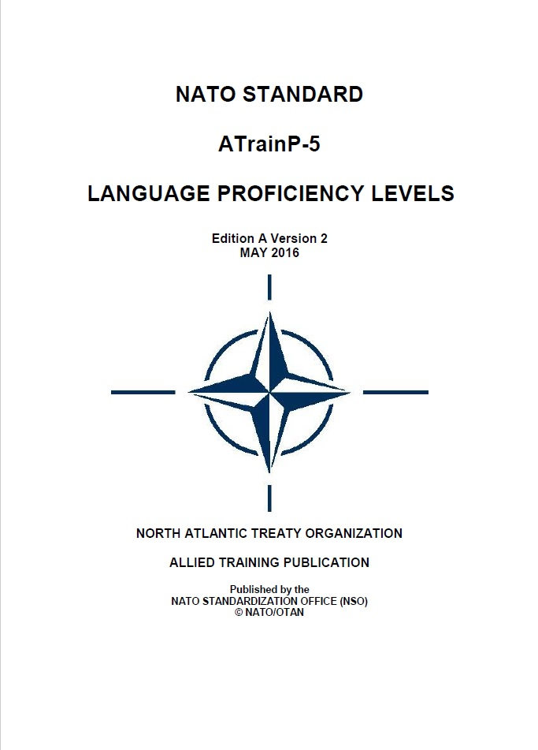
EDITIONS 3, 4, and 5
    2009: STANAG 6001 Edition 3
          Plus levels
          New labels
          NATO agreed definition of Language proficiency:
            “an individual’s unrehearsed, general language communication ability”
    2010: STANAG 6001 Edition 4
    Purpose of Plus levels extended to recording/reporting
    2014: STANAG 6001 Edition 5
          No textual changes in the descriptors
          Format change: descriptors removed from the STANAG and
          published in ATrainP-5 Ed A
        In Edition 5, NATO formally designated BILC as custodian of STANAG 6001.
2016: ATrainP-5 Ed A V2
  Correction of minor typos

Slide 29
TIMELINE
1960s-1975
1991-1999
2000-2014
2015-present
1976-1990
FOUNDATIONS
LIMITED USE
RENEWED URGENCY
EXPANSION
CONSOLIDATION
Cold War
PfP Assistance
Interoperability
Professionalisation
2003: Edition 2
2009: Edition 3
1976: Edition 1
2010: Edition 4
2014: Edition 5

Slide 30
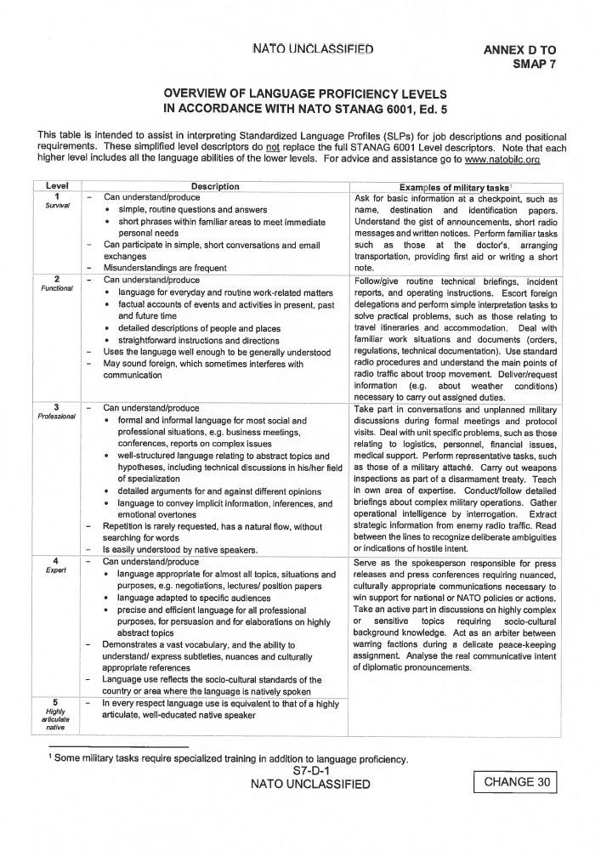
CONSOLIDATION and RECOGNITION (2015-present)
Stability and institutional embedding
No changes to the level descriptors
Continued professionalisation of teaching and testing
Increased standardisation (Policy Recommendations)
Formal recognition in NATO-policy (AAP-16 NATO Manpower Policy and Procedures)
  STANAG 6001 embedded in NATO education and personnel systems
As a custodian, BILC has become responsible for
  periodically reviewing and updating the STANAG and its descriptors
  promoting their consistent interpretation and application among participating nations

Slide 31


THE PERSISTENT CHALLENGE
Common interpretation and consistency across nations
Deputy Commander NATO Airborne Early Warning & Control Force (E3A):
“Comparable performances may be rated differently across nations.”
(BILC STANAG 6001 Testing Workshop, The Hague, 2025)
STANAG 6001 only functions if nations interpret and apply it consistently
Maintaining a common interpretation remains a key interoperability challenge

Slide 32

IS STANAG 6001 STILL FUTURE-PROOF?
Questions and criticisms
Common interpretation remains difficult
Portability and conversion questions continue to reappear
STANAG language certificates are not widely recognised outside defence
Maintaining national testing systems requires expertise and resources
Why not simply use the CEFR?
widely used and internationally recognised civilian framework
facilitates portability and comparability outside defence
supported by extensive teaching and learning resources
no need for NATO-specific descriptors and dedicated testing systems

Slide 33
VIABILITY
Why STANAG 6001 remains essential
NATO needs precise proficiency measurement for operational and high-stakes decisions in defence contexts
Misjudging language ability can directly affect safety, decision-making, and mission effectiveness
Unlike CEFR levels, STANAG levels are fixed thresholds with clearly defined floors and ceilings
  All requirements must be consistently demonstrated to attain a level
BILC promotes common interpretation and quality standards across nations
STANAG testing follows common testing and rating principles
The CEFR itself does not regulate how tests are developed, administered, or standardized
  CEFR-based tests vary widely in purpose, methodology, and quality

Slide 34

























THE STANAG 6001 ECOSYSTEM
A shared proficiency framework connecting NATO nations

Staffing & Deployability Common language requirements for NATO assignments and missions
Interpretation
Standardisation Guidance

Multinational Operations
Stronger cooperation in all NATO and Partner activities
Seminars & Workshops
Sharing expertise Building common understanding

Expanded Descriptors
Development Refinement Updates

Personnel Selection
Fair, transparent and comparable language requirements

Training & Qualification
Rater training
Test development
STANAG 6001
NATO Language Proficiency Scale
Benchmarking
& BAT
Evidence-based alignment
Interoperability
Effective communication across nations
and operations

National Testing Systems
Aligned with STANAG 6001

Policy Recommendations
Supporting national and NATO policies
Education & Training
Curricula, materials and tests aligned to a common standard
NATO & Partner Nations
Shared standard adopted
Language Training and Testing Systems in NATO Nations

Slide 35
THE SIGNIFICANCE OF STANAG 6001
The real significance of STANAG 6001
is the TRUST that NATO gradually developed
Trust cannot be enforced – it must be earned
BILC and STANAG 6001 grew together and are inextricably linked
Without BILC, there would be no STANAG 6001
Without STANAG 6001, there would be no BILC
(in its current form)

Slide 36
STANAG 6001 EVOLUTION
Edition | Date | Structural Change | Functional Impact
STANAG 6001 Ed 1 | 1976 | First NATO-agreed standard to describe language proficiency – Short descriptors in Annex A | First, crucial step towards standardisation
STANAG 6001 Ed 2 | 2003 | Expanded descriptors added in Appendix 1 to Annex A | First detailed interpretation guidance
STANAG 6001 Ed 3 | 2009 | Expanded descriptors replace original short ones in Appendix 1; Plus levels included as Annex A; New labels for proficiency levels “Proficiency” defined | Major conceptual expansion and formalisation
STANAG 6001 Ed 4 | 2010 | Included two additional purposes of plus levels; no changes in descriptors | Broader operational use of plus levels
STANAG 6001 Ed 5 ATrainP-5 Ed A V1 | 2014 | Level descriptors removed from main document and published in ATrainP-5 Ed A | Separation of agreement and implementation
ATrainP-5 Ed A V2 | 2016 | Correction of minor typos | No conceptual change
Notes:
Optional slide for those who want a one-page overview of the evolution of STANAG 6001

