Slide 1
Words Spoken, Words Unspoken
Cross-cultural communication
in multinational organizations
STEPHEN HAUGHEY SWEDISH ARMED FORCES

Slide 2
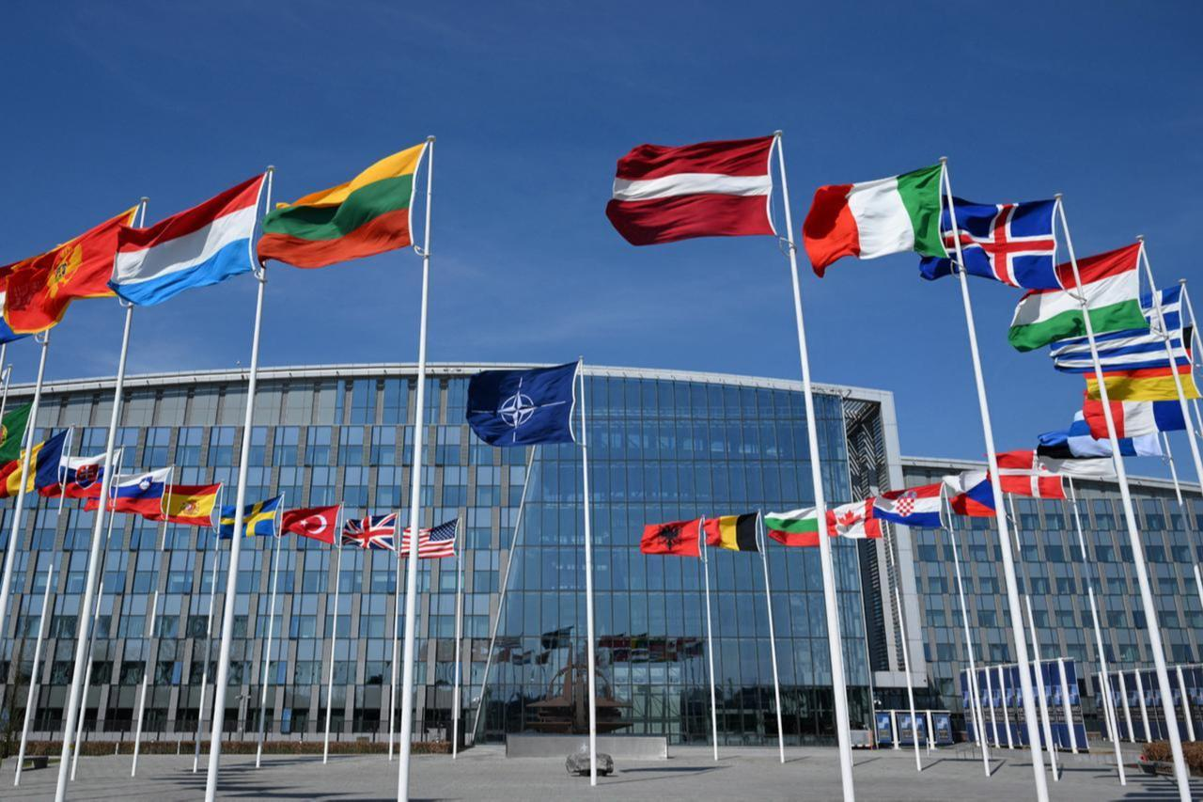
NATO: 32 member countries

Slide 3
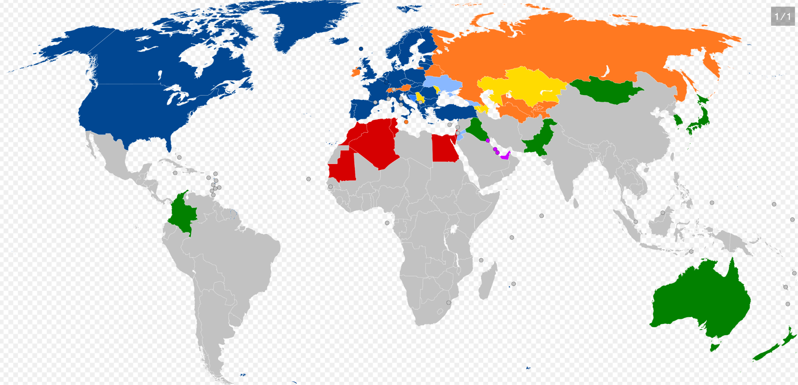

Slide 4
NATO
Cross-cultural competence (3C)
The ability of military personnel to effectively understand and operate within diverse cultural environments, crucial for coalition operations, stabilization, and engagement with local populations.
3C enables NATO personnel to achieve mission goals in complex, foreign environments without requiring extensive prior regional knowledge.

Slide 5
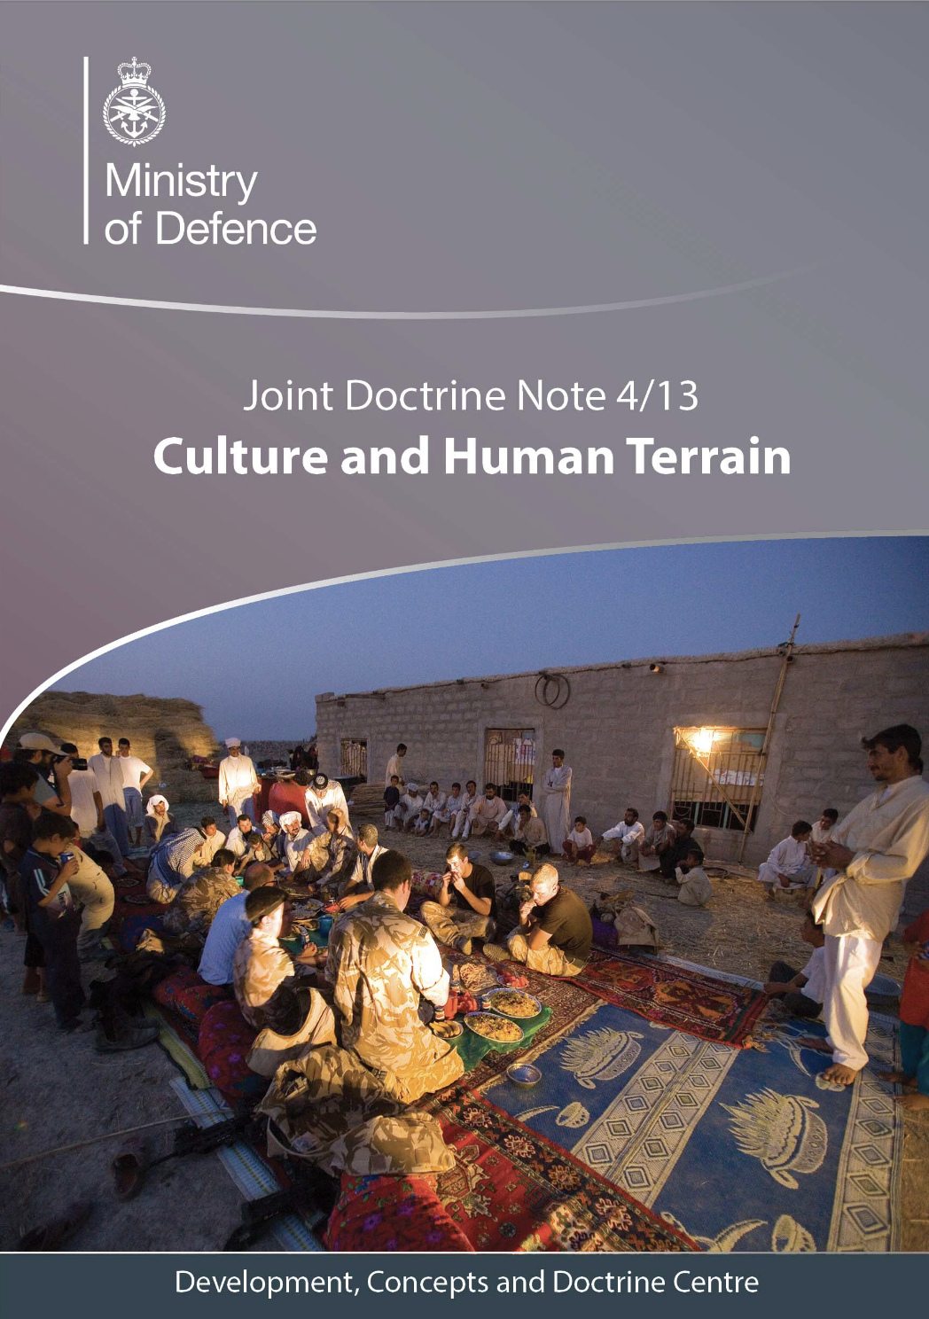
Defining Culture

Slide 6
What is Culture?
Describing culture is a complex task as it comprises many attributes. There are, however, a number of generic characteristics (or norms) that can be identified. The following are the most important.
    A. Sharing
    B. Learning
    C. Habits
    D. Patterns
    E. Dynamism
    F. Multiplicity
Excerpt: UK MoD JDN 4/13
Culture and Human Terrain

Slide 7
Cultural Practices and Social Structures
It is important to think about all aspects of culture and to avoid only focussing on the obvious and different aspects of a group. One way of ensuring that sensitivities and complexities are properly examined is to distinguish between cultural practices and social structures.
Excerpt: UK MoD JDN 4/13
Culture and Human Terrain

Slide 8
Cultural Practices
Cultural practices are immediately observable in a society, such as a style of dress, the way people greet each other, and displaying flags and other symbols. Guides to cultural ‘dos and do nots’ usually focus on cultural practices as they are the easiest to identify and learn. Recognising a group’s cultural practices, however, will only give a superficial understanding of the group and will not necessarily define why people do what they do.
Excerpt: UK MoD JDN 4/13
Culture and Human Terrain

Slide 9
Social Structures
Social structures are the foundations that underlie cultural practices. For example, the physical form of a greeting, such as a handshake or a kiss, is a cultural practice that is visible and can be copied. However, the group’s unconscious rules about the relationships between superiors or subordinates, or about how people interact, will influence the choice of whether to use a handshake or kiss when greeting. If we want to understand a group properly, and know how to engage with it, these underlying behavioural drivers need to be examined in depth.
Excerpt: UK MoD JDN 4/13
Culture and Human Terrain

Slide 10
Cultural Practices 01
THE CHEERFUL COUNTENANCE:
To smile or not to smile
A brief comparison of Thailand and Russia

Slide 11
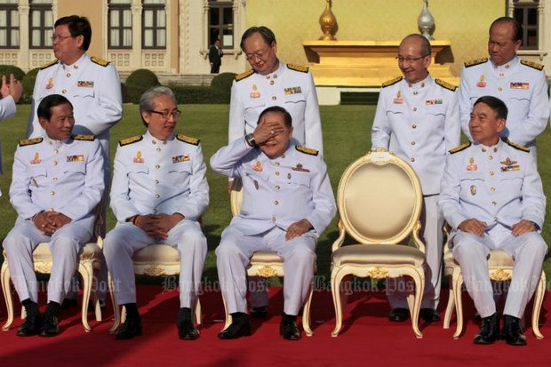
Thailand: The Land of Smiles

Slide 12
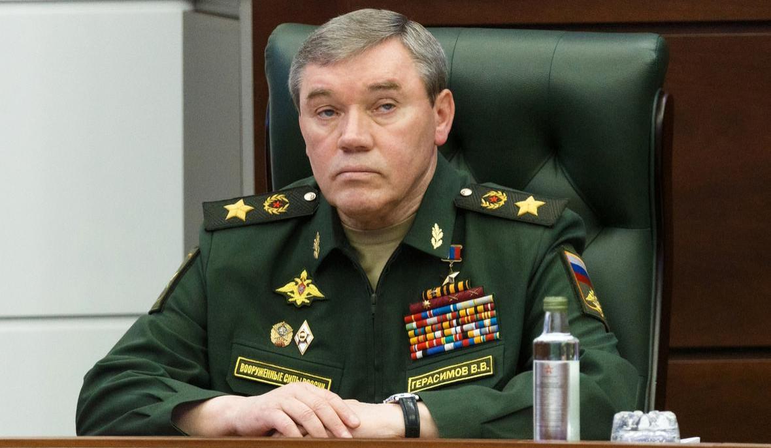
Russia: The Land of Frowns

Slide 13

Thai Classroom: Let’s Have Fun!

Slide 14
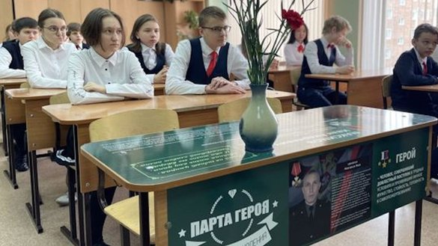
Russian Classroom: Веселье? В другом месте.

Slide 15
Cultural Practices 02
WHEN A NOD MEANS "NO"
AND A HEAD SHAKE MEANS "YES"
The curious case of the south Balkans:
Albania, Bulgaria and Greece

Slide 16
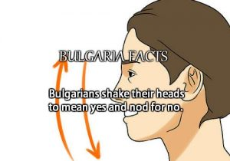
Source: Bulgarian Embassy, Washington DC.

Slide 17
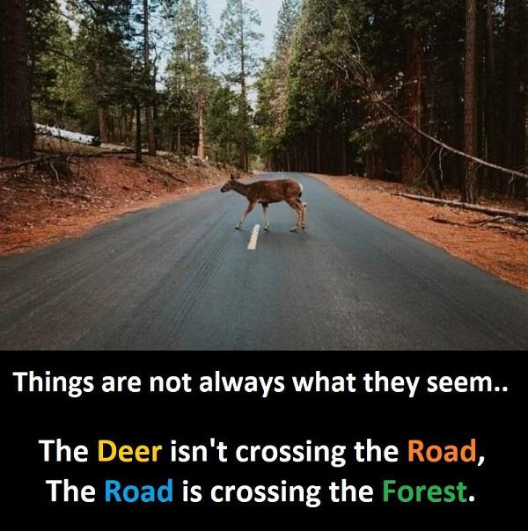

Slide 18

This Greek lady is really saying "NO!".

Slide 19
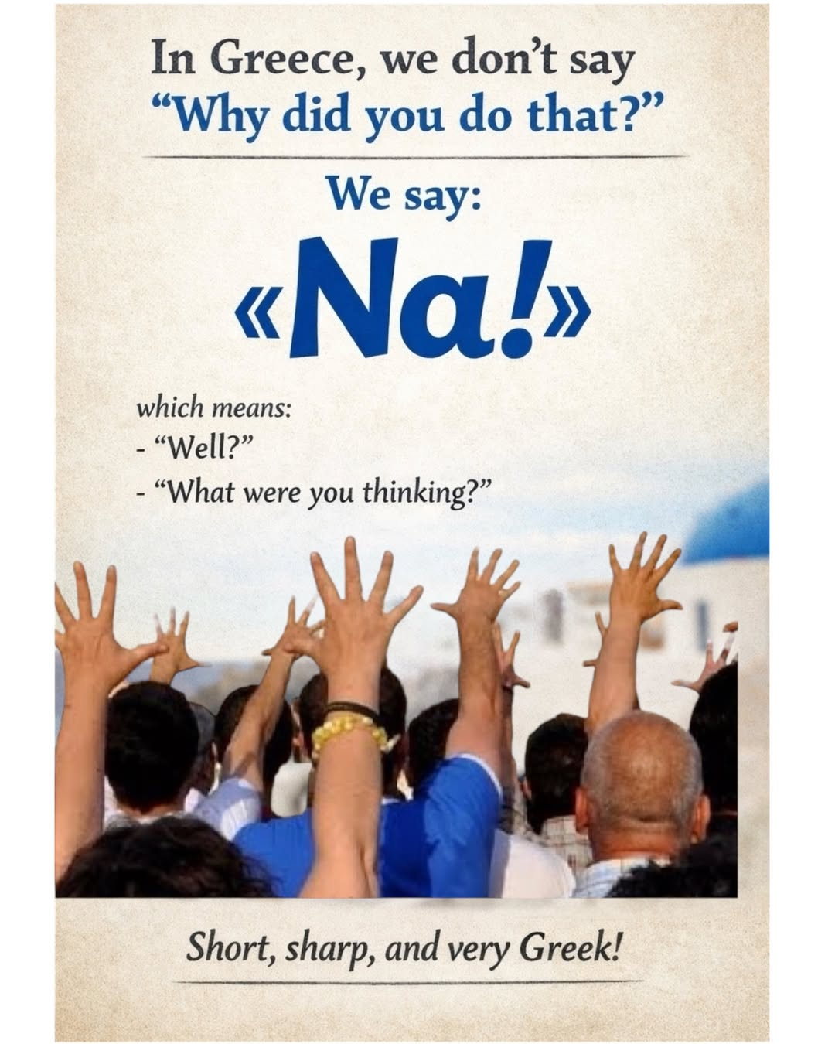
Greek bonus tip

Slide 20
Social Structures..
but first a question
“It is important for a manager to have at hand precise answers to most of the questions that his subordinates may raise about their work.”
Do you agree?

Slide 21
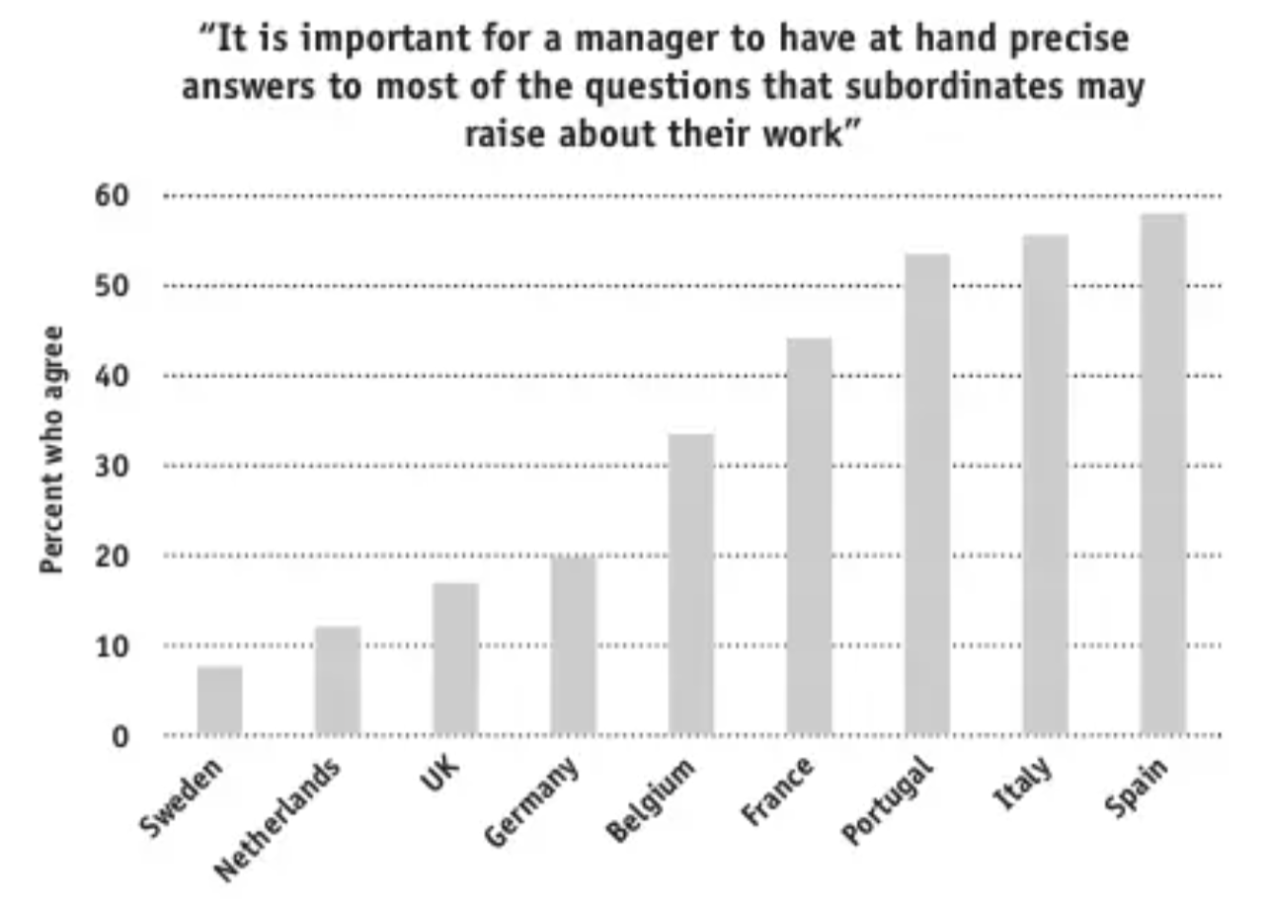
Professor André Laurent polled hundreds of European managers about a number of leadership issues. This was one of the questions he asked. The percentages of respondents from each country who responded "yes" to this question were as follows:

Slide 22
Here's another question
What is the oldest parliament in the world?

Slide 23
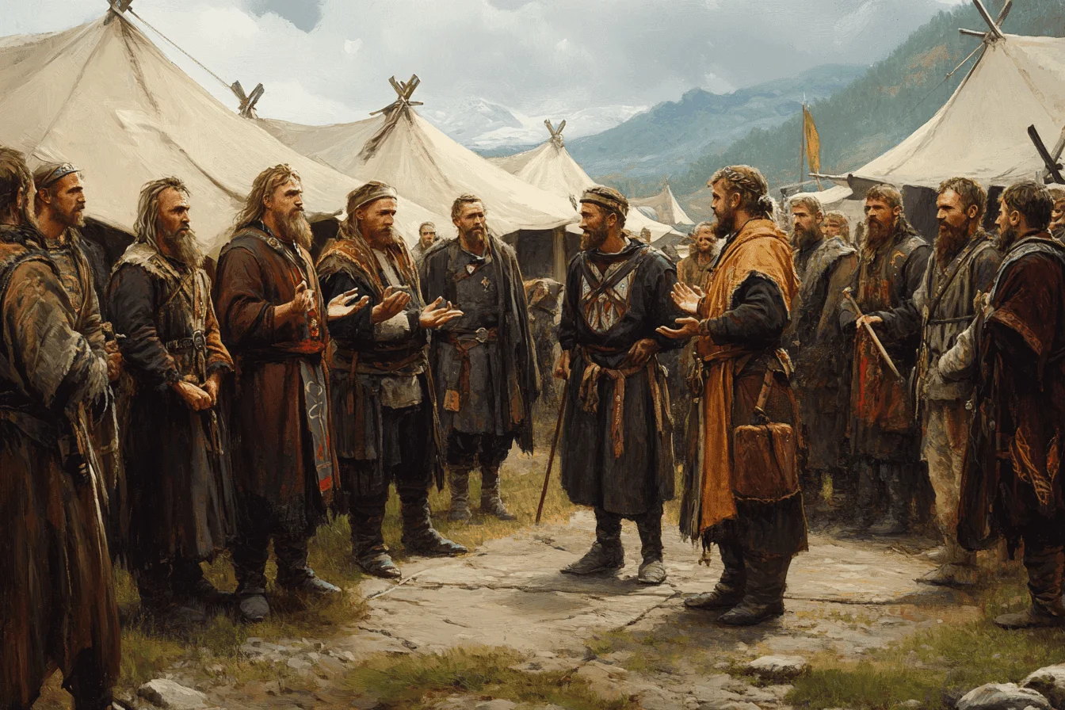
The Althing in Iceland.

Slide 24

Legend has it that when the King of the Franks sent an envoy to negotiate with the Vikings, the puzzled man returned confused and disheartened, complaining, "I couldn't figure out who to talk with. They said they were all the chiefs."

Slide 25
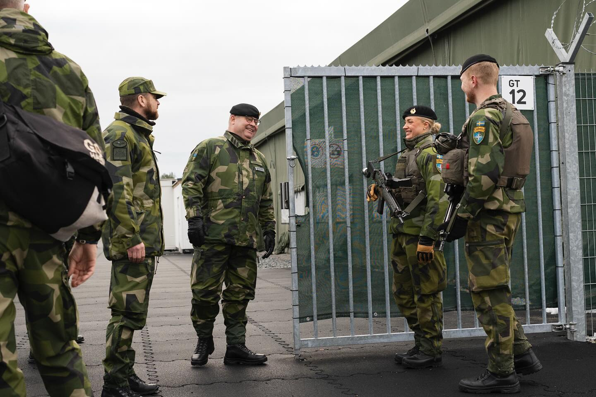
Social Structure: Nordic informality.

Slide 26
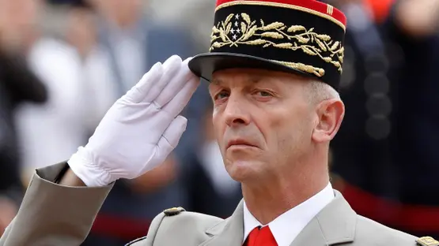
La structure sociale: On ne se tape pas sur le ventre.

Slide 27
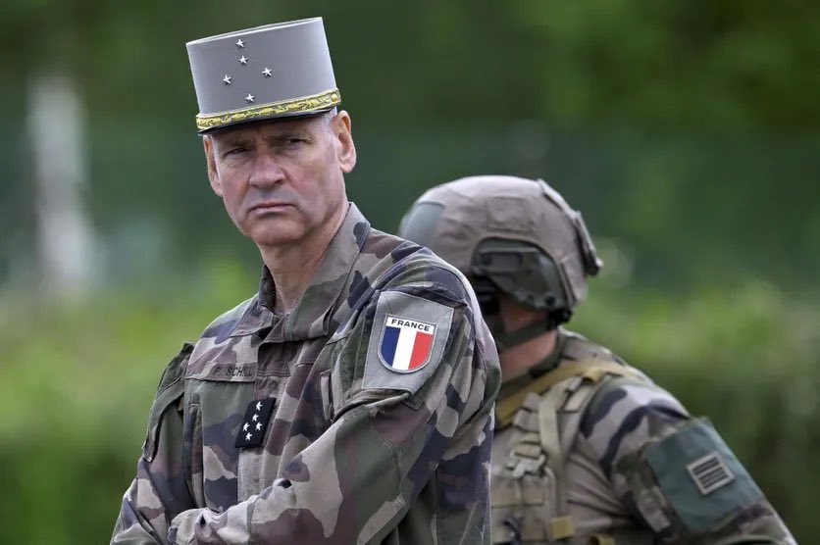
Non mais sérieusement.

Slide 28
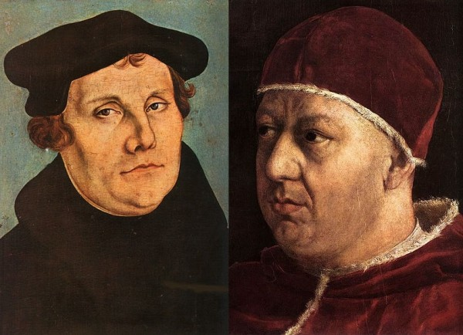
Protestantism vs Catholicism?

Slide 29
Closing Remarks
"Nos autem, cui mundus est patria
velut piscibus equor"
"To me, the world is one native country,
like the sea is to fish"
Dante Alighieri
De Vulgari Eloquentia

