Slide 1


COGNITIVE WARFARE
BUILDING COGNITIVE RESILIENCE THROUGH MILITARY EDUCATION
Presented by
Jeremy Walters
Polish Air Force University

Slide 2
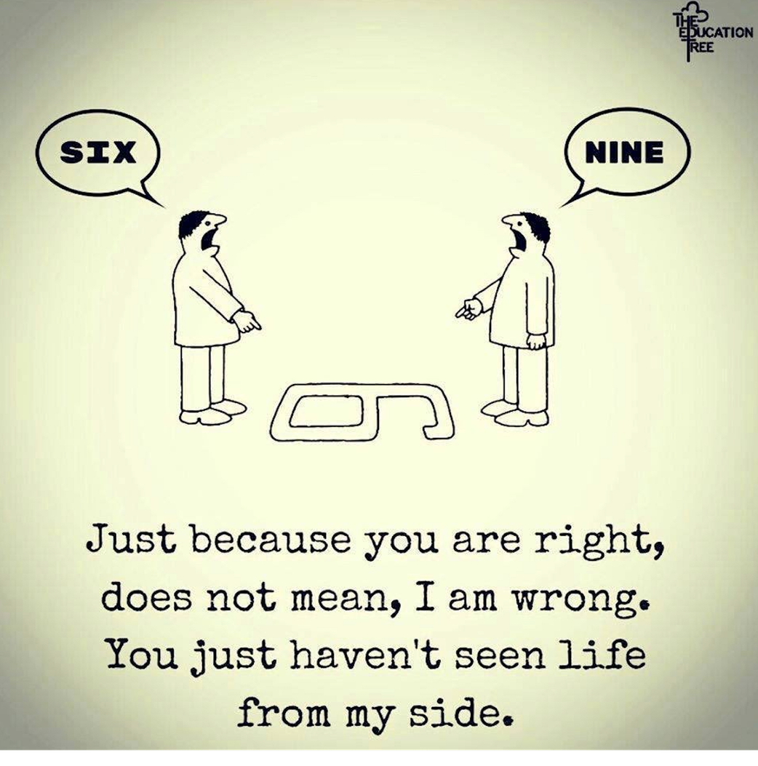
INTRODUCTION
In democratic societies, what shapes policy more —
facts, or perception?

Slide 3

DEFINING
COGNITIVE WARFARE
(...) the activities conducted in synchronization with other instruments of power, to affect attitudes and behaviours by influencing, protecting, and/or disrupting individual and group cognitions to gain an advantage. (NATO ACT 2023)

Slide 4

DIFFERENCE BETWEEN
COGNITIVE
AND
INFORMATION WARFARE
1
Information Warfare
Controls information flow.
2
  Cognitive Warfare
  Controls how people react to information.

Slide 5
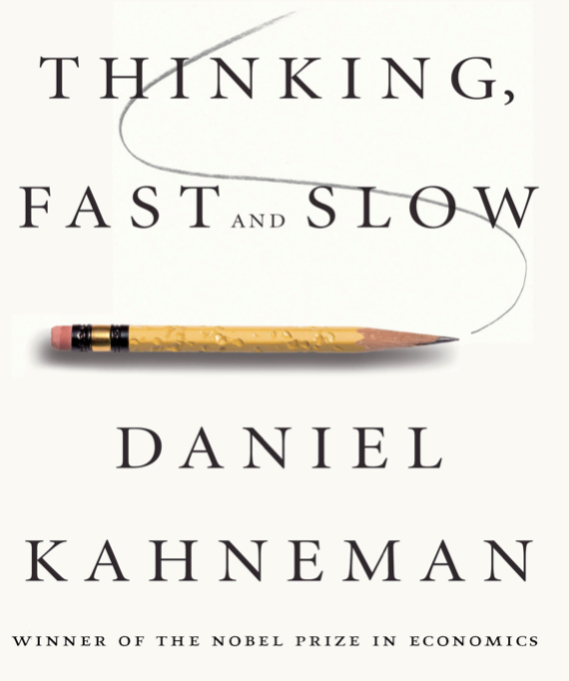
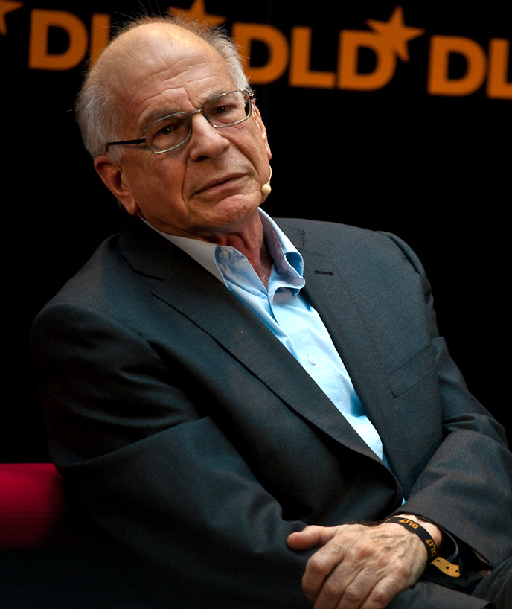
FAST vs SLOW THINKING

Slide 6
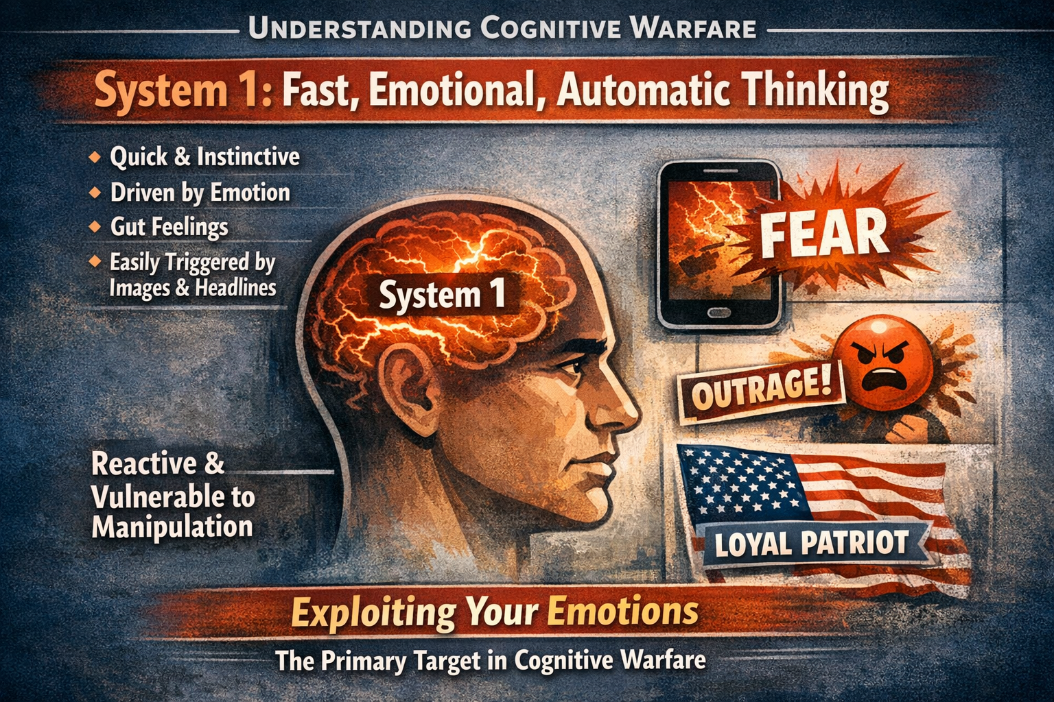
FAST vs SLOW THINKING

Slide 7
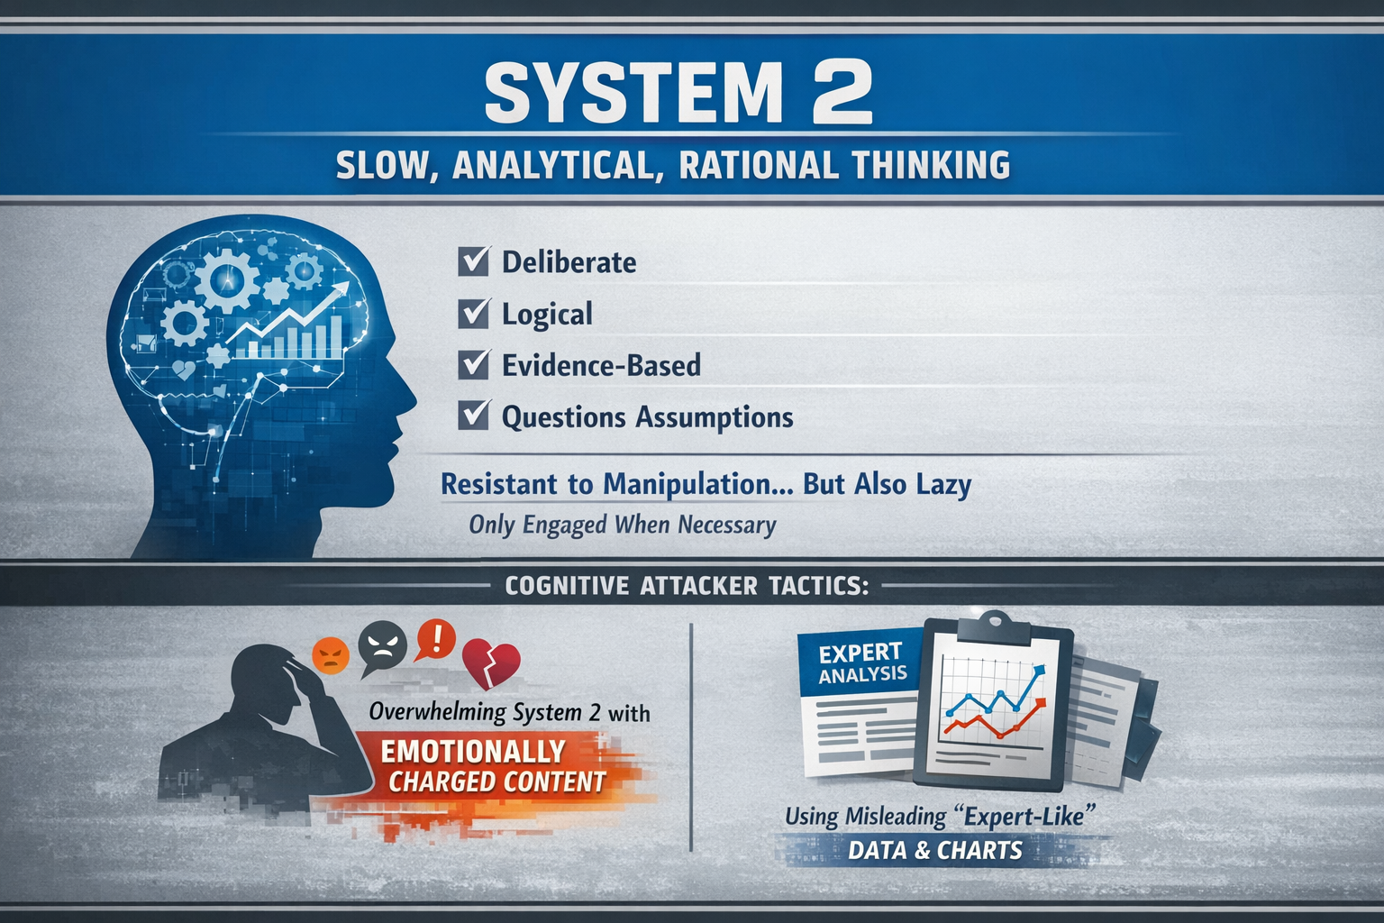
FAST vs SLOW THINKING

Slide 8
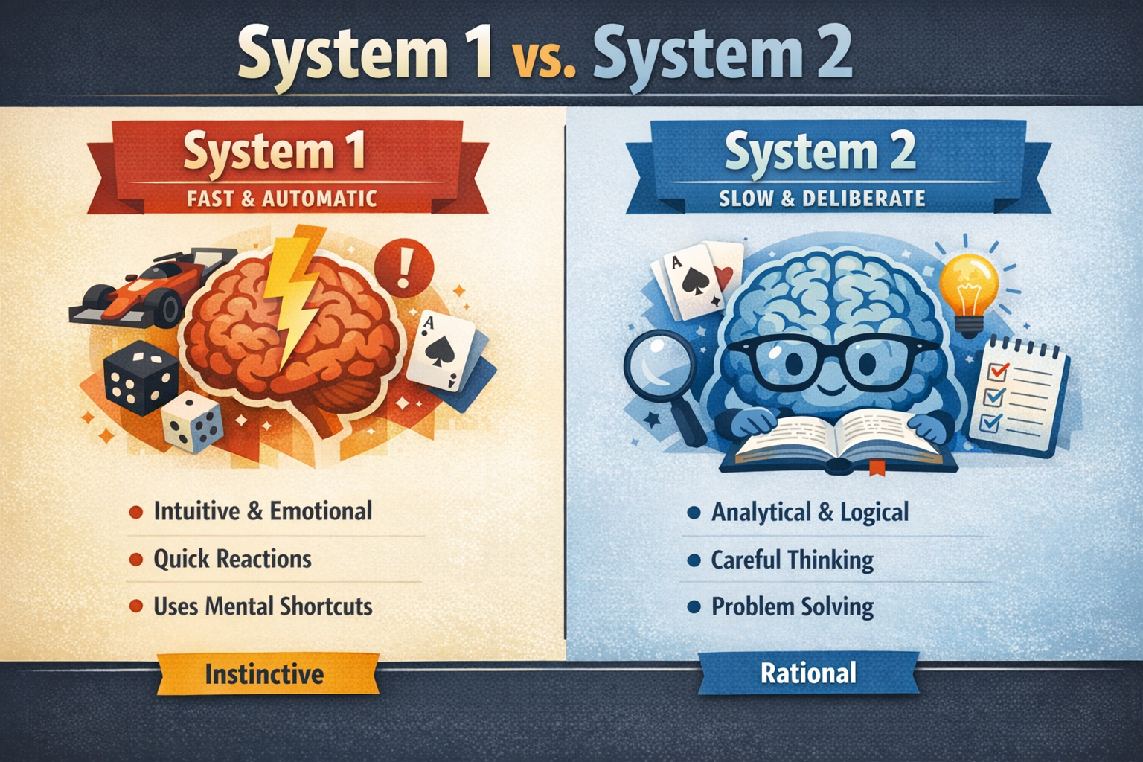
FAST vs SLOW THINKING

Slide 9

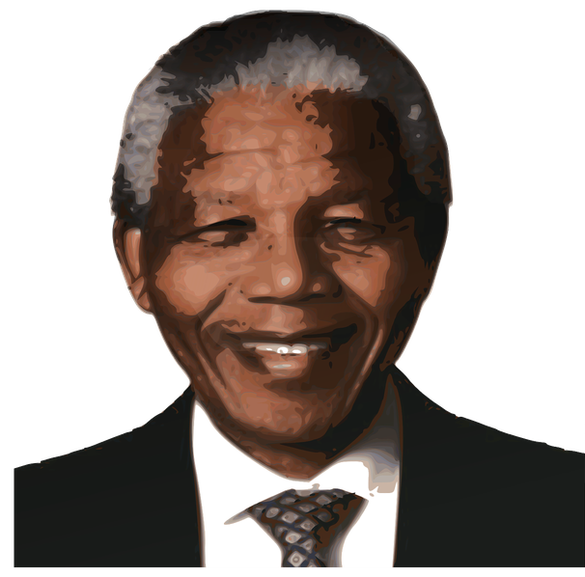
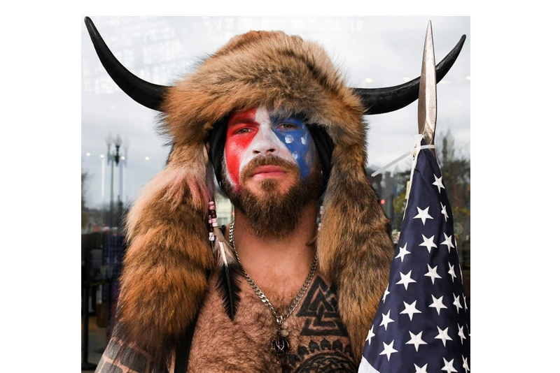
COGNITIVE WARFARE IN THE DIGITAL AGE
  BRAIN DEPENDENT
  MANDELA EFFECT
  US CAPITOL RIOTS
Relies on neurological resources.
A cognitive glitch in the human matrix?
An information vector.

Slide 10
CASE INTRODUCTION: CHINA–TAIWAN
  CHINA VS TAIWAN
China’s Cognitive Warfare Campaigns Against Taiwan

Slide 11
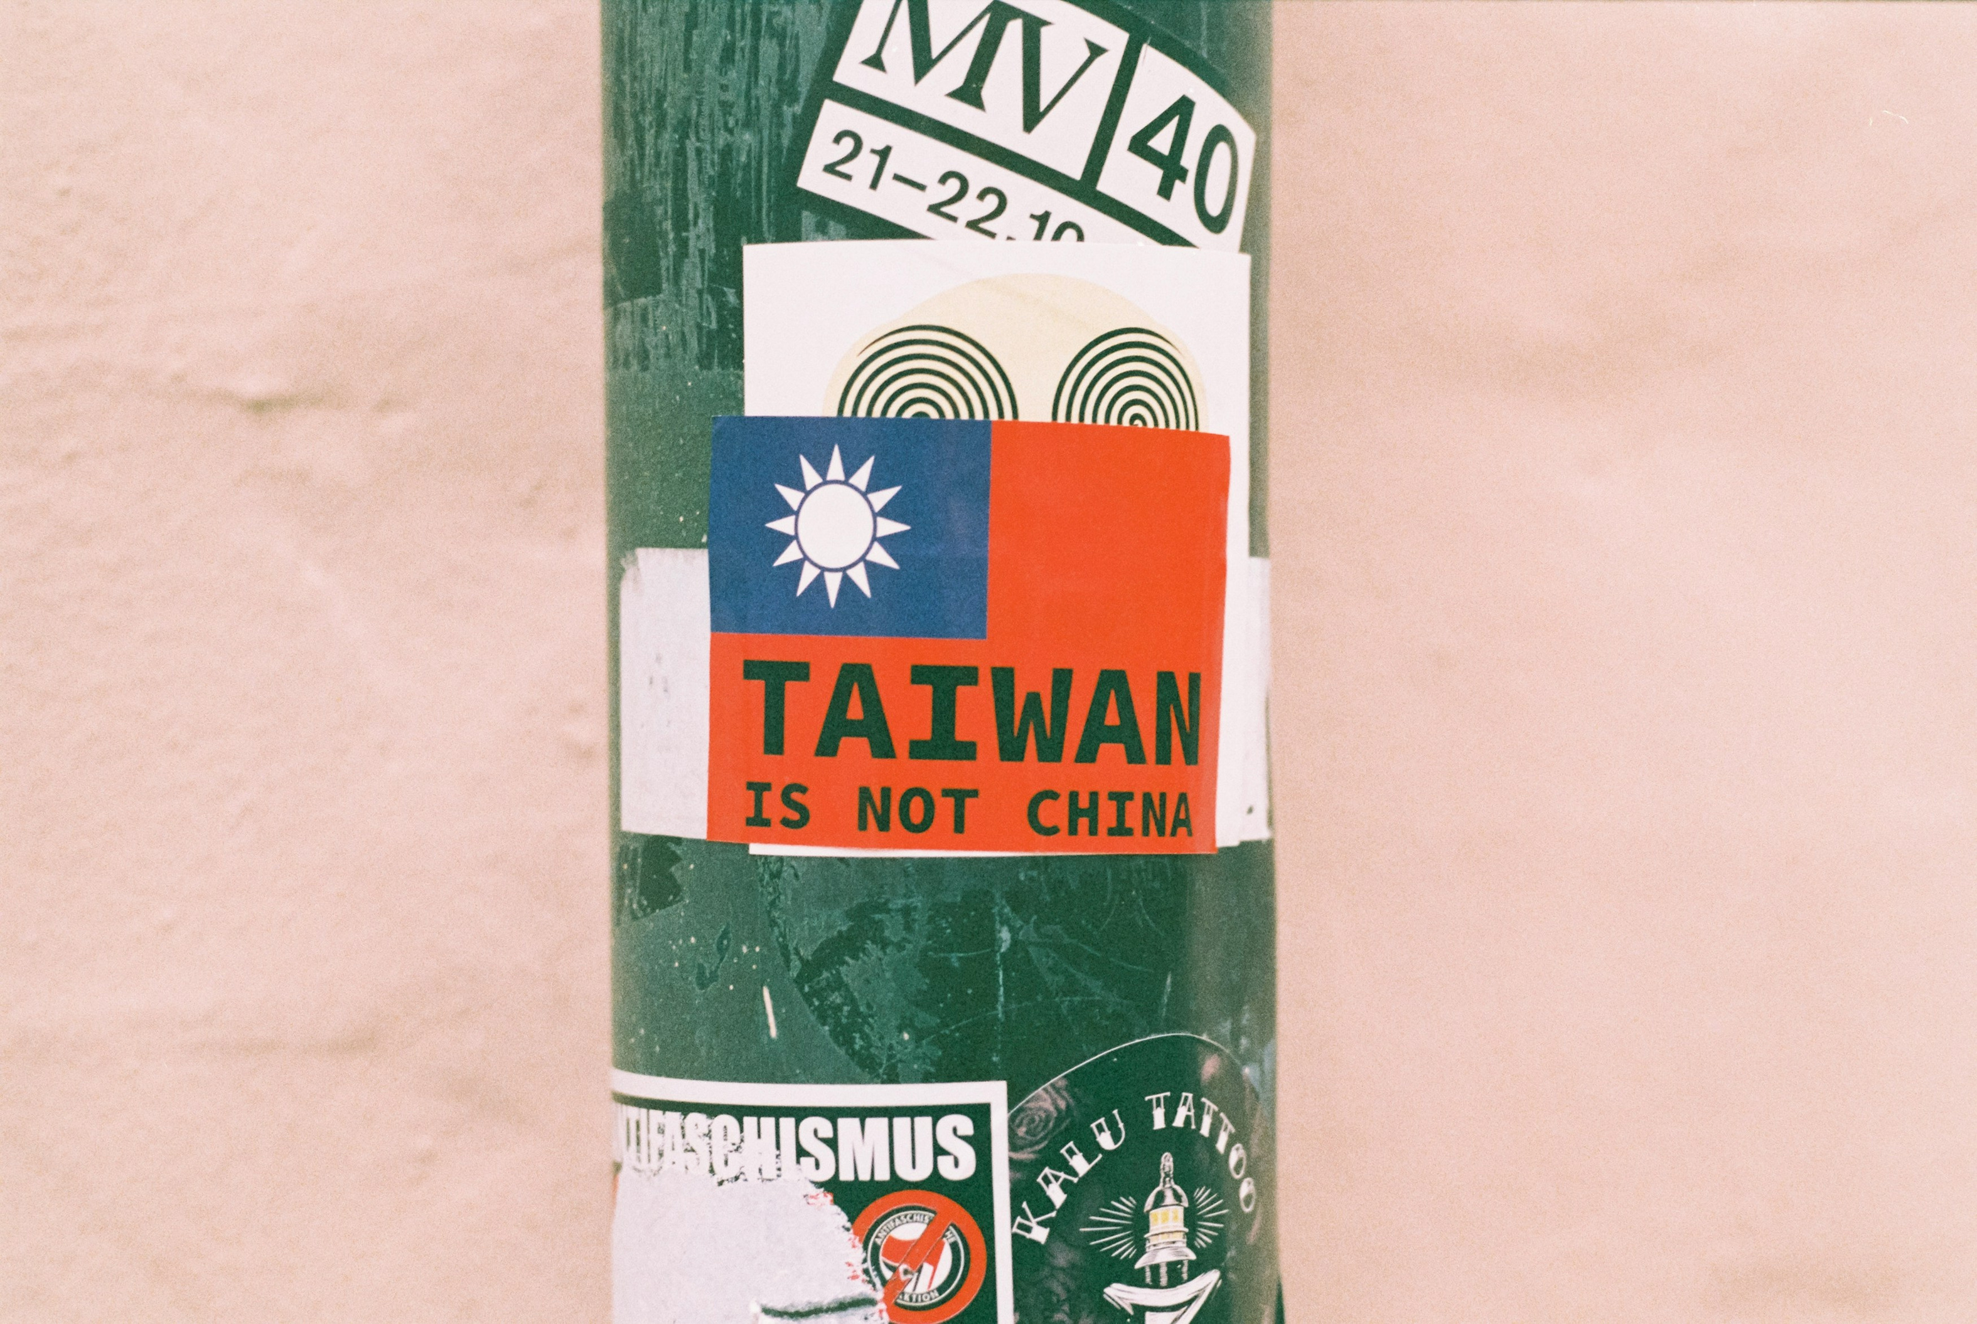
CHIINA VS TAIWAN
1
Description
2
  Tactics

Slide 12
CHIINA VS TAIWAN
1
  Description
China conducts persistent cognitive warfare aimed at influencing Taiwanese public opinion, eroding trust in democratic institutions, and promoting unification narratives.

Slide 13
CHIINA VS TAIWAN
2
  Tactics
  Precision micro-targeted social media narratives
  Deepfake videos of Taiwanese officials
  Coordinated harassment and disinformation during elections
  Manipulation of “system 1 and system 2” cognition through emotional triggers and coercive messaging

Slide 14
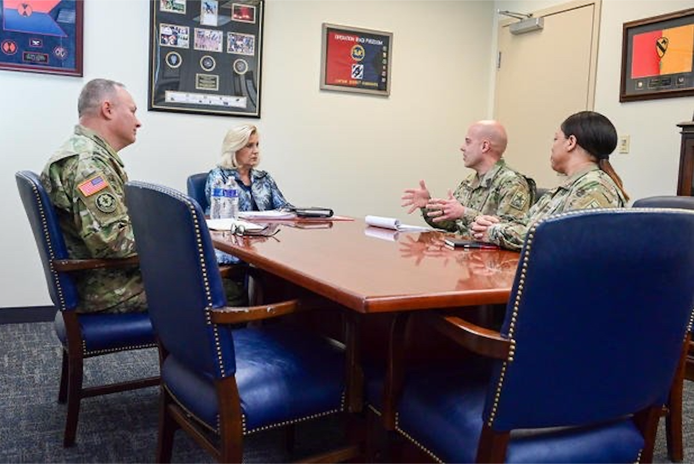
PART II – GROUP WORK

Slide 15
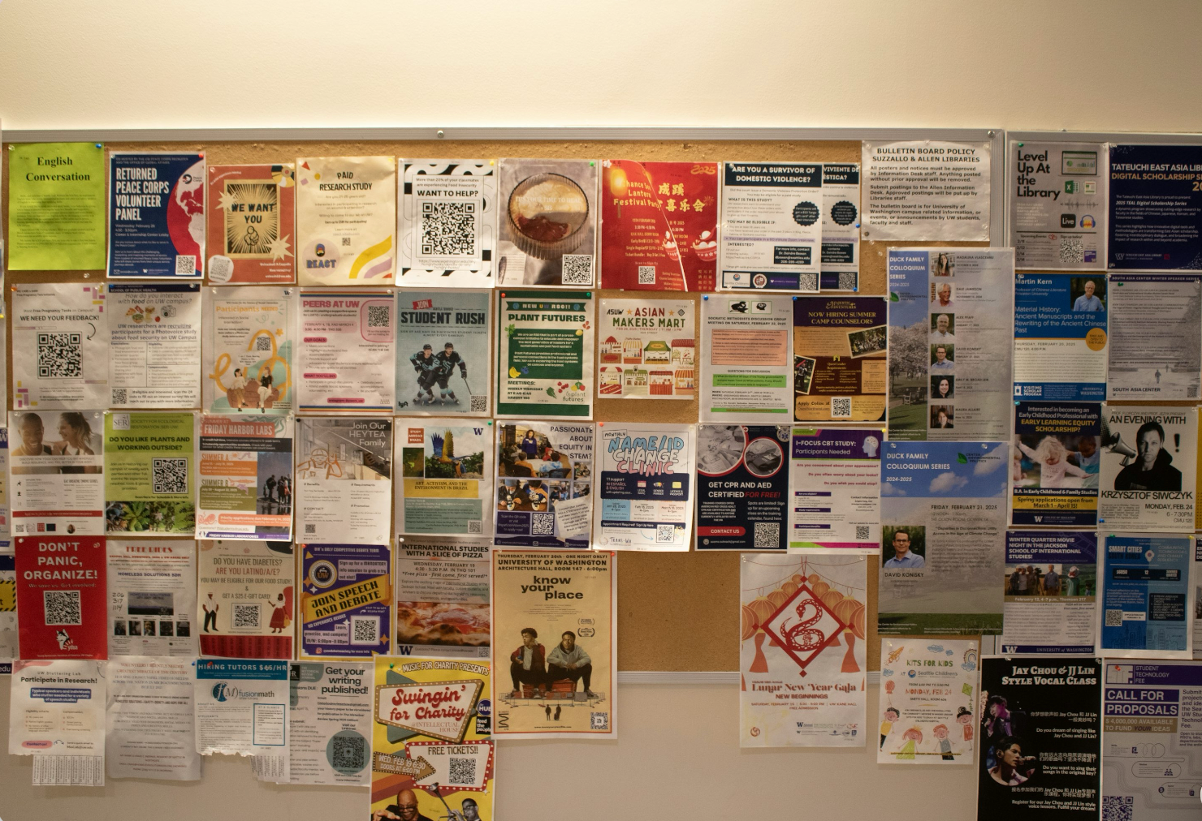
ACTIVITY ONE
Identify:
• Emotional direction (fear? inevitability? pride?)
• Target identity assumption
  • Which cognitive shortcut is triggered?
1
Classify:
• System 1 activation?
  • System 2 manipulation?
2
Discuss:
• Why does repetition make this powerful?
• Would one single message be effective?
3

Slide 16
ACTIVITY ONE
 | Micro-Narrative | Emotional Direction | Target Identity | Cognitive Shortcut | System 1 / 2 | Effect of Repetition
1
2
3
4
5
6

Slide 17
ACTIVITY ONE
Discussion Questions
1
Which narrative felt most subtle?
2
Which would be hardest to publicly counter?
3
Did any feel “normal” rather than persuasive? Why?

Slide 18
ACTIVITY TWO
1
  Identify Factual Elements
2
  Identify Interpretive Framing Language
3
Highlight Emotionally Charged Vocabulary

Slide 19
ACTIVITY TWO
Discussion Questions
1
  Why is this difficult to counter?
2
What happens if you debunk only part of it?

Slide 20
ACTIVITY THREE
1
  How do we recognise in-group language?
  Can linguistic familiarity override analytical caution?
2
3
What role does tone play in shaping trust?
4
How might others exploit local linguistic habits?

Slide 21
ACTIVITY THREE
  Audiences judge authenticity by:
1
  Familiar expression
2
Cultural cues
3
Emotional resonance
AUTHENTICITY IS FREQUENTLY PERCEIVED THROUGH STYLE
NOT VERIFIED THROUGH FACT-CHECKING.

Slide 22
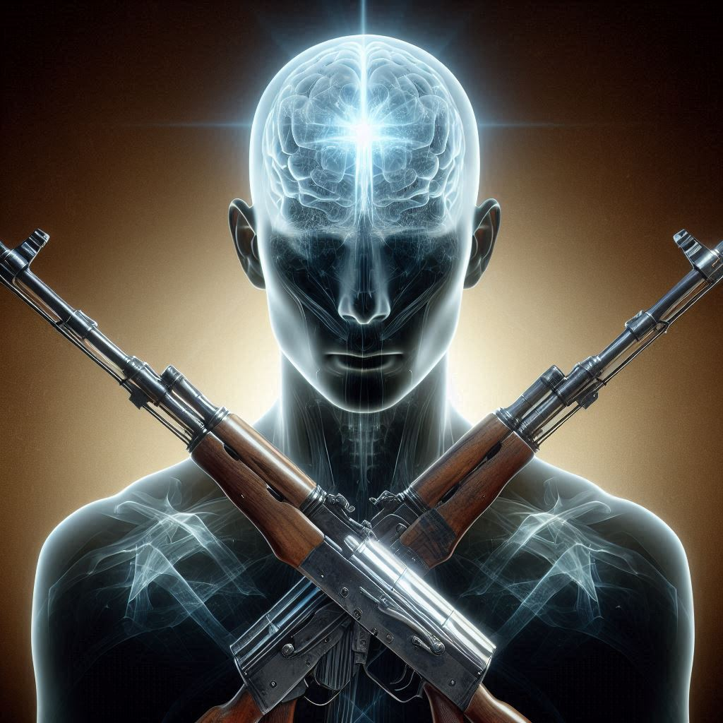
CONCLUSION

Slide 23
  WHICH TACTIC FELT MOST SUBTLE?
  WHICH WAS HARDEST TO COUNTER?
  WHAT COGNITIVE VULNERABILITIES WERE TARGETED?
  WHAT DOES THIS IMPLY FOR:
• MILITARY LANGUAGE TEACHING?
• TERMINOLOGY INSTRUCTION?
• INTEROPERABILITY?

Slide 24

THANK YOU
Jeremy Walters
Polish Air Force University

