Slide 1
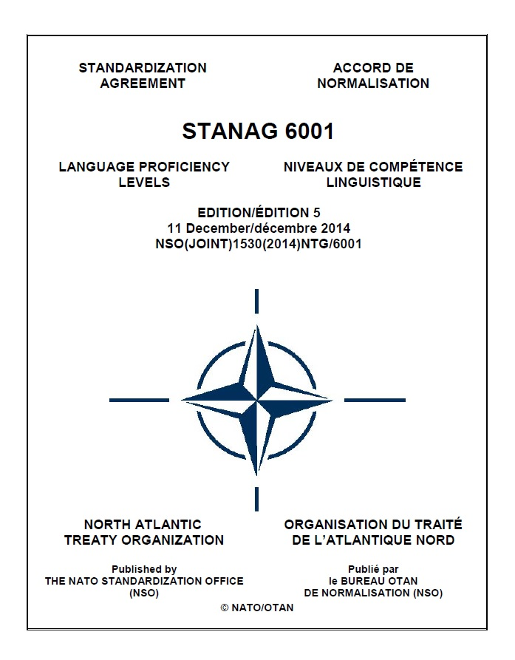
STANAG 6001 at 50
BUREAU FOR INTERNATIONAL
LANGUAGE COORDINATION
The Story of
Standardising Language Proficiency in NATO
Gerard Seinhorst
Netherlands Defence Language Centre
BILC Conference 2026 – Budapest
Notes:
This year marks not only 60 years of BILC, but also 50 years of STANAG 6001.
Most people in BILC know the STANAG very well as a working instrument. But far fewer know how it actually developed – or why NATO came to rely on it so heavily.
As someone who has been involved in BILC for many years, I have seen how STANAG 6001 gradually evolved from a relatively limited reference scale into a central element of NATO interoperability.
So today I’d like to take you on a short journey on the history of STANAG 6001: how it alle started, and how it became the NATO-wide language standard.

Slide 2
INTRODUCTION
STANAG 6001 in NATO
Standardization Agreement (STANAG) on language proficiency
Developed by BILC in the 70s; first adopted in 1976
Ratified by all NATO nations, used in many Partner Nations
Part of the 6000-series:
  personnel & administration
  training and education
  reporting standards
  language policy
Nowadays, it is one of the most widely used STANAGs in NATO
Notes:
STANAG 6001 is NATO’s common framework for describing, assessing and reporting language proficiency.
It was adopted in 1976, ratified by all NATO nations, and is now also used widely among partner nations.
What began as a relatively modest standard eventually became one of NATO’s most widely recognised interoperability instruments.

Slide 3

STANAG 6001 in NATO
How did STANAG 6001 become NATO’s trusted language standard?
Why and how was it created?
How did it evolve?
Why did NATO continue relying on it?
How was trust in the standard developed?
Why does it still matter today?
Notes:
The guiding question of my presentation is:
How did STANAG 6001 become NATO’s trusted language standard?
Not simply how it was written – but why NATO continued relying on it for fifty years.

Slide 4

A TRIBUTE
Dr Martha Herzog
Principal author of the current STANAG 6001 level descriptors
Key figure in the BILC Working Group on Testing and Assessment
Her work continues to shape NATO language testing today
Notes:
Before going into the history itself, I want to briefly acknowledge someone whom many of you may not have known personally, but whose influence on STANAG 6001 is difficult to overstate: Dr Martha Herzog.
For many years until her passing away in 2020, she played a central role in developing the descriptors as we know them today, and shaping the testing philosophy behind the STANAG.
Her work continues to influence NATO language testing up to this day.
Before we go back in history, I’d like to devote a few words on a person that has been extremely important for the development of the STANAG 6001: Dr Martha Herzog. Dr Herzog worked for many years at the US DLIFLC as Head of the Evaluation and Standardization Directorate, until her retirement in 2005.
Dr Herzog worked in the 1970 at the proficiency descriptors of the Foreign Service Institute (the FSI scale, which later, with her contributions evolved into the Interagency Language Roundtable (ILR) scale, one of the most influential language scales to date.
Important source of historical information
Instrumental in the development of STANAG 6001 > Groundbreaking work on the first scale that used
Unfortunately, Dr Herzog passed away in 2020, and she did no longer attend BILC activities a long before that, so it may be that many of you don’t know her, but I think it is important to keep the memory of her alive for all what she has done for BILC and NATO.

Slide 5
THE EVOLUTION OF STANAG 6001
1960s-1975
1991-1999
2000-2014
1976-1990
FOUNDATIONS
LIMITED USE
RENEWED URGENCY
EXPANSION
CONSOLIDATION
2015-2026
Cold War
PfP Assistance
Interoperability
Professionalisation
Notes:
Over five decades, STANAG 6001 evolved from a short descriptive scale into a comprehensive international framework for language testing and standardisation.
Its history reflects broader developments within NATO itself: the shift from static Cold War structures to multinational expeditionary operations, the enlargement of the Alliance, the rise of interoperability as an operational necessity, and more recently the professionalisation of military language testing.

Slide 6
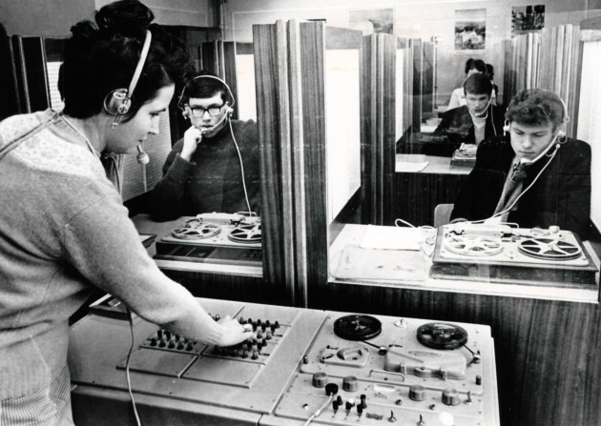
THE PRE-STANAG YEARS (1960s-1975)
The situation before STANAG 6001
No common NATO language standard
Different national systems and testing traditions
Emphasis on new teaching methods (e.g. audio-lingualism), not proficiency scales
No shared definition of language proficiency
Increasing multinational cooperation
What meant “working proficiency in English” or “fluent in French”?
 Need for comparable proficiency levels
Notes:
In the 1960s and early 1970s, NATO faced a practical problem.
While multinational cooperation increased, there was no shared understanding of what language proficiency actually meant.
Different nations used different systems, and terms like “good English” or “working level” were not comparable.
This created risks for staff work, training, and operational communication.
Much attention in the 1950s and 1960s went into new teaching methodologies and intensive language instruction, but far less into systematically defining what different stages of language proficiency actually meant.
Prior to the introduction of a standardized system, nations used their own scales (often merely categories without descriptors, such as: elementary, good, very good, full knowledge (typically needed for translators and interpreters), leading to inconsistencies in interpreting language ability.
NATO needed a more comparable system.
BILC began addressing this issue in the early 70s, not long after its establishment in 1966.

Slide 7

TOWARDS A COMMON STANDARD
Syndicate on Foreign Language Proficiency Levels (BILC Conference 1972):
0 No knowledge
A Limited or elementary
B Adequate or working
C Full or near native
first step toward a structured scale
➔ aim: to produce a table of language levels, not detailed descriptors
Few existing models
mostly examination-based grading systems
focus on grammar mastery, vocabulary size
norm-referenced (how well someone performed on a test)
BILC CONFERENCE 1972 (GBR)
Notes:
It is sometime believed that de first Edition of the STANAG was merely a copy and paste of the U.S. Interagency Language Roundtable (ILR) scale.
But that is not orrect, for the simple reason that the ILR scale did not exist as such until the mid 1980s.
In the early 1970s, BILC started their own effort to develop more structured proficiency classifications.
In 1972 the “Syndicate on Foreign Proficiency Levels” came with a draft scale that included 4 levels.
At that stage, the ambition was still relatively modest: not a sophisticated framework, but simply a common table of language levels.
It is important to remember that at that time, very few functional proficiency scales existed internationally.
Even if it strikes us as somewhat unpolished, this was groundbreaking work.
Unfortunately, there are no surviving records identifying exactly who participated in this syndicate.
What we do know is that it was chaired by the Belgian Major Horekens – shown here in the red circle.
At the same time, the U.S. Foreign Service Institute was already participating in BILC activities through Dr James Frith – indicated in green.
It is therefore quite possible that the syndicate became aware through him of the functionally oriented proficiency scale then being developed at the FSI for use across the U.S. government.
While we cannot prove direct influence, the similarities in structure and terminology strongly suggest that these ideas did not develop entirely independently.

Slide 8
EXTERNAL INFLUENCE
Influence of the 1968 FSI proficiency scale (U.S. Foreign Service Institute)
FSI is the key origin point for functional proficiency scaling as we know it
first widely institutionalised scale with systematic, extended, functionally oriented descriptors
strongly influenced the ILR scale, ACTFL Proficiency Guidelines, STANAG 6001, and later the CEFR
originally centred on speaking and tied to the “FSI” speaking test format (later OPI)
writing/reading were less systematically integrated early on
Notes:
James Frith was the Director of the U.S. Foreign Service Institute, and played a key role in the development of the FSI language scale, which later evolved into the ILR scale.
The FSI was one of the first functional proficiency scales describing what people could actually do with language.
It probably started as a sort of set of criteria to rate speaking ability, so initially it did not cover all four skills.

Slide 9
A HYBRID CONSTRUCT
BILC “borrowed” from the 1968 FSI scale:
6-point structure, with descriptive labels for each level
  Level 0: No practical proficiency
  Level 1: Elementary
  Level 2: Fair (Limited working)
  Level 3: Good (Minimum professional)
  Level 4: Very good (Full professional)
  Level 5: Excellent (Native/bilingual)
focus on functional language use
similar terminology – Levels 0 and 5 were identical, although other levels and skills were worded differently
Notes:
In the spirit of “better to steal a good idea, than invent a poor one,” BILC borrowed useful elements from the FSI scale, among which the six-level structure, and similar terminology.
The labels in brackets were borrowed from the FSI scale, but the Syndicate added evaluative terms such as fair, good, very good, and excellent.
That reflects the thinking of the time, when language assessment was still heavily influenced by norm-referenced and achievement-oriented approaches, rather than by purely functional proficiency concepts.
Looking back, it was something of a historical coincidence that BILC came into contact with the functionally oriented descriptors of the FSI scale. Had that not happened, or if the syndicate had chosen not to use them, STANAG 6001 might have become a completely different instrument – e.g., one centred on classroom achievement instead of operational language performance.

Slide 10
A HYBRID CONSTRUCT
BILC’s own contributions:
4-digit “Standardised Language Profile” (SLP) L/S/R/W, e.g. SLP3232
“test-neutral” framework − independent of teaching methodology or test format
Higher ambition – intended as a NATO-wide standard
From the 1973 report of the Working Group on Proficiency Levels:
Notes:
But BILC also introduced major innovations of its own: the descriptor structure for reading and writing, introducing a four-skill framework (SLP), and establishing a test-neutral standard suitable for multinational use.
The SLP system transformed the scale from a descriptive framework into an operational NATO instrument.
For the first time, language ability could be recorded consistently across four skills: listening, speaking, reading, and writing.
That was a major conceptual step toward interoperability

Slide 11
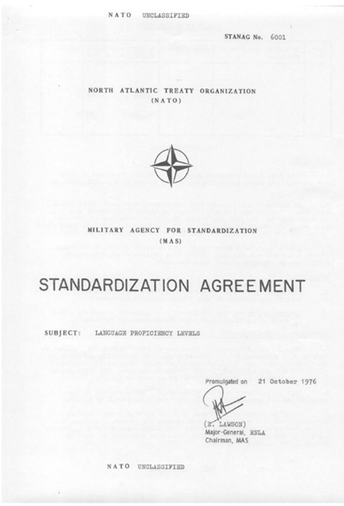
STANAG 6001 – EDITION 1 (1976)
From the 1978 BILC Report (Working Group on Testing)
Notes:
STANAG 6001 Edition 1 was adopted in 1976.
Anyone who imagines that this was followed by major celebrations would be disappointed.
The ratification happened largely within NATO standardisation structures, and awareness of the new STANAG was probably limited to a relatively small group of BILC members and language specialists.
At the time, few people realised how influential the STANAG would eventually become.

Slide 12
STANAG 6001 – EDITION 1 (1976)
Only after 1999, BILC increasingly assumed a central role in the interpretation, development, and standardisation of STANAG 6001.
Notes:
The aim and agreement were described in the main text of the STANAG, and the table of language proficiency levels were included in Appendix 1.
Only after 1999, BILC increasingly assumed a central role in the interpretation, development, and standardisation of STANAG 6001. But this was certainly not the case in the years after 1976.

Slide 13
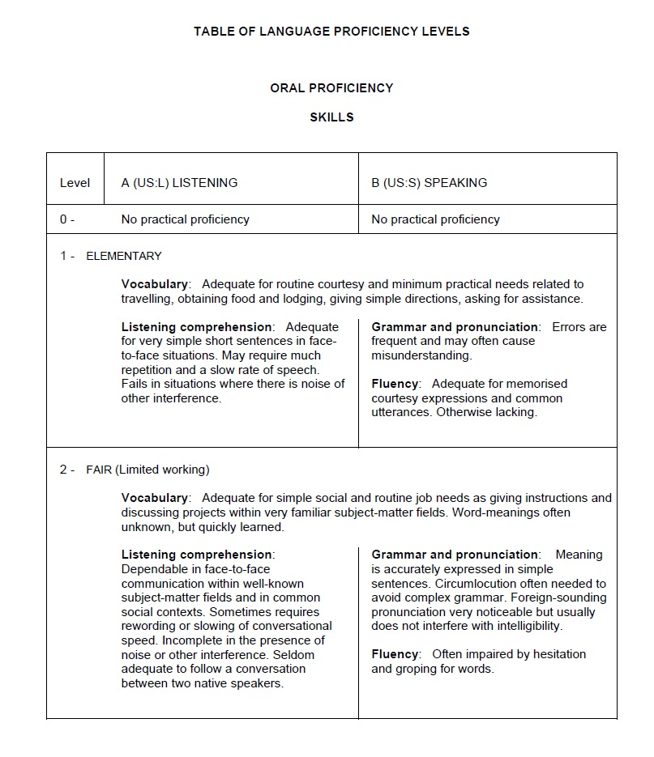
Notes:
The original descriptors were extremely brief —
often only one or two sentences, as you can see from this sample page.
But the key achievement was not detail – it was agreement.
For the first time, NATO nations shared a common language proficiency framework.

Slide 14
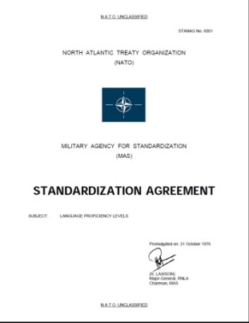
TIMELINE
1960s-1975
1991-1999
2000-2014
1976-1990
FOUNDATIONS
LIMITED USE
RENEWED URGENCY
EXPANSION
CONSOLIDATION
2015-2026
Cold War
PfP Assistance
Interoperability
Professionalisation
2003: Edition 2
1976: Edition 1
Notes:
After Edition 1 was published, a period started that could be called one of limited use.

Slide 15
LIMITED USE (1977-1990)
Edition 1 ratified by all NATO nations by spring 1977
Focus on international staff appointments
Interpretation varied
Many nations continued to use their own national classification system
 Limited operational use
From the 1978 BILC Report:
“It has always been recognised that the levels themselves are of limited value without appropriate measuring instruments (tests).”
Notes:
Initially, the STANAG had limited practical impact.
Many nations continued using their own systems,
and interpretation varied considerably.
The standard existed - but there was still no common testing culture behind it, even though from the very beginning it was recognised how important a structured testing system was to make the scale useful.

Slide 16
TIMELINE
1960s-1975
1991-1999
2000-2014
1976-1990
FOUNDATIONS
LIMITED USE
RENEWED URGENCY
EXPANSION
CONSOLIDATION
2015-2026
Cold War
PfP Assistance
Interoperability
Professionalisation
2003: Edition 2
1976: Edition 1
Notes:
Things were about to change after the Cold War.

Slide 17
RENEWED URGENCY (1991-1999)
End of the Cold War
Change of focus, from intelligence languages to operational languages (mainly English)
PfP expansion and operational pressure
PfP nations start building language training and testing systems based on STANAG 6001
  requests for help with interpreting and operationalising the descriptors
mission-oriented armed forces
  language requirements expanding beyond senior staff officers
 Need for a clear and usable standard with a shared interpretation became more urgent
Notes:
The Partnership for Peace dramatically expanded NATO cooperation,
and the new partner nations needed operational language systems very quickly.
NATO became much more mission-oriented, which meant that language requirements were growing too.
Now the STANAG became operationally important.

Slide 18
SHORTCOMINGS of EDITION 1
From Descriptors to Practice
lack of detailed specifications → limited usefulness for assessment purposes
the brevity of the descriptions allowed for multiple interpretations
NATO nations developed their own testing systems and local interpretations
  amplification documents circulated informally through BILC
absence of common testing guidance or shared rating practices
increasing concern about the comparability of national STANAG results
STANAG 6001 risked losing credibility as a common NATO standard
1999: NATO Training Group/JSSG formally requested BILC to develop interpretive guidance
Notes:
Only then it was found that Edition 1 had some important shortcomings:
the original descriptors were too brief to support consistent interpretation.
Different nations were effectively applying different standards
This created a serious interoperability concern.
Comparable performances could receive different ratings across nations.
And once STANAG levels became linked to staffing and deployment decisions, those inconsistencies became much more consequential.
However, a major turning point came in 1999, when the JSSG requested BILC to develop interpretive guidance for the scale.
This is the moment when BILC increasingly moved from being mainly a discussion forum, to becoming the professional custodian of the system.

Slide 19
TIMELINE
1960s-1975
1991-1999
2000-2014
1976-1990
FOUNDATIONS
LIMITED USE
RENEWED URGENCY
EXPANSION
CONSOLIDATION
2015-2026
Cold War
PfP Assistance
Interoperability
Professionalisation
1976: Edition 1
Notes:
This period of expansion began around 2000 and continued until about 2014.

Slide 20











EXPANSION OF THE SCALE (2000-2014)
Working Group on Testing and Assessment
Established by BILC SC in 1999, chaired by Dr Martha Herzog
Representatives from 11 BILC member nations
Initial goal: to elaborate on and interpret the original STANAG 6001 descriptors
KEY TURNING POINT in the history of STANAG 6001
Led to the ‘Interpretation document’ (2001)
  expanded descriptors for each skill at each level, including Level 0+ (Memorized Proficiency)
  based on U.S. Interagency Language Roundtable (ILR) descriptors
  successfully trialled in the new BILC Language Testing Seminar
Included in Edition 2 (2003) as Annex A to Appendix 1
Notes:
In 1999, BILC established the Working Group on Testing and Assessment under the leadership of Dr Martha Herzog.
This was probably the single most important turning point in the history of STANAG 6001.
The group developed expanded descriptors, interpretive guidance, and a much stronger theoretical framework.
From this point onward, STANAG 6001 evolved into a professional proficiency system.

Slide 21
WORKING GROUP on TESTING and ASSESSMENT
WORKING GROUP
Language Testing Seminar (2000)
Interpretation document (2001)
STANAG 6001 Edition 2 Appendix 1 (2003)
Plus Level Descriptors (2005)
STANAG 6001 Testing Workshops (2010- )
Benchmark Advisory Test (BAT) (2009)
Edition 3 (2009)
Advanced Language Testing Seminar (2011)
Level 4 Framework (2014)
Prototype
Level 4 Test (2015)
Notes:
The work of the Working Group quickly expanded far beyond the original task of simply interpreting the descriptors.
The expanded descriptors were incorporated into the first major revision of the STANAG, and later formed the basis for the development of the Plus Level descriptors.
That work, in turn, eventually led to the Level 4 Framework and the Prototype Level 4 Test — developed as guidance for nations that needed to assess very high-level language proficiency.
At the same time, the activities of the Working Group also gave rise to a whole series of professional development initiatives within BILC:
the Language Testing Seminar,
the Advanced Language Testing Seminar,
and later the annual STANAG 6001 Testing Workshop.
Together, these activities gradually created a multinational community of practice and a growing body of shared expertise.
And it was precisely this collective expertise that later made another major initiative possible: the development of the Benchmark Advisory Test, or BAT, aimed at promoting more consistent interpretation and application of STANAG 6001 across national testing programmes.

Slide 22
GROWING PAINS
Unintended consequences of succes
STANAG 6001 became central to NATO staffing, deployment, and interoperability
national tests and rating practices were not always aligned
  comparable performances could receive different ratings across nations
  one nation’s Level 3 might equal another nation’s Level 2
SLP requirements for NATO posts became inflated
  SLPs were often based on people-comparisons rather than task analysis
    “The last officer was a Level 3 and struggled - therefore we need a 4.”
  very high SLP requirements (‘native proficiency’) sometimes functioned as de facto selection filters
➔ Inconsistent application of the standard became a growing interoperability concern within NATO
Notes:
At the same time, the success of the STANAG created new problems.
National interpretations still varied, and due to this SLP requirements set by NATO became inflated
One nation’s Level 3 could still resemble another nation’s Level 2.
This became a growing interoperability concern within NATO, but also within BILC.

Slide 23
ACTION #1: THE LABELS
Level | Editions 1 and 2 | Edition 3
0 | No practical proficiency | No proficiency
0+ | -- | Memorized
1 | Elementary | Survival
2 | Fair (Limited working) | Functional
3 | Good (Minimum professional) | Professional
4 | Very good (Full professional) | Expert
5 | Excellent (Native/bilingual) | (Equivalent to) Highly-articulate native
The new labels helped mitigate the inflation of SLPs
Notes:
One immediate helpful corrective measure was changing the labels.
Terms like ‘limited working’ or ‘minimum professional’ unintentionally encouraged inflation.
The newer labels - such as Functional, Professional, and Expert - better reflected actual language use requirements.

Slide 24
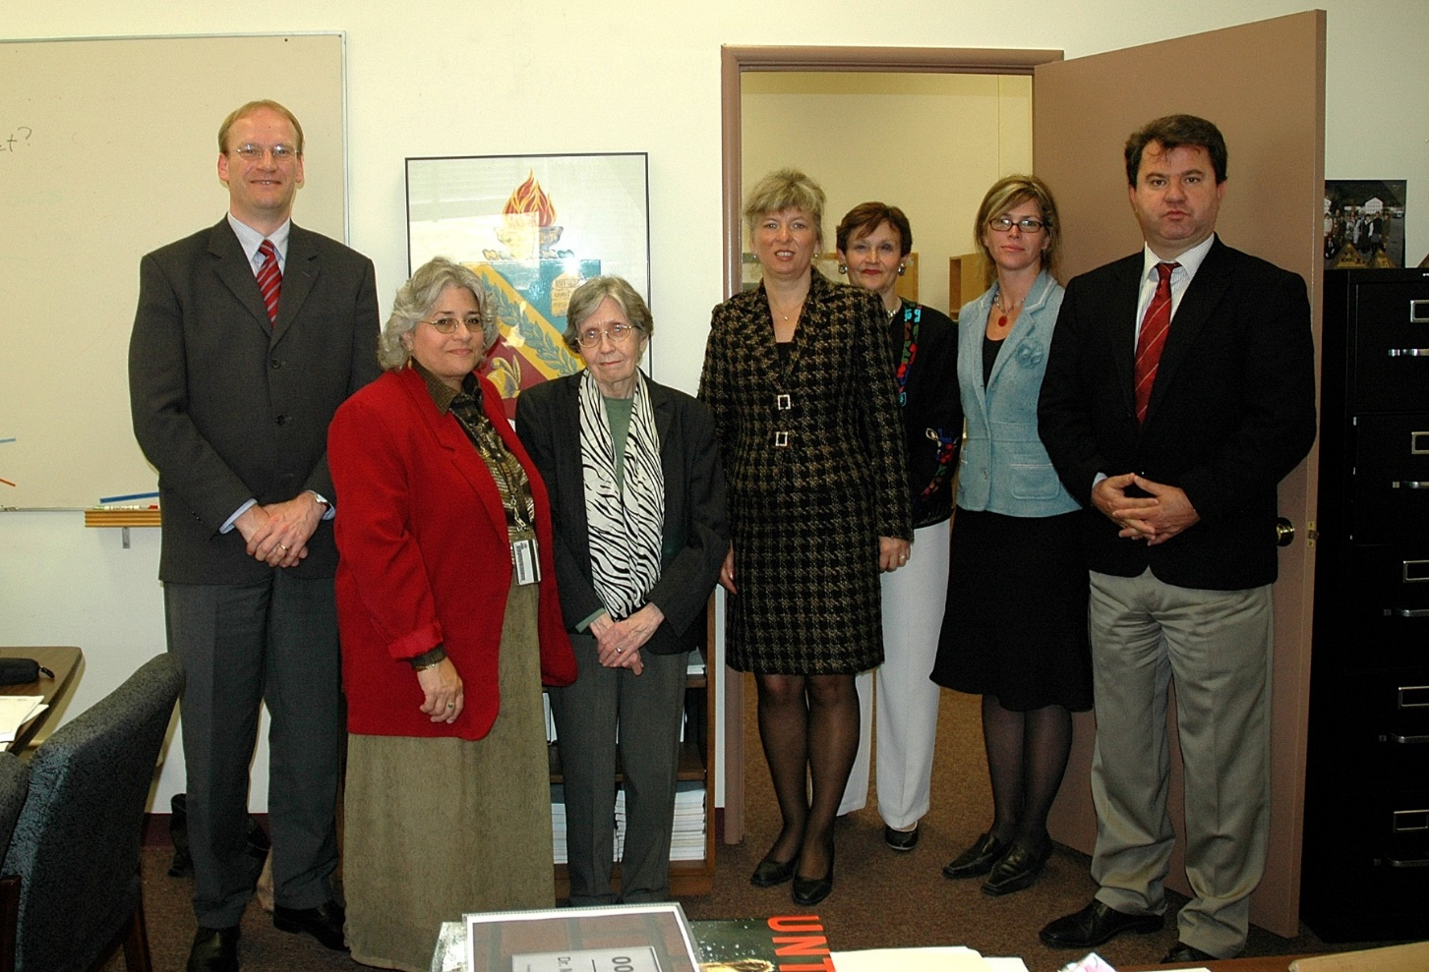
ACTION #2: PLUS LEVELS
In 2005, a subgroup of the WGoTA developed “plus levels” for all skills
adopted as Annex A to Appendix 1 of Edition 3 of STANAG 6001
Purpose
finer granulation of “in-between” proficiency
recognition of language ability clearly above a level threshold, but not consistently meeting the next higher level
Key principles
plus levels do not constitute separate thresholds
intended for testing and reporting purposes (optional use)
not intended or suitable for defining job SLP requirements
Notes:
Another important development was the introduction of the Plus Levels.
Their purpose was to recognise proficiency that clearly exceeds one threshold, but does not yet consistently meet all the requirements of the next higher level.
It is important to understand, however, that the Plus Levels were never intended for defining job SLP requirements.
In essence, a plus level indicates performance that is transitional rather than fully established at the next level.
For staffing purposes, NATO needs clearly demonstrated and consistently sustainable proficiency thresholds – not partial attainment of a higher level.
After all, no commander wants someone who can perform at the required level ‘most but not all of the time’.

Slide 25
ACTION #3: FRAMEWORK DEVELOPMENT
Not only the descriptors were expanded, but also the underlying theoretical principles
Each level represents a range, rather than a point on the scale
It is a criterion-based proficiency scale, not performance or job-specific language use
Each descriptor defines Task / Conditions / Accuracy:
what a person can do
under which conditions
and how well
Assessment is non-compensatory assessment  weaknesses in one skill cannot be compensated by strengths in another (e.g. SLP3131 ≠ average Level 2 proficiency)
Cumulative structure  each higher level includes the abilities of the lower levels
Progression is exponential rather than linear  reflected in the “inverted pyramid” model
Notes:
During this period, BILC also clarified the underlying principles of the scale.
STANAG 6001 is criterion-based, non-compensatory, and cumulative. Moreover it is exponential in progression rather than linear, as reflected in the ‘inverted pyramid’.
This model was developed by dr Clifford for the ILR scale already in the 80s.

Slide 26
THE INVERTED PYRAMID / CONE
Quantity
5
Quality
4
Time
3
2
1
Notes:
The inverted pyramid or cone illustrates that the higher one goes up in the scale, the more time and effort it takes to attain a level.
The value is that it gives a better idea of the time on task to reach a certain level.

Slide 27


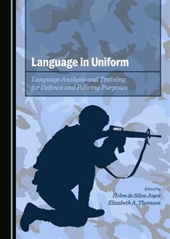

OTHER ACTIONS TAKEN
seminars and workshops to train language professionals from NATO nations in a common interpretation of the levels, and in the development of valid and reliable language tests
norming activities: multinational test item development, norming sessions, sharing of test items, prompts, and speaking and writing samples
development of the Level 4 Framework and prototype Level 4 test, demonstrating that Level 4 is only required in exceptional cases involving highly nuanced language use
Benchmark Advisory Test (BAT)(2009 and 2022) to promote more consistent interpretation and application of STANAG 6001 across national testing programmes
Notes:
At the same time, BILC invested heavily in seminars, workshops, benchmarking, and tester training – because descriptors alone are never enough.

Slide 28
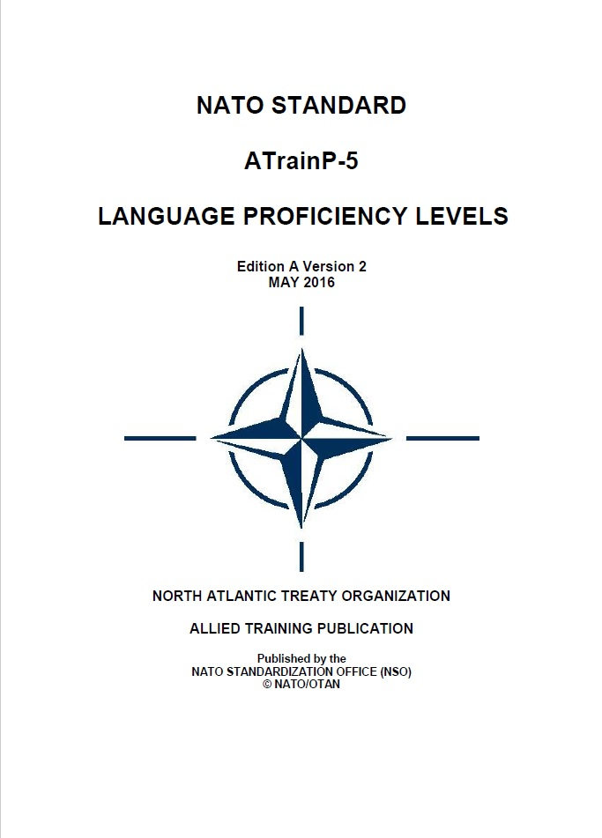
EDITIONS 3, 4, and 5
    2009: STANAG 6001 Edition 3
          Plus levels
          New labels
          NATO agreed definition of Language proficiency:
            “an individual’s unrehearsed, general language communication ability”
    2010: STANAG 6001 Edition 4
    Purpose of Plus levels extended to recording/reporting
    2014: STANAG 6001 Edition 5
          No textual changes in the descriptors
          Format change: descriptors removed from the STANAG and
          published in ATrainP-5 Ed A
        In Edition 5, NATO formally designated BILC as custodian of STANAG 6001.
2016: ATrainP-5 Ed A V2
  Correction of minor typos
Notes:
Between 2003 and 2014, several new editions further refined and formalised the system.
Since then, the emphasis has shifted away from rewriting descriptors, and more toward maintaining consistency, reliability, and professional standards across NATO.
With Edition 5, BILC was formally recognised as the custodian of STANAG 6001.
An important structural change was also introduced: the proficiency level descriptors, which had previously appeared as an appendix to the STANAG, were moved into a separate document – ATrainP-5, Edition A.
This made the STANAG itself more stable and easier to maintain.
As a result, revisions to the descriptors no longer require an entirely new STANAG edition; instead, only ATrainP-5 receives an updated version number.
In fact, this has already happened, as the current document is ATrainP-5 Edition A, Version 2.

Slide 29
TIMELINE
1960s-1975
1991-1999
2000-2014
2015-present
1976-1990
FOUNDATIONS
LIMITED USE
RENEWED URGENCY
EXPANSION
CONSOLIDATION
Cold War
PfP Assistance
Interoperability
Professionalisation
2003: Edition 2
2009: Edition 3
1976: Edition 1
2010: Edition 4
2014: Edition 5
Notes:
The period since the latest Edition of the STANAG is marked by consolidation and further recognition of the standard within NATO.

Slide 30
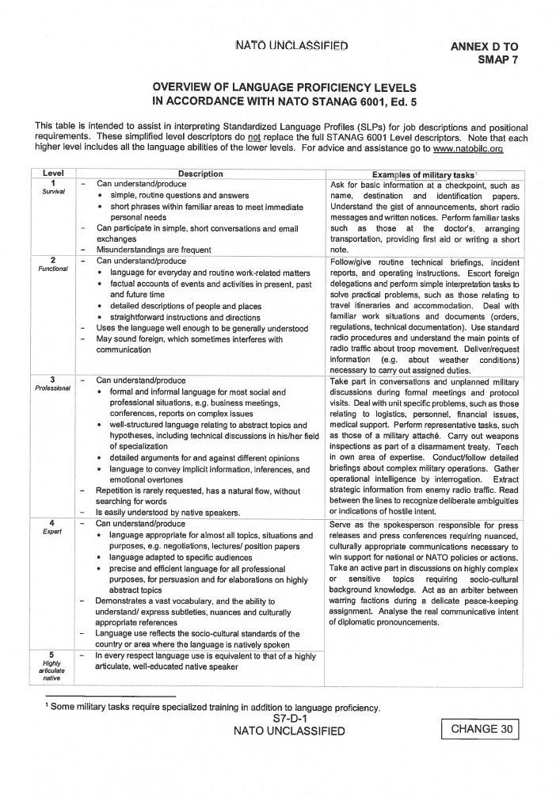
CONSOLIDATION and RECOGNITION (2015-present)
Stability and institutional embedding
No changes to the level descriptors
Continued professionalisation of teaching and testing
Increased standardisation (Policy Recommendations)
Formal recognition in NATO-policy (AAP-16 NATO Manpower Policy and Procedures)
  STANAG 6001 embedded in NATO education and personnel systems
As a custodian, BILC is responsible for
  periodically reviewing and updating STANAG 6001 and its descriptors
  promoting their consistent interpretation and application among participating nations
Notes:
It is a period of relative stability, with BILC’s focus shifting increasingly toward professionalisation and standardisation across NATO.
An important development was the inclusion of STANAG 6001 in the latest version of NATO’s Allied Administrative Publication 16 – NATO’s key policy document for personnel management, sometimes referred to as the “personnel management bible.”
Although the STANAG itself was reduced to a single-page reference, that is not the important point.
What matters is that NATO formally recognises and uses one common standard – STANAG 6001 – for describing and reporting language proficiency.
Another significant change is that, in the latest edition, BILC is formally identified as the custodian of STANAG 6001.
This means BILC is responsible not only for periodically reviewing and updating the STANAG and its descriptors, but also for promoting their consistent interpretation and application across the Alliance.

Slide 31


THE PERSISTENT CHALLENGE
Common interpretation and consistency across nations
Deputy Commander NATO Airborne Early Warning & Control Force (E3A):
“Comparable performances may be rated differently across nations.”
(BILC STANAG 6001 Testing Workshop, The Hague, 2025)
STANAG 6001 only functions if nations interpret and apply it consistently
Maintaining a common interpretation remains a key interoperability challenge
Notes:
Despite all the progress made over the decades, one key challenge remains: consistency of interpretation.
Different nations may still interpret the same proficiency level differently.
In other words, comparable performances may still receive different ratings across NATO nations.
This issue was highlighted again during last year’s Testing Workshop, where the Deputy Commander of NATO’s NAEW CF spoke about language requirements and communication challenges within his unit – a truly multinational environment with personnel from 21 NATO nations.
His message reinforced an important reality:
a proficiency scale only works if all nations apply it in a consistent way.
This remains one of NATO’s central interoperability challenges today.
And importantly, this is not a failure of the scale itself, but rather a natural consequence of its multinational nature.

Slide 32

IS STANAG 6001 STILL FUTURE-PROOF?
Questions and criticisms
Common interpretation remains difficult
Portability and conversion questions continue to reappear
STANAG language certificates are not widely recognised outside defence
Maintaining national testing systems requires expertise and resources
Why not simply use the CEFR?
widely used and internationally recognised civilian framework
facilitates portability and comparability outside defence
supported by extensive teaching and learning resources
no need for NATO-specific descriptors and dedicated testing systems
Notes:
This naturally raises broader questions:
Why continue maintaining a NATO-specific system?
Why not simply adopt the CEFR?
These are legitimate questions —
especially given the costs and expertise required to maintain testing systems

Slide 33
VIABILITY
Why STANAG 6001 remains essential
NATO needs precise proficiency measurement for operational and high-stakes decisions in defence contexts
Misjudging language ability can directly affect safety, decision-making, and mission effectiveness
Unlike CEFR levels, STANAG levels are fixed thresholds with clearly defined floors and ceilings
  All requirements must be consistently demonstrated to attain a level
BILC promotes common interpretation and quality standards across nations
STANAG testing follows common testing and rating principles across NATO nations
The CEFR itself does not regulate how tests are developed, administered, or standardized
  CEFR-based tests vary widely in purpose, methodology, and quality
Notes:
The answer is that NATO requires something more controlled and operationally precise than most civilian frameworks provide.
In military contexts, misjudging language proficiency can directly affect safety, coordination, and mission effectiveness.
STANAG levels therefore function as strict thresholds, supported by professional testing principles and multinational standardisation efforts.
In other words: NATO does not merely need a language framework.
It needs a trusted proficiency system.

Slide 34



























THE STANAG 6001 ECOSYSTEM
A shared proficiency framework connecting NATO nations

Staffing & Deployability Common language requirements for NATO assignments and missions
Interpretation
Standardisation Guidance

Multinational Operations
Stronger cooperation in all NATO and Partner activities
Seminars & Workshops
Sharing expertise Building common understanding

Expanded Descriptors
Development Refinement Updates

Personnel Selection
Fair, transparent and comparable language requirements

Training & Qualification
Rater training
Test development
STANAG 6001
NATO Language Proficiency Scale
Benchmarking
& BAT
Evidence-based alignment
Interoperability
Effective communication across nations
and operations

National Testing Systems
Aligned with STANAG 6001

Policy Recommendations
Supporting national and NATO policies
Education & Training
Curricula, materials and tests aligned to a common standard
NATO & Partner Nations
Shared standard adopted
Language Training and Testing Systems in NATO Nations
Notes:
This slide perhaps best illustrates what STANAG 6001 has ultimately become:
not simply a scale, but an entire interoperability ecosystem —
connecting policy, testing, training, benchmarking, staffing, and multinational operations.

Slide 35
THE SIGNIFICANCE OF STANAG 6001
The real significance of STANAG 6001
is the TRUST that NATO gradually developed
Trust cannot be enforced – it must be earned
BILC and STANAG 6001 grew together and are inextricably linked
Without BILC, there would be no STANAG 6001
Without STANAG 6001, there would be no BILC
(in its current form)
Notes:
The success of STANAG 6001 is not just about the quality of its descriptors.
Its real significance lies in the trust it has earned over the years.
By embedding the STANAG in its policy, NATO clearly shows that it has trust in the standard, in the assessments, and ultimately in each other’s certification, and consequently trust in what BILC does.
And that trust cannot be imposed or enforced. It is built over time – through consistent practice, shared understanding, and professional dialogue.
In many ways, BILC and STANAG 6001 evolved together – and became inseparable.
It can be assumed that without BILC, there would be no STANAG 6001.
But it is equally true that without STANAG 6001, there would be no BILC (in its current form).

Slide 36
STANAG 6001 EVOLUTION
Edition | Date | Structural Change | Functional Impact
STANAG 6001 Ed 1 | 1976 | First NATO-agreed standard to describe language proficiency – Short descriptors in Annex A | First, crucial step towards standardisation
STANAG 6001 Ed 2 | 2003 | Expanded descriptors added in Appendix 1 to Annex A | First detailed interpretation guidance
STANAG 6001 Ed 3 | 2009 | Expanded descriptors replace original short ones in Appendix 1; Plus levels included as Annex A; New labels for proficiency levels “Proficiency” defined | Major conceptual expansion and formalisation
STANAG 6001 Ed 4 | 2010 | Included two additional purposes of plus levels; no changes in descriptors | Broader operational use of plus levels
STANAG 6001 Ed 5 ATrainP-5 Ed A V1 | 2014 | Level descriptors removed from main document and published in ATrainP-5 Ed A | Separation of agreement and implementation
ATrainP-5 Ed A V2 | 2016 | Correction of minor typos | No conceptual change
Notes:
Optional slide for those who want a one-page overview of the evolution of STANAG 6001

